Slide 1
800 MHz Interference: What Is It, How Do We Mitigate It and What Does the Future Hold?
Jay M. Jacobsmeyer, P.E.
Pericle Communications Company
jacobsmeyer@pericle.com
FCC 800 MHz Public Forum
November 6, 2017

Slide 2
Types of Interference
Out-of-Band Emissions
  Occurs at the cellular base station transmitter
  Practically non-existent after rebanding (guardband filtering)
Receiver Intermodulation*
  Non-linear mixing of external carriers in receiver front end
  Interference is created inside the receiver
  Can be operator-only mixes or Sprint/A/B cross products
Receiver Blocking (Overload)
  Only one frequency necessary to cause problem
*Spectral regrowth also occurs in the receiver and is created by a single interfering carrier. It is a form of intermodulation.

Slide 3
Typical Receiver Front End
Bandpass Filter is the Weakness
  Typically passes 845-875 MHz
  Ideally should be limited to 851-861 MHz
LNA is Usually Where IM Occurs
  Higher third order intercept is better
  But amplifier with higher intercept draws more current

Slide 4
Receiver IM Examples (3rd order)
Sprint Alone, 2A-B Product CDMA & LTE
Sprint & A-Band UMTS (Two of Three Products)
4
*Third product is A+B-C type, roughly 12.25 MHz wide and centered on 856.7 MHz.

Slide 5
Non-Filter Solutions
Higher IIP3 LNA
  E.g., results in 80 dB IMR per TIA-603 versus 70 dB
  Tradeoff with battery life
Attenuators for AGC (or variable gain amps)
  Switch attenuators in or out depending on detected signal

Slide 6
Strong Signal IM (SSIM)
Vendors test & spec radios for intermodulation rejection measured from a baseline equal to the RX sensitivity
E.g., if receiver has 75 dB rejection and -120 dBm sensitivity, interfering signal is only -45 dBm
But the problem cell sites create signals at ground level way above -45 dBm; -20 dBm or higher is common
Two radios with identical 75 dB IM std. rejection may have vastly different SSIM rejection at -20 dBm
SSIM rejection never appears in the mfr’s datasheet
But it’s important, ask for it!

Slide 7
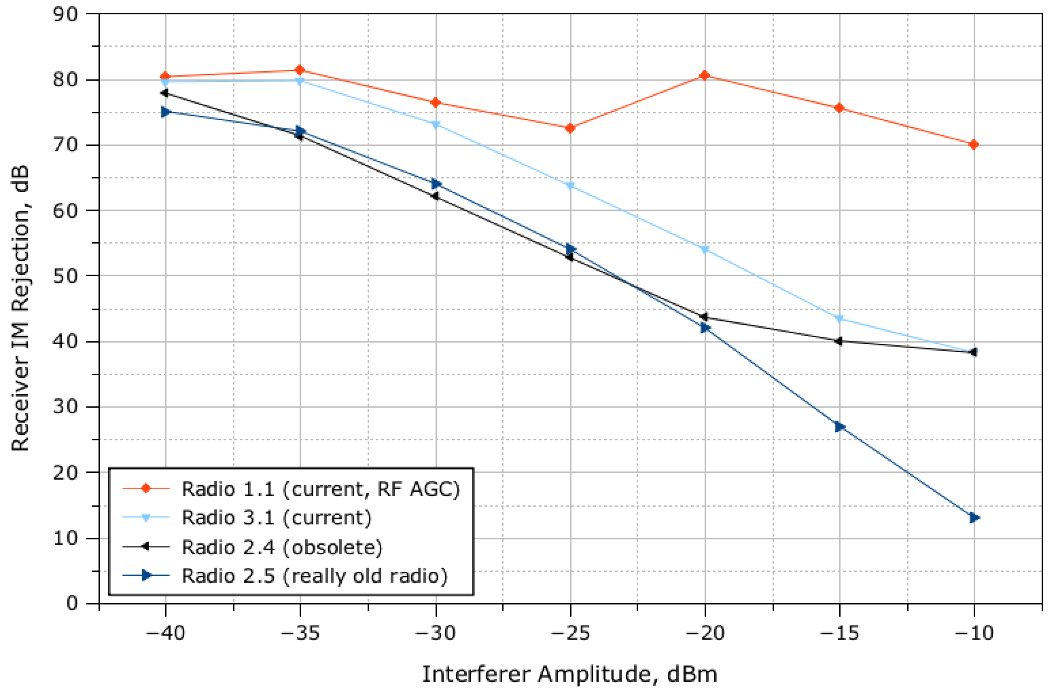
Should this be an industry standard minimum (70 dB)?
(Desense is still 40 dB here)
Best in Class
None of these radios uses new PS bandpass filter
Current Model
Recently Retired
Very Old Model

Slide 8
700 MHz vs. 800 MHz Comparison
Docket WT 12-40 increased ERP of 800 MHz cellular from 500 W per carrier to 1,000 W/MHz in some cases
One stated objective was to harmonize with 700 MHz but final rules show some differences. See Table.
Parameter | 700 MHz, Parts 27.50(b), 27.55(c) | 800 MHz, Part 22.913(a),(b),(c)
ERP Urban Area | 1,000 W/MHz | 1,000 W/MHz
Max PFD* | 3,000 μW/m² | 3,000 μW/m²/MHz
Protection area | 1 km from cell site | 98% of 1 km from cell site
*For a 0 dBi antenna, a PFD of 3,000 μW/m² is equivalent to -13 dBm at the antenna terminal

Slide 9
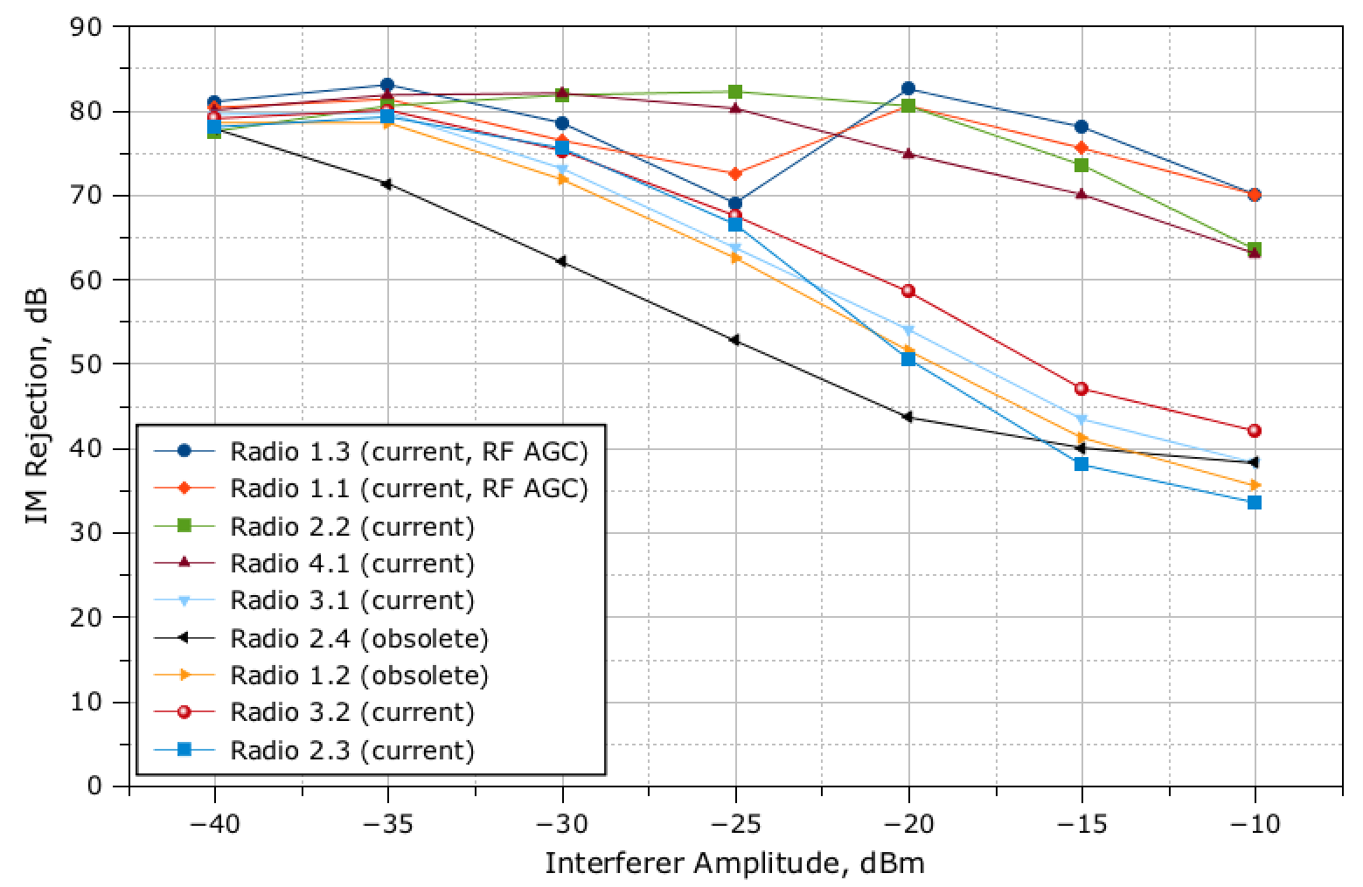
All radios P25 capable
All Specified Same
36.5 dB Variation
With Strong Interferer
Max allowed by rule = -3 dBm
(not measured)

Slide 10
What Does this Mean to the PS User?
With -20 dBm interferer and 70 dB SSIM rejection, the radio requires -90 dBm to overcome interference
  Lots of locations in the service area have at least -90 dBm
With -20 dBm interferer and 38 dB SSIM rejection, the radio requires -58 dBm to overcome interference
  Only locations immediately around the PS repeater site have at least -58 dBm
Poor performing radios will have many outages near 800 MHz cell sites with low antennas.

Slide 11
Conclusions
Rebanding does not eliminate interference
  It creates conditions that make interference manageable
Co-existence is a shared responsibility
  Radio vendor must produce radio with robust front end
  Public safety users must specify SSIM rejection performance in RFPs
  Cellular operator must have limits on power flux density
Technology solutions are being adopted
  RF AGC systems are very effective without bandpass filters
  With end of rebanding, bandpass filters also appearing
  But performance is uneven, some vendors slow to adopt solutions
  Public safety must ask for better performance
  If your radio has an Advanced RF AGC feature, turn it on!

Slide 12
Conclusions, cont’d
New Part 22.913 raises issues (WT 12-40)
  Increases cellular ERP from 500 W max to 1,000 W/MHz
    E.g., a 13 dB increase for a 10 MHz LTE carrier
  Power flux density limit does little to protect public safety
    3,000 μW/m²/MHz
    If present, results in -3 dBm at antenna terminal (10 MHz LTE)
    This unusually high PFD will impair even the best radios
    Even with 70 dB rejection, the desense for -3 dBm interferer is 47 dB
  High PFDs may not occur in practice, but this exceptionally high PFD limit encourages sloppy network designs that produce unnecessarily high PFDs at ground level

Slide 13
Conclusions, cont’d
Bottom Line: Receiver improvements are appearing, but new Part 22.913 “moves the goalpost”
What can the cellular operator do to help?
  Don’t raise ERP at low sites that are more likely to have high PFD
  Employ antennas with suppressed sidelobes
  Notify public safety licensee (per 22.913(c)), but include PFD prediction at ground level in notification

Slide 14


