Slide 1
Connect America Fund
Phase II Auction (Auction 903) Application Workshop
Applying to Participate — FCC Form 183
March 14, 2018

Slide 2
Disclaimer
Nothing herein is intended to supersede any provision of the Commission's rules or public notices. These slides should not be used as a substitute for a prospective applicant's review of the Commission's orders, rules, and public notices relating to the Connect America Fund Phase II Auction (Auction 903). Prospective applicants must familiarize themselves thoroughly and remain current with the relevant Commission rules, application and bidding procedures, and the procedures, terms, and conditions contained in Auction 903 public notices.

Slide 3
Questions?
Send questions to auction903@fcc.gov

Slide 4
Overview of Auction 903
Will award up to $1.98 billion over 10 years
Support for provision of both broadband and voice services to fixed locations
Multi-round reverse auction
All entities must be qualified in order to place bids
Winning bidders must be authorized to receive support, become ETCs, and submit a Letter of Credit after the auction

Slide 5
Timing / Completed Steps
Comment Public Notice – August 2017
Procedures Public Notice – January 2018
Final eligible areas – February 2018
Applicant education – March 2018
  Application Instructions
  Auction Application Tutorial

Slide 6
Timing / Next Steps
Short-form application filing window: 3/19-30
Review of applications
Initial results announced in Status Public Notice
Resubmission filing window
Review of resubmitted applications
Final status announced in Qualified Bidders Public Notice

Slide 7
Timing / Next Steps
Bidder education – June
Mock auction – week of July 16
Bidding begins July 24
Bidding results announced in Closing Public Notice
Long-form application filing window

Slide 8
Today’s Objectives
Demystify the short-form application
Provide potential applicants with a head-start on assembling required information
Minimize errors and omissions

Slide 9
Useful Tools for Completing Application
Additional information available at www.fcc.gov/auction/903
1. Auction 903 Procedures Public Notice
2. Application Tutorial
3. FCC Form 183 Application Instructions
4. Workshop slides and video

Slide 10
Six Sections of the FCC Form 183
Applicant Information
  Legal Classification
  Applicant and Address
  Contact Details
  Responsible Party
  Authorized Bidders
  Eligible Telecommunications Carrier
  FCC Form 477/FCC Form 499
  Operational and Financial Information
State & Performance Tier/Latency
Agreements
  Joint Bidding Arrangements
Ownership
  Disclosable Interest Holders
  FCC Regulated Businesses
Summary
  Application Error Summary
Certify and Submit
  Application Certifications

Slide 11
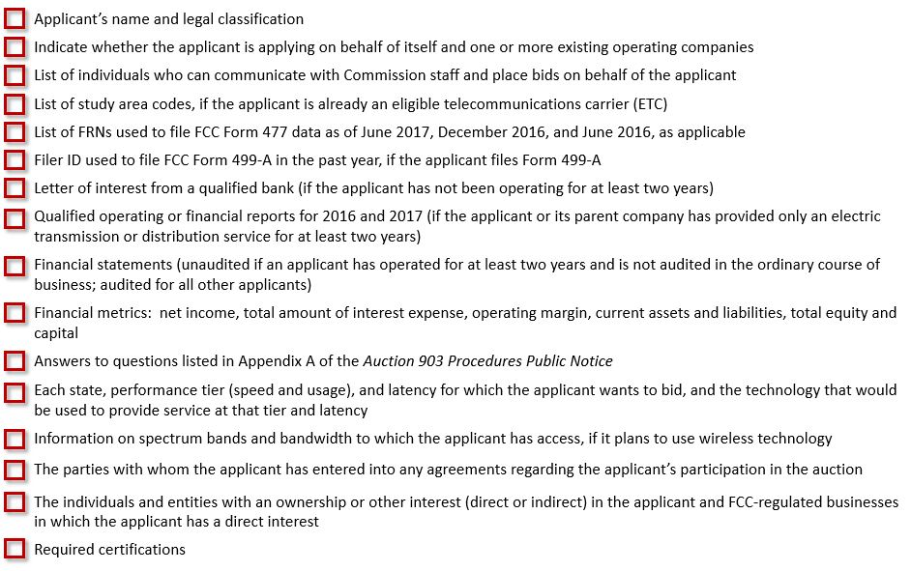
Checklist of Information Needed to Complete FCC Form 183

Slide 12
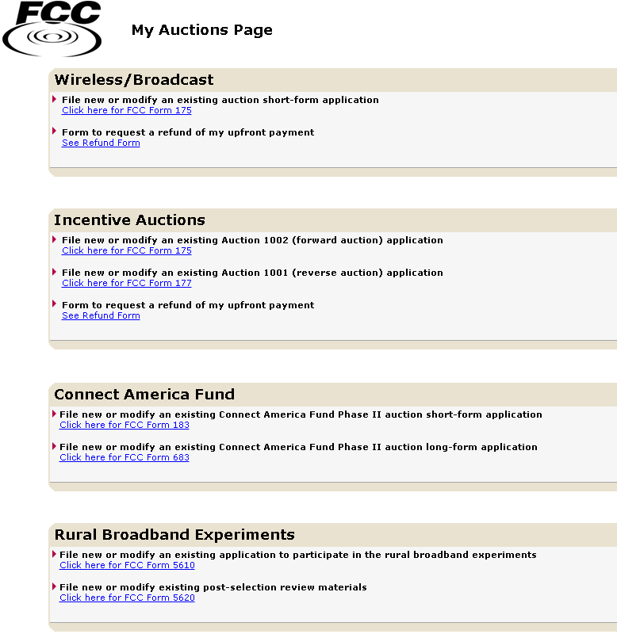
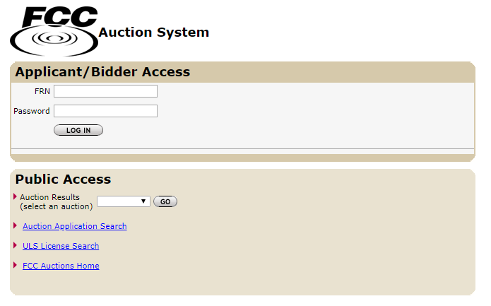
Accessing FCC Form 183
Open a web browser and navigate to:
auctions.fcc.gov (primary location) or
auctions2.fcc.gov (secondary location)
Obtain a FCC Registration Number (FRN) by registering here:
www.fcc.gov/cores

Slide 13
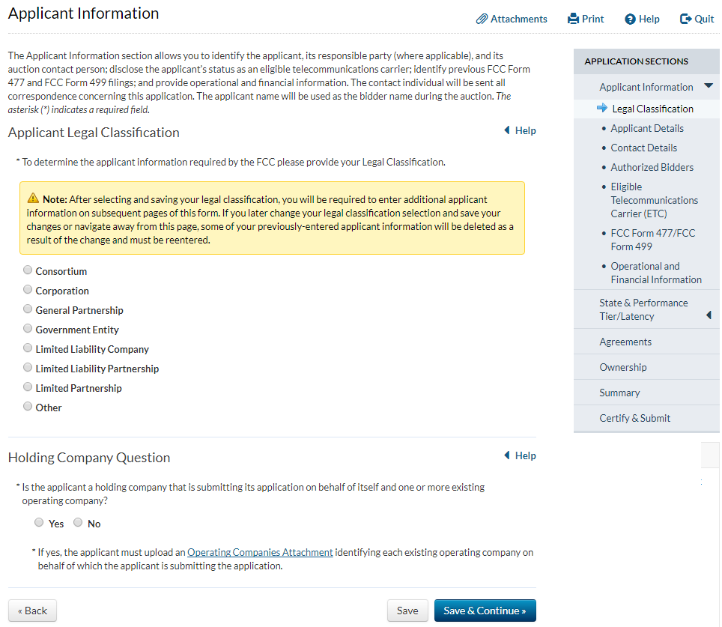
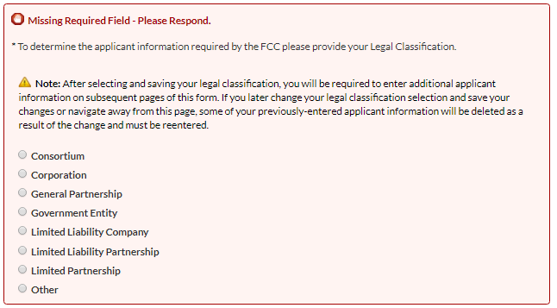
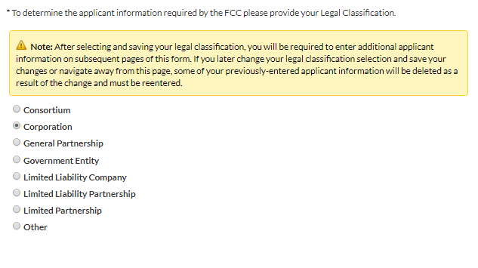
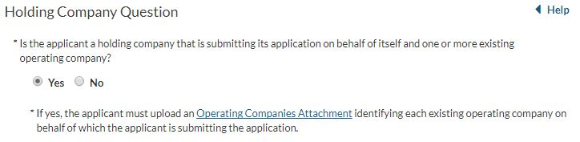
Legal Classification
The navigation pane displays the sections of the FCC Form 183
Questions marked with an asterisk are required
Consortium applicants must identify the members
If submitting application on behalf of existing operating companies, must identify those operating companies

Slide 14
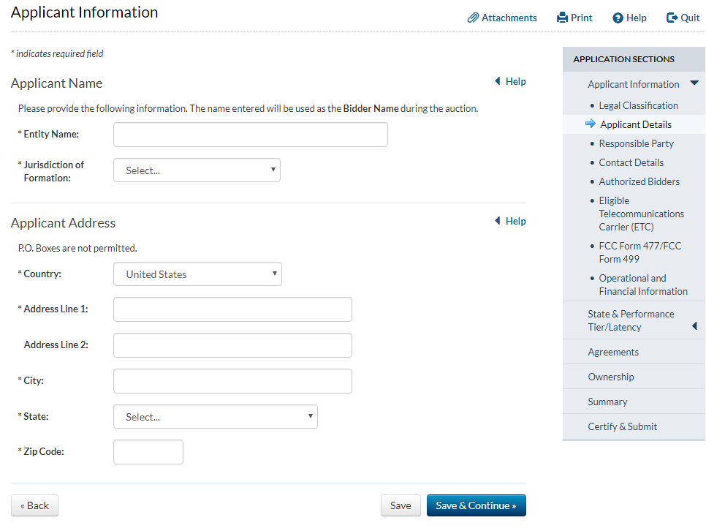
Name and Address
Name will be used as the Bidder Name throughout the auction

Slide 15
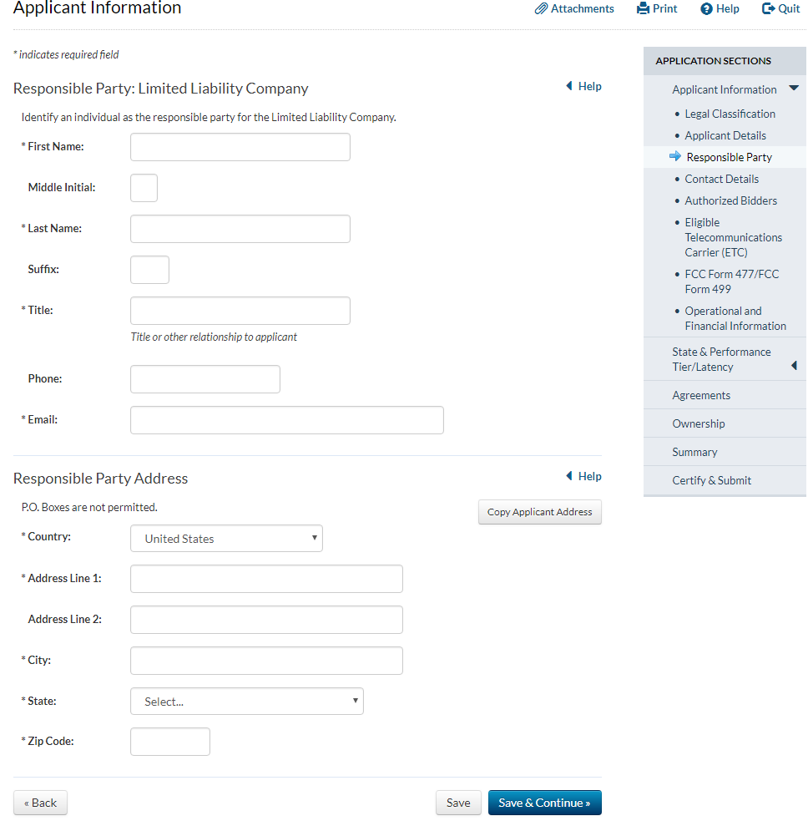
Responsible Party
This screen is not displayed if an applicant is a general partnership
For corporations, the responsible party should be an officer or director
For limited partnerships, the responsible party should be a natural person

Slide 16
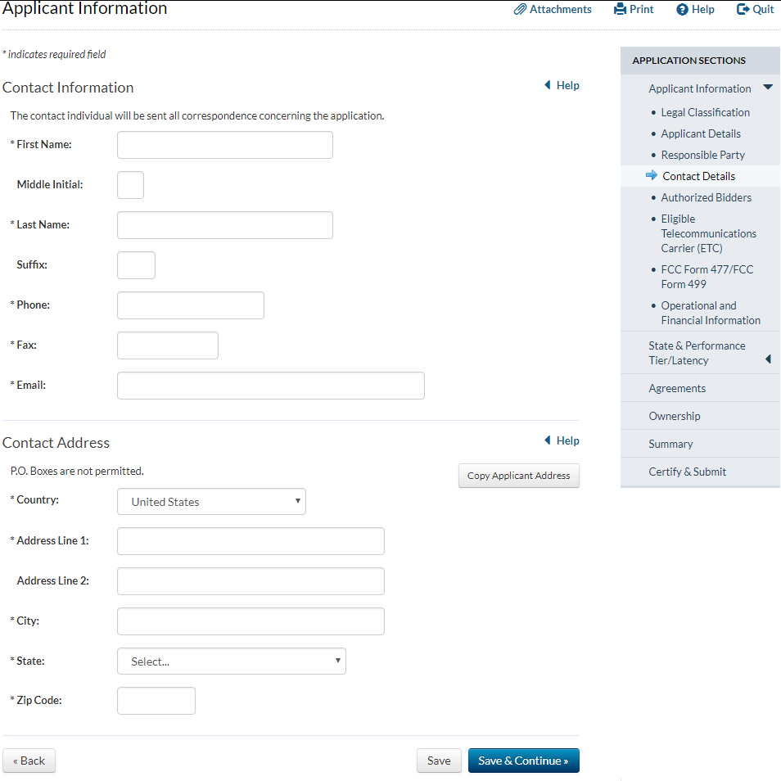
Contact Information
The FCC will communicate only with the Contact Individual
The FCC will mail all correspondence to
the Contact Address
  No PO Boxes!
You can change the contact individual and address if necessary
  It is important to keep all contact information up-to-date

Slide 17
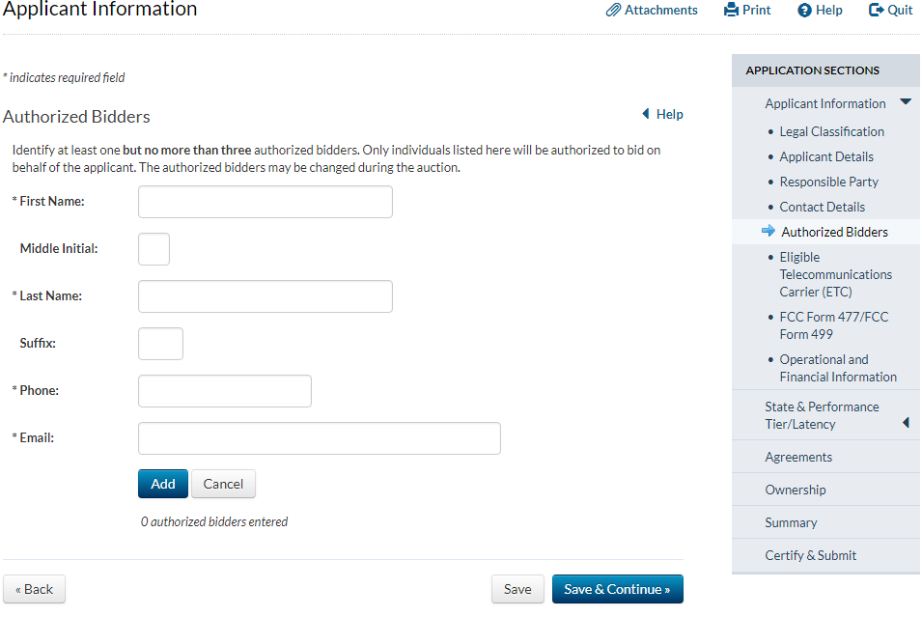
Authorized Bidders
Up to 3 authorized bidders
These are the people that are allowed to bid for the applicant during the auction
You can change them if necessary

Slide 18
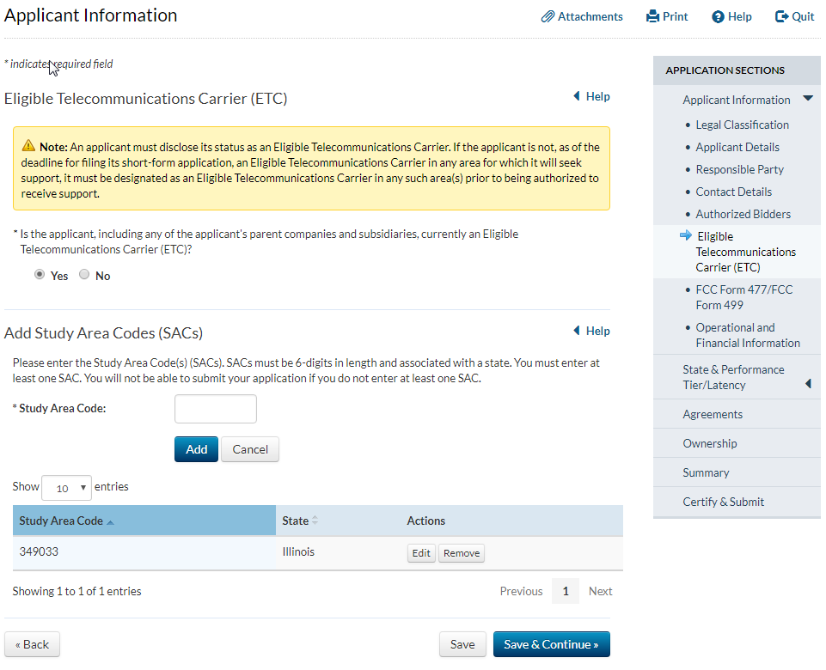
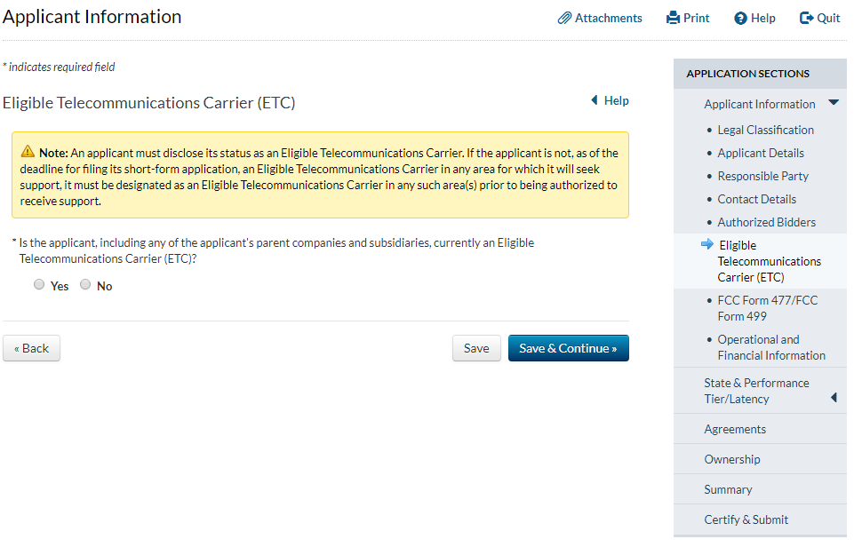
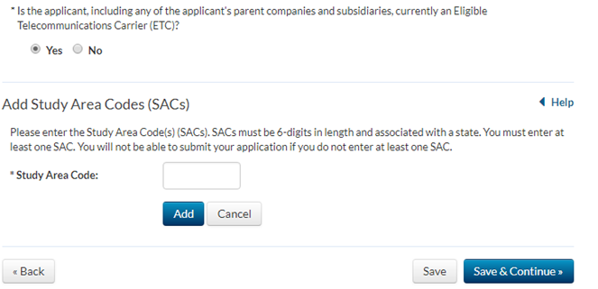
Eligible Telecommunications Carrier Question
Respond yes if an ETC in any area, not just where applicant intends to bid
Applicants are not required to be ETCs to participate in the Phase II auction
Winning bidders must obtain ETC designation for the relevant areas within 180 days of auction close

Slide 19
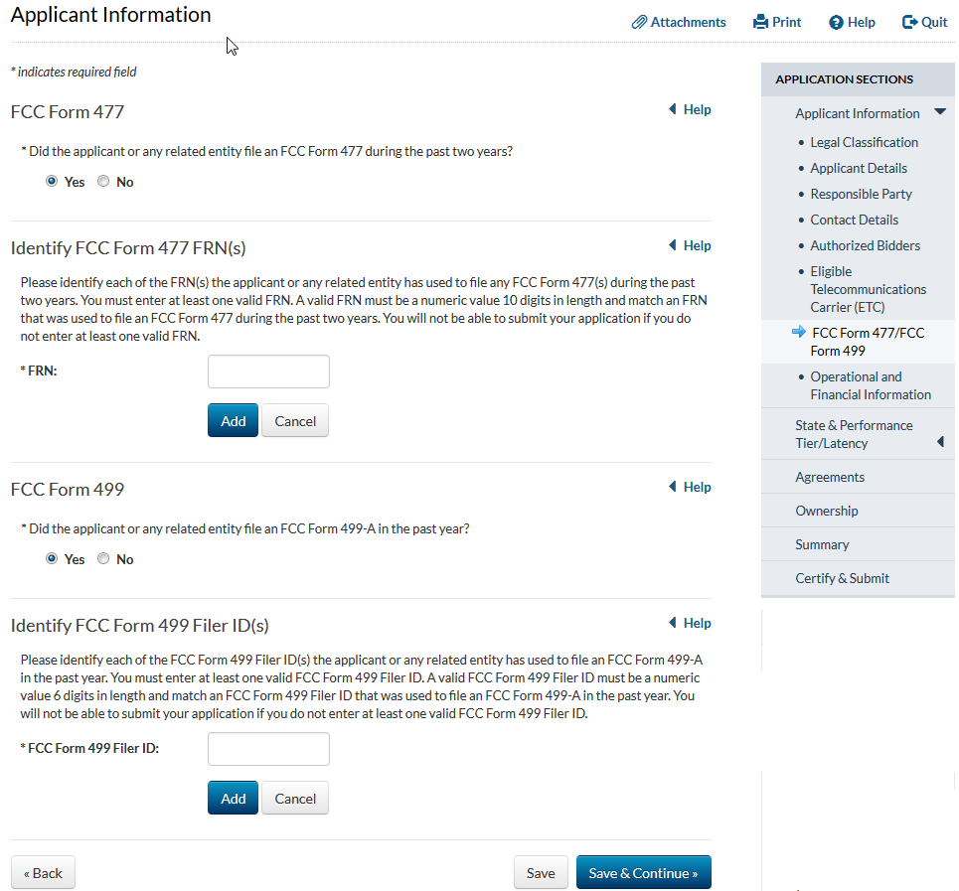
FCC Form 477/FCC Form 499 Information
Relevant FCC Form 477 filings include data as of June 30, 2017; December 31, 2016; or June 30, 2016
Relevant FCC Form 499-A is the filing due April 3, 2017
Related entities include the applicant’s parent company, the operating companies identified by a holding company applicant, and the members of a consortium or joint venture

Slide 20
Operational and Financial Information (O&F)
At Least Two Years of Experience
Fewer Than Two Years of Experience
Electric Only
Voice and/or Broadband
Audited
Unaudited
Audited
Unaudited
Audited

Slide 21
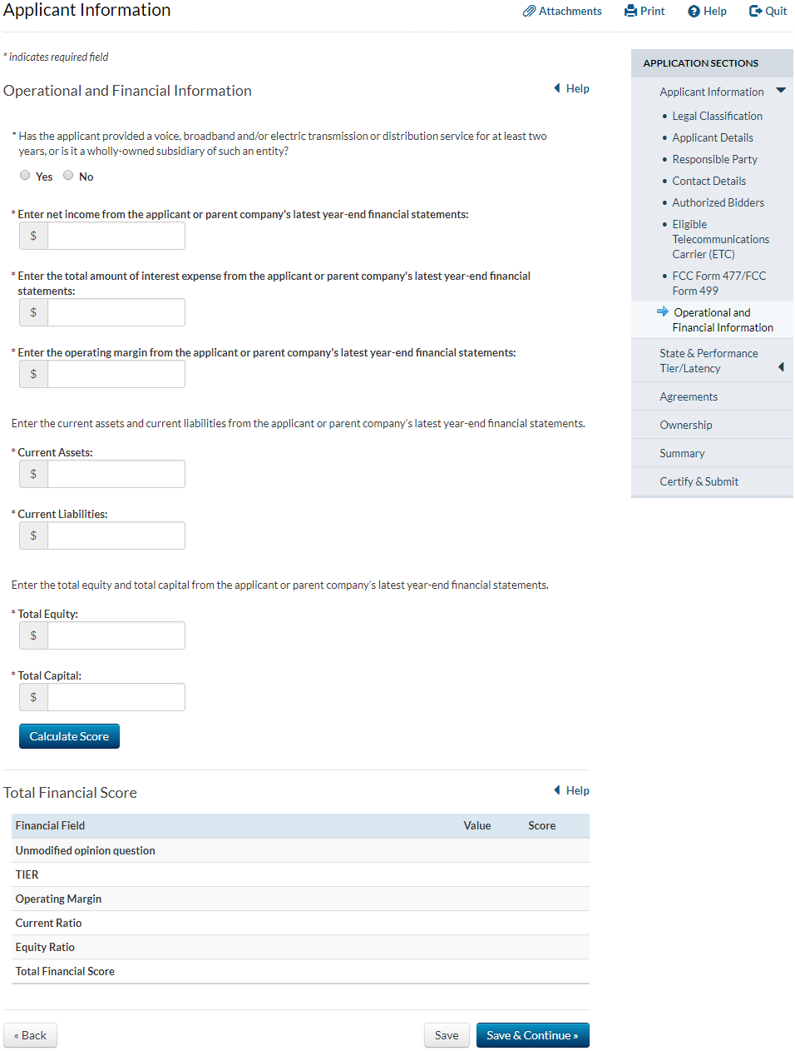
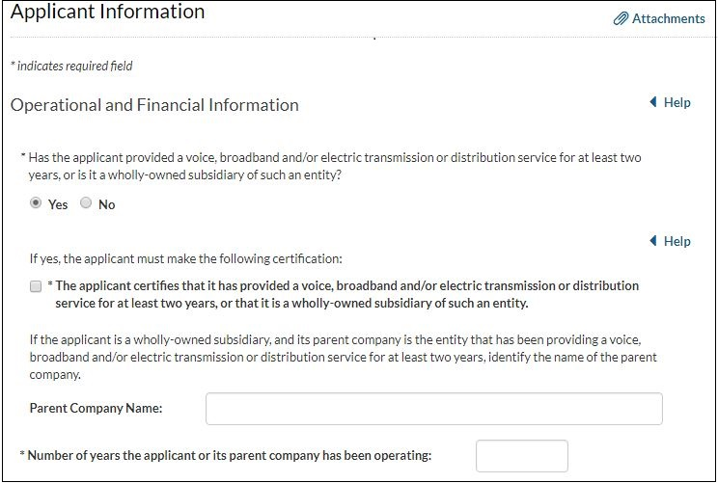

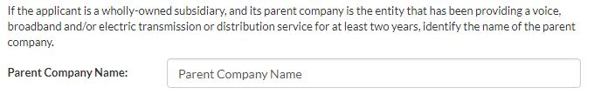
O&F: At Least Two Years of Experience
Identify if applicant has been providing voice, broadband, and/or electric transmission or distribution services for at least 2 years
Round down years in operation to nearest year

Slide 22
Operational and Financial Information (O&F)
At Least Two Years of Experience
Fewer Than Two Years of Experience
Electric Only
Voice and/or Broadband
Audited
Unaudited
Audited
Unaudited
Audited

Slide 23
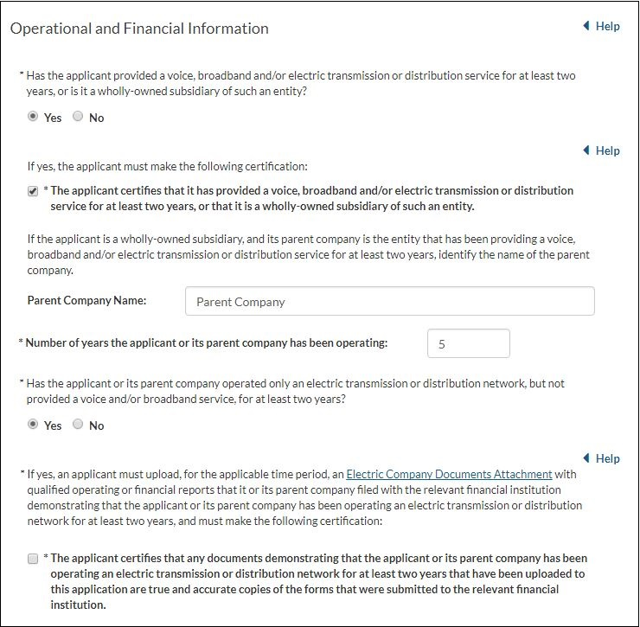
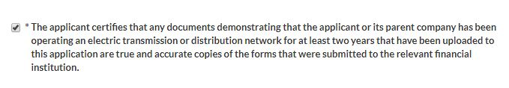
O&F: Experienced Electric-Only Applicants
An electric-only applicant has not also been providing a voice and/or broadband service for at least two years
Electric-only applicants must submit qualifying reports from 2017 and 2016 as evidence of operational history
FCC Form 183 is pending approval by the Office of Management and Budget pursuant to the Paperwork Reduction Act of 1995, Public Law 104-13

Slide 24
Operational and Financial Information (O&F)
At Least Two Years of Experience
Fewer Than Two Years of Experience
Electric Only
Voice and/or Broadband
Audited
Unaudited
Audited
Unaudited
Audited

Slide 25
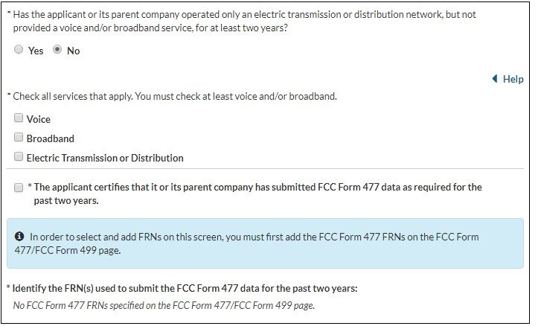
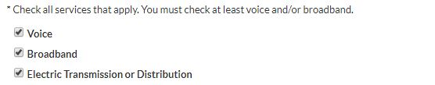
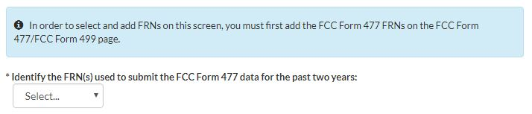
O&F: Experienced Broadband and/or Voice Applicants
Identify all services being provided for at least two years
  Must select voice or broadband at a minimum
Certify FCC Form 477s were submitted as required
  Filings that include data as of June 30, 2017; December 31, 2016; and June 30, 2016
Select FRNs associated with entity that has been providing voice and/or broadband for at least two years
  Can only select FRNs provided on FCC Form 477/Form 499 page

Slide 26
Operational and Financial Information (O&F)
At Least Two Years of Experience
Fewer Than Two Years of Experience
Electric Only
Voice and/or Broadband
Audited
Unaudited
Audited
Unaudited
Audited

Slide 27
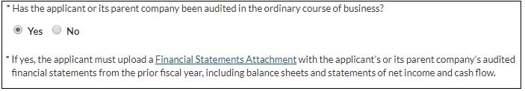
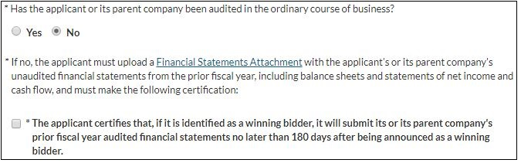

O&F: Financial Requirements for Experienced Applicants
At Least Two Years of Experience and Audited in Ordinary Course of Business
Submit fiscal year-end 2017 financial statements if available, otherwise 2016 financial statements
Include balance sheets and statements of net income and cash flow
If not audited in the ordinary course of business, may instead submit unaudited financial statements & certify will submit audited financial statements within 180 days of being announced as a winning bidder
At Least Two Years of Experience and Not Audited
in Ordinary Course of Business

Slide 28
Operational and Financial Information (O&F)
At Least Two Years of Experience
Fewer Than Two Years of Experience
Electric Only
Voice and/or Broadband
Audited
Unaudited
Audited
Unaudited
Audited

Slide 29
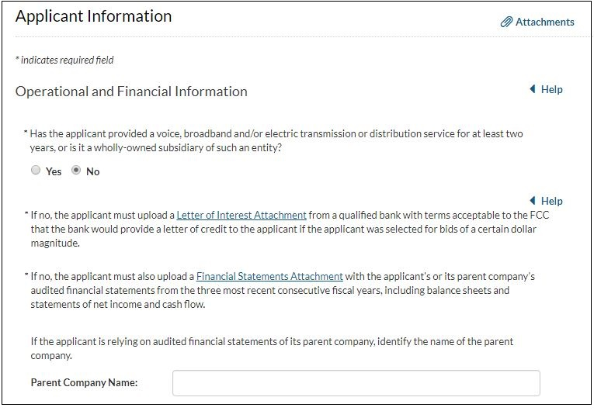
O&F: Requirements for Applicants with Fewer than Two Years of Experience
Letter of interest must be from an eligible bank, commit to follow the terms of the model letter of credit, and specify a maximum dollar amount
Must submit three years of audited financial statements
  No option to submit unaudited financial statements
  Submit fiscal year-end 2017, 2016, 2015 statements if available, otherwise submit 2016, 2015, 2014 financial statements

Slide 30
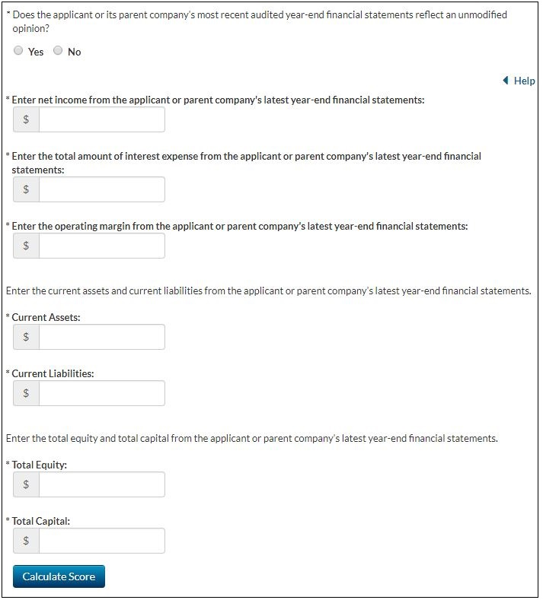
O&F: Financial Metrics and Scoring
All applicants, regardless of experience, must enter metrics
Enter metrics from the most recent financial statements submitted with the application
Unmodified opinion question will appear only if applicable
A score of less than three will warrant further financial review
May seek confidential treatment of financial information using an abbreviated process

Slide 31
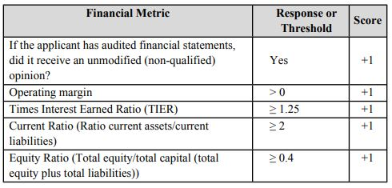
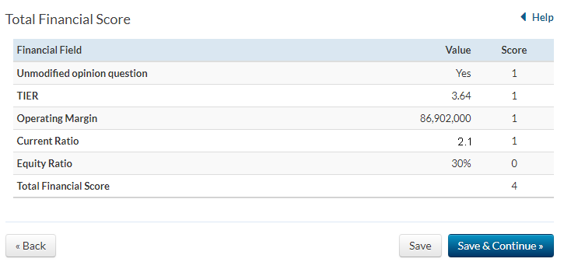

O&F: Financial Metrics and Scoring
((Net Income plus Interest Expense)/Interest Expense)

Slide 32
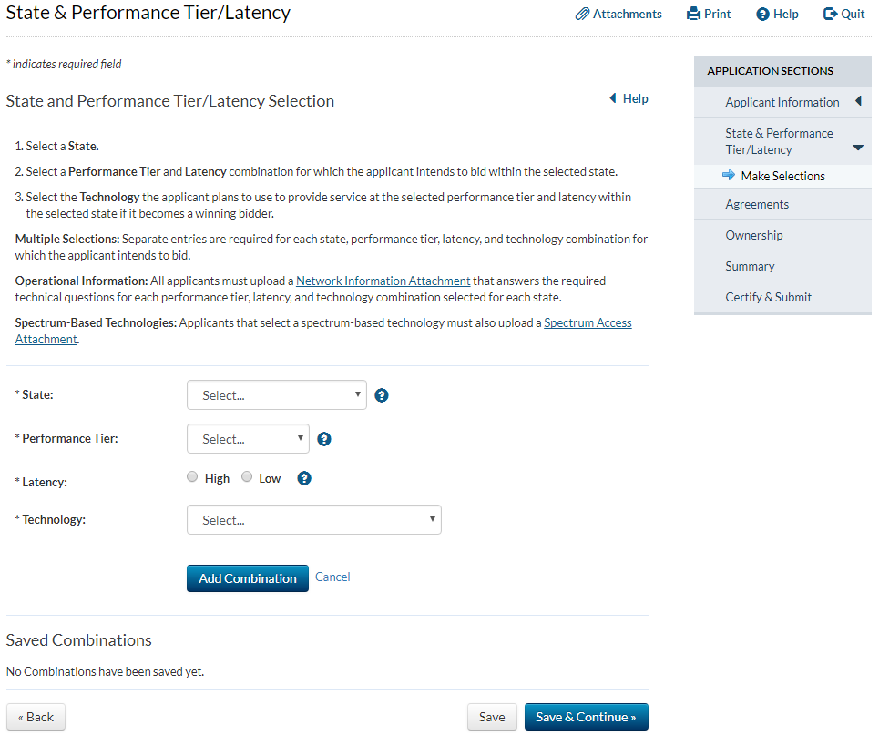
State & Performance Tier/Latency Selection
Select:
State
Performance Tier
  Minimum
  Baseline
  Above Baseline
  Gigabit
Latency
  High
  Low
Technology

Slide 33
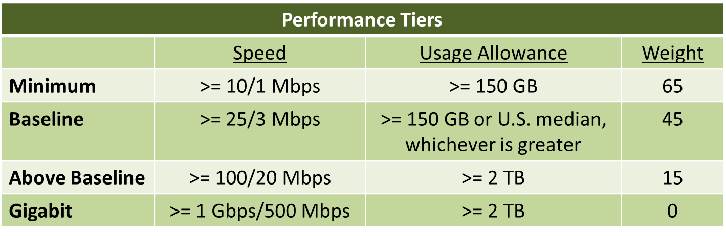
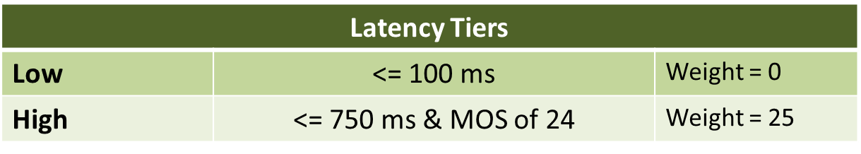
Service Tiers

Slide 34
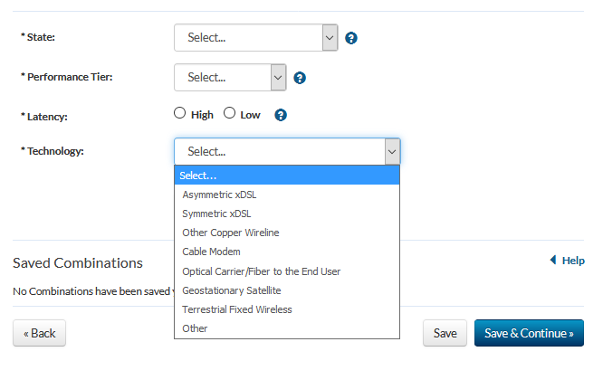
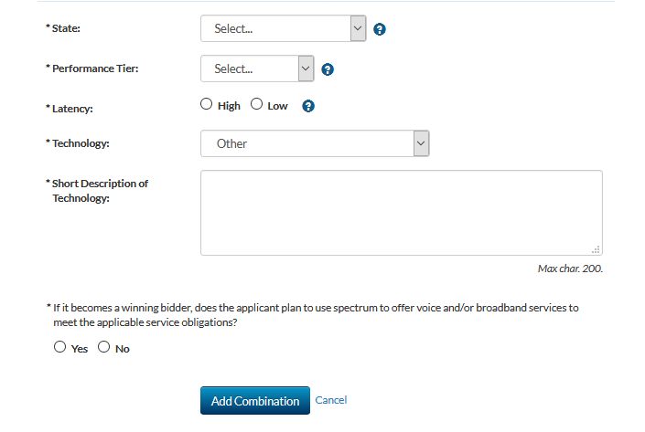
State & Performance Tier/Latency Selection
Select state, performance tier, and technology from drop down menus.
Click on either high or low to select latency
Describe “Other” technology
Indicate whether using spectrum

Slide 35
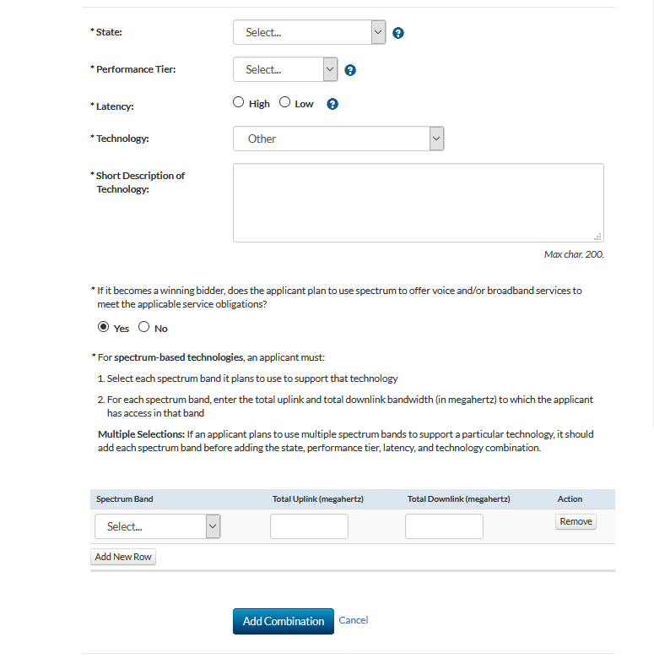
State & Performance Tier/Latency Selection

Slide 36
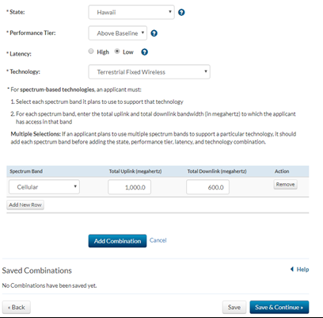
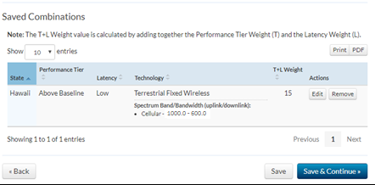
State & Performance Tier/Latency Selection

Slide 37
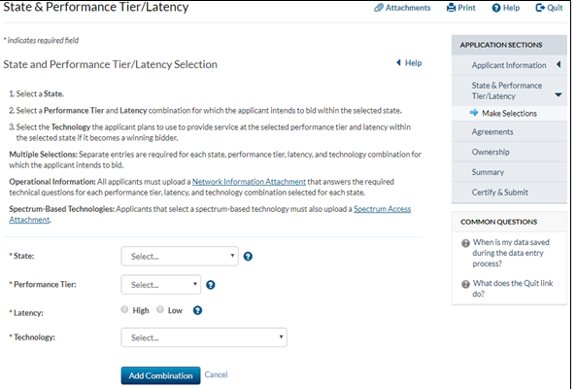
State & Performance Tier/Latency Selection

Slide 38
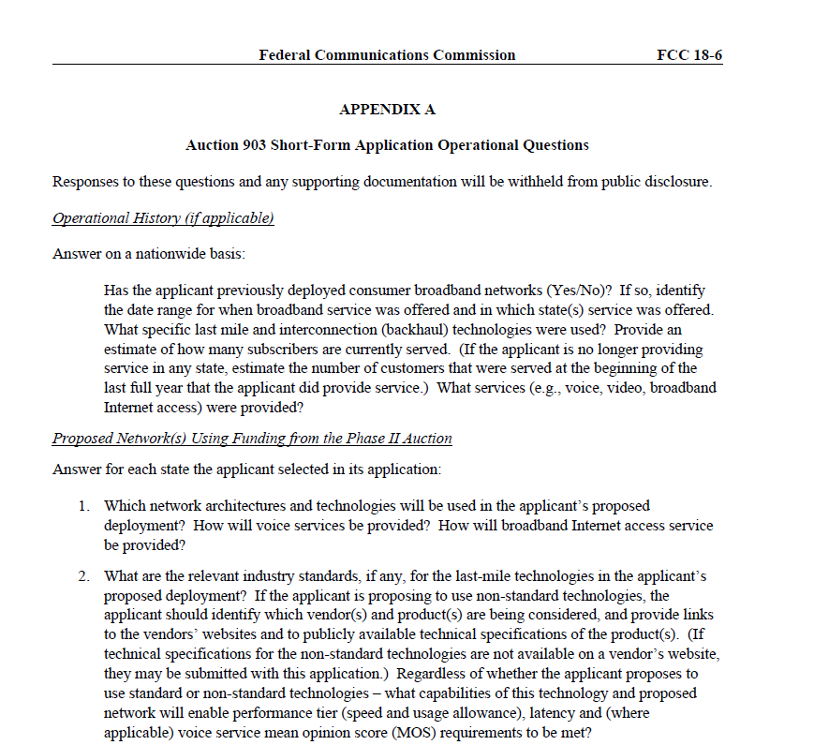
Operational Questions
Appendix A to the Auction 903 Procedures Public Notice

Slide 39
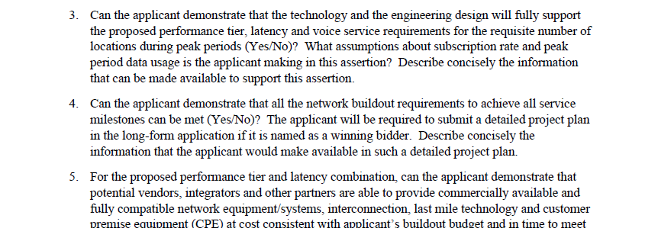
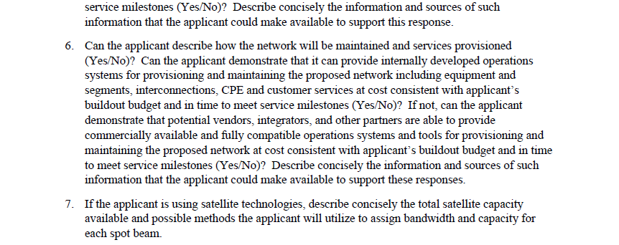
Operational Questions

Slide 40
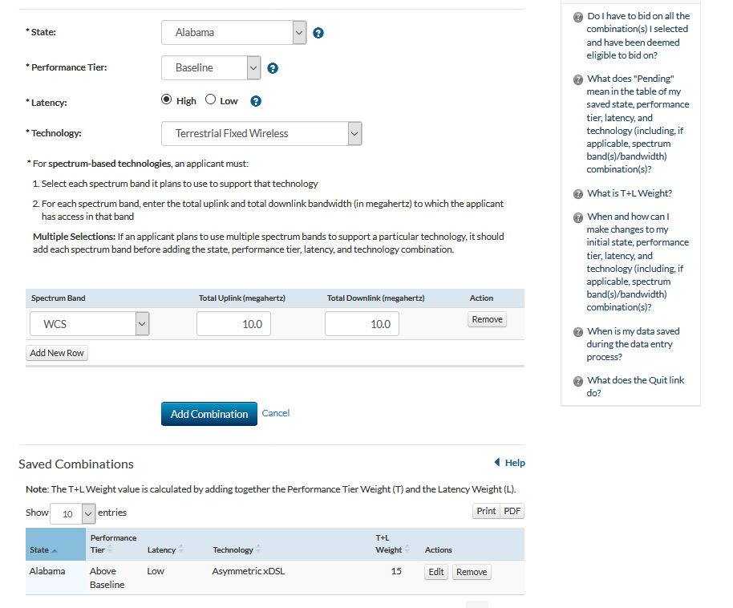
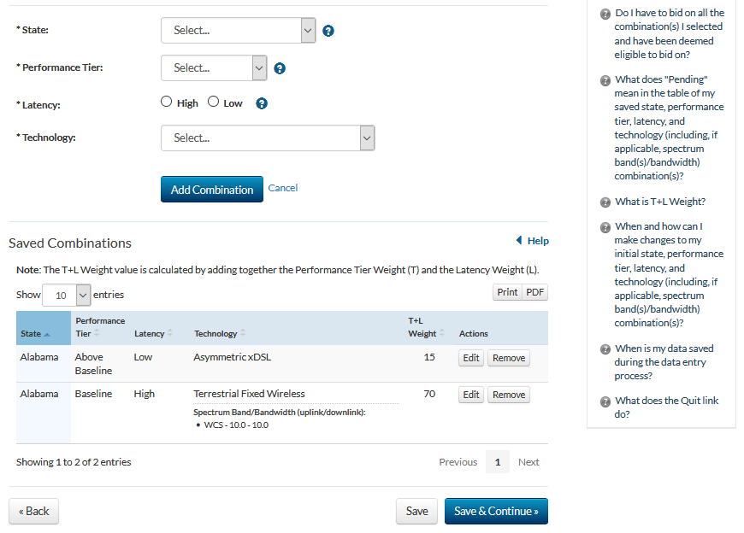
State & Performance Tier/Latency Selection

Slide 41
Impermissible State Overlaps
Applicants that are commonly controlled or are parties to a joint bidding arrangement are prohibited from bidding in any of the same states
  Commonly controlled applicants are those in which the same individual or entity either directly or indirectly holds a controlling interest – i.e., positive or negative de jure or de facto control of the applicant
  Joint bidding arrangements are those that
    relate to any eligible area in Auction 903 and
    involve bids or bidding strategies, including arrangements regarding Phase II support levels (i.e. bidding percentages) and specific areas on which to bid, as well as any arrangements relating to the post-auction market structure in an eligible area

Slide 42

Avoiding Impermissible State Overlaps
Two options for avoiding impermissible state overlaps:
  Submit a single short-form application and qualify to bid as one applicant in a state
  Submit separate short-form applications and qualify to bid independently, though not in the same state
Caution: Exercise due diligence before submitting an application to confirm that no other commonly controlled entity or party to a joint bidding arrangement, or an entity that controls any party to such an arrangement, has selected any of the same states

Slide 43
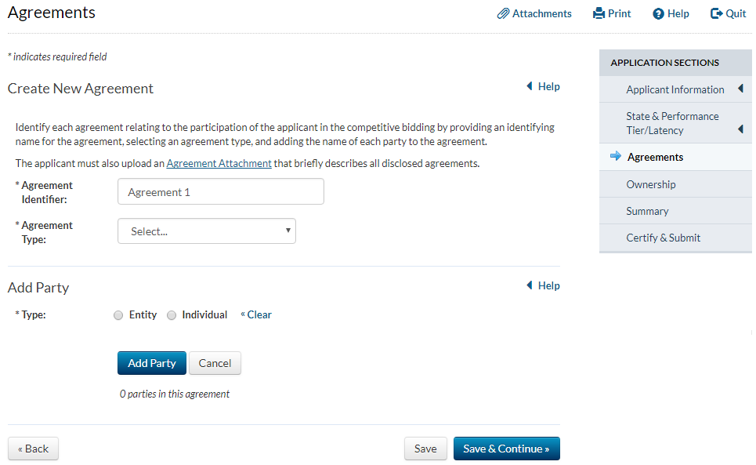
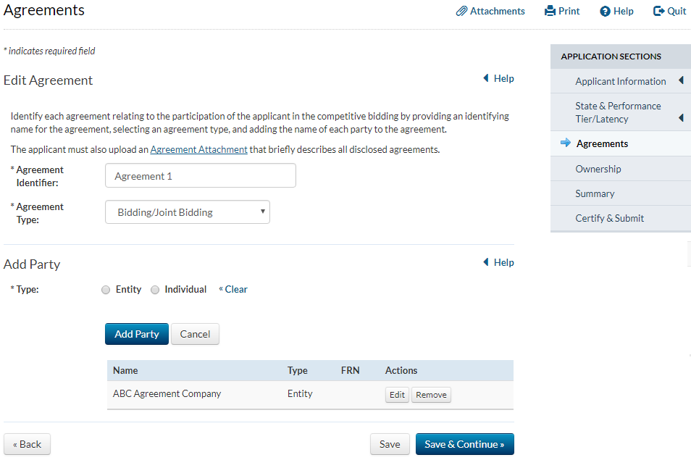
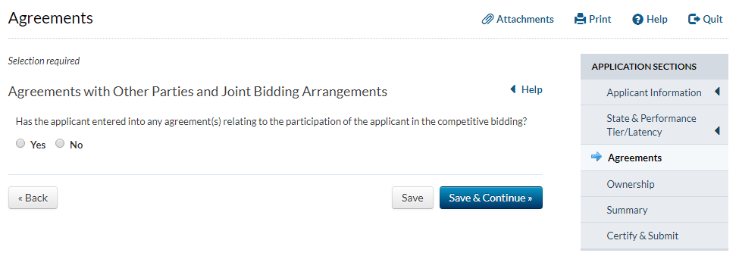
Agreements
  Disclose any agreement relating to the applicant’s participation in the competitive bidding
  Applies to any arrangements with other parties regardless of whether they are applying to participate in Auction 903
  Agreement need not be reduced to writing

Slide 44
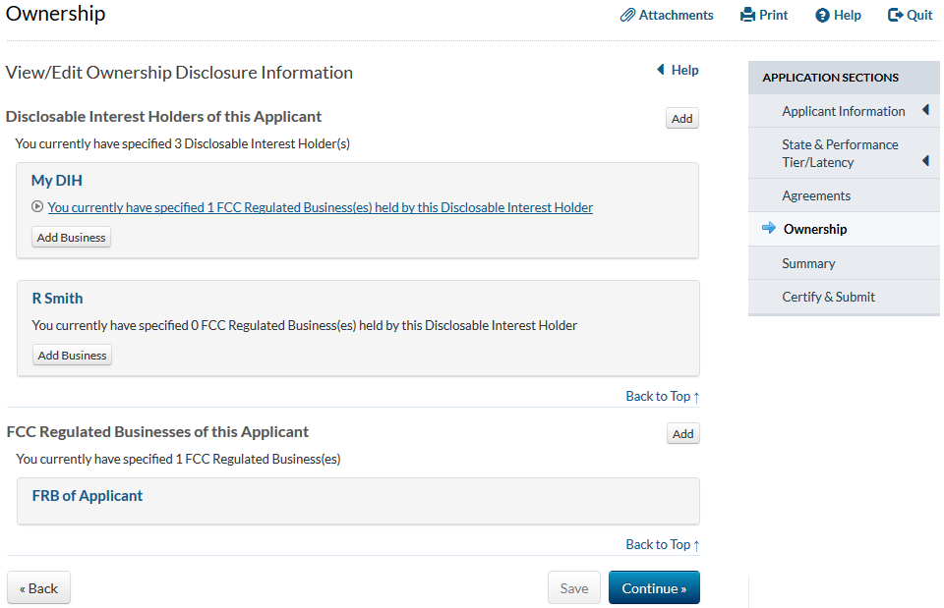
Ownership

Slide 45
Disclosable Interest Holders
A disclosable interest holder (DIH) includes real parties-in-interest and any individual or entity that directly or indirectly controls and/or holds certain ownership interests including, but not limited to:
any party holding 10% or more of stock in the applicant
in the case of a limited partnership, each limited partner whose interest in the applicant is 10% or greater
in the case of a general partnership, each partner
in the case of an limited liability company, each member whose interest in the applicant is 10% or greater
all parties holding indirect ownership interests in the applicant that equal 10% or more
See 47 CFR§1.2112(a)(1)-(6) and 54.315(a)(1)

Slide 46
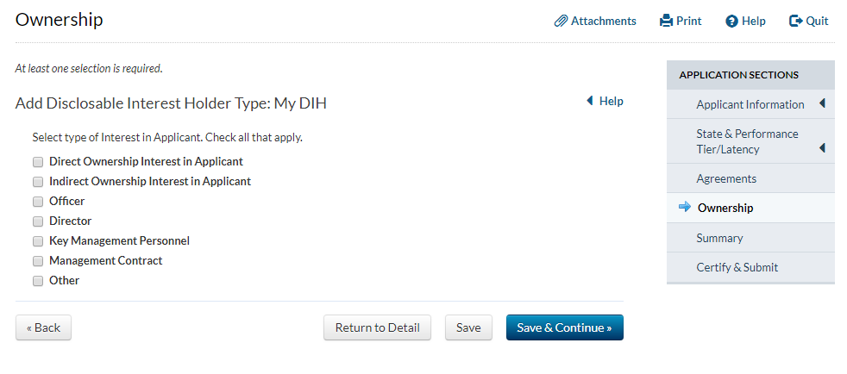
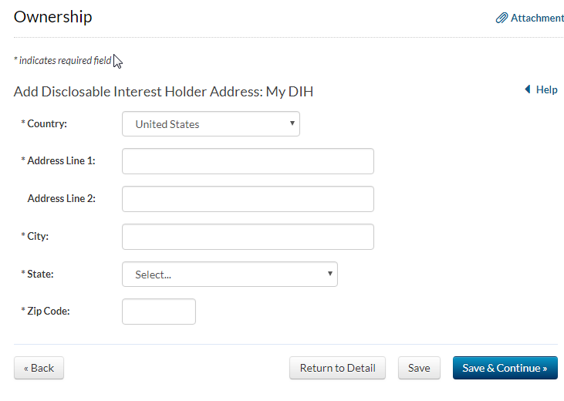
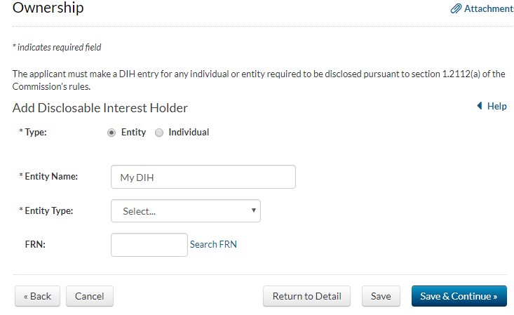


Disclosable Interest Holders
Provide information about the DIH (e.g., contact info, type of interest, etc.)
Use “Other” to disclose interests not listed in Form 183
Report the percent of interest held by the DIH
  DIHs with no equity or other relevant ownership interest in the applicant should put “0”
  Percent of Interest” should reflect aggregate disclosable ownership interests in the applicant (both direct and indirect)

Slide 47
Indirect Disclosable Interest Holders
To determine whether you need to report an individual or entity as an indirect DIH:
Successively multiply the ownership percentages for each link in the vertical ownership chain that equals 10% or more of the applicant
If the ownership percentage for an interest in the chain exceeds 50% or represents de facto control:
  Treat it and report it as if it were a 100% interest
  In some cases, the sum of all the percentages held by DIHs may exceed 100%

Slide 48
Multiplier Example
  B Corp. and C Corp. must be disclosed as direct DIHs
  Homer, Bart, and Lisa would be disclosed as indirect DIHs, but not Marge
B. Corp.
Homer: 0.80 x 20 = 16%
Marge: 0.20 x 20 = 4%, below threshold
C Corp.
Bart: 0.10 x 100 = 10%
Lisa: 0.90 x 100 = 90% (report as 100%)
Applicant
B Corp.
Homer
Marge
C Corp.
Bart
Lisa
80%
20%
20%
10%
80%
90%

Slide 49


Indirect Disclosable Interest Holders—Attachment
You must submit an “Indirect Ownership” attachment
The attachment may include any additional information you believe will assist FCC staff in reviewing the ownership information
  Ex: If the disclosed equity interests in a corporate applicant do not equal 100% because numerous shareholders have interests below the 10% threshold, explain this in the attachment
    It can also include an ownership chart

Slide 50


FCC Regulated Businesses

Slide 51


Error Summary
Once you have reviewed your application and fixed the errors, you may continue to certify and submit
Just because the FCC Form 183 did not find errors does not mean that the application is complete; Commission staff will review for completeness

Slide 52



Certify & Submit
Upon the successful submission of your application, you will receive a unique confirmation number as well as the date and time of submission
Applications must be submitted prior to 6:00 PM ET on March 30, 2018
Late applications will not be accepted
If you do not see and click this button, you have not submitted your application!

Slide 53

Modifications
You may make an unlimited number of changes to your application prior to 6 PM ET, March 30, 2018
The status will continue to read “Submitted,” but you must re-certify and submit the application for the changes to be submitted
After you click the “Certify & Submit” button on the Certify and Submit page, you will receive a new confirmation of submission and the yellow warning will disappear

Slide 54
Duty to Maintain Accuracy and Completeness
Pursuant to 47 CFR§1.65, each applicant has a continuing obligation to maintain the accuracy and completeness of information in a pending application to participate in Auction 903
Must be amended within five days after a significant occurrence

Slide 55
Limited Information Disclosure Procedures
Automatically not accessible
  State selections
  Performance tier and latency combination(s) selected and weight
  Responses to the operational questions in Appendix A of the Procedures PN and any supporting documentation
  Spectrum access attachment (if any)
Not accessible if requested via abbreviated process
  Financial information and individual financial scores
Not accessible if requested by section 0.459 process
  All other information if request not adversely decided

Slide 56


Prohibited Communications Rule
Section 1.21002 prohibits Auction 903 applicants from cooperating, collaborating, or communicating, in any way, with any other applicant regarding any applicant’s bids or bidding strategies, unless the applicants are members of a joint bidding arrangement disclosed on their applications

Slide 57
Prohibited Communications Rule
Applies to applicants starting at application deadline, regardless of whether they qualify, bid, or are no longer bidding
“Applicant” includes entity applying, any party with control of the applicant entity, any party controlled by the applicant entity or controlled by a party controlling the applicant entity
“Bids or bidding strategies”
Communications with third parties who may be conduits to other applicants (e.g., press, analysts, consultants)
Review Procedures Public Notice and consider past guidance
  http://wireless.fcc.gov/auctions/prohibited_communications

Slide 58
Compliance Strategies
You have until the application deadline to prepare
  Communications prior to the deadline cannot violate the rule, but if you repeat or refer to them after deadline – could be a violation
  Educate your employees, contractors, and consultants
    Broad definition of “applicant”
    Indirect and/or inadvertent communications that reach another applicant can violate rule
  Plan how to protect your bidding information and consider who needs to know it
Some communications are OK – e.g., business discussions unrelated to bids or bidding strategies

Slide 59
Using Third-Party Consultants
Using consultants is OK, but manage risk of communications to another applicant after the deadline
  Individual
    Use non-disclosure agreement for representing a single applicant
    If an individual serves multiple applicants, advice may be influenced by knowledge of others’ bidding strategies
  Firm
    Use separate individuals with ethical walls
  Establish plan with consultant before application deadline so that communications after deadline are unnecessary
    Consider using proxy bidding

Slide 60
Contact Information
FCC Auctions Hotline General Auction Questions Auction Process and Procedures | (888) 225-5322, option two; or (717) 338-2868 Hours of service: 8:00 a.m. – 5:30 p.m. ET, Monday through Friday
Technical Support Electronic Filing FCC Auction System (Hardware/Software Issues) | (877) 480-3201, option nine; or (202) 414-1250 (202) 414-1255 (TTY) Hours of service: 8:00 a.m. – 6:00 p.m. ET, Monday through Friday

Slide 61
Questions?
Send questions to auction903@fcc.gov

