Slide 1
Connect American Fund
Phase II Auction
(Auction 903)
Application Workshop
Bidding System Sneak Peek
March 14, 2018

Slide 2
Disclaimer
The examples that appear in this presentation do not reflect any predictions or assumptions about the actual bidding in the auction, what the base clock percentage will be in a particular round, when the budget will clear, the auction schedule, the number of rounds, or the outcome of the auction. The examples do not reflect the Auction 903 final eligible areas. The bidding system shown in the screen shots is not the final version of the bidding system that will be used for Auction 903. Company and bidder names are fictitious. Any similarity to actual company names, PINs, FCC Registration Numbers (FRNs), or other personal information is coincidental.

Slide 3
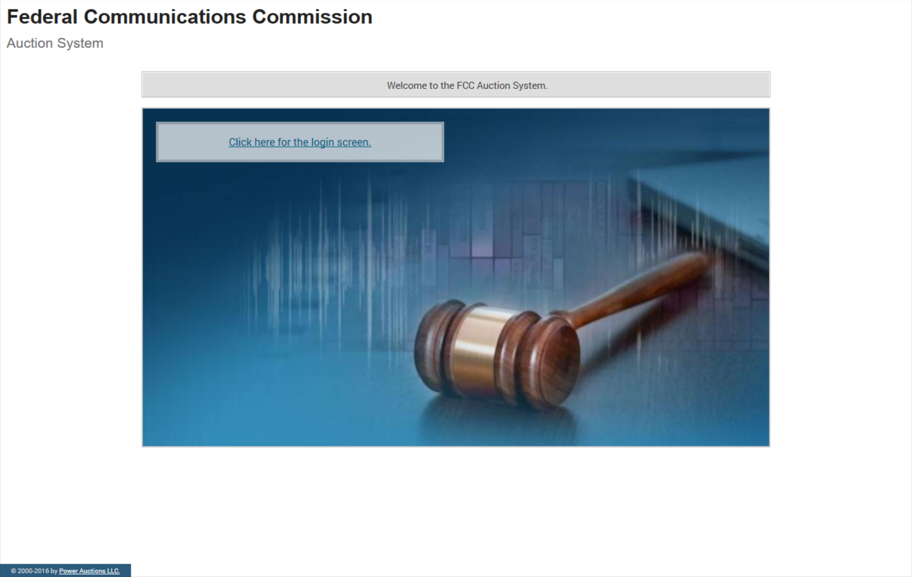
Auction System Home Page

Slide 4
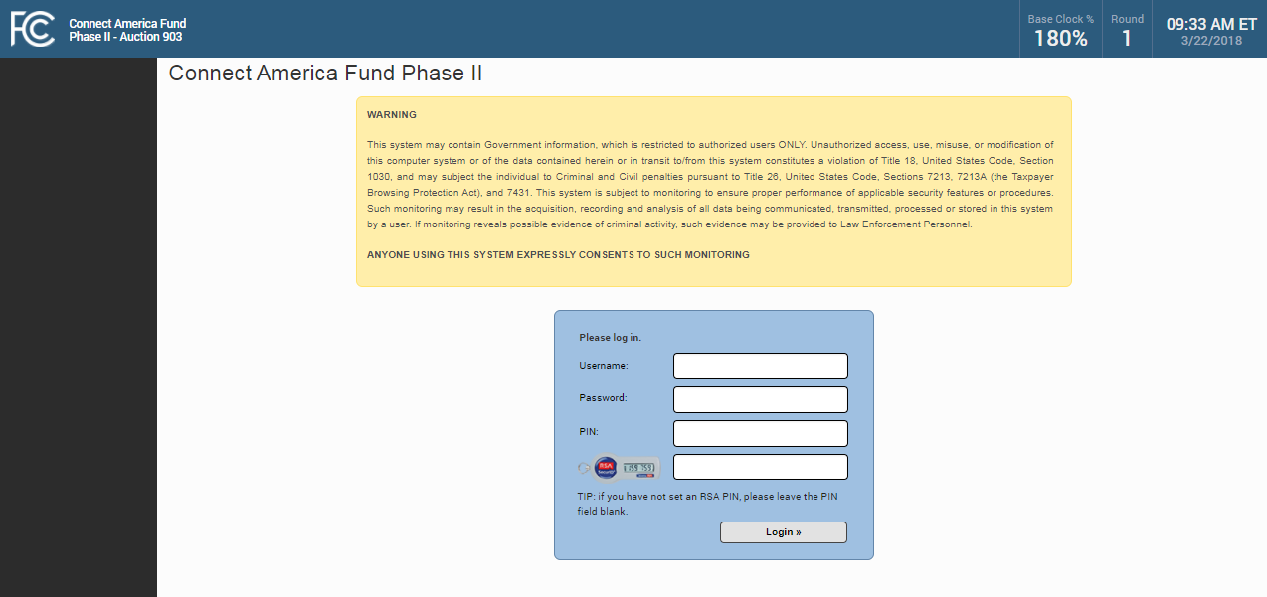
Logging In

Slide 5
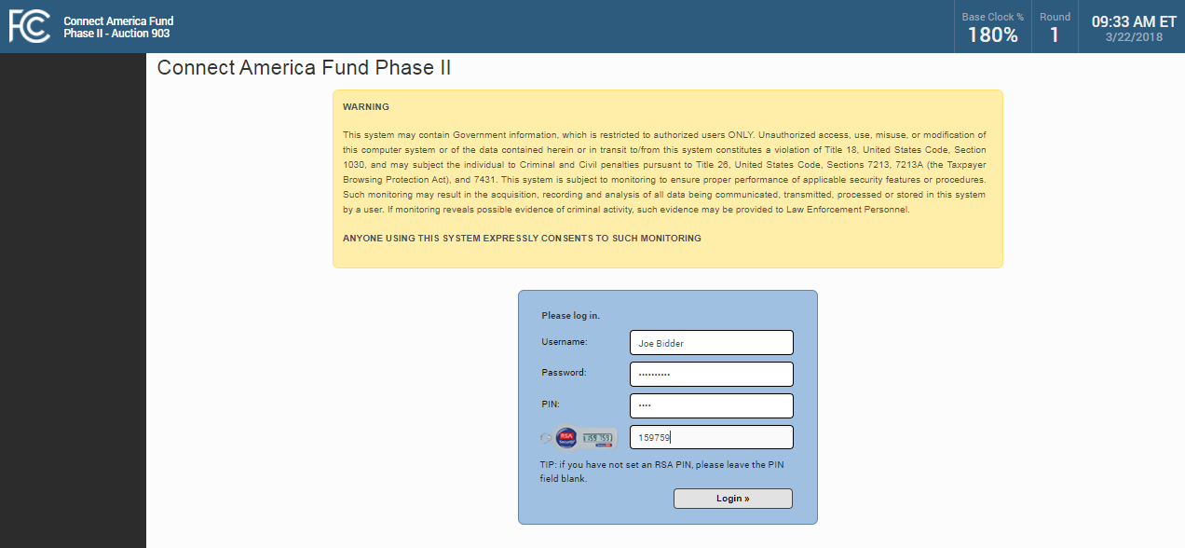
Logging In

Slide 6
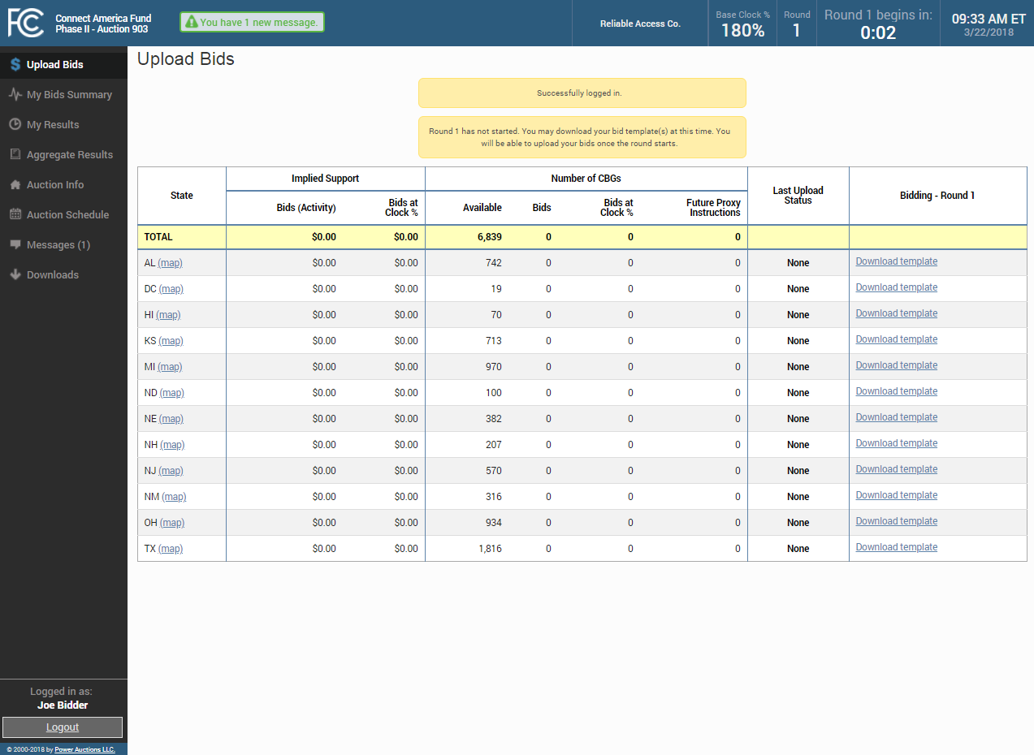
First Page — Upload Bids

Slide 7
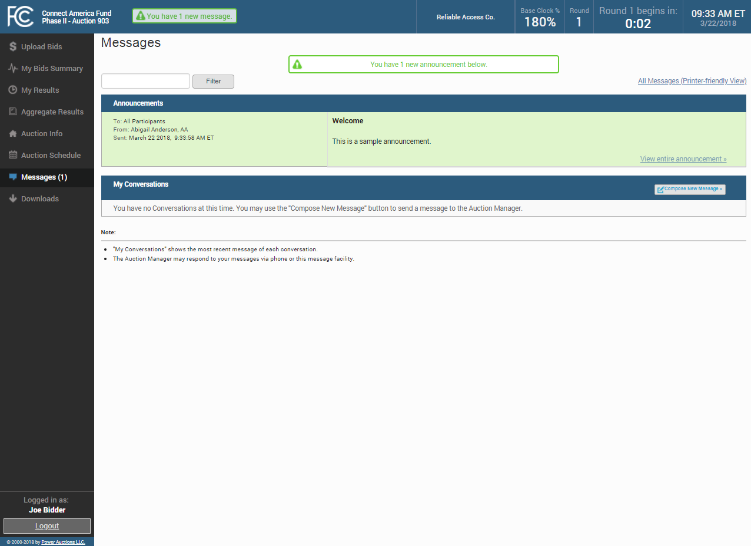
Messages

Slide 8
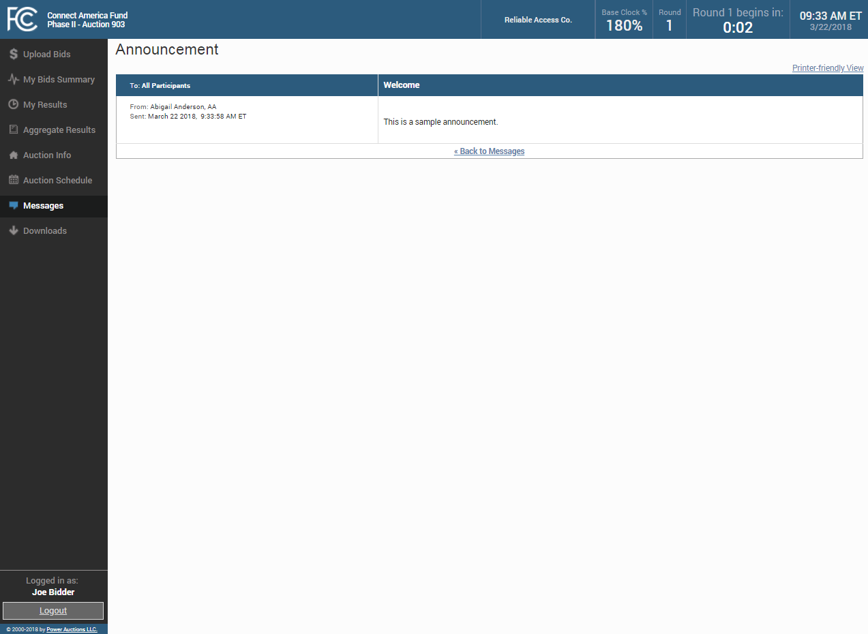
Announcements

Slide 9
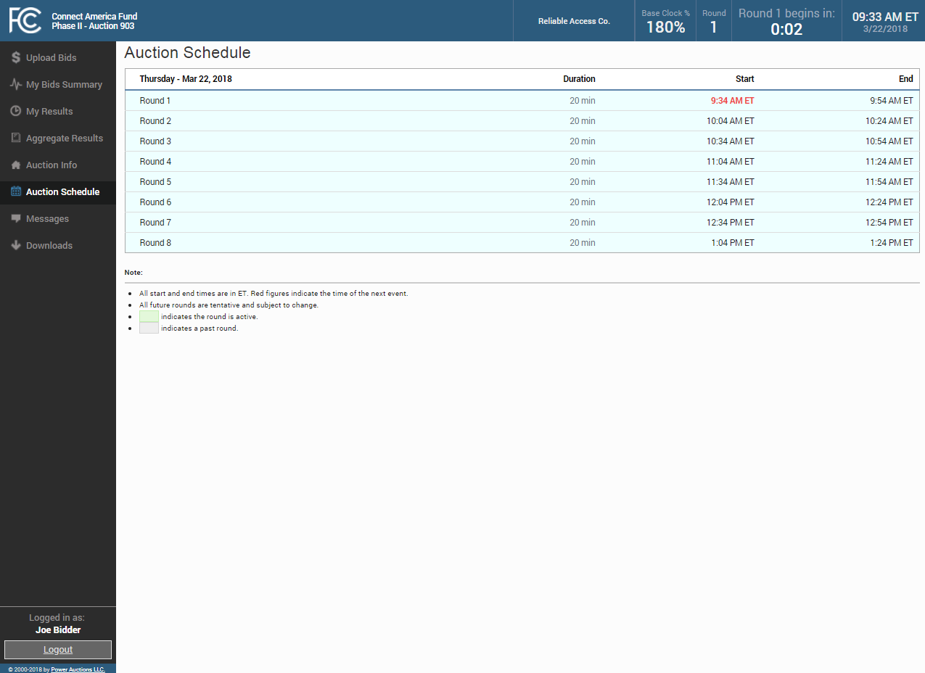
Auction Schedule

Slide 10
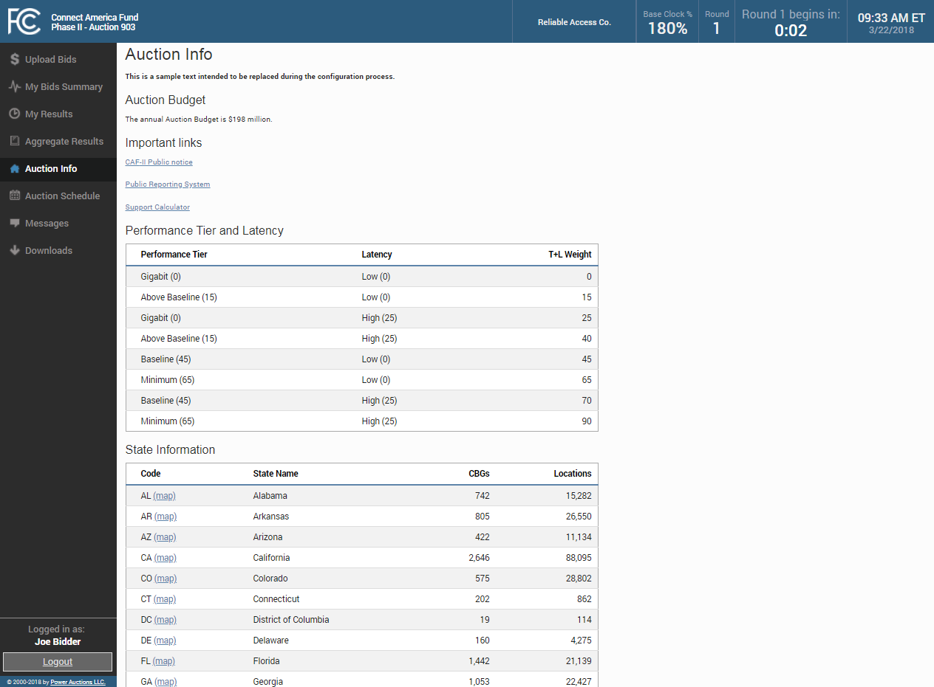
Auction Info

Slide 11
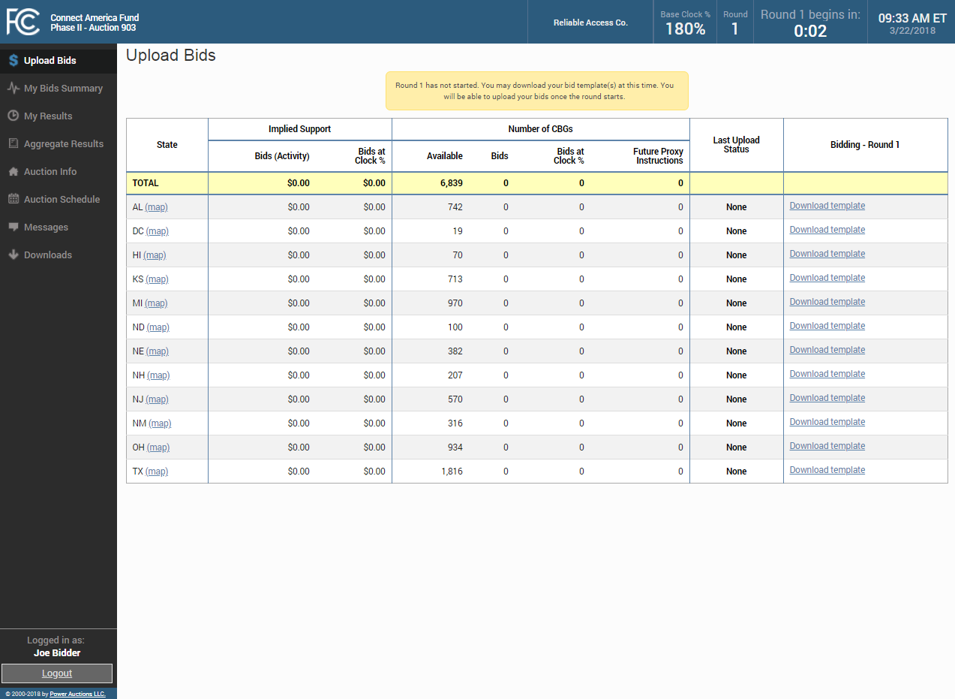
Upload Bids

Slide 12
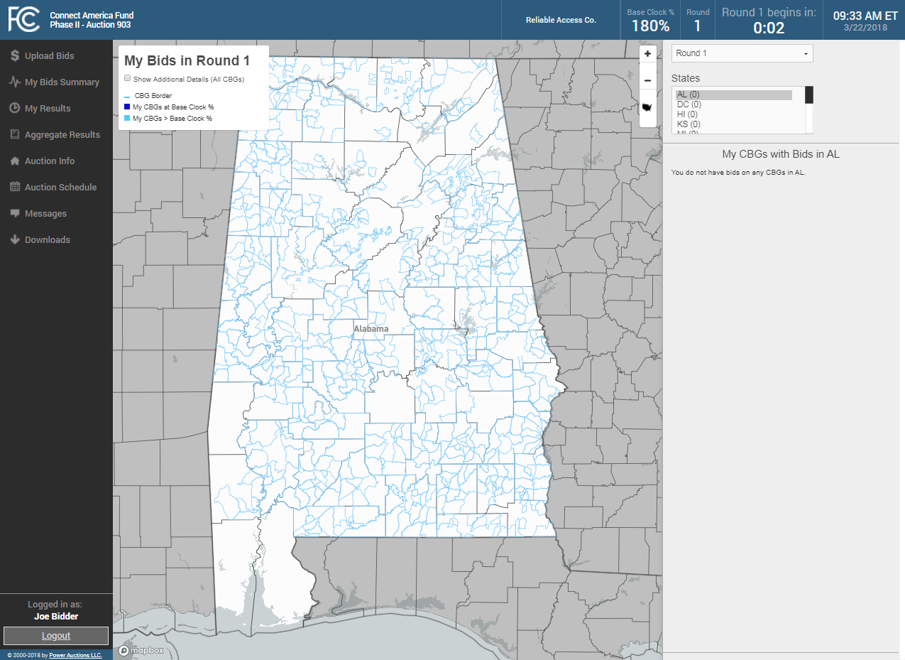
GIS Maps

Slide 13
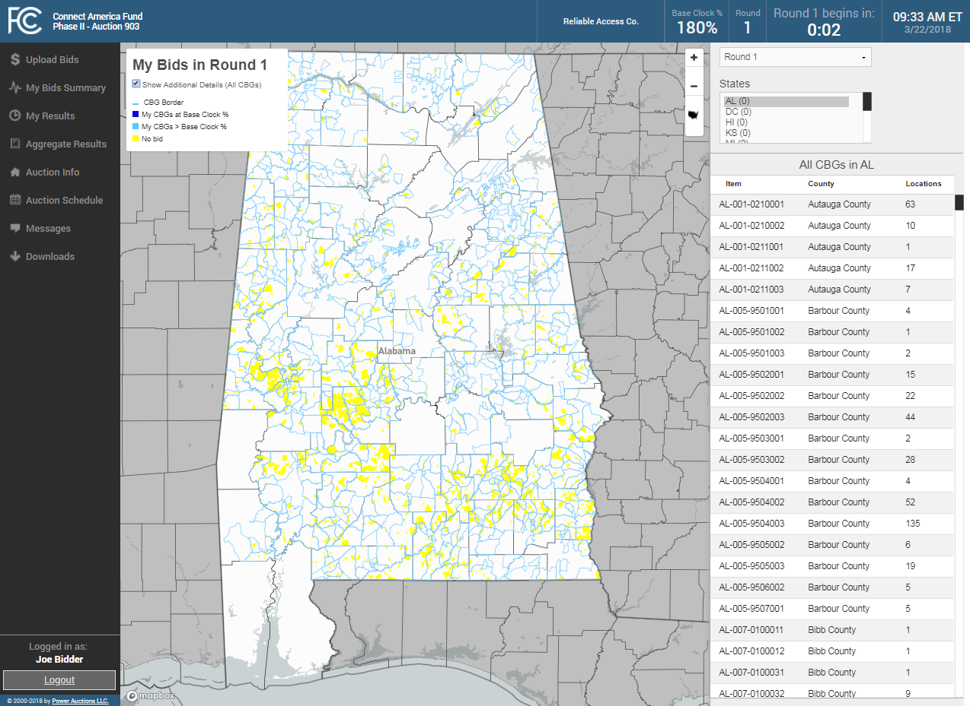
Additional Details (All CBGs)

Slide 14
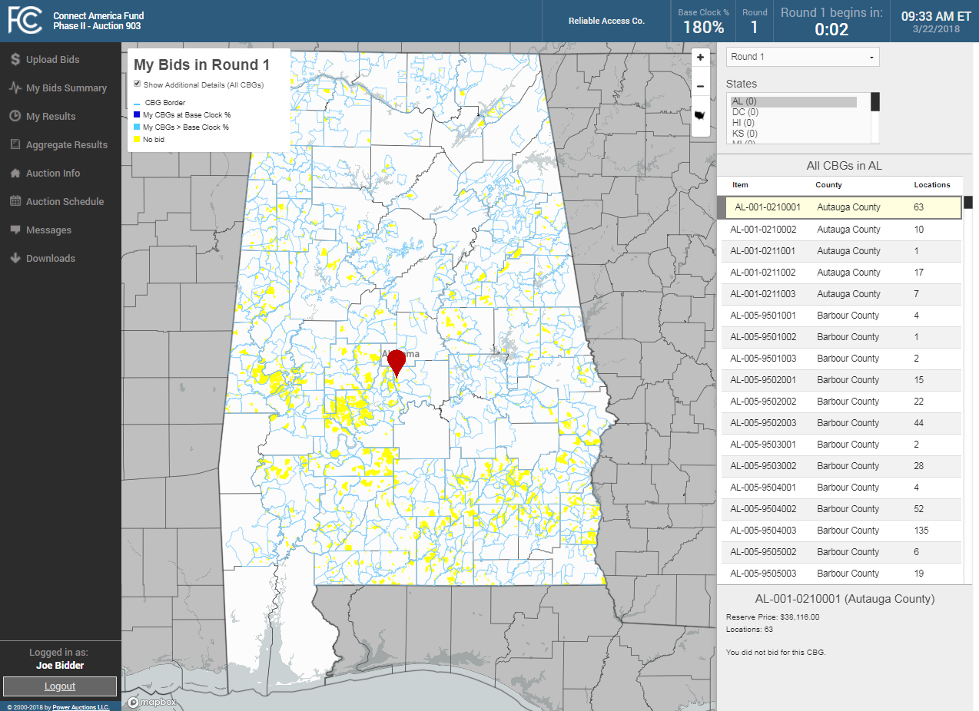
Select An Item From The List

Slide 15

Downloading Template Before Round Opens

Slide 16
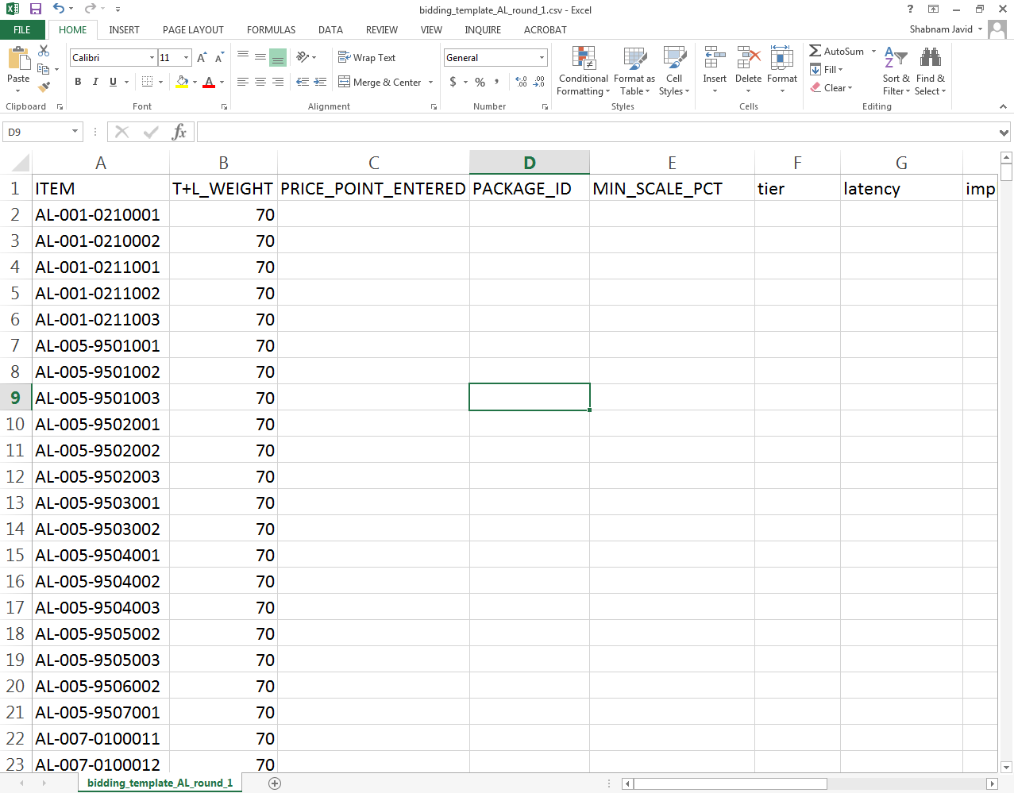
Enter Bids In Template

Slide 17
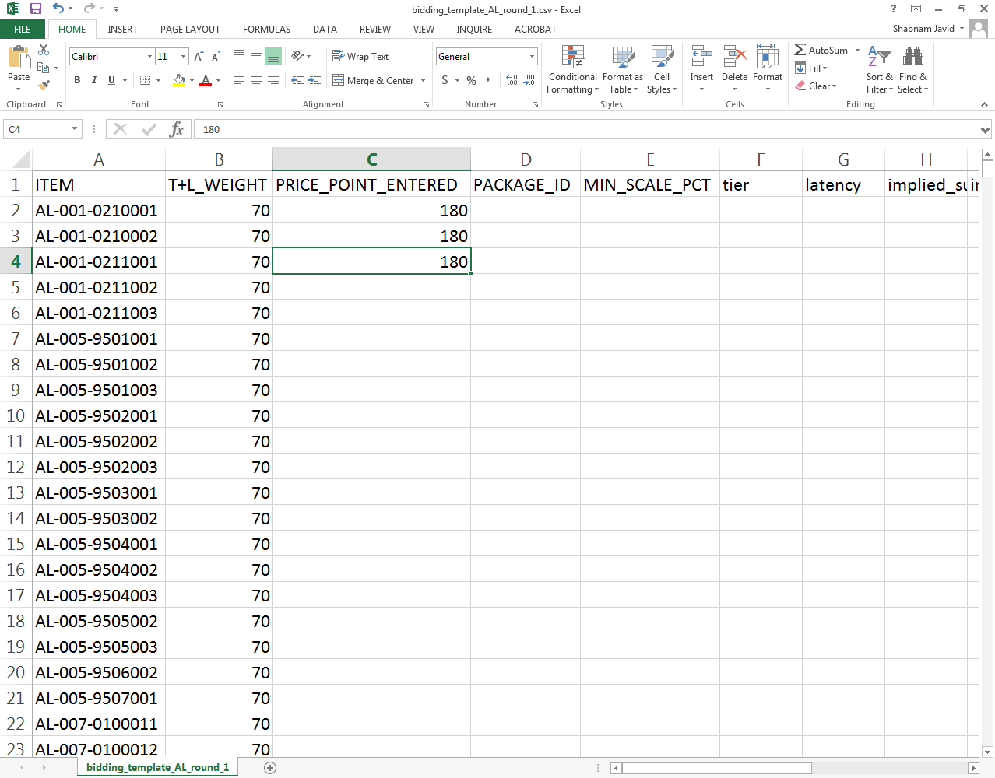
Enter Bids: Single Item

Slide 18
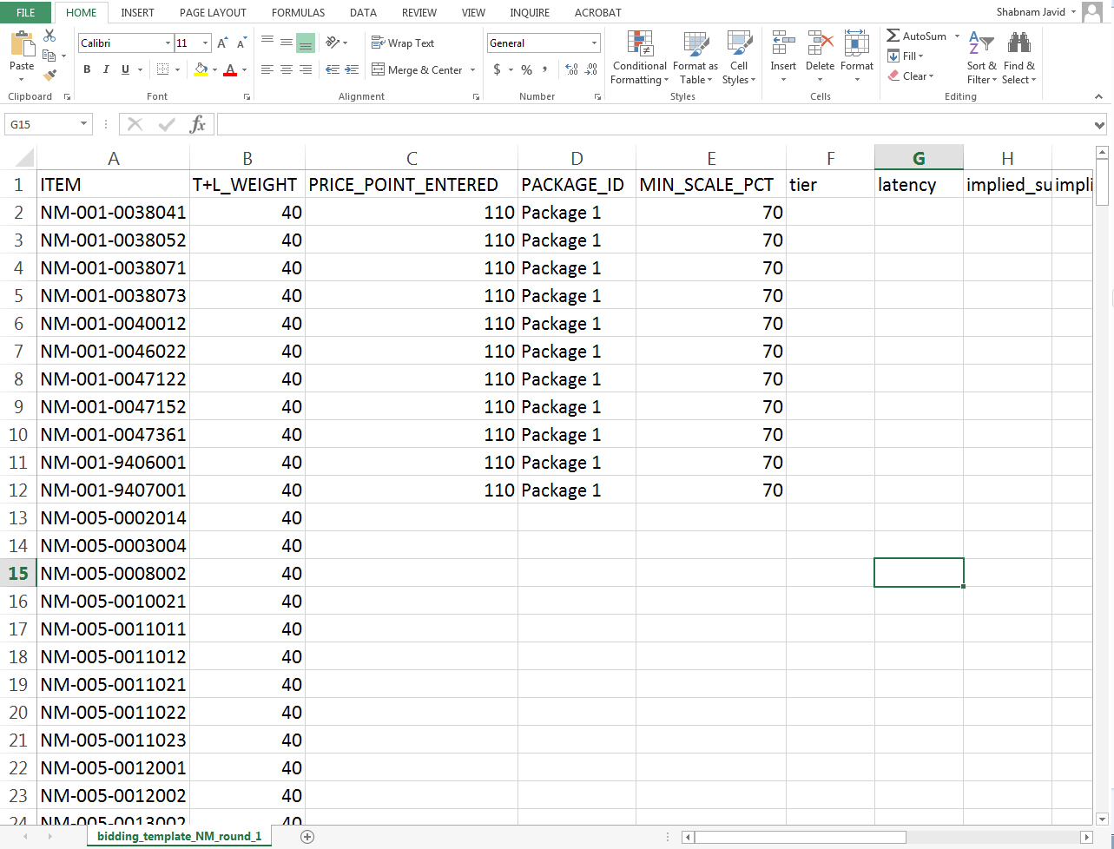
Enter Bids: Package

Slide 19
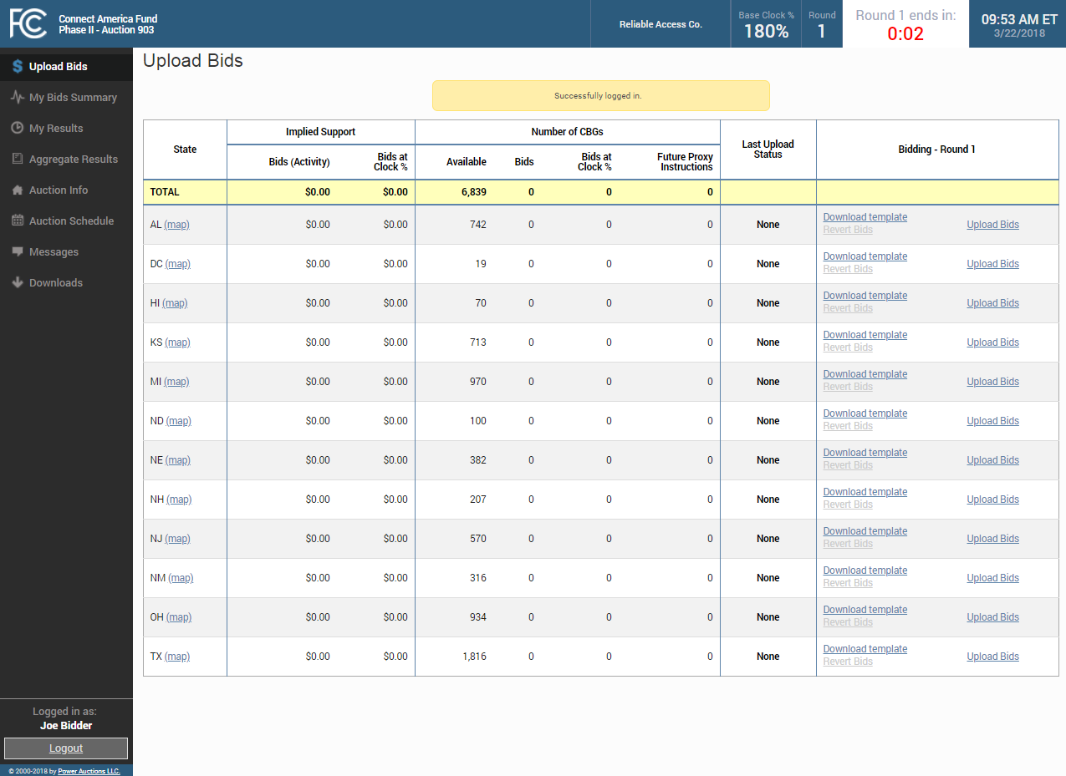
Upload Bids After Round Opens

Slide 20
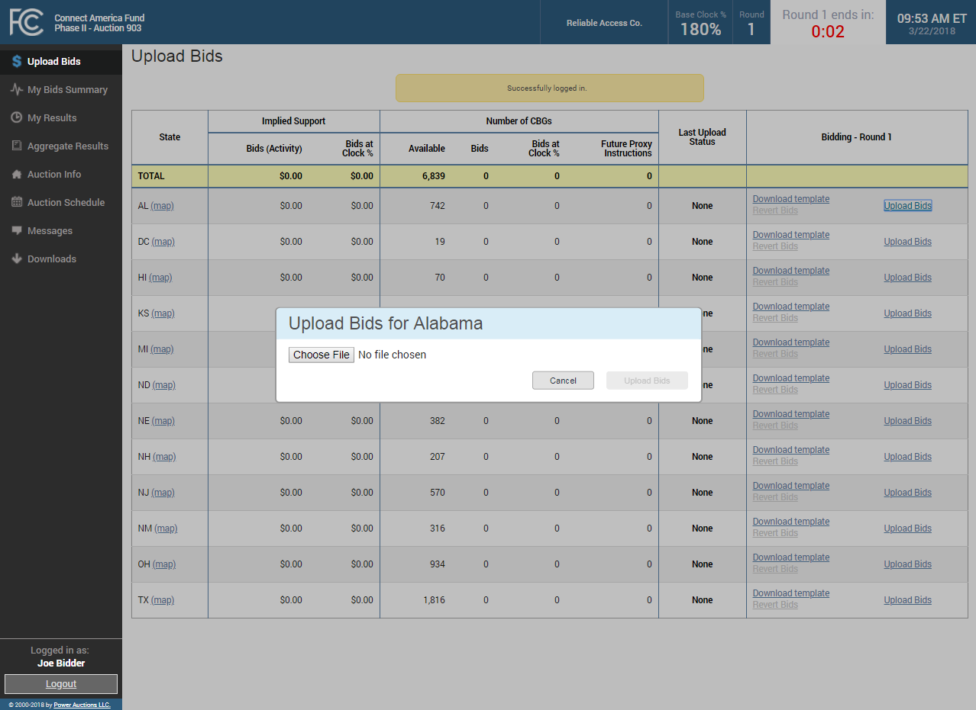
Choose File

Slide 21
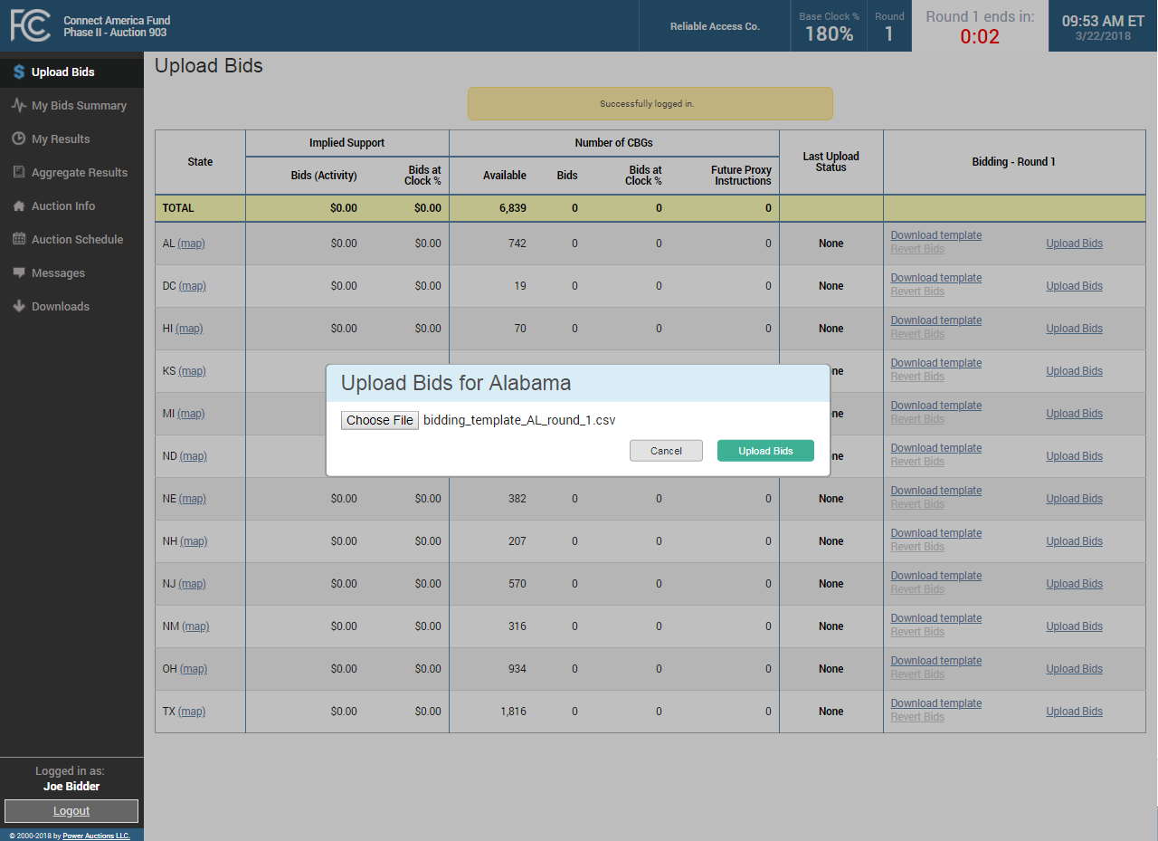
Upload Bids

Slide 22
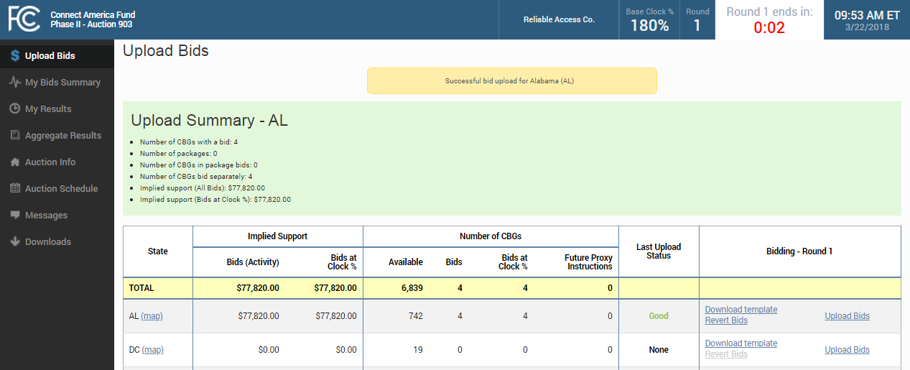
Successful Bid Upload

Slide 23
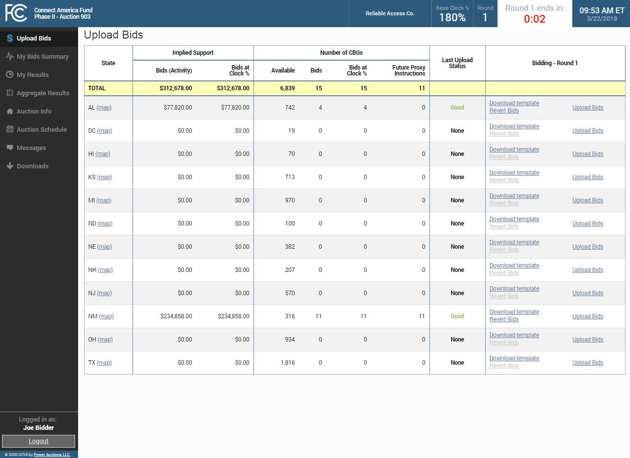
Uploaded Bids

Slide 24
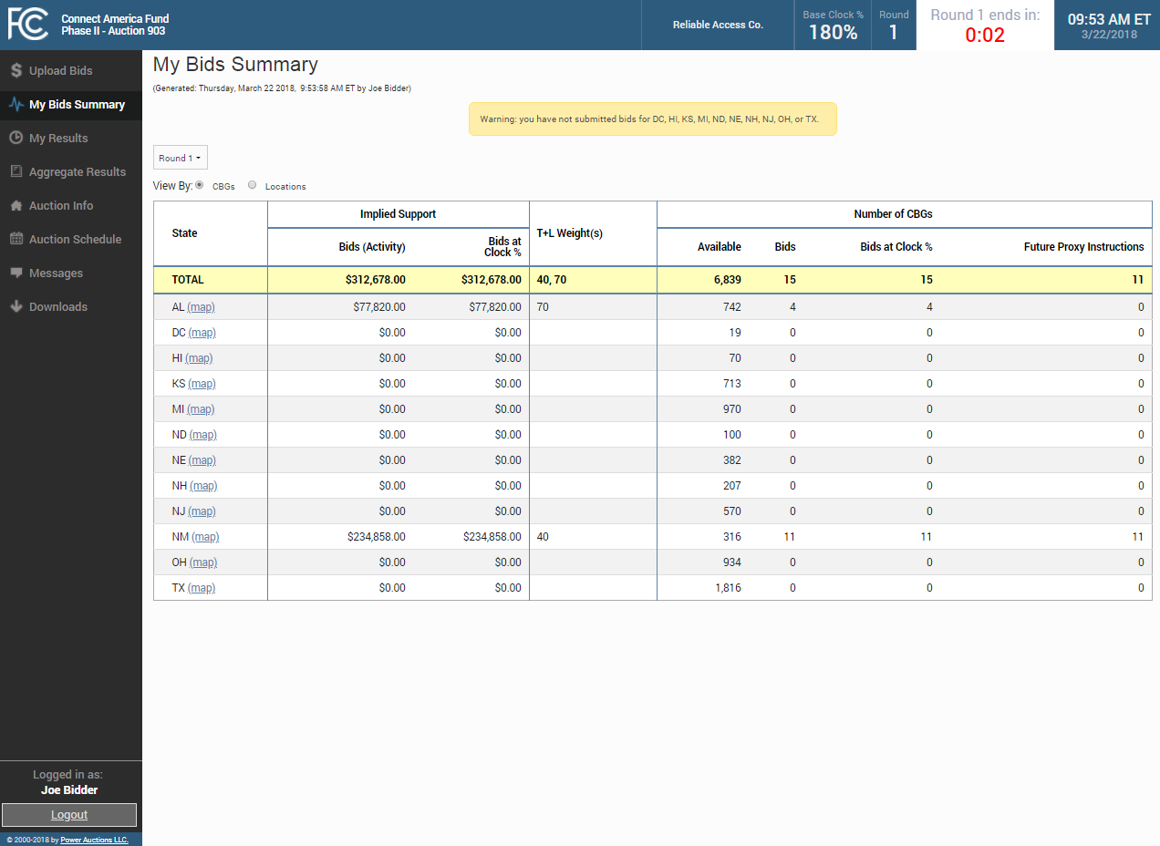
My Bids Summary

Slide 25
My Bids Summary Map

Slide 26
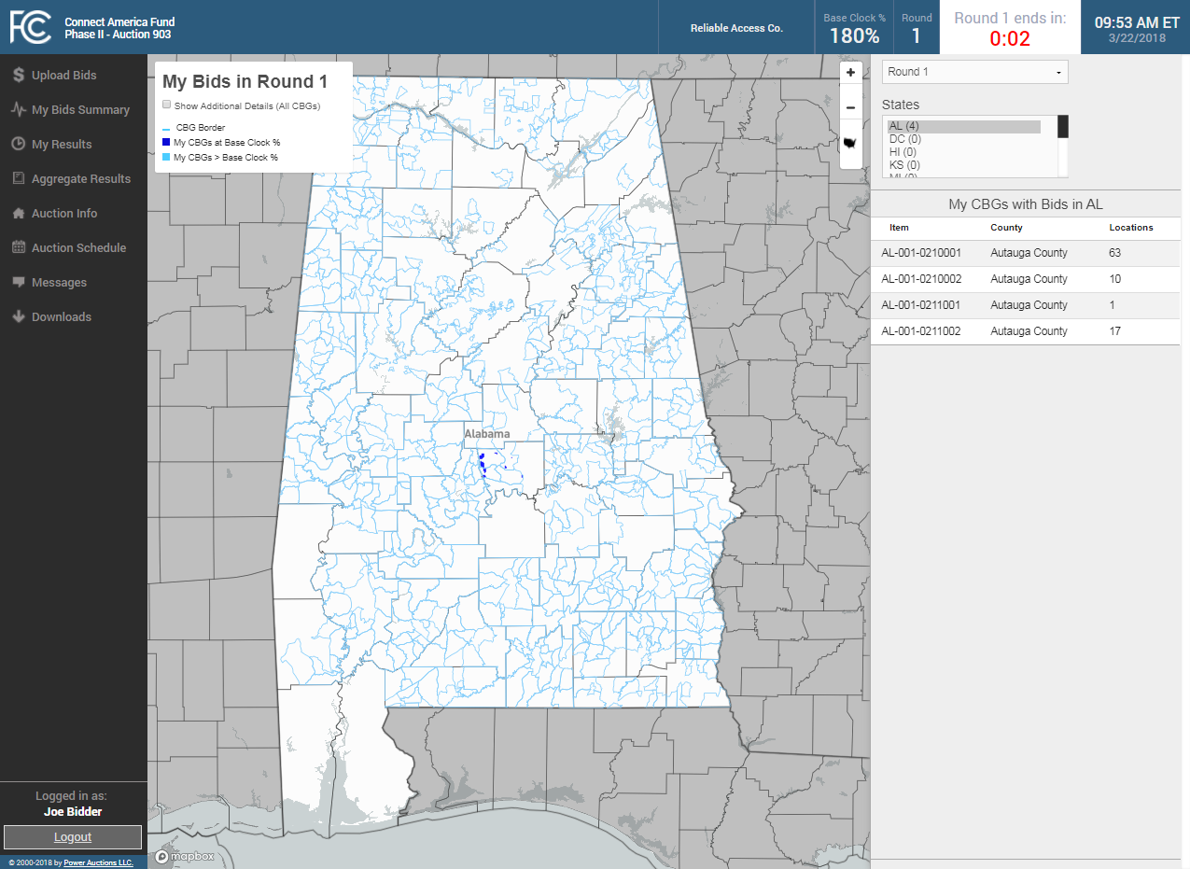
My Bids Map Round 1

Slide 27
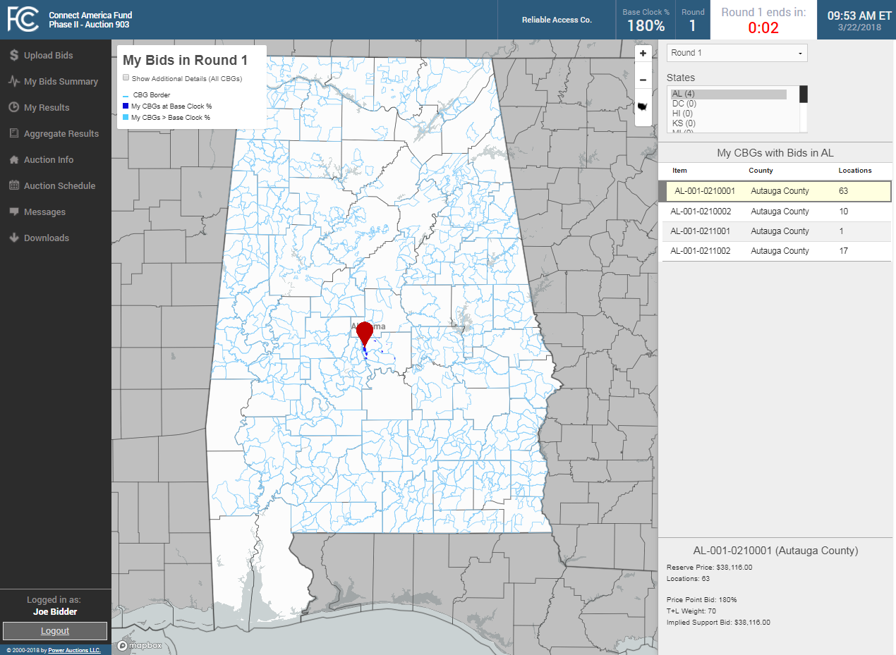
My Bids Map Round 1: Selecting An Item

Slide 28
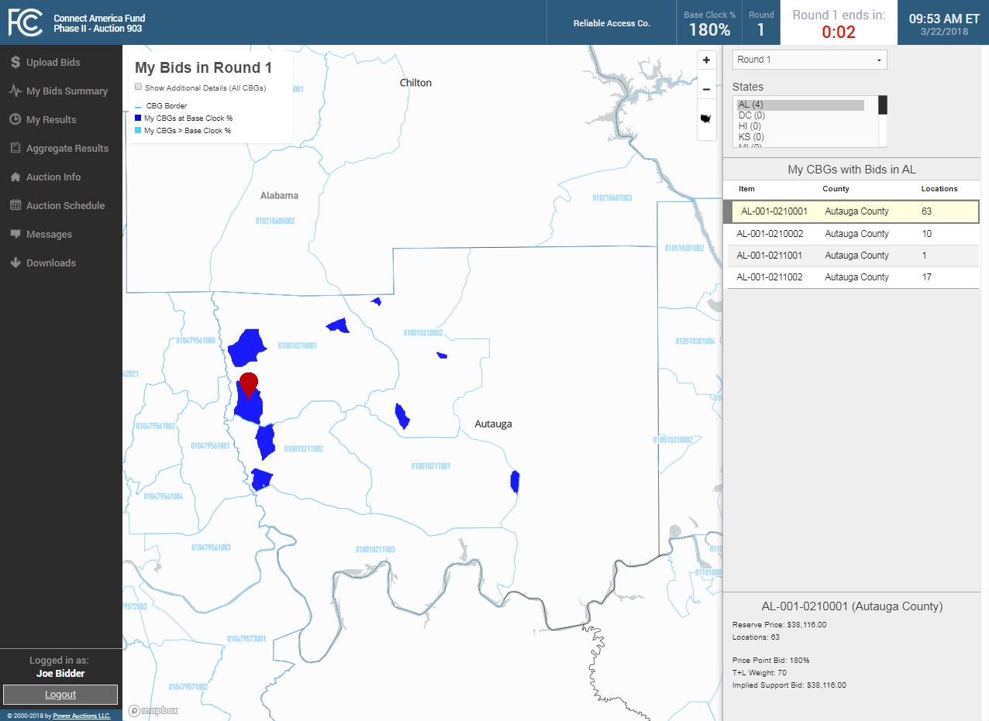
My Bids Map Round 1: Zooming On An Item

Slide 29

My Bids Map Round 1: Selecting An Item

Slide 30

My Bids Map Round 1: Selecting An Item

Slide 31
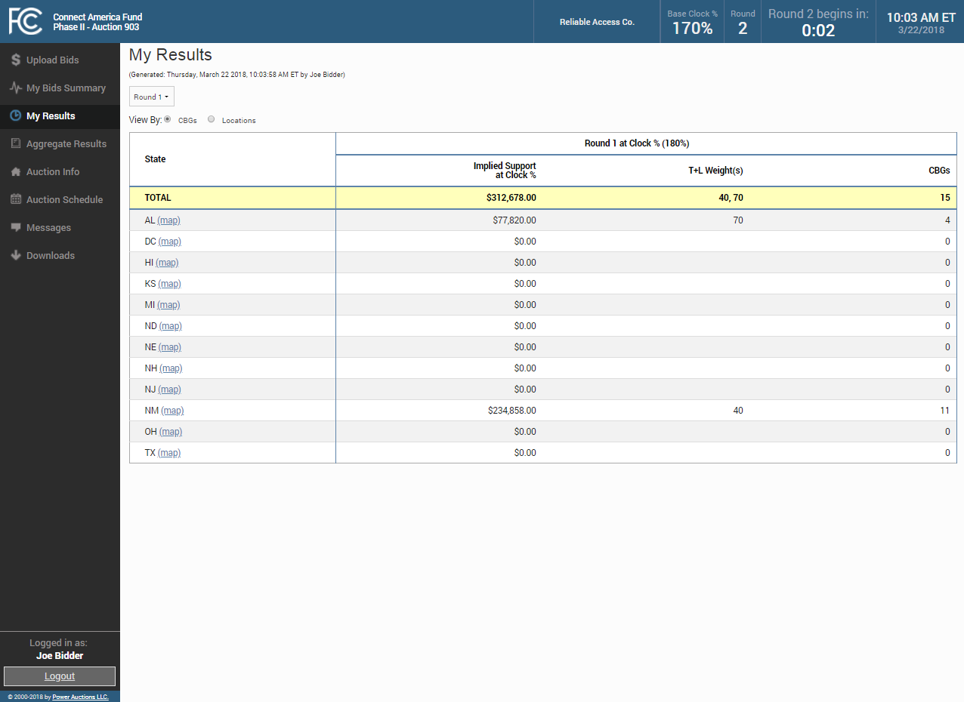
My Results

Slide 32

My Results Map

Slide 33
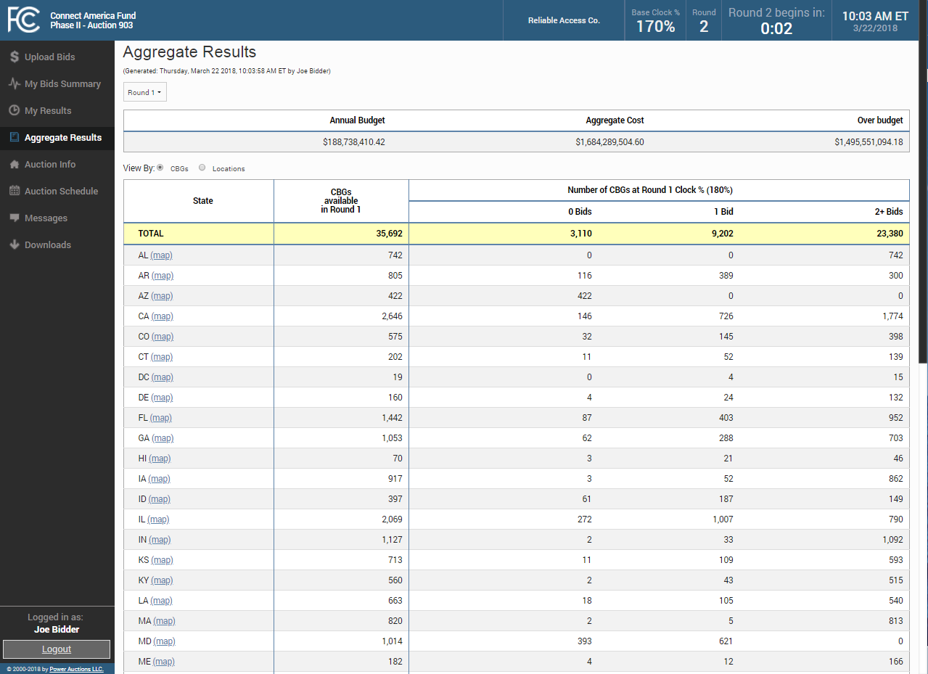
Aggregate Results

Slide 34
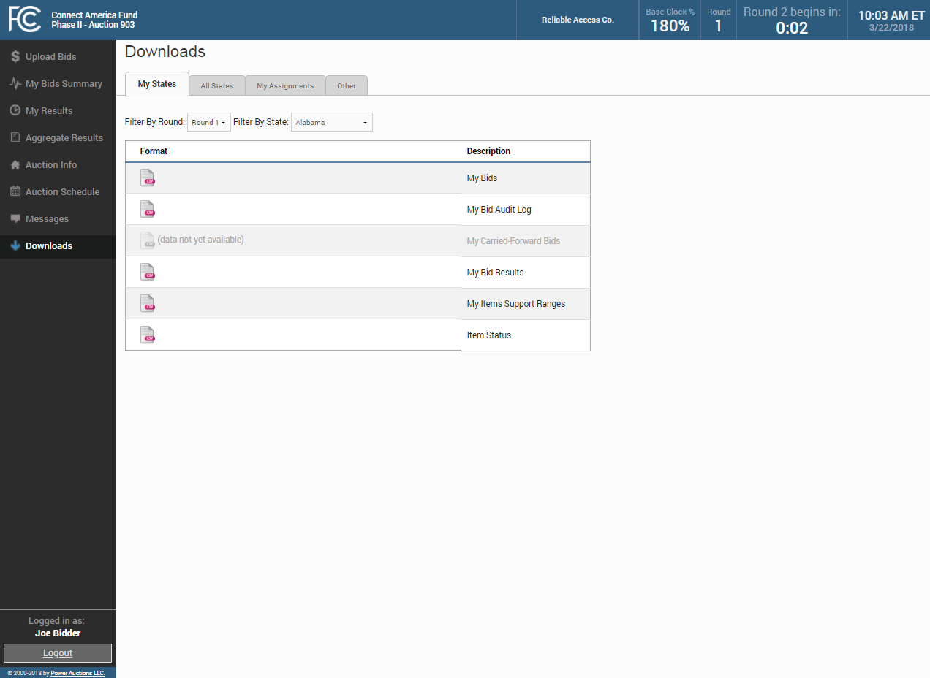
Downloads

Slide 35
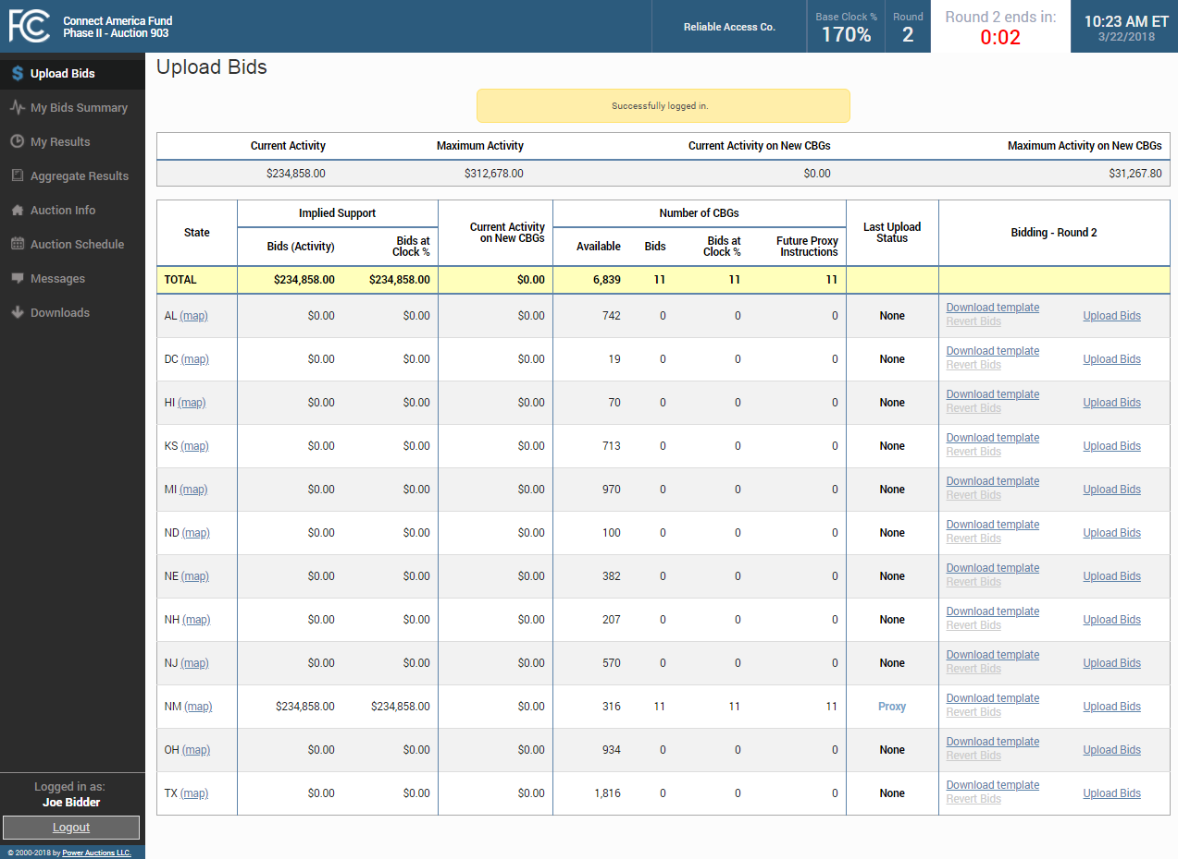
Activity Limits Round 2

Slide 36
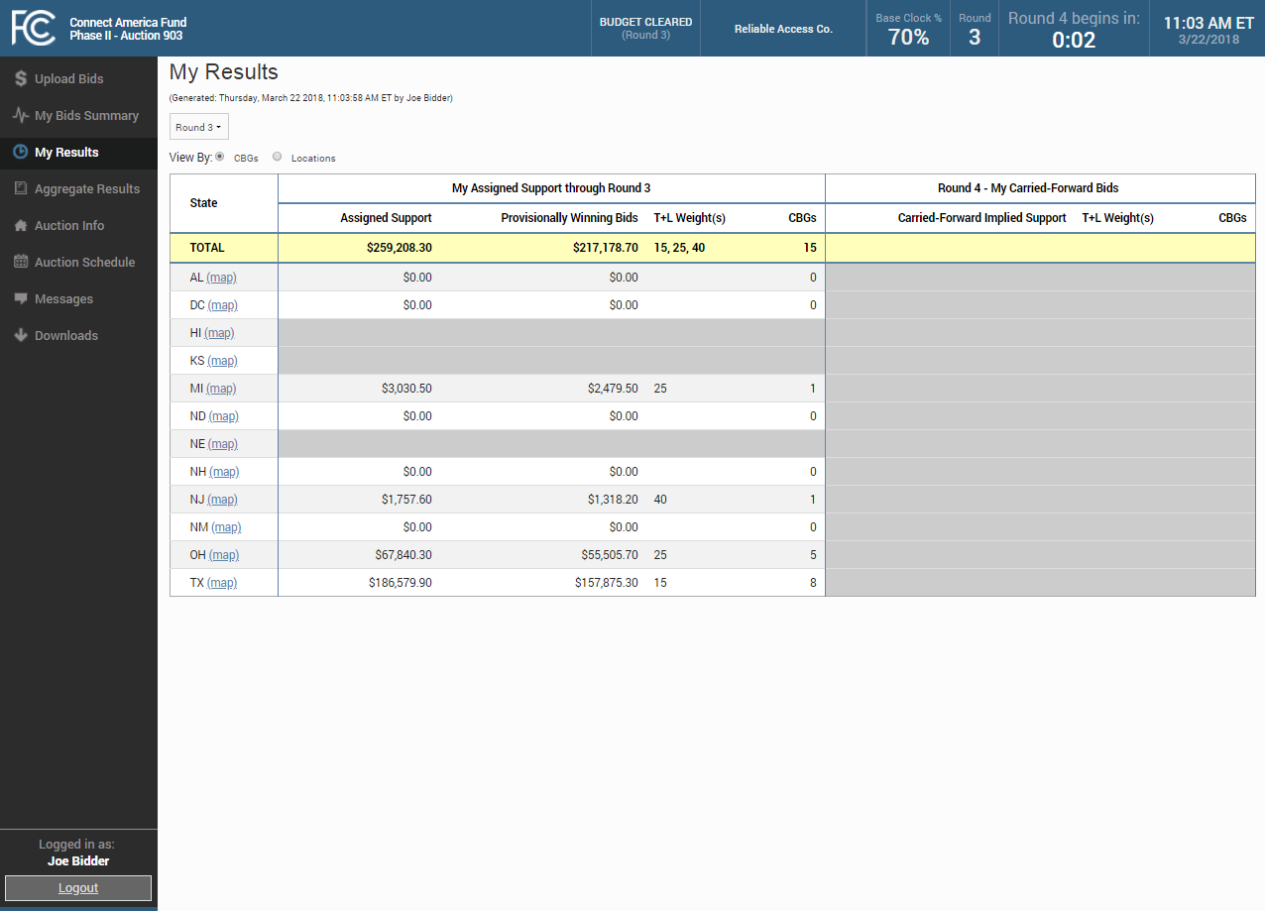
My Results After Budget Cleared

Slide 37
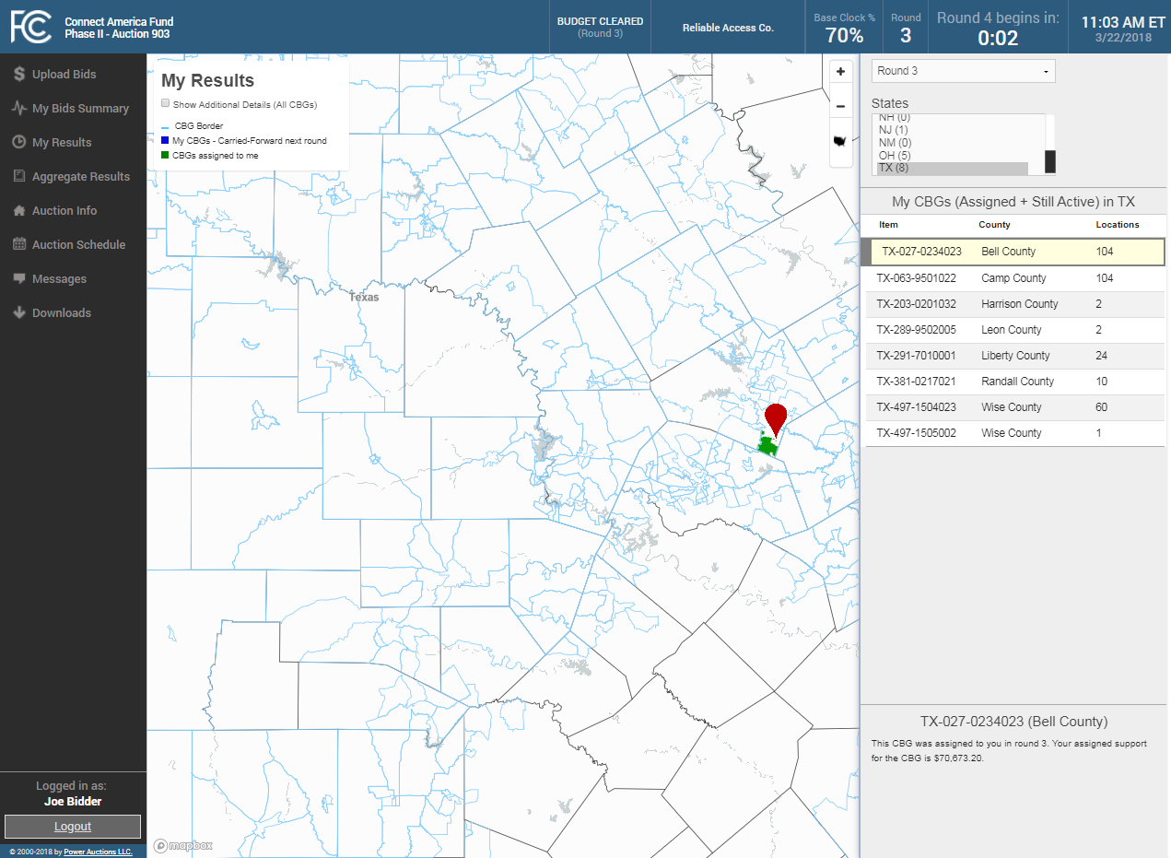
My Results Map After Budget Cleared

Slide 38
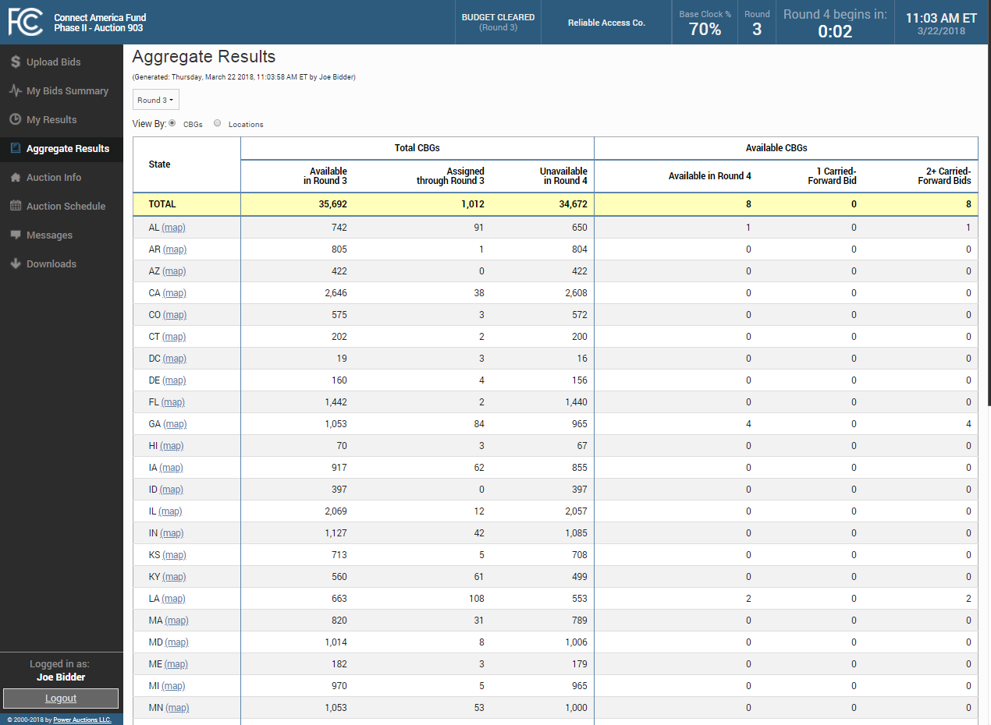
Aggregate Results After Budget Cleared

Slide 39
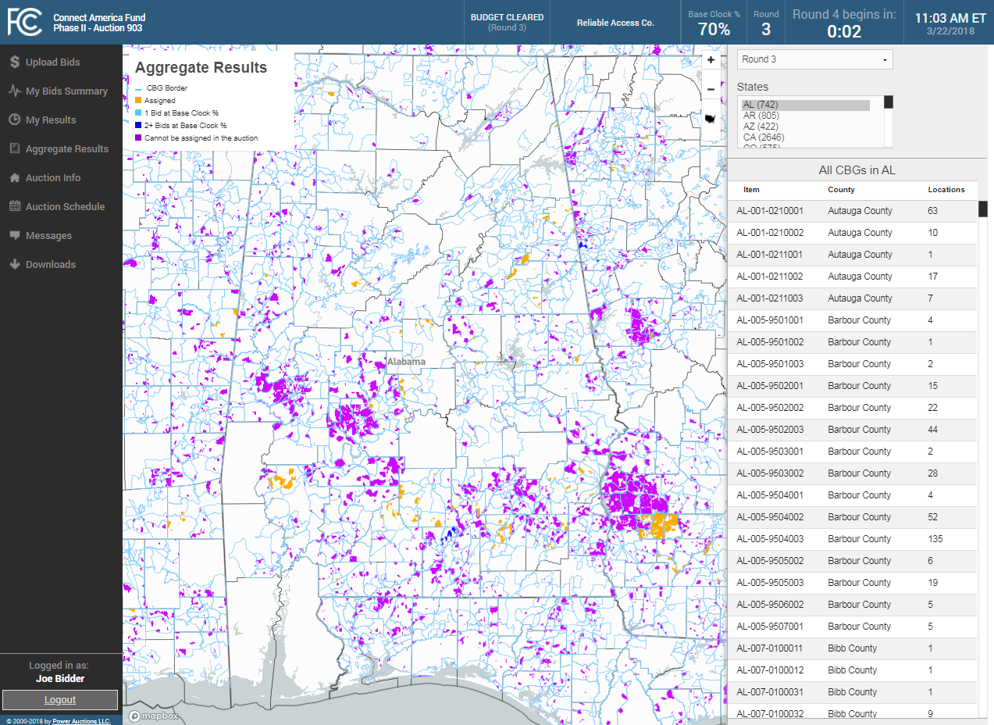
Aggregate Results Map After Budget Cleared

Slide 40
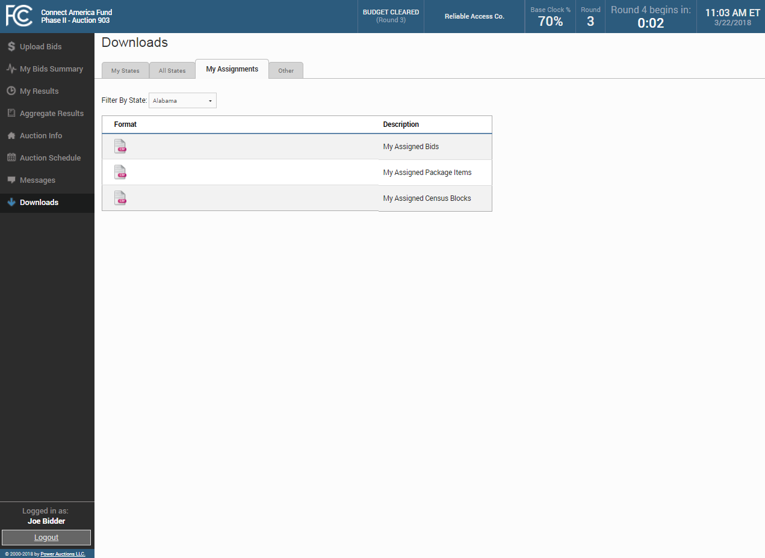
Downloads After Budget Cleared

