Slide 1
A Guide to the Emergency Alert System (EAS) and Wireless Emergency Alert (WEA) System
Public Safety and Homeland Security Bureau
Federal Communications Commission
June 21, 2018

Slide 2
Alerting is a Priority
Integral to the FCC’s mission:
“promoting safety of life and property through the use of wire and radio communication”
47 U.S.C. § 151
U.S. National Policy
“It is the policy of the United States to have an effective reliable, integrated, flexible, and comprehensive system to alert and warn the American people in situations of war, terrorist attack, natural disaster, or other hazards to public safety and well-being (public alert and warning system), taking account of functions, capabilities, and needs and to ensure that under all conditions the President can communicate with the American people.”
Executive Order 13407, “Public Alert and Warning System” (June 26, 2006)

Slide 3
Alerting Systems
(Commercial Communications Infrastructure)
The Emergency Alert System (EAS) is a national public warning system commonly used by state and local authorities to deliver important emergency information, such as weather and AMBER alerts, to affected communities. EAS participants – radio and television broadcasters, cable systems, satellite radio and television providers, and wireline video providers – deliver local alerts on a voluntary basis, but they are required to provide the capability for the President to address the public during a national emergency.
The Wireless Emergency Alert (WEA) system delivers critical warnings and information to the public on their wireless devices. Participation by wireless providers is voluntary, but those that offer the service must adhere to the technical and operational requirements established by the FCC.

Slide 4
Basic Alerting Model
Basic Alerting Model
Trusted Source
Commercial Communications
Infrastructure
The Public
Both the EAS and WEA follow this approach

Slide 5
Trusted Sources
Who or what are trusted sources?
  The President of the United States
  The National Weather Service
  You!
    State, local, county governments
    Emergency management agencies
    State police (AMBER Alerts)

Slide 6
Trusted Sources
How to become a trusted source:
  Understand the alerting systems that are available to you.
  Get training and authorization from FEMA:
      https://www.fema.gov/how-sign-ipaws
  Work with your fellow alerting stakeholders:
    State Emergency Communications Committees (SECCs) are volunteer organizations that administer the EAS at the state and local level.
    Get familiar with your State EAS Plan. State EAS Plans describe state and local EAS operations, and contain guidelines which must be followed to activate the EAS:
        https://www.fcc.gov/public-safety-and-homeland-security/policy-and-licensing division/alerting/general/state-eas-plans
    FEMA IPAWS Team and testing lab:
        https://www.fema.gov/testing-ipaws-lab-jitc
    National Weather Service – local coordination meteorologists: https://www.weather.gov/stormready/contact

Slide 7
The Emergency Alert System (EAS)
EAS Rules – 47 CFR §11.1, et seq.
EAS Participants must deliver Presidential alerts and nationwide, monthly and weekly tests.
      Delivery of other alerts (weather, state, AMBER) is voluntary.
EAS Distribution:
  EAS alerts are delivered to EAS participants either over the internet from FEMA’s Integrated Public Alert and Warning System (IPAWS) gateway or by over-the-air broadcast.
  EAS Participants are required to monitor both systems for redundancy, but IPAWS offers digital sound, enhanced text, non-English alerts, multi-media, and urls

Slide 8
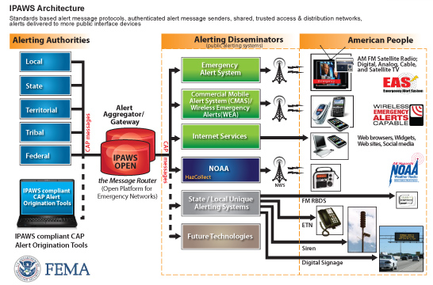
EAS Distribution over IPAWS
Integrated Public Alert and Warning System (IPAWS)

Slide 9
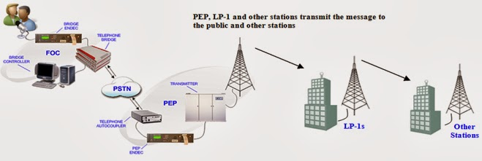
EAS Distribution Over the Air
(the “daisy chain” system)

Slide 10
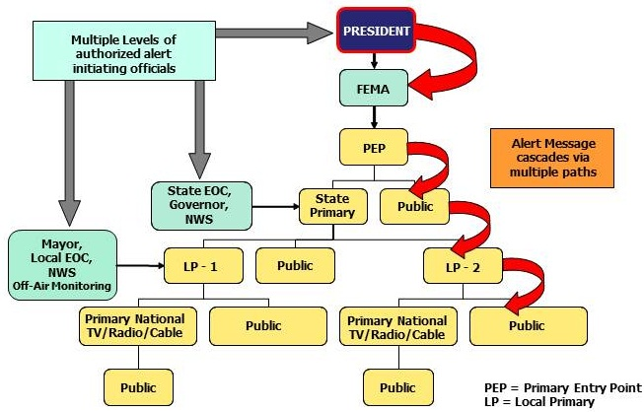
Another way to look at the daisy chain

Slide 11
EAS - Recent Commission Actions
Blue Alerts. A new EAS category that will allow state and local authorities to notify the public of threats to law enforcement and to help apprehend dangerous suspects
  Blue Alerts will warn the public when a law enforcement officer is missing, seriously injured or killed in the line of duty, or when is subject to an imminent credible threat
  Must be implemented for EAS by January 19, 2019
  Must be implemented for WEA by July 19, 2019
Automating State EAS Plans. The FCC adopted rules creating a new, streamlined electronic system for the filing of State EAS Plans that will increase the effectiveness and efficiency of the EAS, while reducing burdens on stakeholders.

Slide 12
Wireless Emergency Alerts (WEA)
WEA Rules – 47 CFR Sections 10.1, et seq.
Established pursuant to Warning, Alert and Response Network (WARN) Act
Uses the IPAWS architecture
Three categories of WEA alerts: Presidential, Imminent Threat and AMBER

Slide 13
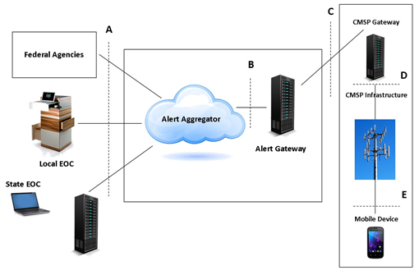
WEA Architecture

Slide 14
WEA - Recent Commission Actions
Improved geo-targeting so that the alerts reach communities affected by an emergency without disturbing others:
  Participating wireless providers are currently required to “best approximate” the area to be alerted
  Participating wireless providers will be required to match the area within 1/10 of a mile by November 2019
Improved alert message content to help communities communicate clearly and effectively:
  Active URLs (web sites and telephone numbers)
    National wireless providers are currently required to support active hyperlinks
    Regional providers will be required to support hyperlinks by May 1, 2019
  Message length will increase from 90 to 360 characters by May 1, 2019
  Participating wireless providers must support Spanish language alerts by May 1, 2019
End-to-end WEA testing will be allowed in May 1, 2019

Slide 15
2017 Nationwide EAS Test
On September 27, 2017, at 2:20 pm, FEMA, in coordination with the FCC and the National Weather Service conducted a nationwide test of the EAS.
The nationwide test was designed to assess the reliability and effectiveness of the EAS, with an emphasis on testing the IPAWS.
The test also provided the Commission with an opportunity to evaluate improvements implemented by EAS Participants since the 2016 nationwide EAS test
EAS Participants nationwide were required to register and submit identifying information and results in the FCC’s EAS Test Reporting System (ETRS)

Slide 16
2017 Nationwide EAS Test
The Public Safety and Homeland Security Bureau released its report on April 13, 2018
  Overall, the 2017 Nationwide EAS Test demonstrated that IPAWS continues to deliver high-quality, effective, and accessible EAS alerts
  Test data also reveal that technical issues affect EAS Participants’ ability to receive EAS alerts effectively over IPAWS and that filings from representatives of people with disabilities show that interference with closed captioning and other EAS Participant practices impeded the full accessibility of the test
Over the next year, PSHSB will:
  Encourage EAS Participants to adopt best practices for the delivery of accessible EAS alerts and upkeep of EAS equipment, particularly to allow prioritization of IPAWS=based EAS alerts
  Work with the SECCs and EAS equipment manufacturers to reach out to EAS Participants to encourage them to update their EAS equipment and software to ensure successful participation in tests and compliance with the Commission’s rules.

Slide 17
Hawaii False Alert
Report and Recommendations
On January 13, 2018, the State of Hawaii Emergency Management Agency mistakenly sent a false ballistic missile alert using the EAS and WEA
FCC’s Public Safety and Homeland Security Bureau investigated the event and released a report with recommendations to guard against and mitigate false alerts:
    https://www.fcc.gov/document/fcc-releases-report-hawaii-false-emergency-alert

Slide 18
Hawaii False Alert
Report and Recommendations
Recommendations include:
  Establishing redundant and effective lines of communication with key stakeholders during emergencies
  Conducting regular internal tests in a controlled and closed environment, such as FEMA’s Integrated Public Alert and Warning System (IPAWS) Test Lab
  Requiring more than one credentialed person to validate message content prior to transmission of a high-impact alert, as well as all tests
  Implementing specific upgrades to alerting software and developing standard operating procedures for responding to false alerts
  Consult with SECCs on a regular basis—at least annually—to ensure that EAS procedures, including initiation and cancellation of actual alerts and tests, are mutually understood, agreed upon, and documented in the State EAS Plan.

Slide 19
Alerting Roundtable and Other Outreach
On May 15, 2018, the Bureau hosted a public roundtable with stakeholders to share lessons learned and to promote a continued dialogue.
Recommendations and major take-aways:
  Engage in proficiency training and adopt best practices for alerts and tests
  Building local relationships is essential. Stakeholders, including SECCs and State emergency managers, should meet on a regular basis.
  State personnel responsible for initiating alerts should take the training offered by FEMA and practice using the FEMA IPAWS lab, which can be accessed online.
  An archived webcast of the roundtable can be viewed here:
  https://www.fcc.gov/news-events/events/2018/05/emergency-alerting-roundtable

Slide 20
Alerting Roundtable and Other Outreach
The Commission and the Public Safety and Homeland Security Bureau will continue to reach out to government and industry stakeholders to promote best practices and recommendations, including a planned FCC/FEMA webinar for July, 2018.

Slide 21
Questions?
Thank You!
Gregory M. Cooke
Deputy Chief, Policy & Licensing Division
Public Safety & Homeland Security Bureau
Federal Communications Commission
(202) 418-2351 (office)
(301) 466-2441 (mobile)
gregory.cooke@fcc.gov

