Slide 1
A Guide to the Emergency Alert System (EAS) and Wireless Emergency Alert (WEA) System
Public Safety and Homeland Security Bureau
Federal Communications Commission
July 25, 2018
Email Questions to: PLD@fcc.gov

Slide 2
Alerting is a Priority
Integral to the FCC’s mission:
“promoting safety of life and property through the use of wire and radio communication”
47 U.S.C. § 151
U.S. National Policy
“It is the policy of the United States to have an effective reliable, integrated, flexible, and comprehensive system to alert and warn the American people in situations of war, terrorist attack, natural disaster, or other hazards to public safety and well-being (public alert and warning system), taking account of functions, capabilities, and needs and to ensure that under all conditions the President can communicate with the American people.”
Executive Order 13407, “Public Alert and Warning System” (June 26, 2006)

Slide 3
Alerting Systems
(Commercial Communications Infrastructure)
The Emergency Alert System (EAS) is a national public warning system commonly used by state and local authorities to deliver important emergency information, such as weather and AMBER alerts, to affected communities. EAS Participants – radio and television broadcasters, cable systems, satellite radio and television providers, and wireline video providers – deliver local alerts on a voluntary basis, but they are required to provide the capability for the President to address the public during a national emergency.
The Wireless Emergency Alert (WEA) system delivers critical warnings and information to the public on their wireless devices. Participation by wireless providers is voluntary, but those that offer the service must adhere to the technical and operational requirements established by the FCC.

Slide 4
Basic Alerting Model
Basic Alerting Model
Trusted Source
Commercial Communications
Infrastructure
The Public
Both the EAS and WEA follow this approach

Slide 5
Trusted Sources
Who or what are trusted sources?
  The President of the United States
  The National Weather Service
  State, local, county governments
      Emergency management agencies
      State police
  National Center for Missing and Exploited Children (NCMEC) for AMBER Alerts

Slide 6
Trusted Sources
How to become a trusted source:
  Understand the alerting systems that are available to you.
  Get training and authorization from FEMA: https://www.fema.gov/how-sign-ipaws
  Work with your fellow alerting stakeholders:
    State Emergency Communications Committees (SECCs) are volunteer organizations that administer the EAS at the state and local level.
    Get familiar with your State EAS Plan. State EAS Plans describe state and local EAS operations, and contain guidelines which must be followed to activate the EAS: https://www.fcc.gov/public-safety-and-homeland-security/policy-and-licensing division/alerting/general/state-eas-plans
    FEMA IPAWS Team and testing lab: https://www.fema.gov/testing-ipaws-lab-jitc
    National Weather Service – local coordination meteorologists: https://www.weather.gov/stormready/contact

Slide 7
The Emergency Alert System (EAS)
EAS Rules – 47 CFR §11.1, et seq.
EAS Participants must deliver Presidential alerts and nationwide, monthly and weekly tests.
      Delivery of other alerts (weather, state, AMBER) is voluntary.
      EAS Alerts must be accessible to people with disabilities.
EAS Distribution:
  EAS alerts are delivered to EAS Participants either over the internet from FEMA’s Integrated Public Alert and Warning System (IPAWS) gateway or by over-the-air broadcast.
  EAS Participants are required to monitor both systems for redundancy, but IPAWS offers digital sound, enhanced text, non-English alerts, multi-media, and urls

Slide 8
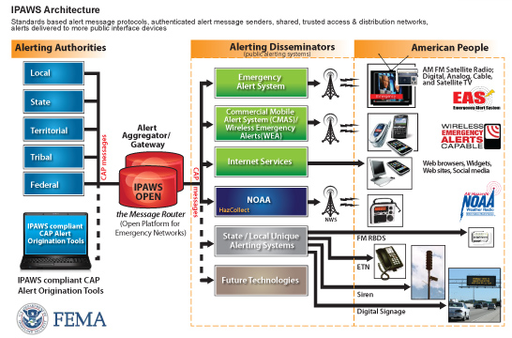
EAS Distribution over IPAWS
Integrated Public Alert and Warning System (IPAWS)

Slide 9
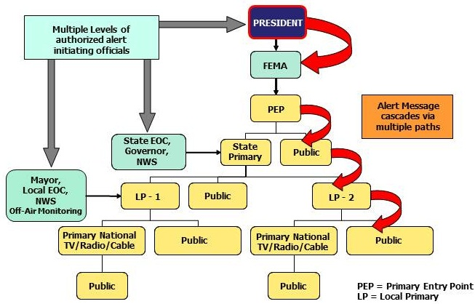
Another way to look at the daisy chain

Slide 10
EAS - Recent Commission Actions
Emergency Alert Reliability Report and Order and FNPRM
  The Report and Order:
  Adopts requirements for performing “Live Code Tests,” i.e., local EAS tests that use actual EAS alert codes to train communities in how to respond to actual alerts and to increase the proficiency of the alert originators.
  Adopts requirements that permit EAS Participants to deliver public service announcements (PSAs) that use the EAS Attention Signal (the 8-second, two-tone audio signal) and a simulation of the Header Code tones (three audible tones that follow the Attention Signal).
  Helps prevent false alerts by requiring that EAS Participants configure their EAS equipment to reject Common Alerting Protocol-based alerts that contain an invalid digital signature and legacy (over-the-air)-based alerts whose expiration time falls outside of specific time limits.
  Requires an EAS Participant to email the FCC’s 24/7/365 Operations Center within 24 hours of its discovery that it has sent a false alert.

Slide 11
EAS - Recent Commission Actions
Emergency Alert Reliability Report and Order and FNPRM
  Further Notice of Proposed Rulemaking:
  Seeks further comment on whether there is a need for additional false alert and lockout reporting beyond that required by the Order.
  Proposes that the EAS rules should be revised to require State EAS Plans to include procedures for preventing and correcting false alerts.

Slide 12
EAS - Recent Commission Actions
Automating State EAS Plans
  The FCC adopted rules creating a new, streamlined electronic system for the filing of State EAS Plans that will increase the effectiveness and efficiency of the EAS, while reducing burdens on stakeholders.
Blue Alerts
  A new EAS category that will allow state and local authorities to notify the public of threats to law enforcement and to help apprehend dangerous suspects
  Blue Alerts will warn the public when a law enforcement officer is missing, seriously injured or killed in the line of duty, or when is subject to an imminent credible threat
  Must be implemented for EAS by January 19, 2019
  Must be implemented for WEA by July 19, 2019

Slide 13
Wireless Emergency Alerts (WEA)
WEA Rules – 47 CFR Sections 10.1, et seq.
Established pursuant to Warning, Alert and Response Network (WARN) Act
Uses the IPAWS architecture
Three categories of WEA alerts: Presidential, Imminent Threat and AMBER

Slide 14
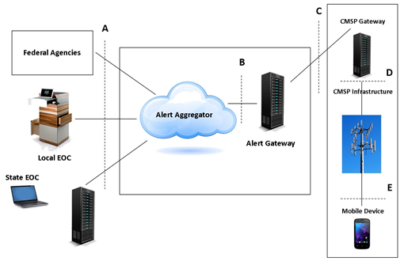
WEA Architecture

Slide 15
WEA - Recent Commission Actions
Improved geo-targeting so that the alerts reach communities affected by an emergency without disturbing others:
  Participating wireless providers are currently required to “best approximate” the area to be alerted
  Participating wireless providers will be required to match the area within 1/10 of a mile by November 2019
Improved alert message content to help communities communicate clearly and effectively:
  Active URLs (web sites and telephone numbers)
    National wireless providers are currently required to support active links
    Regional providers will be required to support links by May 1, 2019
  Message length will increase from 90 to 360 characters by May 1, 2019
  Participating wireless providers must support Spanish language alerts by May 1, 2019
End-to-end WEA testing will be allowed in May 1, 2019
  Some waivers have been granted to permit end-to-end WEA tests prior to May 1, 2019

Slide 16
WEA - Recent Commission Actions
Emergency Alert Reliability Report and Order and FNPRM
Further Notice of Proposed Rulemaking:
  Notes that the Bureau’s Hawaii False Alert report indicated that some wireless subscribers did not receive the WEA false alert and subsequent correction; likewise, press reports of recent WEA tests indicated that some subscribers did not receive the WEA test message.
  Seek comment on factors, such as network distribution issues, that might delay or prevent delivery of WEA alerts to members of the public.
  Seeks comment on whether and if so, how, the Commission should take measures to address inconsistent WEA delivery.
  For example, should the Commission adopt technical standards (or benchmarks) for WEA performance and delivery?

Slide 17
2017 Nationwide EAS Test
On September 27, 2017, at 2:20 pm, FEMA, in coordination with the FCC and the National Weather Service conducted a nationwide test of the EAS.
The nationwide test was designed to assess the reliability and effectiveness of the EAS, with an emphasis on testing the IPAWS and to provide the Commission with an opportunity to evaluate improvements implemented since the 2016 nationwide EAS test.
The Public Safety and Homeland Security Bureau released its full report on April 13, 2018:
  Overall, the 2017 Nationwide EAS Test demonstrated that IPAWS continues to deliver high-quality, effective, and accessible EAS alerts.
  Test data also reveal technical impediments to the full reception of EAS alerts effectively over IPAWS and that interference with closed captioning and other practices impeded the full accessibility of the test.

Slide 18
2018 Nationwide EAS Test
On September 20, 2018, FEMA, in coordination with the FCC, will be conducting a combined nationwide test of the EAS and WEA .
  At 2:18 p.m. Eastern Daylight Time (EDT), FEMA, using the Presidential classification, will send a WEA test message to WEA-capable wireless devices throughout the entire United States.
  At 2:20 p.m. EDT, FEMA will conduct a live test of the EAS, which will be disseminated via the Integrated Public Alert and Warning System (IPAWS).
EAS Participants are reminded that they are required to file with the EAS Test Reporting System (ETRS) as follows:
  Complete Form One on or before August 27, 2018
  File Form Two data on or before 11:59 p.m. EDT, September 20, 2018
  File Form Three on or before November 5, 2018

Slide 19
Hawaii False Alert
Report and Recommendations
On January 13, 2018, the State of Hawaii Emergency Management Agency mistakenly sent a false ballistic missile alert using the EAS and WEA
FCC’s Public Safety and Homeland Security Bureau investigated the event and released a report with recommendations to guard against and mitigate false alerts:
  https://www.fcc.gov/document/fcc-releases-report-hawaii-false-emergency-alert

Slide 20
Hawaii False Alert
Report and Recommendations
Recommendations include:
  Establishing redundant and effective lines of communication with key stakeholders during emergencies
  Conducting regular internal tests in a controlled and closed environment, such as FEMA’s Integrated Public Alert and Warning System (IPAWS) Test Lab
  Requiring more than one credentialed person to validate message content prior to transmission of a high-impact alert, as well as all tests
  Implementing specific upgrades to alerting software and developing standard operating procedures for responding to false alerts
  Consult with SECCs on a regular basis—at least annually—to ensure that EAS procedures, including initiation and cancellation of actual alerts and tests, are mutually understood, agreed upon, and documented in the State EAS Plan.

Slide 21
Alerting Roundtable and Other Outreach
On May 15, 2018, the Bureau hosted a public roundtable with stakeholders to share lessons learned and to promote a continued dialogue.
Recommendations and major take-aways:
  Engage in proficiency training and adopt best practices for alerts and tests
  Building local relationships is essential. Stakeholders, including SECCs and State emergency managers, should meet on a regular basis.
  State personnel responsible for initiating alerts should take the training offered by FEMA and practice using the FEMA IPAWS lab, which can be accessed online.
  An archived webcast of the roundtable can be viewed here:
  https://www.fcc.gov/news-events/events/2018/05/emergency-alerting-roundtable
The Commission and the Public Safety and Homeland Security Bureau will continue to conduct outreach and work together with government and industry stakeholders.

Slide 22
Questions?
Thank You!
Gregory M. Cooke
Deputy Chief, Policy & Licensing Division
Public Safety & Homeland Security Bureau
Federal Communications Commission
(202) 418-2351 (office)
(301) 466-2441 (mobile)
gregory.cooke@fcc.gov
Email Questions to: PLD@FCC.gov

Slide 23
Integrated Public Alert and
Warning System
Wade Witmer
wade.witmer@fema.dhs.gov
>>> IPAWS@fema.dhs.gov
July 19, 2018

Slide 24
Agenda
IPAWS Program
How IPAWS Works
How to Get On-line
Best Practices, IPAWS Lab, Train and Test

Slide 25
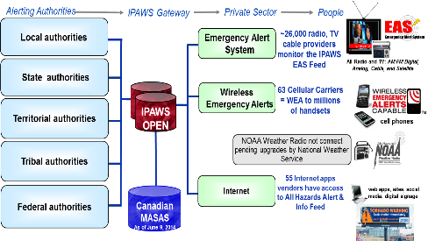
IPAWS a National System for Local Alerting
  Provides local, state, territorial, tribal, and federal agencies access to geo-targeted emergency alert and warning methods:
    Wireless Emergency Alerts (WEA) – broadcast to cell phones in an area
    Emergency Alert System (EAS) - traditional radio/TV warning
    Internet applications and websites
    NOAA All Hazards Weather Radio*
  FEMA**:
    Builds and operates the IPAWS-OPEN aggregator and gateway interfaces
    Administers users of the system in coordination with applicable STTL authorities
    Works with private sector and FCC to continuously enhance and deliver new alerting capabilities
* IPAWS – NOAA connections for NWEM and EAS are offline
**in accordance with Public Law 114-143 - The IPAWS Modernization Act of 2015; Executive Order 13407 - Public Alert and Warning System; and the Robert T. Stafford Disaster Relief and Emergency Assistance Act, Sec. 202. Disaster Warnings

Slide 26
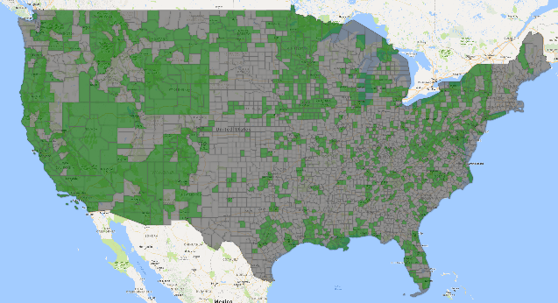


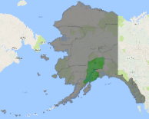
Authorities with IPAWS Public Alerting
as of April 19, 2018
1,045 Total IPAWS Public Alerting Authorities:
970* Local (*includes 15 military bases)
67 State-wide
3 Territory
3 Tribal
2 National
66.7% of the population are covered by a local alerting authority with IPAWS access
Counties in green have at least one local authority
3

Slide 27
IPAWS Usage Statistics (as of April 17, 2018)
(Totals from April 2012 through January 17th, 2018)
36,938
  Total Wireless Emergency Alert (WEA) messages sent
34,788
WEAs sent by NWS
1,192
WEAs sent by NCMEC
958
WEAs sent by state/local
11,200
  Total Emergency Alert System (EAS) messages sent
10,276
EAS, including tests, sent by state/local
926
EAS non-test sent by state/local
2,835,468
Total* messages processed by IPAWS Aggregator
*not all messages sent to the public

Slide 28
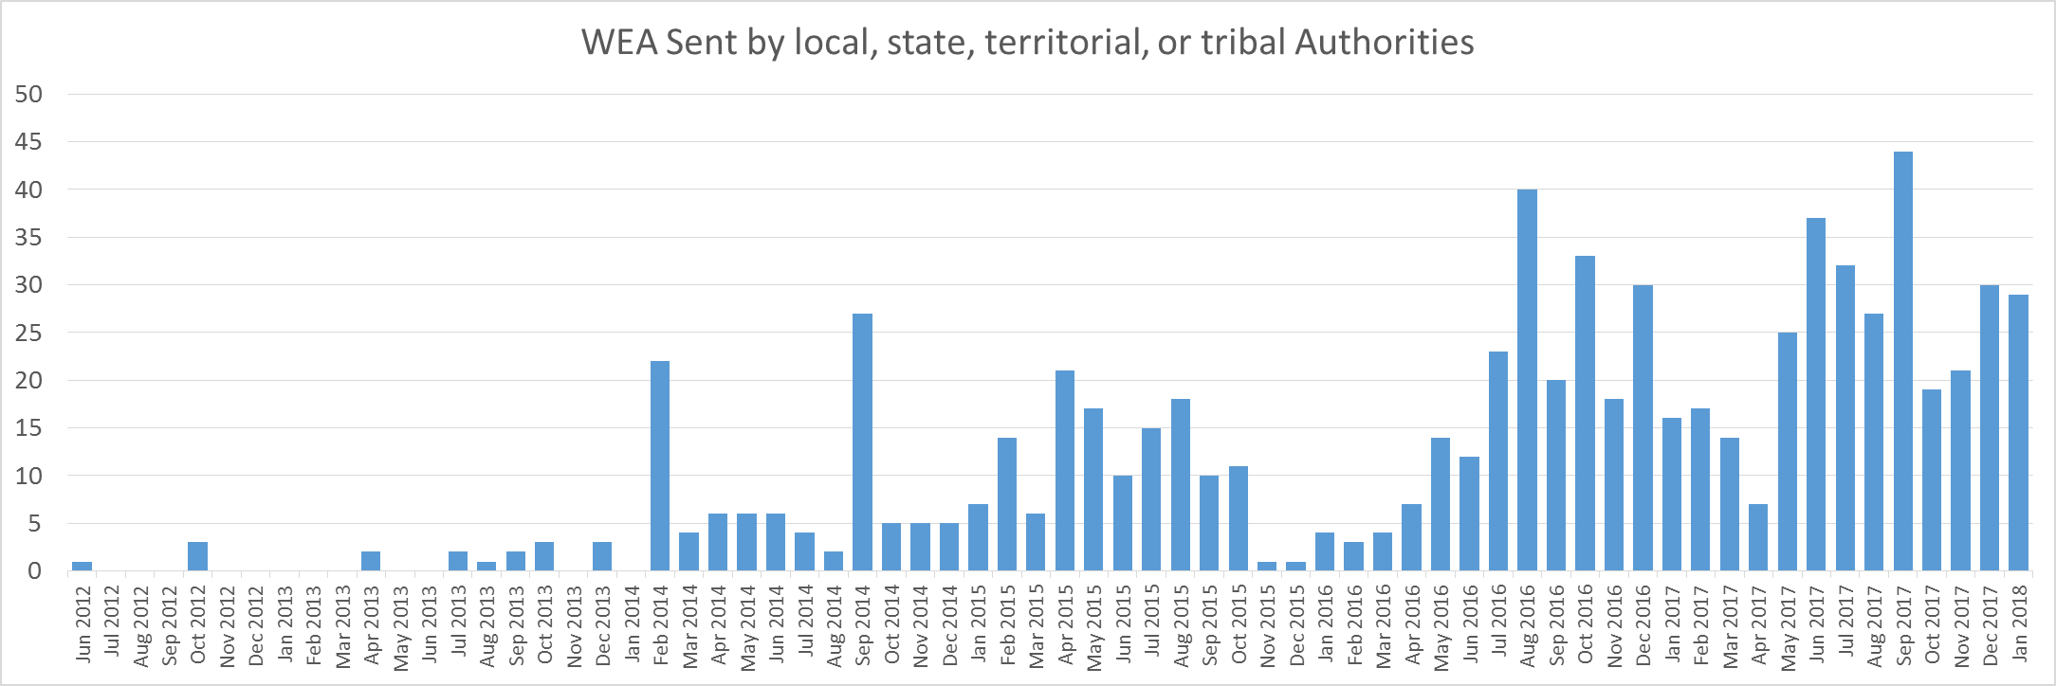
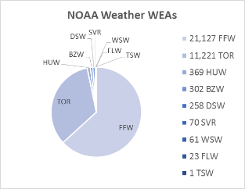
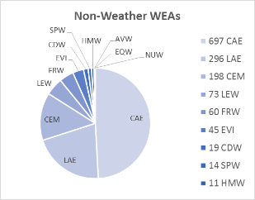
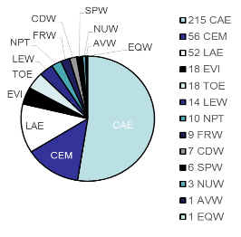
IPAWS WEA Usage Statistics (as of Jan 17, 2018)
WEA sent by local, state, territorial Authorities
monthly since 2012
317 WEA sent in 2017
by SLT
*
*Chart does not include over 32,000 alerts sent by NWS or over 1,000 AMBER Alerts sent by NCMEC since 2012
Non-Weather WEAs
EAS Activations
NOAA Weather WEAs

Slide 29
IPAWS PMO Initiatives: to improve the readiness and effectiveness of State, local, territorial, and tribal authorities to alert and warn the public
Outreach and educational briefings at regional, State, and local conferences to promote best practices for effective public alert and warning procedures, training, and exercises
Revamping IPAWS specific training courses (IS-247 & 251)
Reviewing Emergency Management Institute (EMI) course catalog to insert additional IPAWS information and update and ensure public alert and warning content is consistent
Engaging the other FEMA resources to incorporate public alert and warning planning, training, practice, and exercising into the NIMS Framework.
Engaging mass notification/alerting tool developers to ensure commercial products are intuitive, clearly separate test from live alerts, provide adequate training
Establishing an IPAWS User Workgroup on the MAX Federal Community; an information sharing environment for peer to peer discussion, insights, software tool notes, SOPs/local practices, lessons learned, and public alerting experience

Slide 30
Agenda
IPAWS Program
How IPAWS Works
How to Get On-line
Best Practices, IPAWS Lab, Train and Test

Slide 31
Common public notification/alert/warning methods
Method: | Emergency Use Considerations:
Social Media (Facebook, Twitter, Instagram, etc) | Are you being actively followed before an incident? who’s following you? how often do you post, how frequently are posts re-tweeted, liked, commented on?
Text Message and Email | how current is your data base? Message delivery can be delayed by network congestion
Telephone | how current is your data base? what % of calls are answered by a person? Message delivery can be delayed by network congestion
Agency Website | what’s your typical daily page traffic pre-incident? are hits from local people?
Local Media Coverage | Are people tuned in before the emergency?
Door-to-Door | Time and personnel intensive
Sirens, mobile loud speakers | Do people know what the siren means?
Wireless Emergency Alerts | Text broadcast to any cell phone in the area
Emergency Alert System | interrupts local TV/Radio, but only reaches active listeners
People must be actively seeking info or
pre- register for push notifications
IPAWS location based alerts

Slide 32
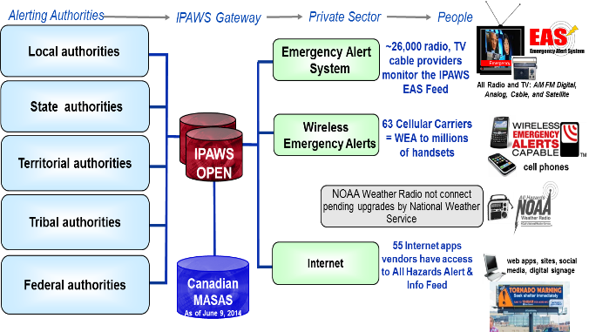
IPAWS Architecture
*
* IPAWS – NOAA connections for NWEM and EAS are offline

Slide 33





















How does an Alerting Authority use IPAWS? …via one of more than 40 vendors with IPAWS interoperability…
Sampling of Vendors:
E Team®
On-The-Go Alerting
Swift911™
VESTA® Alert

Slide 34
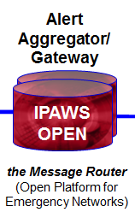
Alert Aggregation
What the Aggregator does:
Authenticates sender
  Web Service Security
  Digital Signature
    Ensures non-repudiation and message integrity
Validates CAP message format
Verifies message is compliant with senders’ permissions
  What alerts can you send
  Where can you send them
  How can you send them

Slide 35
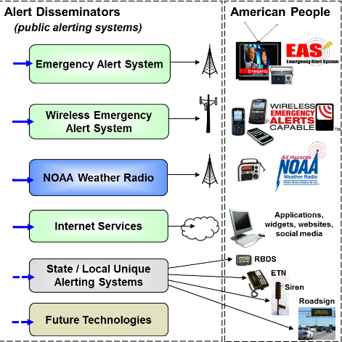
Alert Dissemination and Receipt by the Public
EAS
  Broadcast
  Large footprint
  County-based
WEA
  Broadcast
  Medium footprint
  Polygon based
NOAA Weather Radio *
  Broadcast
  Large footprint
  County-based
* IPAWS – NOAA connections for NWEM and EAS are offline

Slide 36

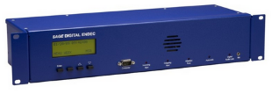
Emergency Alert System
  FCC regulations require all radio, TV, cable stations to monitor the IPAWS EAS feed and, in accordance with your state EAS plan, other radio/TV stations sources
  Audio announcement and text display interrupts programming
  Emergency messages sent via IPAWS to EAS can support :
    Full message text for screen crawl/display
    Audio Attachments (mp3)
    Additional languages
      Check with your local stations to see if they will play alternate language messages

Slide 37
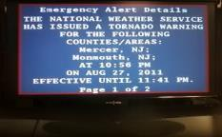

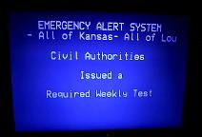
Emergency Alert System (EAS)
Requires Local Coordination & Partnership
  Stations are not required to air local emergency messages!
    Please go meet with them before you have an emergency
EAS “activation” interrupts programing once only!
    Emergency message audio/text is repeated twice – then regular program continues
    TV display format varies station to station
Notes:
FCC regulations require all radio, TV, cable stations to monitor the IPAWS EAS feed and, in accordance with your state EAS plan, other radio/TV stations sources
Emergency messages sent via IPAWS to EAS can support :
Full message text for screen crawl/display
audio attachments (mp3)
Additional languages
Check with your local stations to see if they will retrieve and broadcast alternate language messages. (it’s not required)

Slide 38

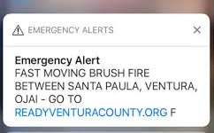
Wireless Emergency Alerts
  “Cell Broadcast” technology
  Not affected by cell site network congestion
  Sent to all phones in the area
Significantly different from SMS/email sign-up based alerting services
  Not subscription based
    True location based alerting - sends alerts to all phones in a cell coverage area - not to a database of phone numbers
    No sign-up or registration
    No app
    No tracking or delivery info or status feed back
Phones are delivered opted-in - but can be turned off in settings.
  90 character text only message
    Can include a URL/web link!

Slide 39
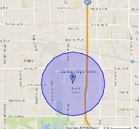
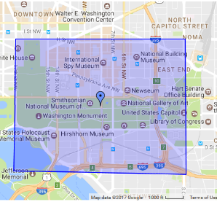
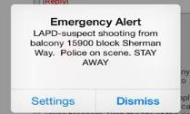
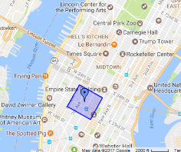
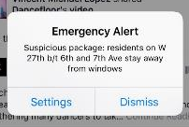
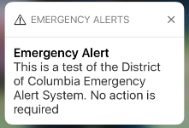
Wireless Emergency Alerts
Alerts can be geo-targeted to area small than a county!
  Targeting is based on cell tower locations
  some alert creation tools do not support WEA geo-targeting

Slide 40
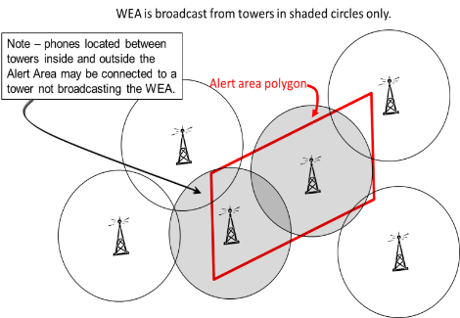
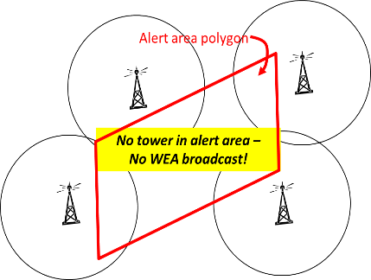
Wireless Emergency Alerts
Alert area must include a cell tower!
Phones using towers in the target area will get message
  Some phones may display the message later than others
Cell network should rebroadcast the WEA in the target area until message expires or is cancelled
  Only phones new to the area should display rebroadcast messages

Slide 41

Changes to WEA in the works…
Participating wireless carriers must support changes to WEA regulations by 2019*:
FCC adopted in September 2016:
  Increase message length from 90 to 360 characters by May 2019
  Add new alert category, “Public Safety Messages” by May 2019
  Spanish language WEA by May 2019
  WEA test code by May 2019
  Support URLs and phone numbers
    Text URLs and phone numbers as of Nov 2016
    “Clickable” URLs and phone numbers as of Nov 2017
FCC adopted in January 2018:
  Hit 100% target area within 0.1 mile overshoot by Nov 2019
  Preserve alerts on phone for 24 hours by Nov 2019
Requires changes to alerting tool interfaces and FEMA’s IPAWS-OPEN
*Changes will be phased into network and phone upgrades. i.e. 90 character and broad geo-targeting will remain in some areas and some phones for years TBD
15

Slide 42
NOAA and IPAWS - Important!
Connection from IPAWS to NOAA Weather Radio for Non-Weather Emergency Messages (NWEM) is offline!
  NWEM support can requested by coordination with local Weather Forecast Offices
NOAA is not sending weather warning to EAS via IPAWS
  EAS stations must get NOAA weather warnings via alternate sources. e.g. monitoring local NOAA Weather Radio stations, state relay networks, etc.
OFFLINE

Slide 43

IPAWS All-Hazards Info Feed
    Internet and web services/applications monitoring alerts for the public
    Web services may distribute or publish alert info to apps, websites, email lists, text messaging groups, social media, etc.
    Sample of companies with access to the All-Hazards Alert Feed:
AtHoc, Inc.
ATI Systems, Inc.
Avalution Consulting, LLC
Broadcast Television Group, LLC
Burli Software, Inc.
Callaway GraphicSoftware
City of Lakewood
CommPower, Inc.
Deaf Link Inc.
Dotomi
EZ Automation
Facebook
Twitzip
Geo-Comm
Global Security Systems
Grandpaham.com
Interop Solutions, LLC
KDEE Technology, LLC
MIR3, LLC
MyStateUSA, Inc.
National Public Radio
Omnilert, LLC
PIER Systems LLC
Public Alerter, LLC
Rapid Notify, Inc.
Rave Wireless
SafeT, Inc.
Samsung Information Systems America Inc.
Singlewire Software LLC
Skitter Inc.
Spectacular Media
Spectrum Solutions
Swan Island Networks, Inc.
TechRadium, Inc.
The Weather Channel Companies
Thunder Eagle, Inc.
TriStateAlerts, LLC
Weather Message Software
WHDT World Television Service
Wisemen Multimedia
WRAL-TV, Capitol Broadcasting Company, Inc.
43

Slide 44
Agenda
IPAWS Program
How IPAWS Works
How to Get On-line
Best Practice, IPAWS Lab, Train and Test

Slide 45
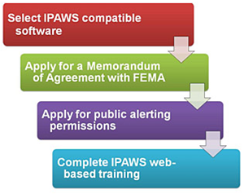
Getting Access to IPAWS
FIRST: Check with your State POC for alerting policy.
Email IPAWS@fema.dhs.gov for an MOA application, instructions, and information.
Obtain an IPAWS-compatible alerting tool
Complete a Memorandum of Agreement
Complete the “Public Alerting Application”
  Coordinate with the state and obtain signature
Complete IPAWS web-based training
After FEMA IPAWS office has the state coordinated “Public Alerting Application” and your completed training certificate, public alerting will be enabled in your agencies profile in the IPAWS and you can begin to send alerts.
Digital Certificates expire after 3 years. Your alerts will be rejected when certificate is expired. Check your certificate expiration date!
Ensure IPAWS Office has up to date contact information for your agency!

Slide 46
Agenda
IPAWS Program
How IPAWS Works
How to Get On-line
Best Practices, IPAWS Lab, Train and Test

Slide 47
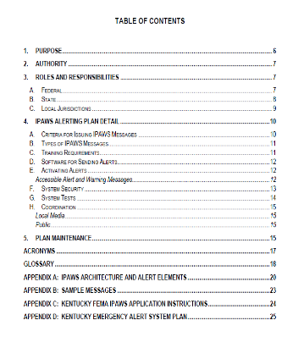
Alert and Warning Best Practices
  Develop Local Policy, Plans and Procedures
    Assign alerting roles and responsibilities
    Establish guidelines for what and when to send
    Identify common local hazards
    Create procedural checklists
    Draft local hazard emergency messages
    Establish neighboring jurisdiction coordination plans
    Share information with public
    Review, update, revise periodically

Slide 48
Alert and Warning Best Practices
  Train and Practice
    Be ready to use public alerting tools in an emergency
    Use the IPAWS Lab
  Educate and Inform Public
    Educate the public on capabilities
  Coordinate with neighboring jurisdictions
  Exercise and Test
    Exercise regularly with off-line systems
    Send periodically “live code” test to the public
    Involve the public and solicit feedback

Slide 49
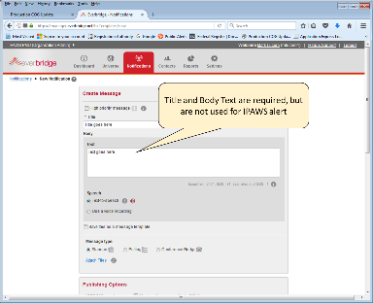
  Train, Practice, Test using your alert/warning tool!
49

Slide 50







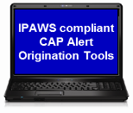



IPAWS Lab - “offline” version of IPAWS
…Practice sending alerts!
Live networks = people’s TVs, radios &
cell phones!
Production
Certificate
Live
IPAWS OPEN
Emergency
Test Environment
devices at the IPAWS Lab only
IPAWS
LAB
Test
Certificate
Emergency

Slide 51
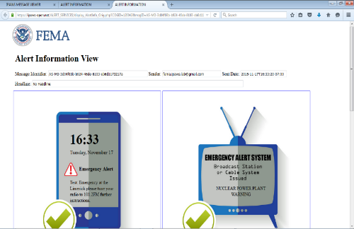
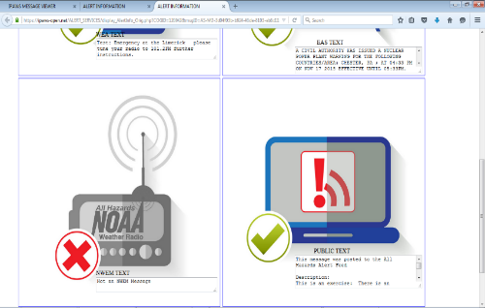
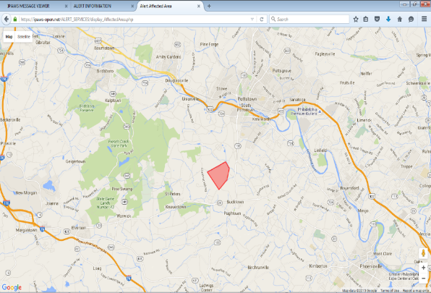
  IPAWS Lab - Test Message Viewer Website
Web page to see the result of alerts sent to the IPAWS Lab environment:
Uses:
practice using tools, creating and sending alerts
test, exercise, and train alert senders
https://ipaws-open.net/ALERT_SERVICES/postedmessages.php?COGID=[your COGID# here]

Slide 52

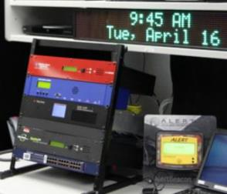
  Use the IPAWS Lab!
The IPAWS Lab supports:
  Training and testing in a safe/closed environment
  18+ sample alert origination tools
  All EAS dissemination devices
  Other devices capable of receiving IPAWS
  Hands-on training
  Virtual and table-top exercise support
  Scenario and best-practice review
  Expert assistance
  Supports the “IPAWS Message Viewer” – allows for individual training/testing
52

Slide 53
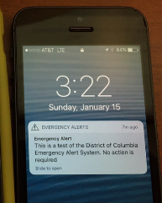
Live Testing
Only way to know how a WEA will behave in your area
  Cell network configurations are different in every locality
Recommended testing actions outline:
  Check in with IPAWS Office
  Make a test plan
  Coordinate with FCC for waiver
  Test and practice against the IPAWS Lab environment and Alert Viewer
  Tell the public about the test details
    what the message will say
    where alert will be targeted
    How phones that get the test will sound and behave
  Conduct the test
  Ask public for comments after the test
    e.g. Where were they when they got the WEA.
  Report back to the public on how the test went

Slide 54
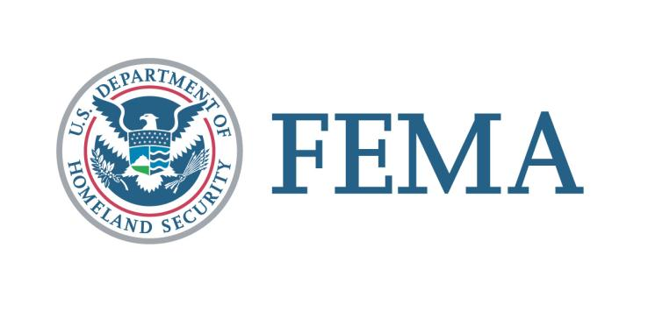
IPAWS Program Office
FEMA Resilience, National Continuity Programs, IPAWS Division
ipaws@fema.dhs.gov

