Slide 1
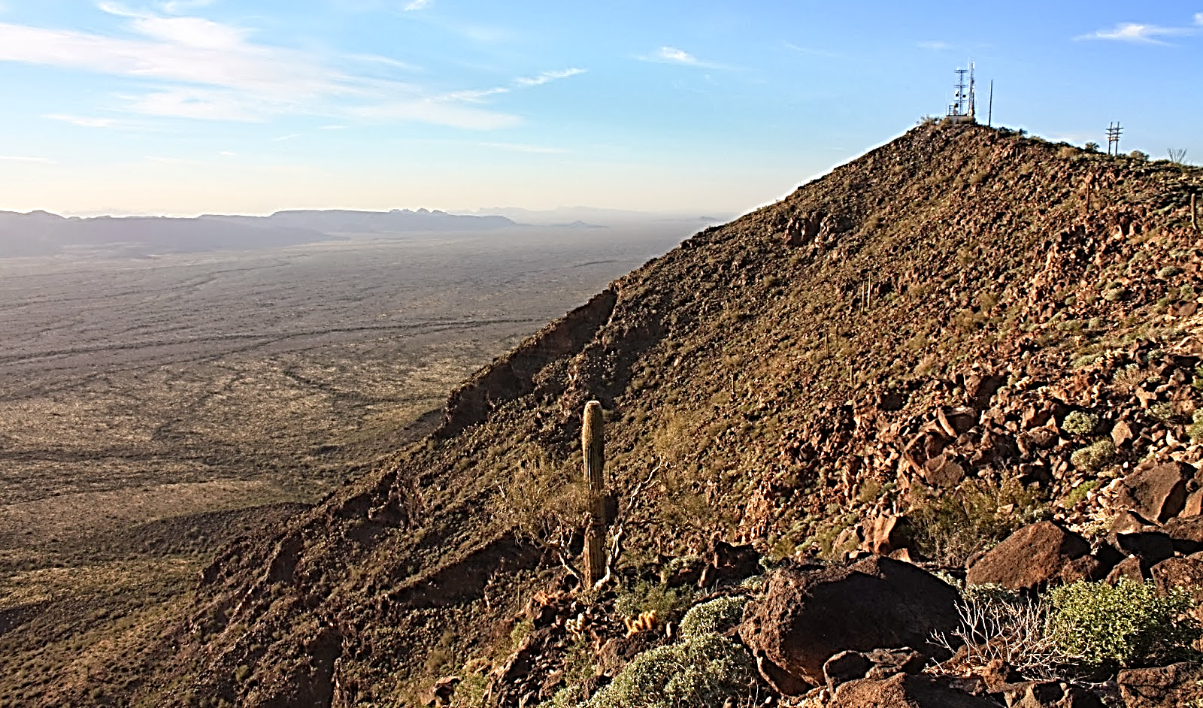
2nd Wireless Infrastructure Report and Order (R&O) Changes to Tribal Participation Requirements for Section 106 Review

Slide 2
Jill Springer, Federal Preservation Officer Competition and Infrastructure Policy Division, Wireless Telecommunications Bureau Matthew Duchesne, Chief Office of Native Affairs and Policy, Consumer and Governmental Affairs Bureau Jaime Loichinger, Program Analyst Advisory Council on Historic Preservation

Slide 3
WTB Infrastructure Team supporting Tribal Participation: Diane Dupert, Division Chief, Technologies, Systems & Innovation Division Matthew Hartnett, Program Analyst Maira Delao, TCNSHelp Administrator Leon Jackler and Don Johnson, Attorney Advisors ONAP Team supporting S106 Tribal Participation Janet Sievert and Sayuri Rajapakse, Attorney Advisors

Slide 4
FCC and Tribal Consultation
June 2000 Policy Statement
Unique Legal Relationship with Federally Recognized Tribes
Fiduciary Duty
Government to Government Relationship
Calls for Consultation Prior to Implementing Regulatory Action or Policy with Potential to Significantly or Uniquely Affect Tribes
Office of Native Affairs and Policy (ONAP)
Promoting Deployment on Tribal Lands
Consulting with Tribal Nations generally
Supporting WTB and Tribal Participation in Section 106 Reviews

Slide 5
ACHP and Tribal Role in S106 Reviews
On Tribal Lands: 36 CFR 800.2 (c)(2) (i)Consultation on tribal lands.
(A)Tribal historic preservation officer. For a tribe that has assumed the responsibilities of the SHPO for section 106 on tribal lands under section 101(d)(2) of the act, the tribal historic preservation officer (THPO) appointed or designated in accordance with the act is the official representative for the purposes of section 106. The agency official shall consult with the THPO in lieu of the SHPO regarding undertakings occurring on or affecting historic properties on tribal lands.
(B)Tribes that have not assumed SHPO functions. When an Indian tribe has not assumed the responsibilities of the SHPO for section 106 on tribal lands under section 101(d)(2) of the act, the agency official shall consult with a representative designated by such Indian tribe in addition to the SHPO regarding undertakings occurring on or affecting historic properties on its tribal lands. Such Indian tribes have the same rights of consultation and concurrence that the THPOs are given throughout subpart B of this part, except that such consultations shall be in addition to and on the same basis as consultation with the SHPO.

Slide 6
ACHP and Tribal Role in S106 Reviews
Off Tribal Lands: 36 CFR 800.2(c) (2) (ii)Consultation on historic properties of significance to Indian tribes and Native Hawaiian organizations.
Section 101(d)(6)(B) of the act requires the agency official to consult with any Indian tribe or Native Hawaiian organization that attaches religious and cultural significance to historic properties that may be affected by an undertaking. This requirement applies regardless of the location of the historic property. Such Indian tribe or Native Hawaiian organization shall be a consulting party.
(D) When Indian tribes and Native Hawaiian organizations attach religious and cultural significance to historic properties off tribal lands, section 101(d)(6)(B) of the act requires Federal agencies to consult with such Indian tribes and Native Hawaiian organizations in the section 106 process. Federal agencies should be aware that frequently historic properties of religious and cultural significance are located on ancestral, aboriginal, or ceded lands ofIndian tribes and Native Hawaiian organizations and should consider that when complying with the procedures in this part.

Slide 7
FCC Program Alternatives Governing S106 Reviews
Wireless NPA and Collocation NPA
ACHP, NCSHPO and FCC are signatories
Establish alternative S106 review requirements, establish some exclusions
ACHP 2001 Delegation Letter: Role of Applicants

Slide 8
Section 106 and the NPA: Tribal Requirements
Identify Indian tribes and NHOs that may attach religious and cultural significance to potentially affected Historic Properties.
Tribal or Ancestral Lands
TCNS = Reasonable and Good Faith Effort to Identify Tribes
Applicant follows Tribes’ preferred communication preference (e.g., email, USPS).
Applicant must be sensitive and respectful in communications.
Provide information reasonably necessary for the Tribe to evaluate whether Historic Properties of religious and cultural significance may be affected.
Provide Tribe reasonable opportunity to respond (usually 30 days from information receipt) and make a reasonable effort to follow up.

Slide 9
Section 106 and the NPA: Tribal Requirements
Where possible, applicant and Tribe reach an agreement on the presence or absence of effects that may obviate the need for consultation.
If Tribe identifies a historic property, applicant invites Tribe to become “consulting party” and notifies the FCC.
If the project will affect the historic property, the applicant consults to avoid, minimize or mitigate effect.

Slide 10
Tower Construction Notification System - TCNS
Voluntary system proprietary to FCC, developed to facilitate identification of and contact with potentially affected Tribes.
Tribes and NHOs designate geographic areas of interest
The FCC protects this information as confidential
Basic information as supplied by applicant automatically forwarded to interested Tribes.
Tribal response informs applicant whether it is interested in further participation.
Does not substitute for Section 106 process or government-to-government consultation unless Tribe disclaims interest.

Slide 11
2nd Wireless R&O
Adopted March 2018, effective July 2018.
Established that “small cells” as defined in the Order are not federal undertakings subject to S106 review (or NEPA).
Does not affect the NPA and associated requirements for non-small cells.
Clarified what FCC requires of applicants with respect to Tribal participation in S106.
New rules do not apply on Tribal lands, only off Tribal lands.
Does not affect or alter the NPAs or Section IV processes.
FCC maintains and updates a “Q&A” document on Tower and Antenna Siting webpage addressing issues associated with implementation.

Slide 12
Changes to Tribal Participation Requirements
Information Requirements.
Response Timelines.
Fees.
Consultant Services.

Slide 13
Information Requirements
Applicants must provide all Tribal Nations with a Form 620 (New Towers) or Form 621 (Collocations) where the form is prepared for SHPO review.
Facilities in industrial parks and utility/communications rights of way are excluded from SHPO review under NPA Sections III D and E. Because these deployments still require Tribal participation, the R&O establishes “alternative submission packet” requirements to include contact information, project coordinates and mapping, facility and site descriptions and aerial and site photographs. Applicants must provide the “alternative submission packet” if not providing a Form 620/621.

Slide 14
Response Timelines
The review clock begins to run on the date that the Tribal Nation can be shown to have received or may reasonably be expected to have received the required information.
Applicants should convey the Form 620/621 or alternative submission packet to the Tribe following their preferred means for receiving review information (e.g. email, USPS mail). This may be described in the Notice of Organizations or expressed directly by the Tribe to the applicant.
Applicants must provide a complete and accurate submission packet to start the clock.
Uploading the Form 620/621 to the E-106 system starts the referral clock and generates a notification to the Tribe that the information is available to review.
Alternative submission packets for projects excluded from SHPO review must be uploaded at the time of the TCNS filing, which starts the 30-day referral clock.
Applicants should make a reasonable effort to follow up to confirm receipt, clearly communicating that the contact is a courtesy and not an indication of tardiness.

Slide 15
Response Timelines
If a Tribe does not respond within 30 calendar days of receiving required information electronically (USPS delivery= 35) the applicant can refer the matter to the FCC for follow up.
Tribes that have not provided any reply within TCNS should be referred in the system.
Tribes that cannot be referred in TCNS may be eligible for manual referral provided that they do not have “NRENI” language in their details (check this).
Upon receiving referrals, the FCC sends a letter or email requesting that the Tribe responds within 15 calendar days if interested in participating in the review.
The FCC then attempts a follow-up call.
If the Tribal Nation does not respond within 15 calendar days, the applicant may move forward with construction unless notified otherwise by the FCC.

Slide 16
Fees
Consistent with ACHP guidance, the R&O affirmed that applicants have no legal obligation to pay up-front fees when providing Tribal Nations with the opportunity to comment on proposed facility deployments.
If a Tribal Nation purports to condition its response on the receipt of up-front compensation, the FCC will treat its position as a failure to respond. We encourage applicants to explain the Order’s position on fees and reiterate the invitation to comment on the project. If no comment is received by the end of the review period, the applicant may refer the Tribe as non-responsive as previously described.
Tribal Nations remain free to request upfront fees and applicants may, if they choose, voluntarily pay such fees.
The R&O recognizes, however, that the parties must mutually agree on the terms of any compensation in advance.

Slide 17
Consultant Services
An applicant may ask a Tribal Nation participating in a Section 106 review to conduct surveys or perform other services for which a negotiated fee is appropriate.
If the applicant and Tribe cannot agree on a fee, the applicant may seek other means to fulfill its “reasonable and good faith” identification on behalf of the FCC.
The applicant is not presumed to be required to engage the services of any particular party to assist with identification, monitoring, or mitigation.
The applicant must, however, use a properly qualified consultant or contractor when expert services are required.
With respect to identification and evaluation of historic properties and effects, the professional must meet the Secretary of the Interior’s Professional Qualification Standards.

Slide 18
Consultant Services
Different qualifications may be necessary to apply traditional knowledge in assessing the significance of above ground features, to identify archaeological properties, or to monitor construction.
An agreement regarding compensable services is required before services are performed.
If an applicant and a Tribal Nation disagree on whether the applicant has met the good faith standard of identification in determining what consultant services are required and who to hire, either party may ask the Commission to decide whether the applicant’s obligations have been satisfied.
In the case of a dispute, the applicant will have the burden of substantiating its claim within 15 days; the objecting party will have 15 days to make their case.

Slide 19
Identifying Tribal Religious and Cultural Sites
Under the NPA, Tribal religious and cultural sites are treated differently from historic properties already identified by SHPOs or Federal agencies.
FCC licensees, and those who are building for them, are required to cooperate with the Tribes to identify historic properties of religious or cultural significance.
There are cases where this may require research by Tribal members or THPO staff.
When requested, FCC staff will assist in clarifying requirements.

Slide 20
Be Aware:
Many Tribal historic properties are on high places such as ridge lines, buttes, peaks, or other landforms.
Plant materials may be gathered along stream beds or near wetlands.
Many traditionally-trained archeologists do not recognize above-ground evidence of Tribal sites.
Remember that different Tribes may have different views of the same site.
Protect the location of all sites significant to Tribes.

Slide 21
Traditional Use Sites
Resource Collection Sites
Tool and Materials Production Sites
Reoccurring Encampments
Village Sites
Burial Areas
Other Sites and Areas not known to non Tribal people

Slide 22
REMEMBER
Tribes are sovereign nations and should always be treated with respect.
If a Tribe identifies that a historic property of religious or cultural significance may be affected by a project, the applicant must invite the Tribe to become a consulting party and notify the Commission.
Applicants must discuss Tribal requests to perform additional identification with the Tribe prior to unilaterally dismissing them. When in doubt, consult the Commission.
The spirit of Section 106 is to facilitate Tribal participation.

Slide 23
QUESTIONS?

