Slide 1
First Responder Network Authority
Environmental Compliance Briefing
Claudia Wayne
Environmental Justice Coordinator

Slide 2
What Is the First Responder Network Authority?
The First Responder Network Authority (“FirstNet Authority”) was created by the Middle Class Tax Relief and Job Creation Act of 2012
The FirstNet Authority is an independent authority within the Department of Commerce’s National Telecommunications and Information Administration (“NTIA”)
The FirstNet Authority has entered into a public-private arrangement with, AT&T to deploy and operate a nationwide high-speed broadband network for public safety over 25 years

Slide 3
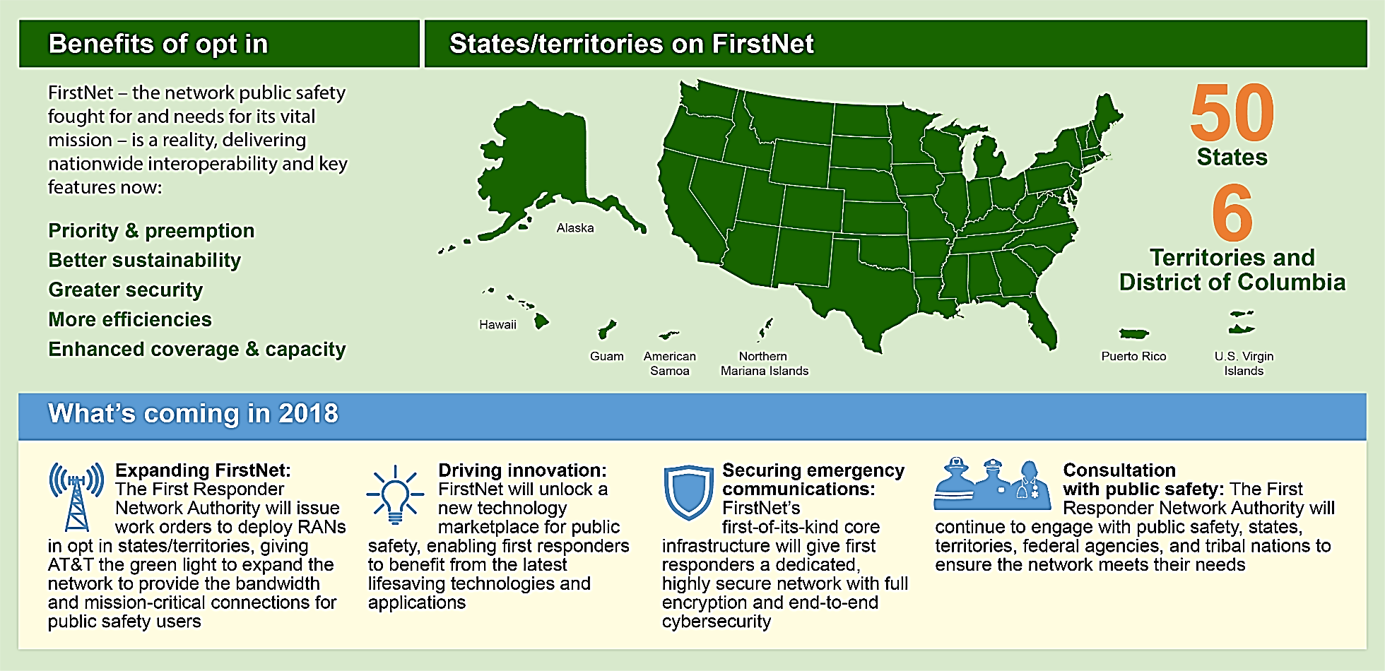
What Is the First Responder Network Authority?
Benefits to Public Safety
Priority and preemption
Physically separate and dedicated core
Greater security
Enhanced coverage and capacity
More than 2,500 agencies signed up so far
Focus in 2018
Expanding FirstNet
Driving innovation
Securing emergency communications
Public safety advocacy/consultation with public safety

Slide 4
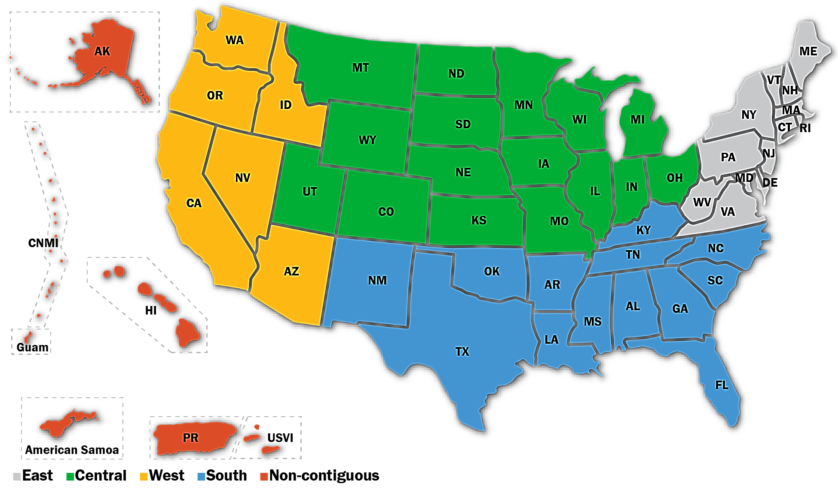
First Responder Network Authority – NEPA & NHPA Compliance
Initial NEPA Implementing Instructions, finalized April 2014
Regional Programmatic Environmental Impact Statements, finalized 2017
Revised NEPA Implementing Instructions, finalized February 2018
All available at www.firstnet.gov or www.regulations.gov

Slide 5
First Responder Network Authority – NEPA & NHPA Compliance
The First Responder Network Authority is both an independent federal entity and a licensee of the FCC
Revised NEPA Implementing Instructions reflect this unique relationship
The First Responder Network Authority reviews information provided by AT&T
FirstNet Authority’s NHPA compliance process aligns with and utilizes the existing FCC process
The Tower Construction Notification System (TCNS) is being used to initiate tribal consultation

