Slide 1
ENT Coordinator Toolkit
Providing high quality captions
using the Electronic Newsroom Technique
Created by the FCC’s Disability Advisory Committee
Adopted October 14, 2020

Slide 2
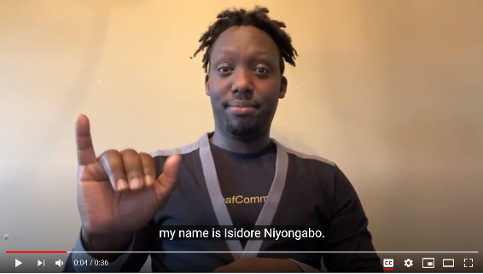
Welcome
  Isidore Niyongabo of National Black Deaf Advocates welcomes viewers to this presentation.
  Click the image to play, or visit this link: https://youtu.be/y5mXEG6cVE4
  Length: 36 seconds
Notes:
Video Transcript:
Hello, my name is Isidore Niyongabo. Thank you for your interest in this toolkit. As a Deaf consumer, I depend on high-quality captions to access television, including live news. We hope the tips presented in this toolkit support your hard work in making your content accessible for all viewers. Thank you.

Slide 3
Why It Matters
  Broadcasters want to reach the largest number of consumers possible
  One in five people are deaf or hard of hearing, and that population will grow as audiences age
  Captions are increasingly shown in public places like gyms, bars, restaurants, and other venues where viewers are unable to hear the audio
  Ensuring accurate, readable captions will best serve your wider audience
  YOU can improve the lives of viewers and expand your audience

Slide 4
FCC Enhanced ENT Rules
In 2014, the FCC established enhanced ENT procedures. Stations that follow these practices are considered to be in compliance with the FCC’s requirements.
  In-studio produced programming will be scripted. These scripted elements will include in-studio news, sports, weather, and entertainment programming.
  For weather interstitials where there may be multiple segments within a news program, weather information explaining the visual information on the screen and conveying forecast information will be scripted, although the scripts may not precisely track the words used on air.
  Pre-produced programming will be scripted (to the extent technically feasible).

Slide 5
FCC Enhanced ENT Rules
  If live interviews, live on-the-scene, and/or breaking news segments are not scripted, stations shall supplement them with crawls, textual information, or other means (to the extent technically feasible).
  These provisions do not relieve stations of their obligations to comply with requirements regarding the accessibility of programming providing emergency information under § 79.2 of the Commission’s rules. 47 CFR 79.2.
  Stations will provide training to all news staff on scripting for improving ENT.
  Stations will appoint an ENT Coordinator accountable for compliance and identify at least one backup ENT Coordinator.
This presentation was created to help stations with practical tips for implementing these best practices.

Slide 6
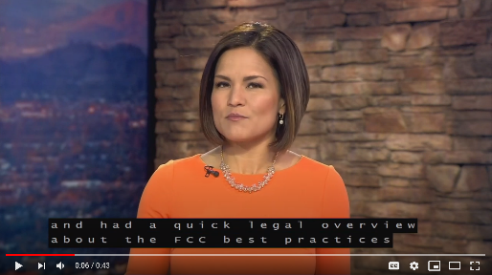
Introduction
A local news anchor introduces us to ENT.
Videos in this presentation are captioned using Electronic Newsroom Technique (ENT) and may display issues commonly associated with the use of ENT. We’ve described specific caption errors below each video.
Click the image to play or visit this link: https://youtu.be/71xO50XQhjI
Length: 43 seconds
Notes:
Video Transcript
In the earlier slides, you learned why captioning is important and had a quick legal overview about the FCC “Best Practices” for Electronic Newsroom Technique captioning, which is also called ENT Captioning.
ENT captioning uses the scripts typed in for the teleprompter or otherwise into the newsroom computer system to create captions for your viewers. In the slides that follow, we plan to share with you some practical tips to improve the viewer experience for ENT.
You will also notice that some of the slides include specially produced brief videos of examples of ENT captioning that will illustrate some of the practical tips discussed here. Make sure to click on those videos and see if you can spot the aspects of captioning that are being highlighted.

Slide 7
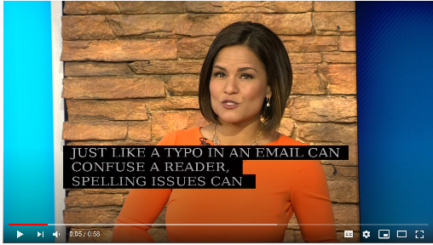
Accuracy: Spelling
  Spelling issues can make captions hard to understand:
  Pay attention to homonyms: their/they’re/there, you’re/your, it’s/its
  Spell foreign phrases and words, do not translate
  Where possible, minimize the use of phonetics as it may be misleading to the viewer
  Be consistent in your spelling
  Click the image to play the video, or visit this link: https://youtu.be/-eqW07uLQEs
  Length: 58 seconds
These captions in this video are generated by ENT and showcase spelling mistakes as an example of errors to avoid.
Notes:
Video Transcript
Just like a typo in an email can confuse a reader, spelling issues can make it harder for viewers who rely on captions to fully experience your programming.
For example, you can see that the captioning below said “you’re” — Y-O-U-APOSTROPHE-R-E — in the captioning instead of “your” — Y-O-U-R. Which brings up another point. Did you see the word “apostrophe” spelled out in the captions? While phonetically spelling out names or phrases may be required for anchors and reporters to read the prompter, we suggest thinking about whether they’re really necessary there as they can be confusing to a viewer of ENT captioning. Looks like I did it again they’re and there!
To make the viewer experience muy bueno, that is “very good,” we also suggest typing out non-English phrases. And be consistent with spelling. For example, if you drop the “e” between “g” and “m” in judgment, stick with it.
Finally, you notice some of my typos in the captioning? We know news scripts are written quickly and on deadline but that can be distracting!

Slide 8
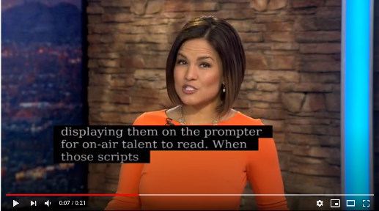
Accuracy: Proper Case
Be consistent with case
  Mixed case is preferred, but try to make sure all content is the same
  See the FCC Disability Advisory Committee’s recommendation on caption case formatting: https://www.fcc.gov/document/dac-recommendation-caption-case-formatting
  Click the image to play the video, or visit this link: https://youtu.be/HV6cZ5q1Hd4
  Length: 21 seconds
These captions in this video are generated by ENT and showcase inconsistent case as an example of improper formatting.
Notes:
Video Transcript
Many, if not most, newsrooms use all caps in writing scripts and displaying them on the prompter for on-air talent to read. When those scripts are turned into ENT captioning, however, ALL CAPS can be hard to read. Whatever you do, don’t mix it up like this video. Be consistent. So stick with ALL CAPS or go with both upper and lower case letters - but pick one way and run with it.

Slide 9
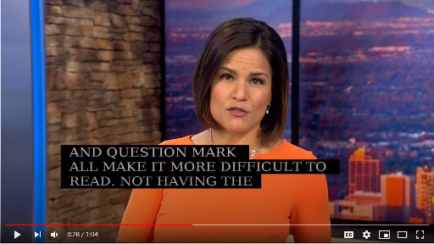
Accuracy: Punctuation
Punctuation is key and affects meaning:
  Use quotation marks when conveying quotes
  Stay away from semicolons – they are often hard to differentiate from colons in captions
  Start a new sentence on a new line where possible
  End sentences with a period, question mark, or exclamation point.
  Use “…” to indicate someone has trailed off
  Click the image to play the video, or visit this link: https://youtu.be/H-ZT-pqop_U
  Length: 1:04
These captions in this video are generated by ENT and showcase improper punctuation to demonstrate the need for proper formatting.
Notes:
Video Transcript
ENT captioning, in theory, offers the opportunity for better punctuation because the remarks are scripted. Did you see the commas for “,in theory,” and then the quotation marks and question mark?
Let’s try that same statement again without punctuation: ENT captioning in theory offers the opportunity for better punctuation because the remarks are scripted did you see the commas
Taking out the commas, period, and question mark all make it more difficult to read. Not having the period or another piece of punctuation at the end of a sentence can make the ENT captioning roll on in one long sentence. I’ve also started new sentences on a new line in the ENT captioning and avoided semicolons. Who uses semicolons in everyday speech anyway?
Finally, if you’re quoting someone, use quotation marks. It makes it easier to understand something someone else said. So, something like he said “Please use quotation marks because ...”
Well, that’s another point. If someone trails off, use three periods to indicate that. Otherwise it looks like words are missing. Oops, forgot a comma there!

Slide 10
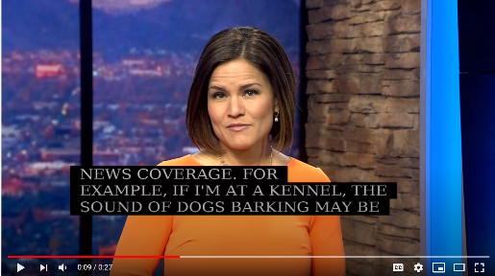
Accuracy: Sound Effects and Music Notes
Sound effects help convey meaning
  Format off-screen action sounds as “noun-verb,” such as “dog barking,” “gun cocking,” or “crowd booing”
  If the source of the sound is visible onscreen, describe just the sound: “singing,” “cheers and applause”
Music notes and lyrics
  If music with lyrics is part of a pre-taped package, include the lyrics in the script. If only a brief clip of music is included or music is included in a unscripted piece, identify by a music note (if your software can add the note)
  Try to be descriptive when identifying music. For example, “rock music,” “classical music,” or “country music” can be helpful descriptions. It also can be helpful to include the artist and title of a song if available
  Click the image to play the video, or visit this link: https://youtu.be/PaTm_o5uKcQ
  Length: 27 seconds
These captions in this video are generated by ENT and cut off, missing portions of the audio, as sometimes happens in ENT captioning.
Notes:
Video Transcript
In pre-recorded packages, off screen sounds often relate directly to the news coverage. For example, if I’m at a kennel, the sound of dogs barking may be important to a story. You can indicate that in the ENT captioning with “dogs barking.”
And for music that plays in pre-recorded segments, we suggest adding “music playing” to the ENT captioning. If you can make out specific lyrics, it would be helpful to include those lyrics in the ENT captioning for pre-recorded segments.

Slide 11
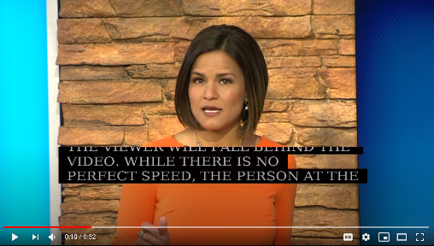
Caption Speed
Speed is important for readability.
  Give viewers enough time to read the captions.
  Captions should be readable and not scroll too far ahead or behind the speaker, even just to “peek” at future script
  On-air talent who control the speed of the teleprompter need to be aware that the speed of the teleprompter affects the speed of caption display
  Click the image to play the video, or visit this link: https://youtu.be/OmYbuQwy6QY
  Length: 52 seconds
Please note that captions in this video are cut off as an example of the lack of synchronicity and completeness when captions run too slow or fast.
Notes:
Video Transcript
If captions go too fast across the screen, they can be unreadable. And if you go too slowly, the viewer will fall behind the video. While there is no perfect speed, the person at the station who is controlling the teleprompter should consider how their scrolling is affecting the viewer relying on captions.
For example, we’re going to replay the same segment where a news person scrolls to see the last sentence.
If captions go too fast across the screen, they can be unreadable. Same with too slow. While there is no perfect speed, those who are controlling the prompter should consider how their scrolling is affecting the viewer relying on captions.
And now, we’ll do it again really slowly.
If captions go too fast across the screen, they can be unreadable. Same with too slow. While there is no perfect speed, those who are controlling the prompter should consider how their scrolling is affecting the viewer relying on captions.

Slide 12
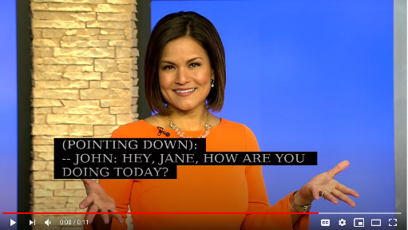
Speaker Changes
Use speaker changes in recorded packages to indicate who is speaking
  “>>” or “- -” denotes new speaker to caption viewers
  note: not all ENT software can use >> symbols
  If possible, add the name followed by a colon after the speaker change
    -- Reporter:
    -- George Clooney:
  Click the image to play the video, or visit this link: https://youtu.be/EzrdahEt_u0
  Length: 11 seconds
The captions for this video were generated using ENT software.
Notes:
Video Transcript
When you have two speakers in a scripted piece, it’s helpful to denote them with two greater-than arrows, or dashes, like this –

Slide 13
Caption Placement
While many TV sets display captioning differently, stations generally can choose to move captions to the top or bottom of the screen to avoid graphics on the over-the-air stream.
Two-line top, full width (32 characters) is the standard for most local newscasts, to accommodate lower thirds, election results, and crawls.
  This may cover the anchor’s forehead, but that is often the lesser of two evils
Periodically review cable and satellite provider placement of captions to learn how your viewers are likely to see them in your market.

Slide 14
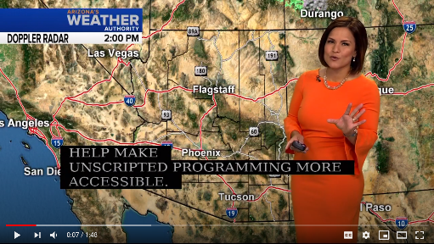
Weather & Unscripted Programming
Tips for making unscripted programming accessible:
  Always include arrows/highlights on maps
  Use full words on graphics
  Make use of crawls
  Write on whiteboards if needed
  Weather scripts should track the words on air to the extent possible
  Stations unable to fully script weather should include a link to a readable forecast (not uncaptioned video) in their weather captions.
Special requirements may apply to emergency weather reports. Click here for more detail.
Click the image to play the video, or visit this link: https://youtu.be/0PSBUdC6qTg
Length: 1:48
  These are ENT captions and miss some of the audio, as can occur in weather reports. ENT Coordinators should seek to avoid captions overlapping important information on-screen.
Notes:
Video Transcript
Now, I’m going to do a pretend weather segment where I show you some things that can help make unscripted programming more accessible. The captioning is going to turn off now, because it’s unscripted. I’m also going to turn off the audio at different parts to give you a feel for how someone who relies on the captioning views the segment.
(CC off) Here’s my weather map: This version has counties highlighted.
(Audio off) The storm is moving eastward.
(Audio back on) Did you catch that the storm is moving eastward? It would be hard with just that map and not being able to hear the audio, right? So take a look at this map, which has arrows pointing for the storm direction. And, instead of abbreviations like “TS,” spell out “thunderstorm.” That can also be helpful.
And look down here - this crawl can give more information.
(Audio off) Thunderstorms moving westward. Expected to reach downtown at 5 p.m.
I’m turning the ENT captioning back on because I’m going to just do a normal, sunny forecast. Expect sunny skies for the weekend. Highs in 70s, lows in the 50s.
While my graphic showed the temperatures, the ENT captioning did not. Sometimes that’s unavoidable, as weather is changing during a newscast. But to the extent you can track the language of a weather report to the script, it will be much more accessible. We know much of the weather is done by ad libbing, and the FCC accepts that. But when you can, it is a great service to your viewers to script as closely as possible.
Remember, there are special rules about emergency weather. You can find out more about those rules at www.fcc.gov/general/access-emergency-information-television.
Speaking of finding out more, sometimes it’s helpful to include a URL to the full textual weather report online in the ENT captioning, especially when weather is changing during a show. Like this -

Slide 15
Additional Efforts
Identify and solicit input from leaders of the deaf and hard of hearing community in your market, e.g., state government offices, Telecommunications for the Deaf and Hard of Hearing, Inc. (TDI), Hearing Loss Association of America (or email advocacy@hearingloss.org), National Association of the Deaf (NAD), and local organizations.
  Make this an ongoing effort
Make sure the contact information for your station’s captioning contact person is available on your website.
Promptly address questions from viewers.
Industry contacts:
National Association of Broadcasters (NAB) – nab.org

Slide 16
Resources
  FCC ENT Small Entities Compliance Guide
  FCC May 10, 2019 Enhanced ENT Forum Event Page
  FCC Closed Captioning of Video Programming on Television Webpage
  Questions? Contact the FCC’s Disability Rights Office by visiting www.fcc.gov/accessibility
  FCC Access to Emergency Information

