Slide 1
Webinar For Low Power Broadcasters on the Emergency Alert System (EAS) and the EAS Test Reporting System (ETRS) _________________
Public Safety and Homeland Security Bureau
Federal Communications Commission
June 8, 2021
Email Questions to: alerting@fcc.gov
Notes:
Hello, everyone, and thank you for joining us. This is the webinar for low power broadcasters on the emergency alert system and the eas test reporting system. I am Maureen Bizhko, an attorney in the FCCs public safety and homeland security bureau. Please send any questions to alerting@fcc.gov.

Slide 2
Goal of this Webinar
Increase low power broadcaster participation in the nationwide EAS test taking place August 11, 2021, and improve compliance with filing required information about low power broadcaster participation in the ETRS.
Educate low power broadcasters on the EAS.
There is also a Wireless Emergency Alert test this year, but this webinar is principally EAS focused. For more information about WEA, please visit our WEA page at https://www.fcc.gov/consumers/guides/wireless-emergency-alerts-wea.
Notes:
We begin by setting forth our goal for the webinar. Our goal for this webinar is to _________.
Another goal of this webinar is to educate Low Power broadcasters on the EAS. We are aware that those listening to this webinar have varying levels of knowledge of the EAS and broadcasters’ part in it. We have attempted to cater to as many levels of understanding as feasible in this time period.

Slide 3
Low Power Broadcaster Participation
Low power broadcasters participated in relatively low rates in the 2019 nationwide EAS test.
In that 2019 test, participation rates were:
55.9 percent for Low Power FM radio broadcasters and 48.1 percent for Low Power TV broadcasters, compared to 81.8 percent for all radio broadcasters and 63.5 percent for all television broadcasters.
Notes:
We have seen, through analysis of data received during the nationwide tests, that for the last two years, LP broadcasters historically have had low rates of participation. In 2019, they had a 50% rate of participation in the nationwide EAS test. Specifically, in 2019 the participation rates were: ________.

Slide 4
Emergency Alert System
The Emergency Alert System (EAS) is a national public warning system commonly used by state and local authorities to deliver important emergency information, such as weather and AMBER alerts, to affected communities.
EAS Participants – radio and television broadcasters, cable systems, satellite radio and television providers, and wireline video providers – deliver local alerts on a voluntary basis, but they are required to provide the capability for the President to address the public during a national emergency. 47 CFR§11.11.
Notes:
For the benefit of those unfamiliar with EAS, we define it here: It is _________. EAS Participants are ________.

Slide 5
The Emergency Alert System (EAS)
EAS Rules – 47 CFR §11.1, et seq.
EAS Participants must deliver Presidential alerts and nationwide monthly and weekly tests.
Delivery of other alerts (weather, state, AMBER) is voluntary.
EAS Alerts must be accessible to people with disabilities.
The visual message portion of an EAS alert, whether video crawl or block text, must be displayed at the top of the television screen or where it will not interfere with other visual messages, in a manner (i.e., font size, color, contrast, location, and speed) that is readily readable and understandable that does not contain overlapping lines of EAS text or extend beyond the viewable display (except for video crawls that intentionally scroll on and off of the screen), and in full at least once during any EAS message.
Notes:
The rules that form the framework for the EAS and the EAS Participants are found in the Code of Federal Regulations, 47 CFR, part 11. You can look them up easily at ecfr.gov. The most relevant take-away from the rules for purposes of this webinar is that EAS Participants must deliver ______. In other words, there is a distinction between state and federal alerts. It is also important to note that EAS Alerts must be accessible to ________.
The FCC and the Federal Emergency Management Agency (FEMA) implement the EAS at the federal level. The EAS infrastructure is also regularly used to distribute weather-related and other emergency alerts.
Broadcasters should that closed captioning does not cover the EAS text and that they take care to ensure the EAS audio is not being drowned out by the programming audio to test their equipment before the test day to ensure they will be able to display the audio and visual component of the EAS message in accordance with the Commission’s accessibility requirements.

Slide 6
EAS Distribution
EAS alerts are delivered to EAS Participants either over the internet from FEMA’s Integrated Public Alert and Warning System (IPAWS) gateway or by over-the-air broadcast.
EAS Participants are required to monitor both systems for redundancy.
Notes:
EAS Distribution. There are two ways for a national alert to be delivered to people watching TV or listening to the radio. Either Over the Internet from FEMAs or over the air broadcast.

Slide 7
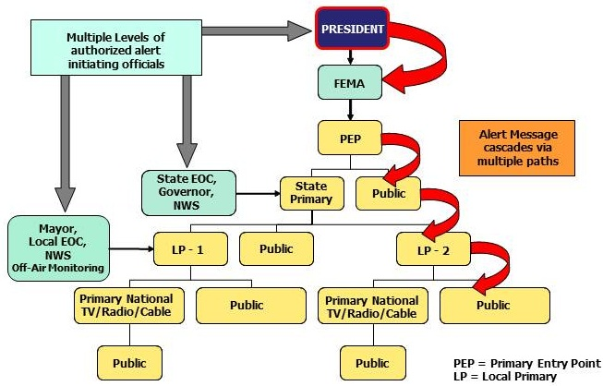
The EAS Protocol “Daisy Chain”
Notes:
This is the “daisy chain” diagram. Here, an alert originator formats an alert using the EAS Protocol and initiates its transmission at a designated entry point in the system. Under the EAS Protocol, an EAS alert uses a four-part message: (1) preamble and EAS header codes (which contain information regarding the identity of the sender, the type of emergency, its location, and the valid time period of the alert); (2) audio Attention Signal; (3) audio message, if included by the alert originator; and (4) preamble and “end of message” (EOM) codes.
Because both the over the air broadcast system and IPAWS can be used by state or government officials, we note here that there are multiple levels of authorized alert initiating officials. For the nationwide test, FEMA initiates the alert. Following the diagram here, it is sent by signal over the air to local and state level officials, who, in turn, send it to broadcasters. The primary purpose of the EAS is to provide the President of the United States with “the capability to provide immediate communications and information to the general public at the National, State and Local Area levels during periods of national emergency,” so that is why you see the president here.
ETRS Form One asks EAS Participants to identify their EAS Designation. We have found that many filers are not well-informed of their designation status. For example, in 2019, 624 stations identified as primary entry point (PEP) stations. However, according to FEMA, there are only 77 Primary Entry Point stations nationwide. Below are the most common designations and their abbreviated definitions. A complete listing is in Section 11.18 of the Rules.
A PEP is a private or commercial radio broadcast station that cooperatively participates with FEMA to provide EAS alerts to the public.
A National Primary (NP) is an entity tasked with the primary responsibility of receiving the Presidential Alert from a PEP and delivering it to an individual state or portion of a state.
A State Primary (SP) is an entity tasked with initiating the delivery of EAS alerts other than the Presidential Alert.
A Local Primary (LP) is an entity that serves as a monitoring assignment for other EAS Participants within the state.
A Participating National (PN) is an EAS Participant that transmits national, state, or Local Area EAS messages, and is not otherwise designated within the State EAS Plan.

Slide 8
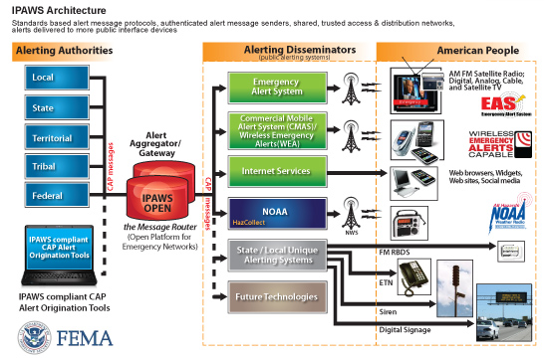
EAS Distribution over IPAWS
Integrated Public Alert and Warning System (IPAWS)
Notes:
The Integrated Public Alert and Warning System (IPAWS) is a national alerting system administered by FEMA. Under this system, EAS Participants monitor a FEMA-administered web site for EAS messages that are written in the Common Alerting Protocol (CAP). IPAWS relies upon the centralized distribution of alerts using an alert aggregator and an Internet-based interface
An EAS test initiated and delivered though through IPAWS has the technical capability to deliver a test that includes the test nature of the event in both the text crawl and audio portion of the alert message. Accordingly, we encourage entities that conduct live code tests to do so via IPAWS to minimize any risk of public confusion.

Slide 9
Nationwide Test 2021
The test is scheduled for Wednesday, August 11, 2021, at 2:20 p.m. EDT.
If conditions on test day require rescheduling the test, the secondary test date is Wednesday, August 25, 2021.
As in 2019, the 2021 nationwide test will be disseminated using the hierarchical, broadcast-based distribution system only, otherwise known as the “daisy chain” (see earlier slide).
Unlike 2019, this year there also will be a WEA test. For WEA, the test alert will appear on consumers’ phones that have opted-in to receive WEA test alerts and will display the test message under the header “Test Message.”

Slide 10
Are Low Power Broadcasters EAS Participants?
EAS Participants include Low Power FM stations (LPFM), low power television stations (LPTV), Class D non-commercial educational FM stations, and EAS Participants that are silent pursuant to a grant of Special Temporary Authority.
EAS Participants are required to participate in nationwide tests and register and file in ETRS.

Slide 11
FAQs
Are low power television stations that operate as television broadcast translator stations required to register and file in ETRS?
Analog and digital low power television (LPTV) stations that operate as television broadcast translator stations are not required to register and file in ETRS.
Are satellite stations or repeaters of a hub station required to register and file in ETRS?
Analog and digital broadcast stations that operate as satellites or repeaters of a hub station (or common studio or control point if there is no hub station) and rebroadcast 100 percent of the programming of the hub station (or common studio or control point) are not required to register and file in ETRS. However, the hub station (or common studio or control point) is required to register and file in ETRS.
Are FM broadcast booster stations or translator stations that entirely rebroadcast the programming of other local FM broadcast stations required to register and file in ETRS?
FM broadcast booster stations and FM translator stations which entirely rebroadcast the programming of other local FM broadcast stations are not required to register and file in ETRS.

Slide 12
EAS Test Reporting System
The ETRS is now open for 2021 filings. There are three filings associated with the nationwide test: Form One (Identifying Information, Form Two (“day of test” snapshot), and Form Three (more detailed information about participation in the test).
Pursuant to Section 11.61 of the Commission’s rules, EAS Participants must renew their identifying information required by ETRS Form One on a yearly basis. Accordingly, all EAS Participants must complete the 2021 ETRS Form One on or before July 6, 2021. EAS Participants must file any corrections to Form One no later than August 5, 2021.
On or before midnight EDT, August 12, 2021, EAS Participants must file “day of test” information sought by ETRS Form Two.
On or before September 27, 2021, EAS Participants must file the detailed post-test data sought by ETRS Form Three. ETRS Forms Two and Three will become available in the ETRS at the time of initiation of the 2021 nationwide test.
Filers can access ETRS by visiting the ETRS page of the Commission’s website at https://www.fcc.gov/general/eas-test-reporting-system. See 47 CFR § 11.61(a)(3)(iv)(A).

Slide 13
Filing in ETRS
How do I access ETRS?
ETRS can be found at https://fccprod.service-now.com/login_with_sso.do?glide_sso_id=10db4616dbb07200f2f2f6531f9619de&fcc_portal_link=etrs .
Some users have experienced problems when filing with Internet Explorer, so we recommend that filers use Chrome or Firefox.
When can I file in ETRS?
The filing windows for ETRS forms are as follows:
Form One submissions must be filed by July 6, 2021.
Revisions to Form One may be completed before August 5, 2021.
Form Two submissions must be filed between the time of the test and midnight Eastern Daylight Time on August 12, 2021.
Form Three submissions must be filed between the time of the test and September 27, 2021.
Notes:
Regarding when you can file in ETRS, we note that filers must file Form One before Form Two, and Form Two before Form Three. As noted above, Forms Two and Three only become available for filing on August 11, the test day.

Slide 14
Filing in ETRS
How to I register an ETRS account?
1. Access ETRS by visiting: https://www.fcc.gov/general/eas-test-reporting-system.
2. Use your registered FCC Username (Username) that is associated with the FCC Registration Numbers (FRNs) for which you will file.
Filers that have already created a Username for use with another FCC system may access the ETRS with that Username.
Filers that do not remember the password that corresponds with their Username may reset it at https://apps2.fcc.gov/fccUserReg/pages/reset-passwd-identify.htm.
Filers that have not previously created a Username may do so by visiting the User Registration System at https://apps2.fcc.gov/fccUserReg/pages/createAccount.htm.

Slide 15
Filing in ETRS
Filers can associate their Username to an FRN by logging in at https://apps.fcc.gov/cores/userLogin.do and clicking on the appropriate option.
Additional information regarding creating and associating FRNs with a Username can be found on the CORES FAQs page at https://apps.fcc.gov/coresWeb/publicHome.do?faq=true.
When a user enters their FRN and Facility ID, ETRS does a lookup from the previous filings window and prepopulates it in the current filing window Form 1.
More information about ETRS and the nationwide Emergency Alert System (EAS) test can be found on the FCC’s ETRS website at https://www.fcc.gov/general/eas-test-reporting-system.

Slide 16
ETRS Video – Form One

Slide 17
ETRS Video – Forms Two and Three

Slide 18
Test Preparations - State EAS Plans
EAS Participants must follow monitoring assignments, including monitoring IPAWS, during a test.
Contact your state’s SECC to learn more. For SECC contact information, see https://www.fcc.gov/public-safety-and-homeland-security/policy-and-licensing-division/alerting/general/state-eas-plans
EAS Participants must monitor two over-the-air EAS sources.

Slide 19
Test Preparations – EAS Handbook
Ensure that a copy of the EAS Operating Handbook is located at normal duty positions, or EAS equipment locations, and is otherwise immediately available to operators.
Review the EAS Operating Handbook for the actions to be taken by operators upon receipt of the test alert and tailoring any actions as necessary that are specific to the EAS Participants’ facilities.
A writeable PDF version of the EAS Operating Handbook can be found on the Bureau’s web site at https://www.fcc.gov/general/eas-test-reporting-system.

Slide 20
Test Preparations - Equipment
Ensure that EAS equipment is accurately configured to monitor the assigned sources.
Ensure that EAS equipment can receive and process the NPT code, the “six zeroes” national location code, and otherwise operate in compliance with the Commission rules.
Upgrade EAS equipment software and firmware to the most recent version.
Manually synchronize EAS equipment clocks to the official time provided by the National Institute of Standards and Technology, if an EAS Participant’s equipment does not automatically synchronize to an Internet time source.
National Institute of Standards and Technology, The Official NIST US Time, http://www.time.gov.
Notes:
It is best to test equipment before the test day to ensure they will be able to display the audio and visual component of the EAS message in accordance with the Commission’s accessibility requirements.

Slide 21
Questions?
Please email alerting @fcc.gov
This webinar will be archived at www.fcc.gov/live
Public Safety & Homeland Security Bureau Federal Communications Commission

