Slide 1
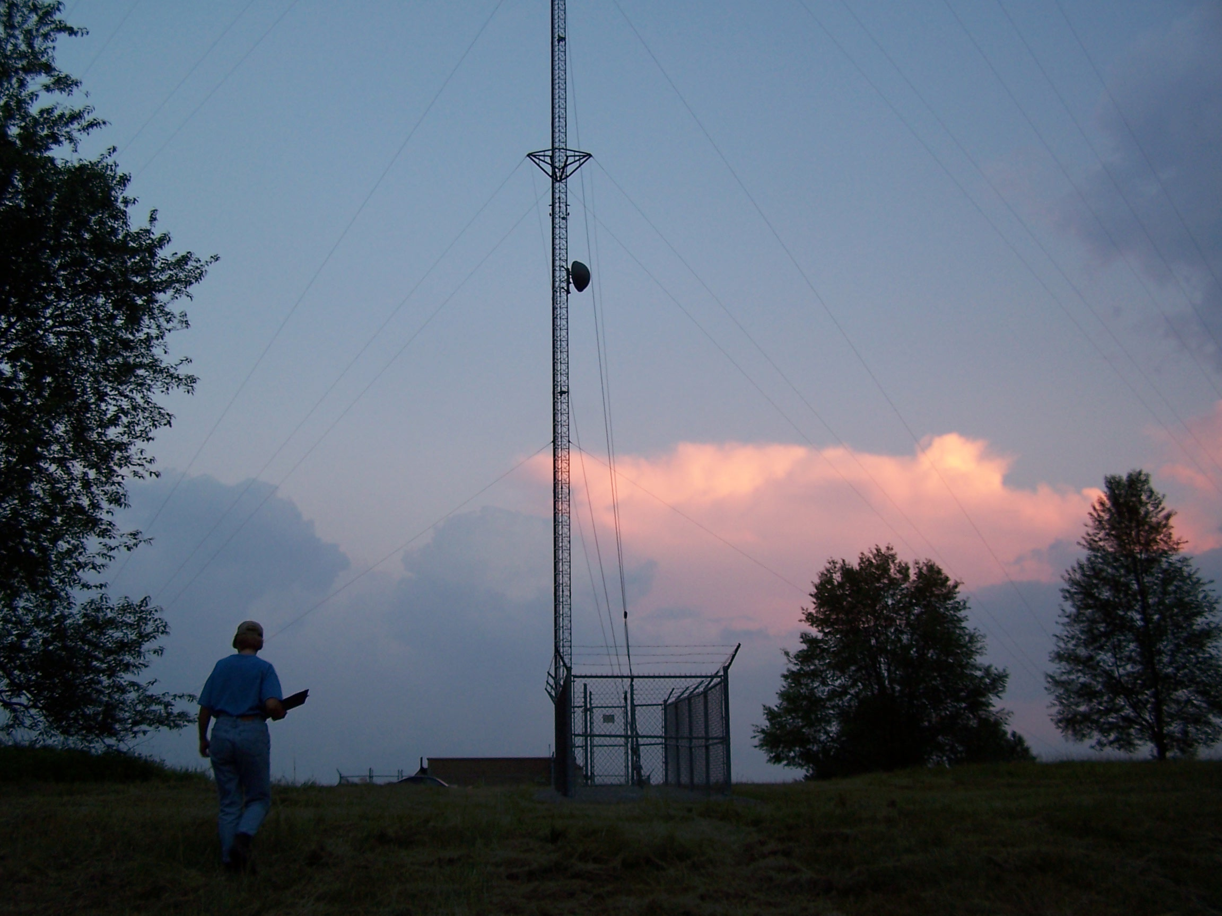
Biological Reviews, FAA Tower Lighting, and Northern Long-eared Bats
JOELLE L. GEHRING, Ph.D.
Federal Communications Commission

Slide 2
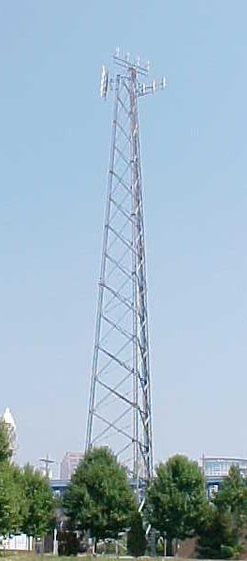
Biological Review
  Threatened and Endangered Species
  Northern Long-eared Bat
  Migratory birds and the new FAA Advisory Circular
  Bald Eagles and Golden Eagles

Slide 3
Biological Review
  Threatened and Endangered Species
  Northern Long-eared Bat
  Migratory birds and the new FAA Advisory Circular
  Bald Eagles and Golden Eagles

Slide 4
Threatened & Endangered Species
Section 1.1307(a)(3) of the Commission’s rules, 47 C.F.R. §1.1307(a)(3), requires applicants, licensees, & tower owners to consider the impact of proposed facilities under the Endangered Species Act (ESA), 16 U.S.C. §1531 et seq.
Applicants must determine whether any proposed facilities may affect listed, threatened or endangered species or designated critical habitats, or are likely to jeopardize the continued existence of any proposed threatened or endangered species or designated critical habitats. Applicants are also required to notify the FCC & file an environmental assessment if any of these conditions exist.

Slide 5
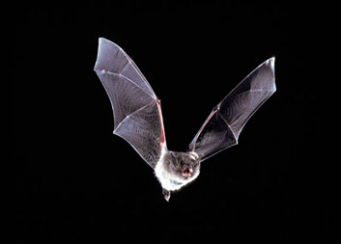
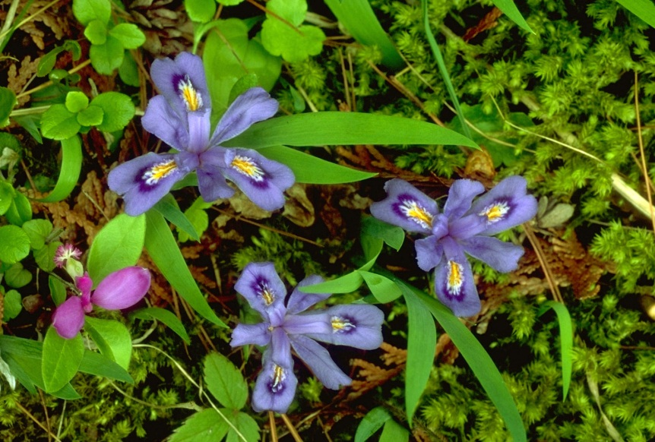
Threatened & Endangered Species
  Plants and animals
  Determine if T&E species at your proposed facility site

Slide 6
Threatened & Endangered Species
Information for Planning and Conservation (IPaC)
  USFWS tool
  Provides species lists, critical habitat designations
  http://ecos.fws.gov/ipac/

Slide 7
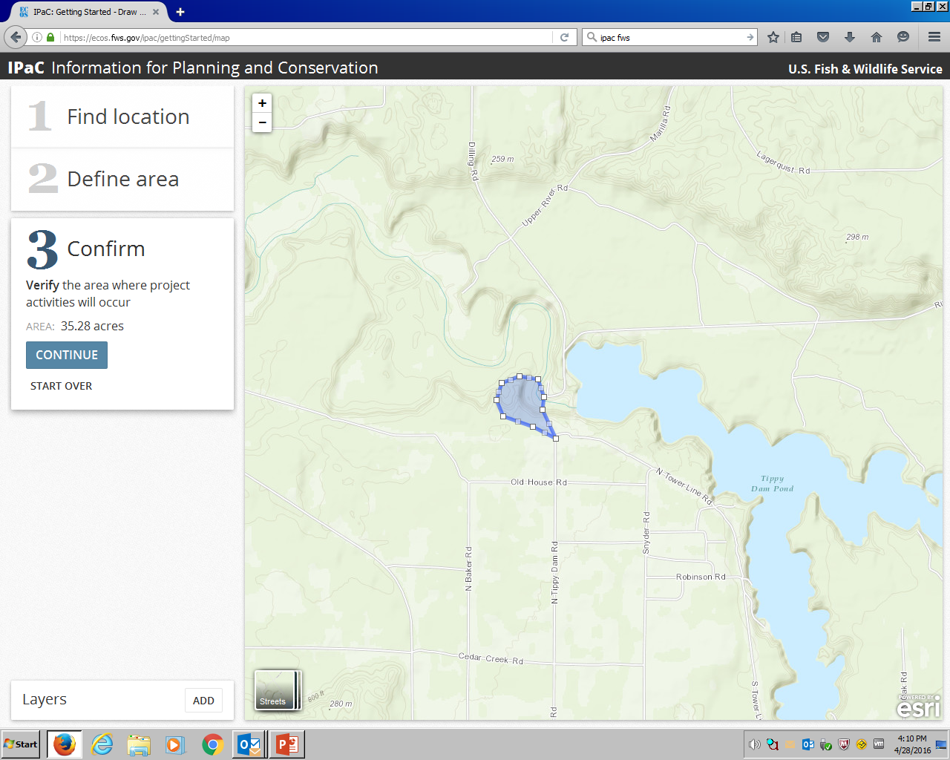
Threatened and Endangered Species

Slide 8
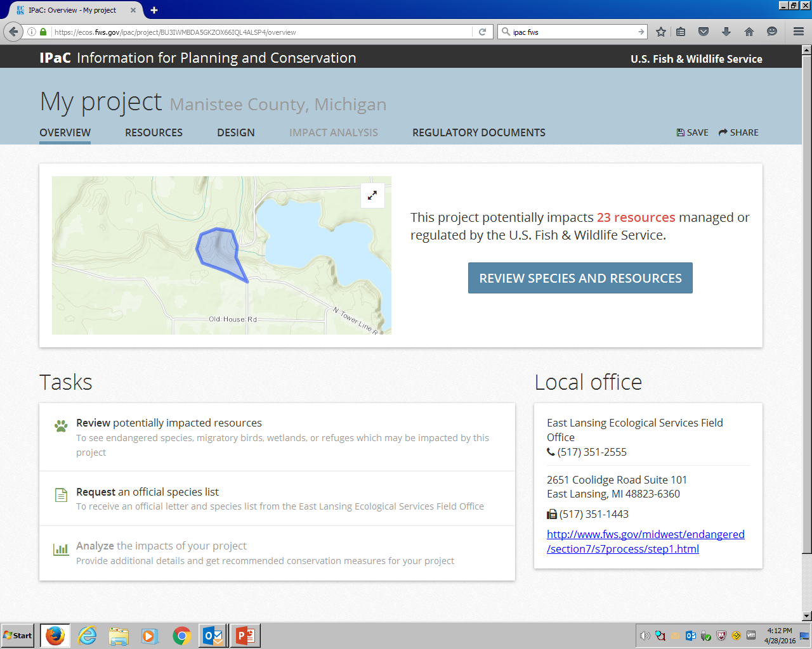
Threatened and Endangered Species

Slide 9
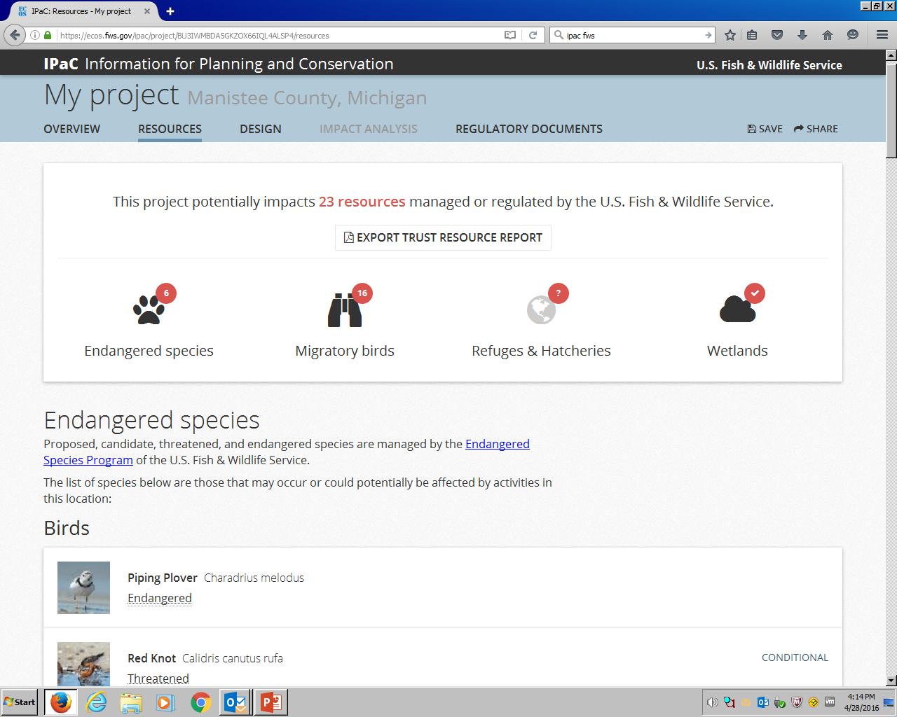
Threatened and Endangered Species

Slide 10
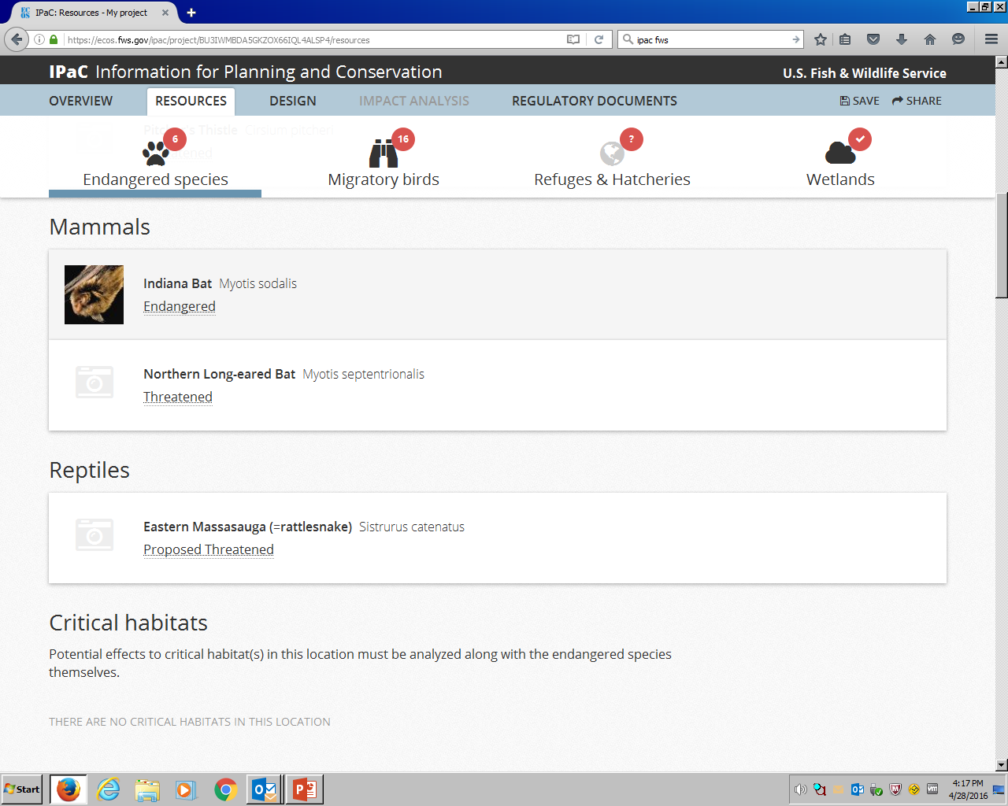
Threatened and Endangered Species

Slide 11
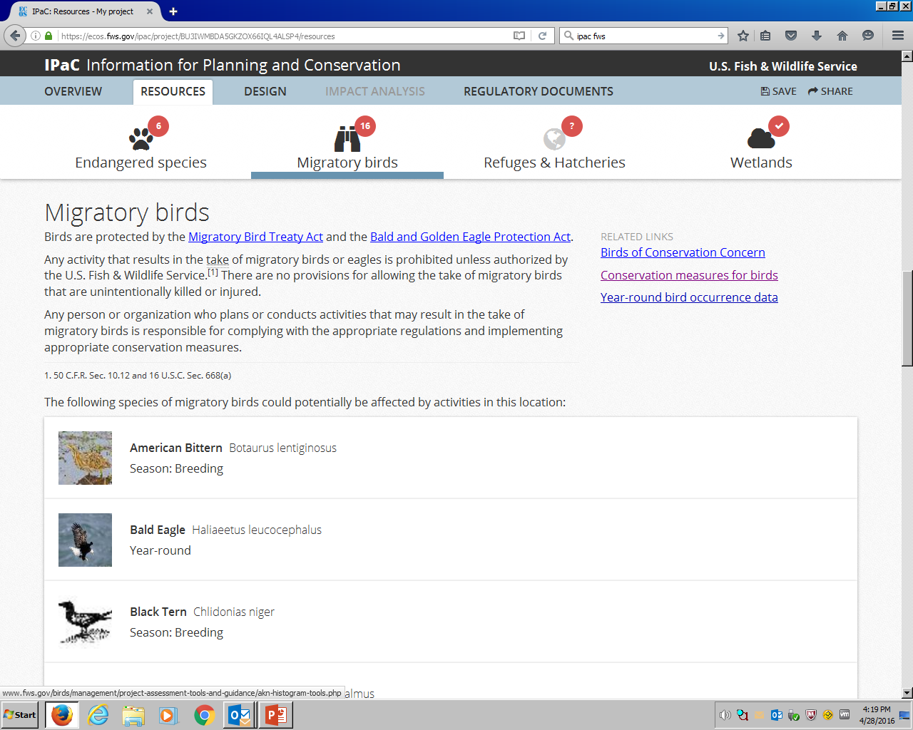

Slide 12
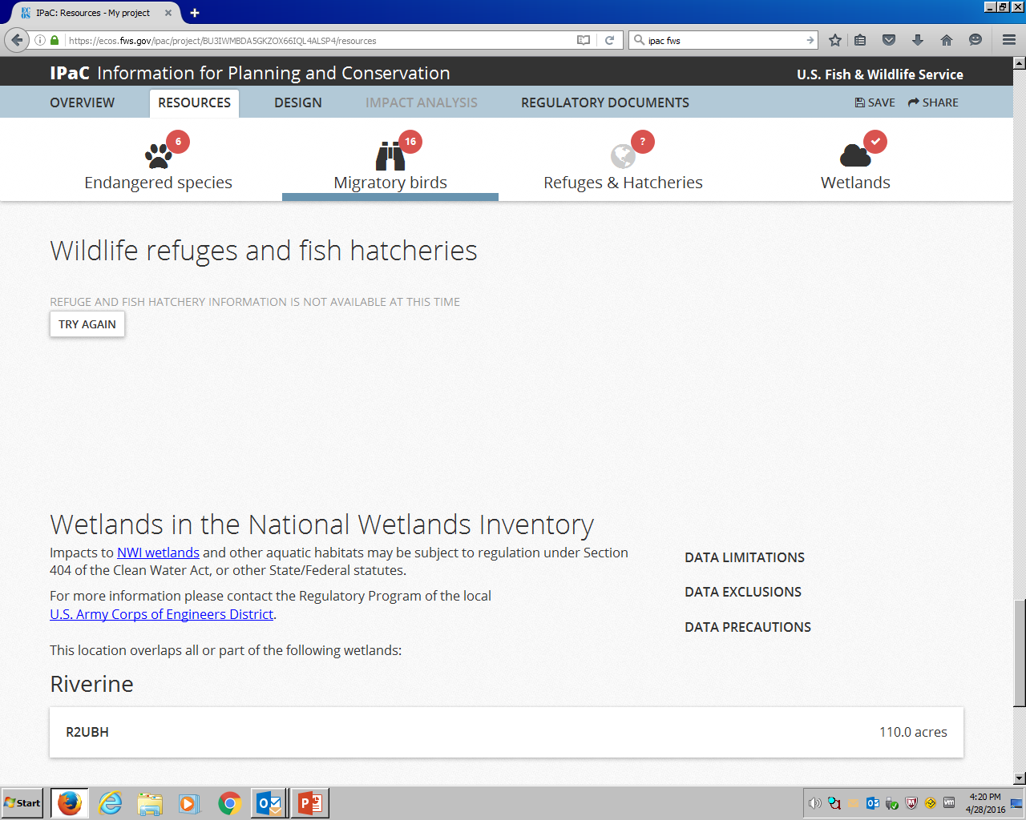
Threatened and Endangered Species

Slide 13
Threatened & Endangered Species
If listed or proposed threatened or endangered species or designated or proposed critical habitats are present in the county or counties where the “action” is located and would not be affected by the proposed antenna structure:
  Explain how the applicant determined that there would be no effect and provide the materials (with citations) that formed the basis for this determination (e.g., maps or lists from relevant FWS databases.)

Slide 14
Threatened & Endangered Species
If the proposed antenna structure may affect, but is not likely to adversely affect, listed or proposed threatened or endangered species or designated or proposed critical habitats in the action area:
  Provide a letter from FWS concurring with the applicant’s informal biological assessment. If any measures are proposed to mitigate any effects on species or habitats, the assessment must outline those measures with FWS concurrence.
  e.g., Indiana bat

Slide 15
Threatened & Endangered Species
If present and if the proposed antenna structure may affect, and is likely to adversely affect, listed or proposed threatened or endangered species or listed or proposed designated critical habitats in the action area
  Prepare a formal biological assessment as outlined in 50 C.F.R. § 402.01 et seq. The applicant should provide the formal biological assessment to the FCC for formal consultation with the FWS.

Slide 16
Threatened & Endangered Species
Protected species not present
  Relevant documentation (e.g., IPaC)
Protected species present, but not affected
  Determination by USFWS or qualified biologist
Not likely to Adversely Affect protected species
  USFWS concurrence
Likely to Adversely Affect protected species
  USFWS incidental take statement

Slide 17
Biological Review
  Threatened and Endangered Species
  Northern Long-eared Bat
  Migratory birds and the new FAA Advisory Circular
  Bald Eagles and Golden Eagles

Slide 18
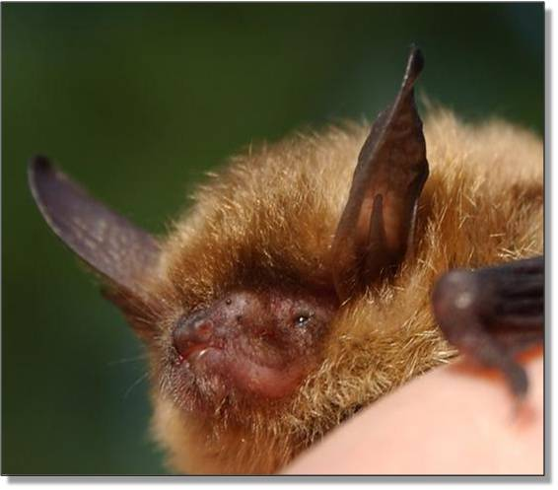
Northern Long-eared Bat
NLEB lives in forests and hibernates in caves, mines, and other locations.
Since 2007 non-native white-nose syndrome has resulted in millions of bat fatalities by infecting bat muzzles, ears, and wings, and disrupting hibernation thereby causing starvation.
WNS has caused significant declines in bat populations, and is continuing to spread.
Notes:
Mention that copies of the NLEB PN are available at the door

Slide 20
Northern Long-eared Bat
NLEB listed as threatened due to spread of WNS
January 14, 2016, USFWS released final rule requiring protective measures
  tower projects in the NLEB’s range must consider potential effects on the NLEB
  all tower construction projects within the NLEB’s range must follow the USFWS process for federal actions at
  http://www.fws.gov/Midwest/endangered/mammals/nleb/KeyFinal4dNLEBFedProjects.html
Notes:
Bring attention to the PN hand-out

Slide 21
Northern Long-eared Bat
USFWS Section 7(a)(1) consultation is required for tower proposals that will:
1. affect a NLEB hibernaculum or could alter the entrance or environment of a hibernaculum, even when bats are not present;
2. remove trees <0.25 miles of a NLEB hibernaculum at any time of year; or
3. remove a NLEB known occupied maternity roost tree or any trees within 150 ft of known occupied maternity roost tree June 1 - July 31.
“Tree removal”: cutting down, harvesting, destroying, trimming, or manipulating in any other way the trees, saplings, snags, or any other form of woody vegetation.

Slide 22
Northern Long-eared Bat
The USFWS recommends using state Natural Heritage Inventory databases to identify the locations of maternity roost trees and hibernacula near project areas.
If proposed towers fall into the any of the three categories contact USFWS Field Office nearest to the project area.
USFWS Section 7(a)(1) consultation triggers the need for an Environmental Assessment with the FCC.

Slide 23
Northern Long-eared Bat
Proposed projects within NLEB range but not in any of the three categories can opt to initiate USFWS Section 7(a)(1) consultation or use the Framework to Streamline Section 7 Consultation (http://www.fws.gov/Midwest/endangered/mammals/nleb/KeyFinal4dNLEBFedProjects.html).
  Framework requires applicants to contact USFWS Field Office at least 30 days in advance of funding, authorizing, or carrying out an action. Include:
    written description of the proposed project, action area, and efforts to find roosts and hibernacula location information
    request for coordination or consultation for other listed species if other species may be affected
Notes:
Bring attention to the PN hand-out

Slide 24
Northern Long-eared Bat
  If the USFWS does not respond to consultation documents within 30 days tower applicant can assume incidental take of NLEB from a particular project is not prohibited.
  Use of the Framework to Streamline Section 7 Consultation does not trigger the need for an EA with the FCC provided the USFWS concurs with the determination of NLAA or does not respond within 30 days.
  If applicant does not conduct an activity as described in determination document, departures must be promptly communicated to appropriate USFWS Field Office. Dead, injured, or sick NLEB must be promptly reported to the appropriate USFWS Field Office.
Notes:
Bring attention to the PN hand-out

Slide 25
Northern Long-eared Bat
We encourage industry to follow USFWS recommendations:
Conduct tree removal outside of pup season (June 1-July 31) and active season (April 1-October 31) to minimize impacts at roosts not yet identified.
Avoid clearing spring staging and fall swarming habitat <5-mile radius of known hibernacula during staging and swarming seasons (April 1-May 15 and Aug 15-Nov 14).
Maintain dead trees and large trees when possible.
Use herbicides and pesticides only if unavoidable.
Minimize exterior lighting, opting for down-shielded, motion-sensor security lights under towers instead of constant illumination.
Notes:
Bring attention to the PN hand-out

Slide 26
Biological Review
  Threatened and Endangered Species
  Northern Long-eared Bat
  Migratory birds and the new FAA Advisory Circular
  Bald Eagles and Golden Eagles

Slide 27

Notes:
Discuss bird navigation and nature of migration

Slide 28
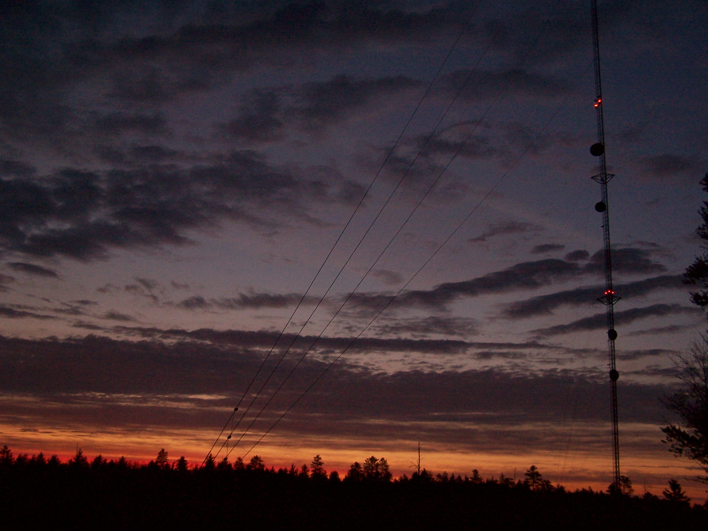
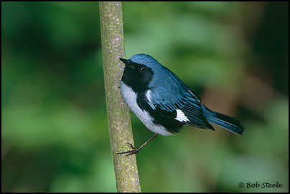
Estimated 4 million – 50 million bird fatalities at communication towers annually in U.S.
Almost all are considered violations of the Migratory Bird
Treaty Act.
Notes:
Discuss bird navigation and nature of migration

Slide 29
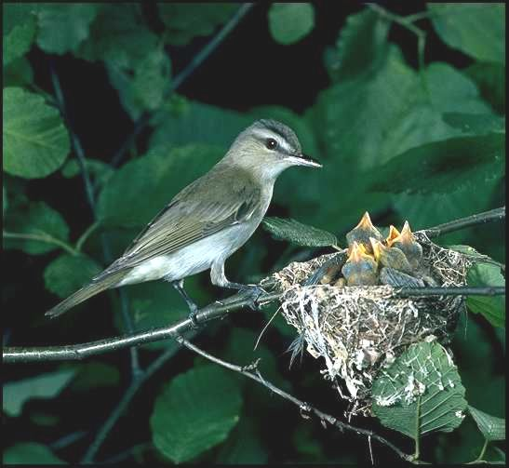
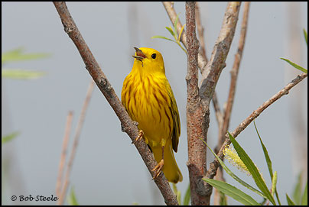
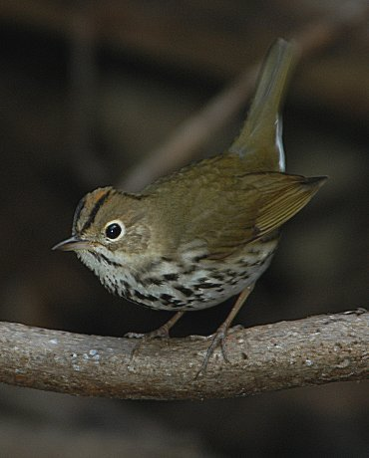
Detected Bird Mortality
I. Jeklin
Most frequently detected
  Songbirds
    Vireos
    Warblers
    Thrushes
    Sparrows
  Shorebirds
  Waterfowl
G. Beaton

Slide 30
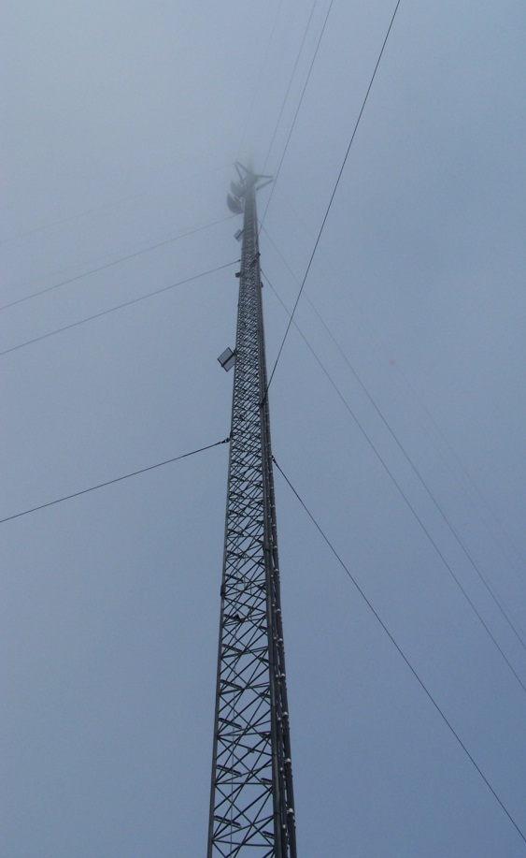
Variables Related to Bird Collisions
  Weather
  Location in the landscape
  Tower support systems
  Tower heights
  Tower lighting systems

Slide 31
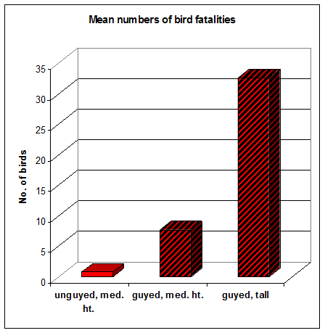
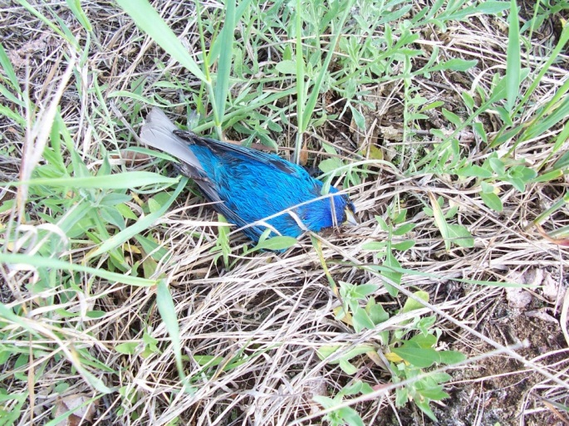
Towers with guy wires result in higher levels of avian mortality than towers without guy wires.

Slide 32
Taller towers result in higher levels of avian mortality than shorter towers.

Slide 33
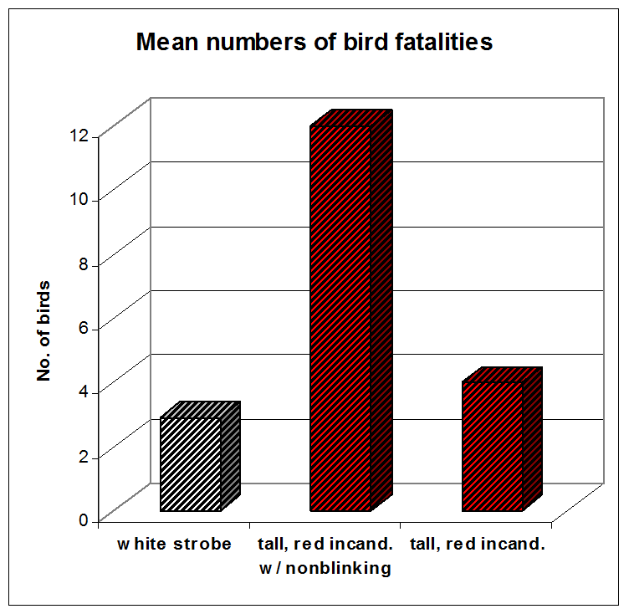
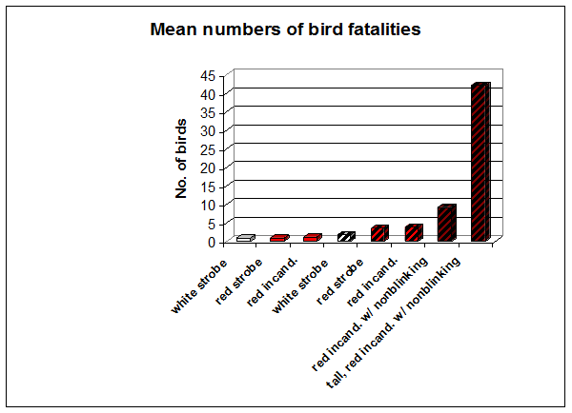

Steady-burning lights on towers result in higher levels of avian mortality than flashing lights.

Slide 34
50-70% reduction in fatalities via
elimination of non-flashing lights
L-865
L-864
L-864
L-864 and L-810

Slide 35
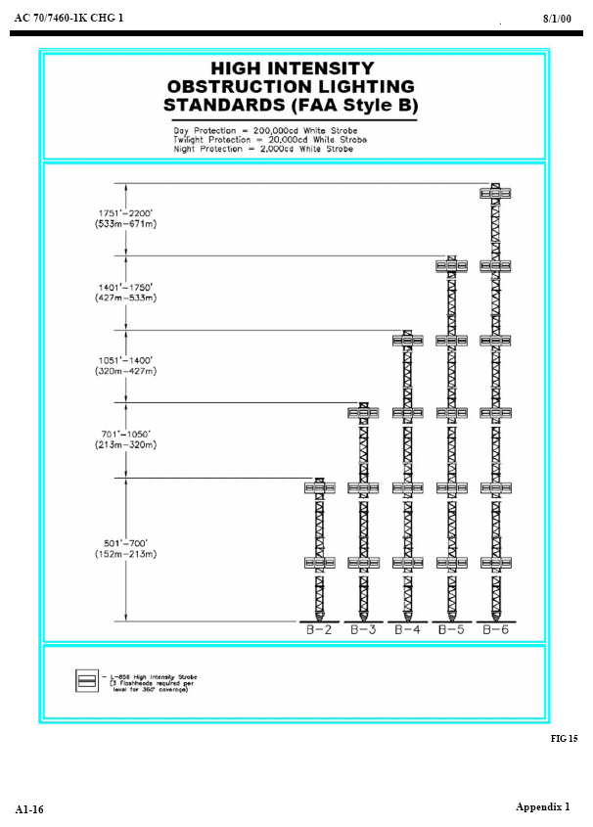
L-865 flashing white
NO non-flashing

Slide 36
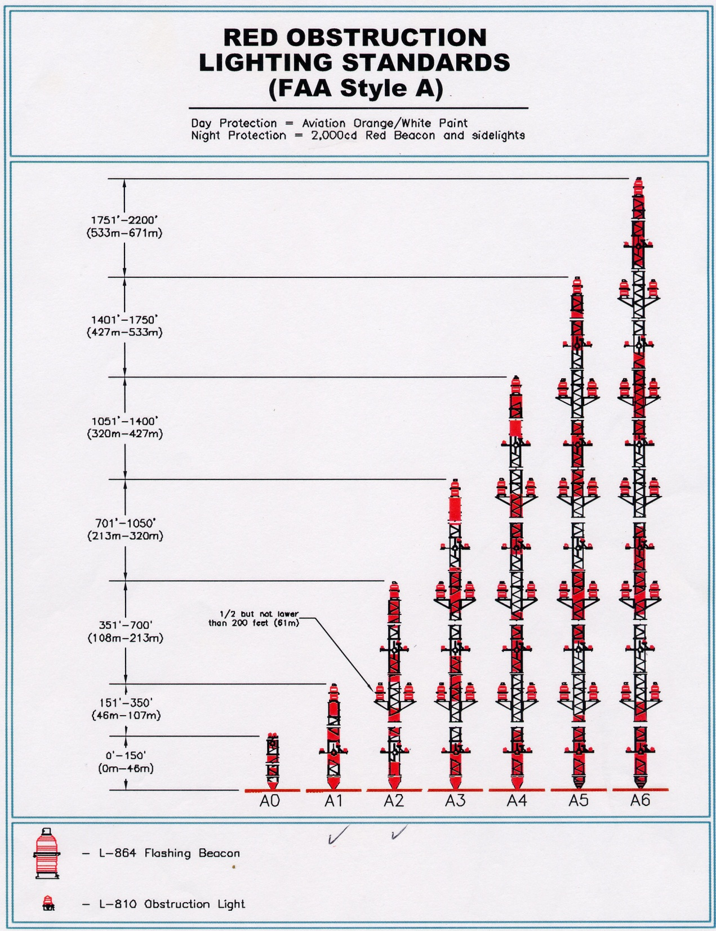
L-864 flashing red
L-810 non-flashing red

Slide 37
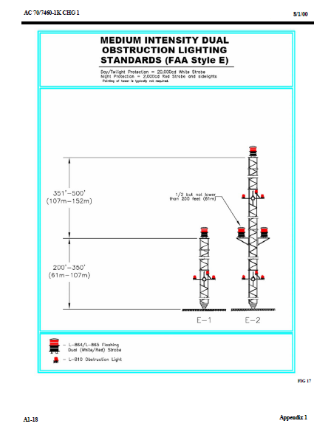
L-864 flashing red
L-810 non-flashing red

Slide 38
Notes:
Highlight new AC

Slide 39
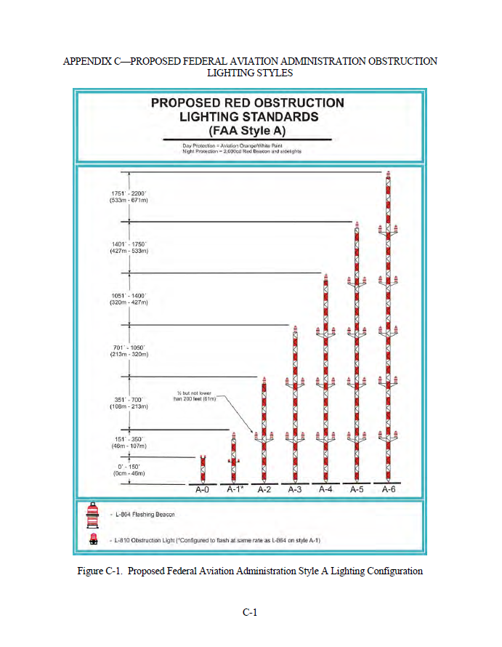

new and existing towers
New FAA lighting standards extinguish non-flashing lights from towers >350 ft. AGL and reprograms them to flash on towers 150-350 ft. AGL
(post September 15, 2016)
Notes:
No need to climb towers, little to no additional cost to change lights, financial savings due to lower energy usage, lower maintenance costs, lower construction costs. Of course the 70% reduction in bird fatalities. Currently LEDs are the best option for reprograming the non-flashing to flashing.

Slide 40
Lighting Deviation Process
To extinguish or eliminate the L-810 tower lights/side-markers on an existing registered tower, or to request use of flashing red lights only on a proposed new tower, you must take the following steps:
File a Marking and Lighting study electronically with the FAA requesting the elimination or omission of steady-burning lights (L-810) with Form 7460-1, Notice of Proposed Construction or Alteration. Designate structure type: “Deviation from Red Obstruction Light Standards.”
Notes:
Detailed explanation of lighting deviation process- handout included in audience materials.

Slide 41
Lighting Deviation Process
Once the FAA has approved the request and assigned a FAA Study Number, file Form 854 with the FCC via the Antenna Registration System (ASR). Please select “MD – Modification” and choose the appropriate FAA Lighting Style. The FCC will typically approve the application and modify the registration within 24 hours.
After the lighting change for a tower has been granted by the FCC via ASR, the steady-burning, side-marker, L-810 tower lights can be extinguished. This is typically accomplished in the tower transmission building and does not ordinarily require climbing the tower. Per the FAA requirements, flashing red lights should flash at 30 FPM (+/- 3 FPM).
Notes:
Detailed explanation of lighting deviation process- handout included in audience materials.

Slide 42
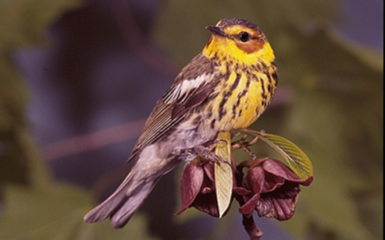
Migratory Birds
  Recommend motion-detector lighting on out buildings
  Towers > 450 ft. (137 m) AGL
  Prepare an Environmental Assessment including a section specifically addressing potential migratory bird impacts and efforts to reduce those impacts (e.g., building lights, bird flight diverters)
  Seek migratory bird comment from FWS

Slide 43
Biological Review
  Threatened and Endangered Species
  Northern Long-eared Bat
  Migratory birds and the new FAA Advisory Circular
  Bald Eagles and Golden Eagles

Slide 44
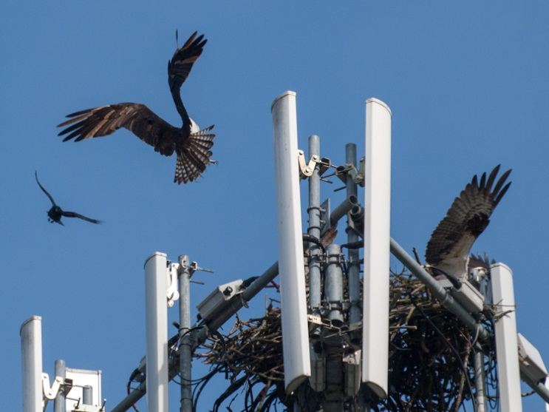
Eagles and other Raptors
  Bald and Golden Eagle Protection Act (BGEPA), MBTA, and some state protection
  Number of nests on towers is increasing.
  Contact USFWS & state natural resource agency before construction or maintenance activities on towers with nests. May require permits. Nest exclusion devices can be used.
  Raptors can become entangled in antenna wires or twine used as nesting material. Minimize excess wires, securely attach wires to tower, and shrink wrap or tape wires together to reduce the risk of entanglement. Contact state natural resources protection agency & USFWS if bird entanglement occurs.
©ingridtaylar
Notes:
In addition to the USFWS guidelines for nest buffers, you may also want to consider this information. Note that Eagle nests may not be included in the IPaC output and other databases may need to be included in your review (e.g., AKN).

Slide 45
Notes:
Bring it all together

Slide 46
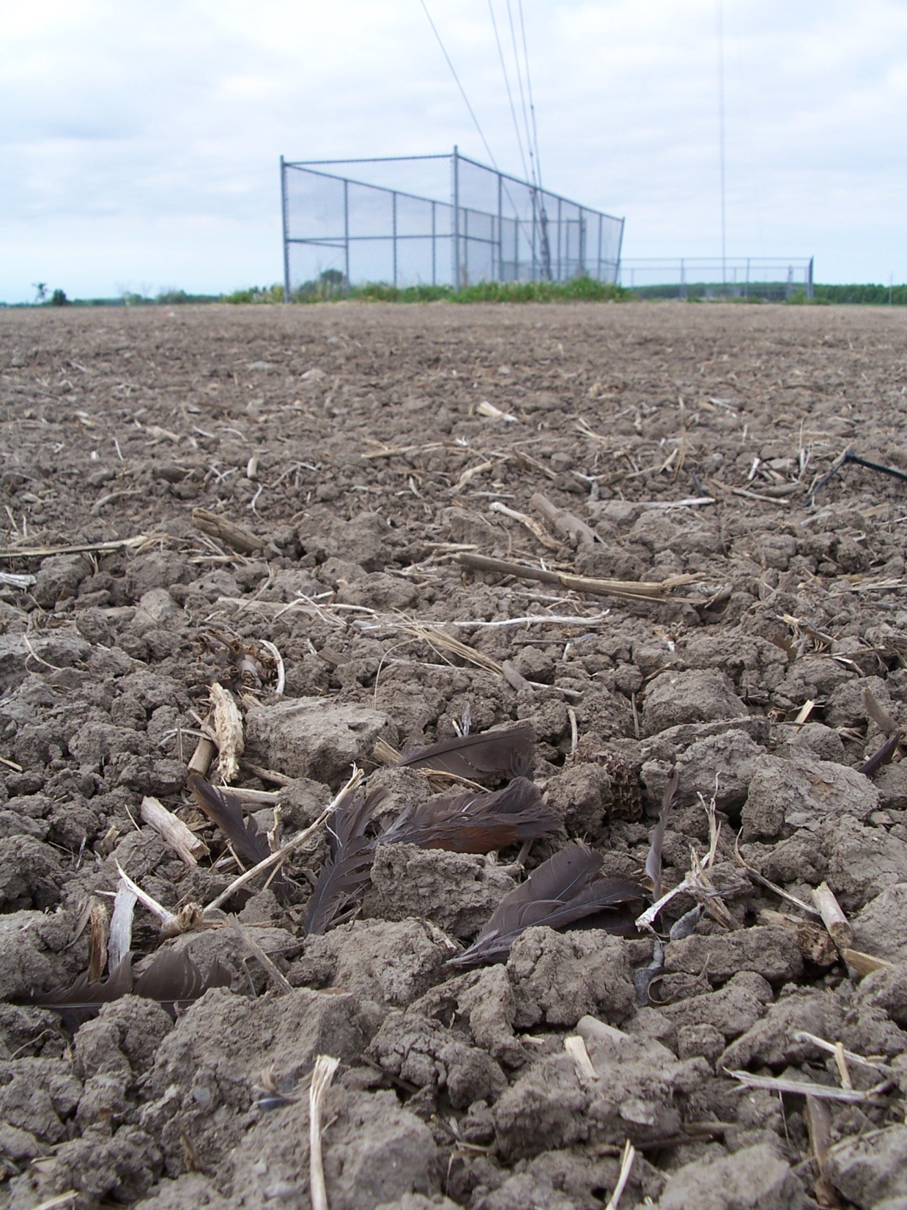
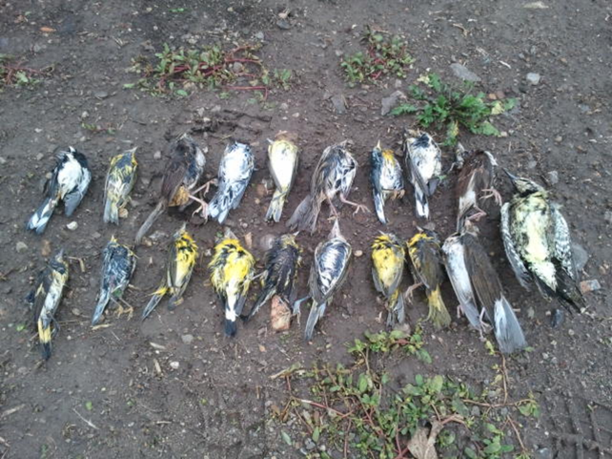
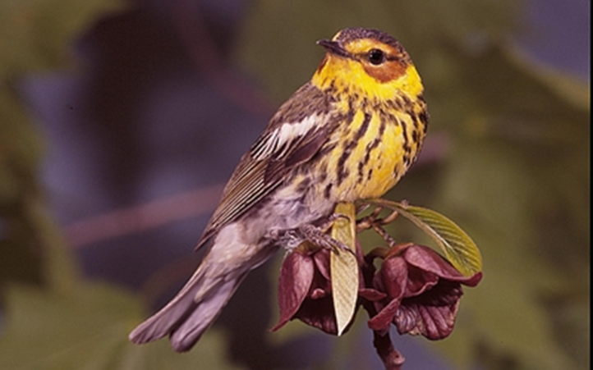
For more information contact:
Joelle.Gehring@FCC.gov

