Slide 1
FCC Section 106 Process and the Archeology of Tower Siting Panelist Presentation May 4, 2016
Suzanne Derrick
Technical Director – Cultural Resources

Slide 2
The NPAs - “Streamlining” and “Certainty”
“Streamlining”
The use of the FCC Form 620 & 621 makes the submissions to every state similar
Defines the APEs
Limits the level of survey required in the APE –Visual Effect
“Certainty”
Provides a “clock” for the consultation process
Provides a mechanism for tribal consultation
Provides a method to conclude consultation even if the SHPO is non-responsive
For further information visit: http://wireless.fcc.gov/siting/historic_preservation.html
But even with the FCC’s expectations being defined in the 2004 NPA, there are still significant differences in what the SHPOs and Tribes request

Slide 3
2004 NPA Guidance | Other’s Expectations
Identification of Historic Properties
APE-VE: Section VI.D.1.a of the 2004 NPA - Research SHPO’s files or designated repositories to identify NR-Listed, NR-eligible (DOE/SHPO Opinion), properties SHPO certifies are in the process of being listed or in the Inventory and already determined eligible. APE-DE: Conduct Research and then Field Survey (if necessary) to identify whether archaeological properties eligible for listing on the National Register of Historic Places exist | Some SHPOs request that consultants treat all properties in their inventories as “historic properties” Consultants are asked to photograph all properties > 50 years of age in the APE-VE, so the SHPO can id which may be eligible and might be affected. Consultants are asked to survey all properties >50 yrs in the APE-VE and make determinations of eligibility.

Slide 4
2004 NPA Guidance | Other’s Expectations
Field Survey in the APE-DE
Section VI.D.2.a of the 2004 NPA states “In addition to the properties identified pursuant to Section VI.D.1, Applicants shall make a reasonable good faith effort to identify other above ground and archeological Historic Properties, including buildings, structures, and historic districts, that lie within the APE for direct effects. Such reasonable and good faith efforts may include a Field Survey where appropriate.” | Some SHPOs require the completion of state-specific survey forms to document the eligibility determination Completion of the state-specific forms can require NR-nomination levels of work SHPOs and Tribes do not always agree on the level of archeological survey required to determine whether archeological properties exist in the APE-DE. Some SHPOs consider entire parcel (or even historic parcel boundaries) to = APE-DE

Slide 5
2004 NPA Guidance | Other’s Expectations
Field Survey in the APE-VE
Section VI.D.1.a of the 2004 NPA states the following relative to the identification of historic properties in the APE-VE: “Applicants are not required to undertake a Field Survey or other measures other than reviewing these records in order to identify Historic Properties” | Some SHPOs and/or Consulting parties request identification survey of one or more properties >50 yrs in the APE-VE. Some SHPOs routinely request an expansion of the APE-VE.

Slide 6
2004 NPA Guidance | Other’s Expectations
Assessment of Effects
Per Section VI.E of the 2004 NPA: Criteria of Adverse Effect are applied “An Undertaking will have a visual adverse effect on a Historic Property if the visual effect from the Facility will noticeably diminish the integrity of one or more of the characteristics qualifying the property for inclusion in or eligibility for the National Register. Construction of a Facility will not cause a visual adverse effect except where visual setting or visual elements are character-defining features of eligibility of a Historic Property located within the APE.” | Some SHPOs do not consider intervening distance, tree cover or topography to have a significant role in softening the visual impact Some SHPOs believe the facility’s presence anywhere in the viewshed will constitute an adverse effect. Some SHPOs only consider the effect to be from the historic property and others consider it to be from the viewer’s perspective when viewing the historic property.

Slide 7
2004 NPA Guidance | Other’s Expectations
Qualifications
Use of an SOI-qualified Architectural Historian/Historian is at applicant discretion unless an assessment of effects is required. SOI-qualified archeologists are required to make determinations of the level of effort required to identify and evaluate archeological resources. Use of professionals with regional experience helps with the identification of regional site types | Some states require all levels of survey be conducted by permitted professionals (SOI-qual is not sufficient). Some states require permits only for later phases of archaeological survey. Some Tribes require specialized survey conducted by contractors approved by the tribes.

Slide 8
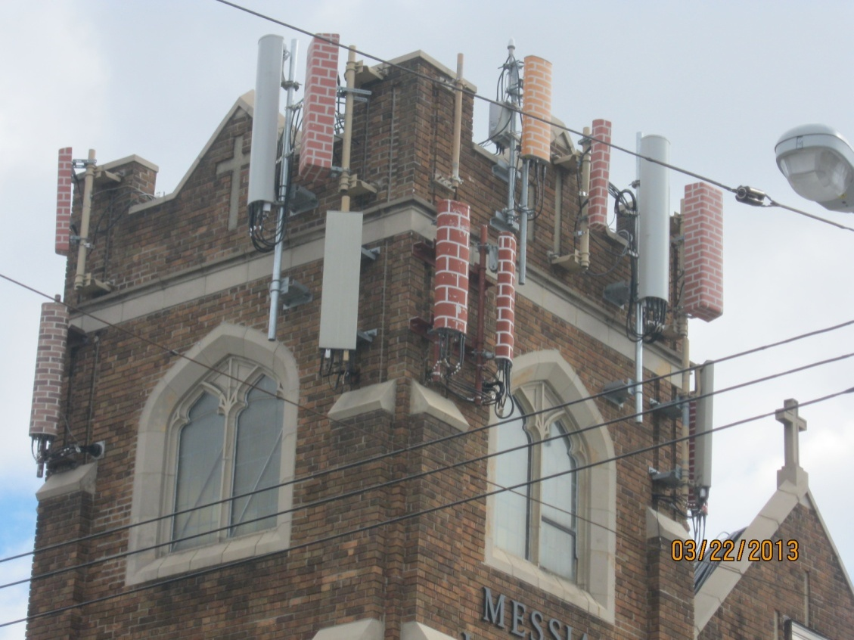
Case Study on Reasonable and Good Faith Effort
Client proposed to install LTE antennas on existing colo
>45 years of age, so SHPO was required
Research identified subject property as being NR-Eligible (2001)
Conditional No Adverse Effect and Painting Plan acknowledged by FCC were a result of a circa 2008 consultation
Several installations were not consistent w/ painting plan

Slide 9
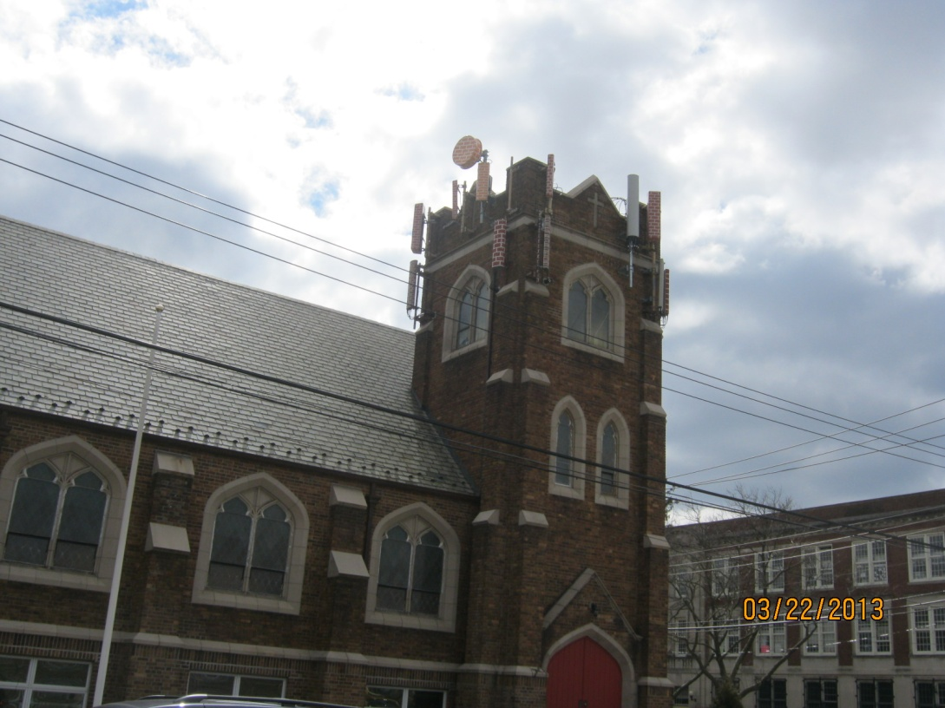
Case Study on Reasonable and Good Faith Effort (con’t)
SHPO responded to LTE submission that a cumulative Adverse Effect has now occurred
Consultant worked with Applicant to show compliance history and to re-design their installation to be consistent w/ painting plan, etc.
Resulted in Conditional No Adverse Effect

