Slide 1
Community Technology Center
College of Menominee Nation, Keshena, WI

Slide 2
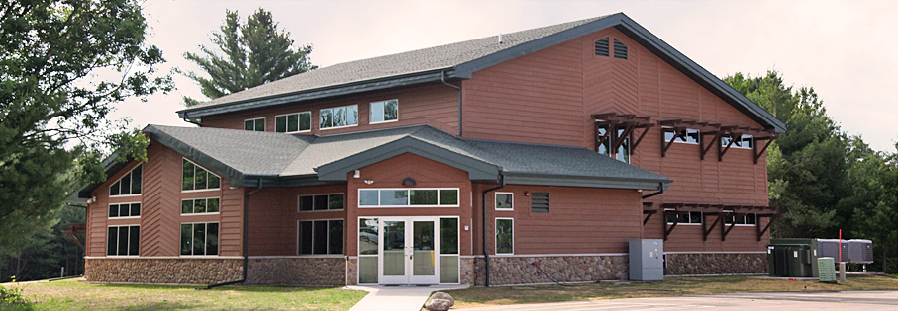
Our Reach
PCC (data through 12/31/12):
Total training hours: 7,266 Technical Education data—
Total participants: 3,633 Classroom instruction: 5,312 hours
Multimedia training: 328 hours, 155 participants 62 participants
GED/College prep: 638 hours, 111 participants Skills Lab (open to public): 2,792 hours
Computer training: 1,652 hours, 684 participants 313 participants

Slide 3
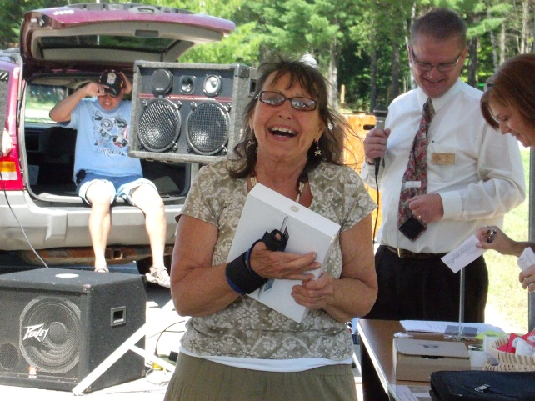
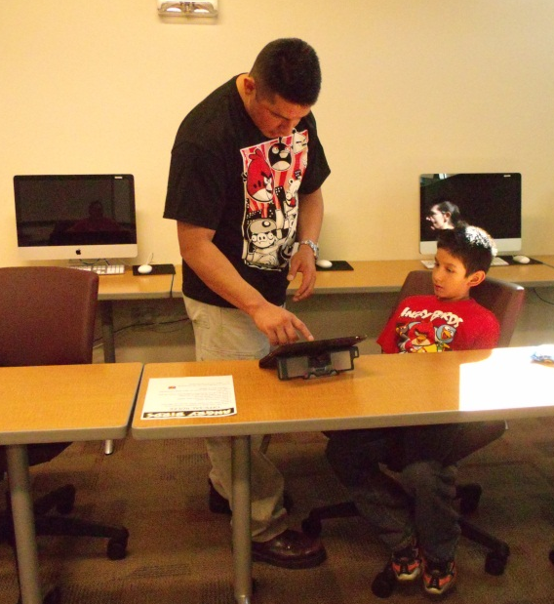
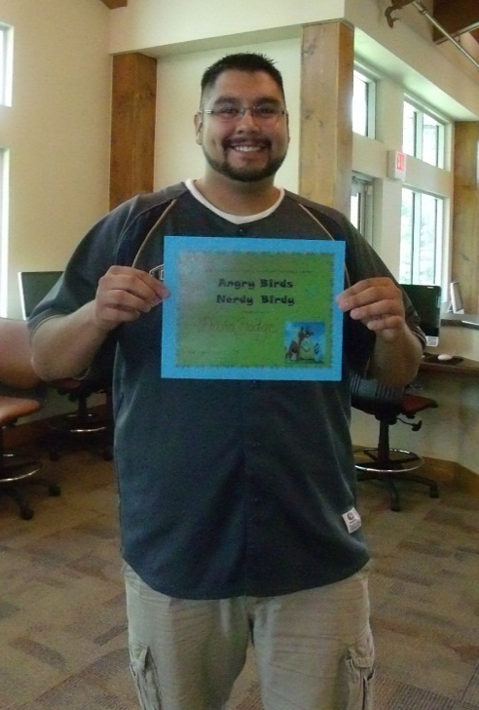
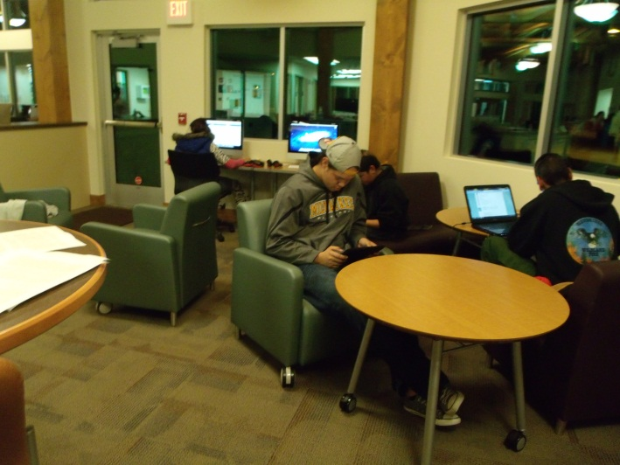
Successful Adoption

Slide 4
Activities of Participants:
Entrepreneurs—work on Business Plans, process paperwork, conduct social media marketing, etc.
Hardware & Software training—Microsoft Office Suite, Adobe, Computer Basics, Mobile technology
Social—Skype, Facebook, Angry Birds tournaments, LinkedIn, Pinterest, Twitter
Youth—Video Game Making Camp, Technology Camp, Class field trips to the Community Technology Center
Elders—Learning how to use a computer, preserving culture, sharing culture, keeping the family connected

Slide 5
Challenges:
Home access in rural, poverty stricken area—too expensive
Transportation—working with Menominee Transit to help
Shift in thought of how to present benefits of Broadband use
Elders interested in preserving culture, not the exciting technology
Meeting needs of consumers by group

Slide 6
Thank you! Tamara Cox-Burnett, CTC Director College of Menominee Nation, Keshena, WI tcox-burnett@menominee.edu

