Slide 1
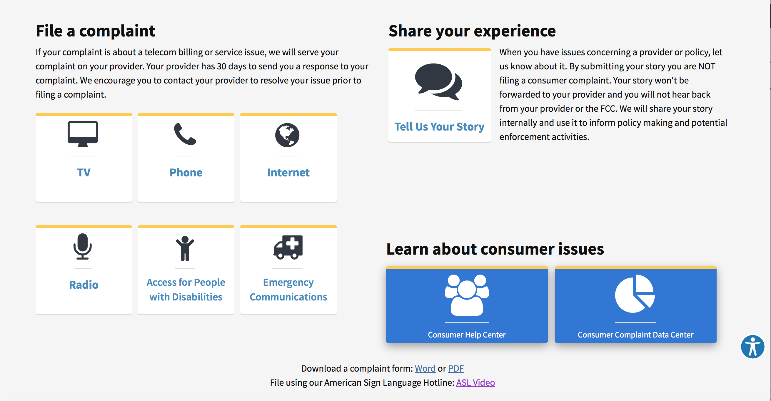
Informal Consumer Complaints
Submit a complaint at consumercomplaints.fcc.gov
Complaints can be filed about:
Billing
Availability
Service Quality
Unwanted Calls
Indecency
Loud Commercials
Accessibility
And More
Or - Share Your Experience

Slide 2
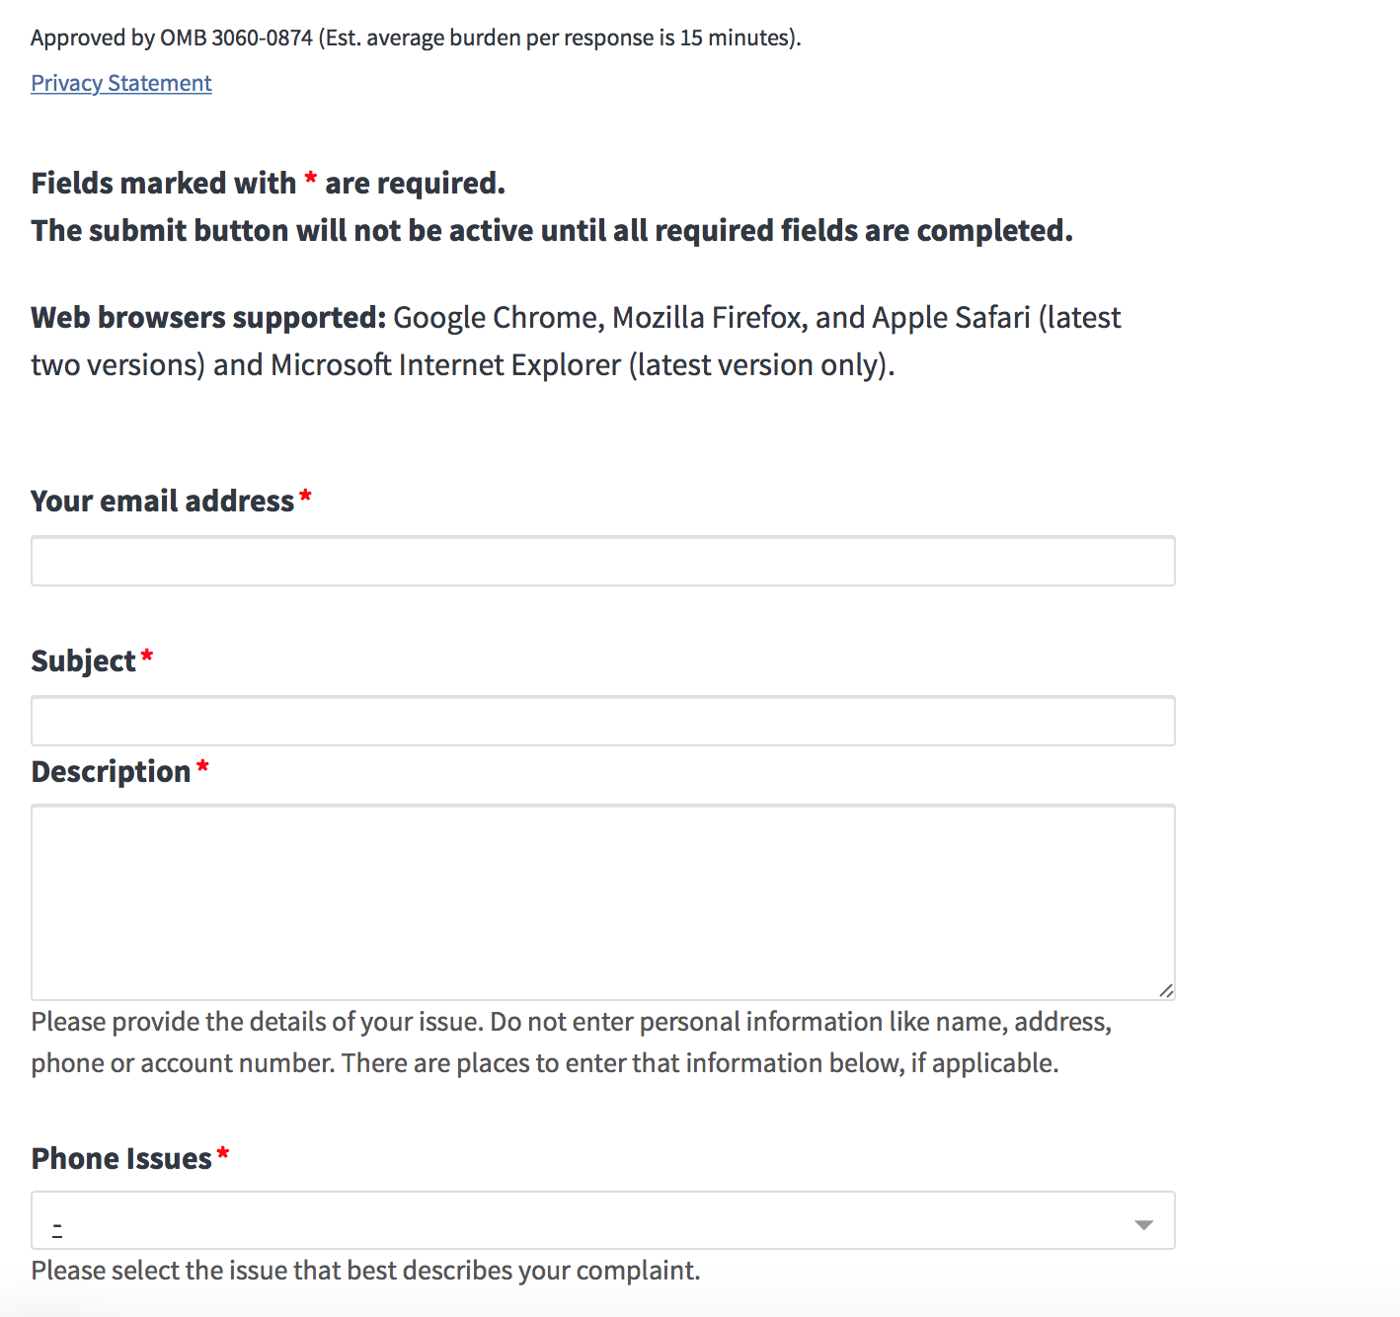
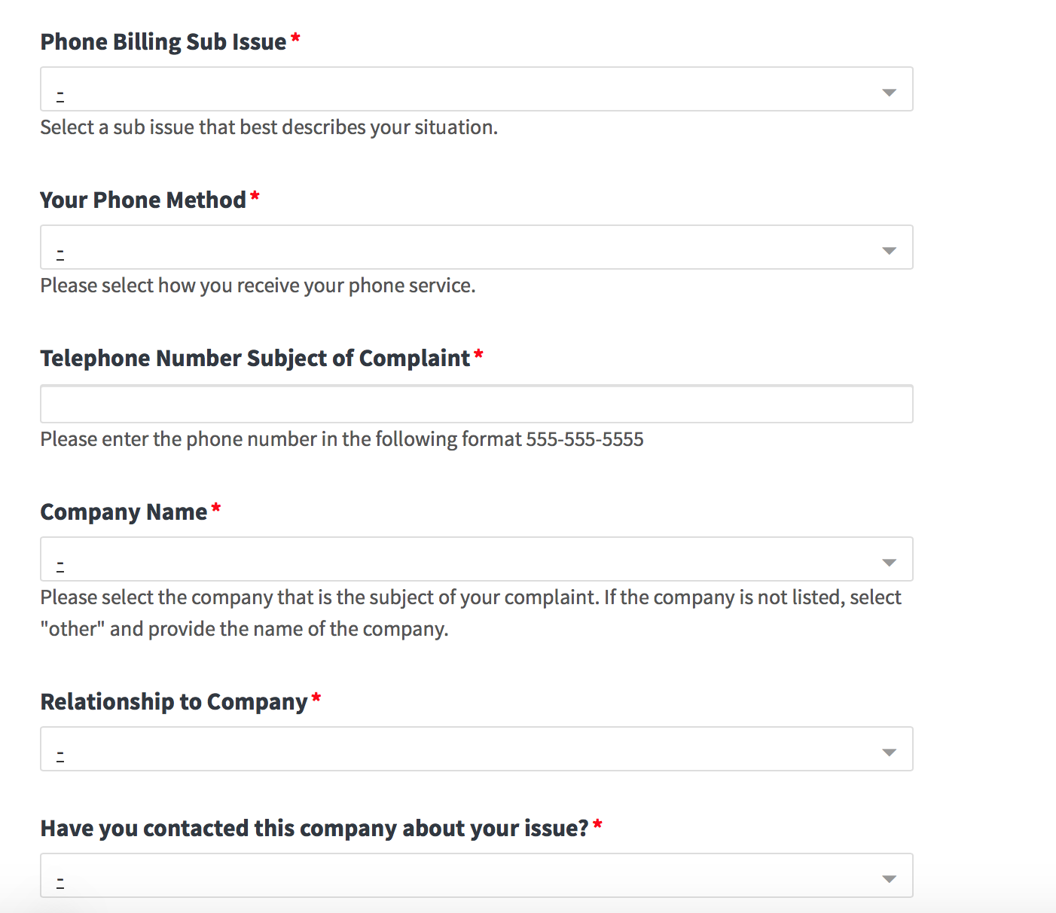
Informal Consumer Complaints
Fill Out Form

Slide 3
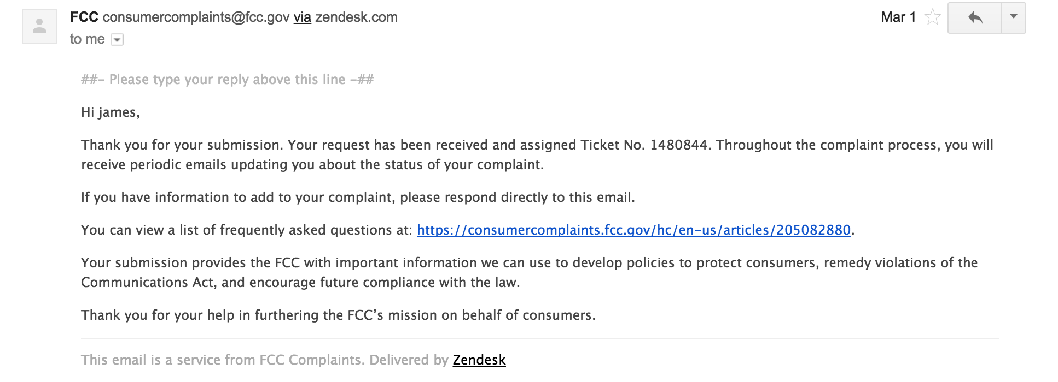
Informal Consumer Complaints
Email Updates (sample)

Slide 4
Informal Consumer Complaints
What Happens Next
Complaints received by the FCC:
Could be served on a provider
Educational information could be sent
Another agency might be involved
Could be shared among the FCC
If served on a provider:
Provider reaches out to the consumer
Provider responds directly to consumer (has 30 days)
Provider also responds to the FCC
Periodic updates sent to consumer by the FCC

Slide 5
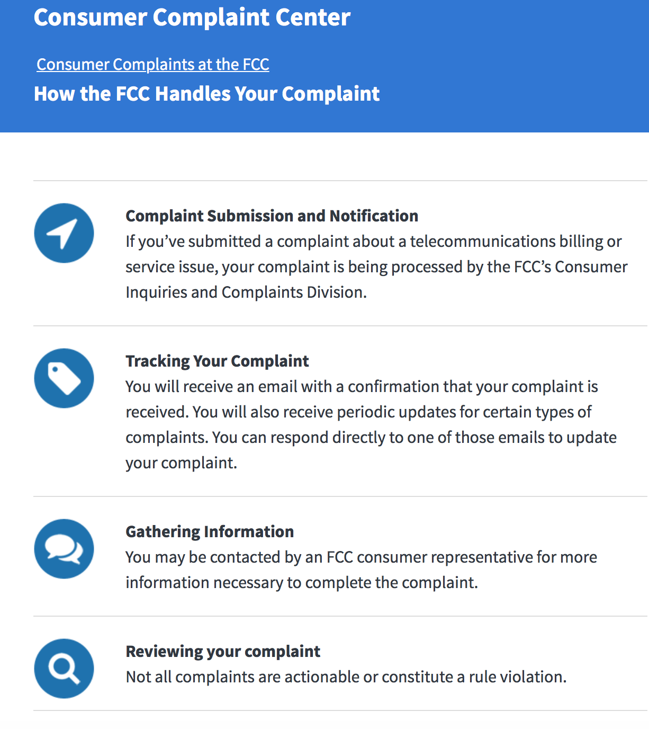
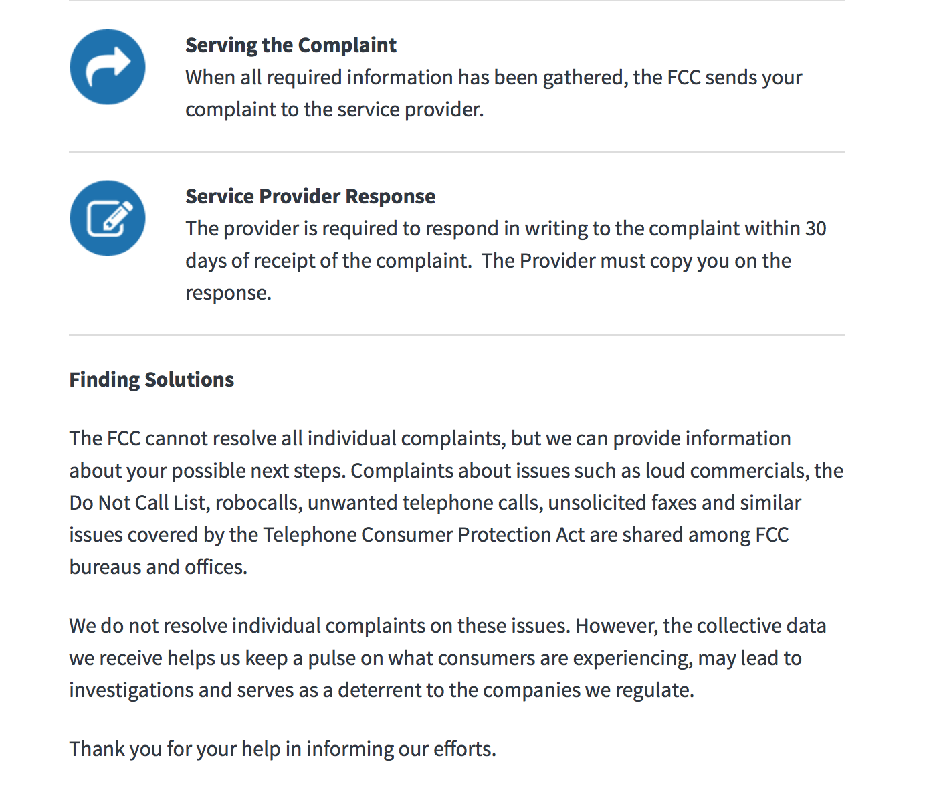
Informal Consumer Complaints
How Your Complaint Is Handled

Slide 6
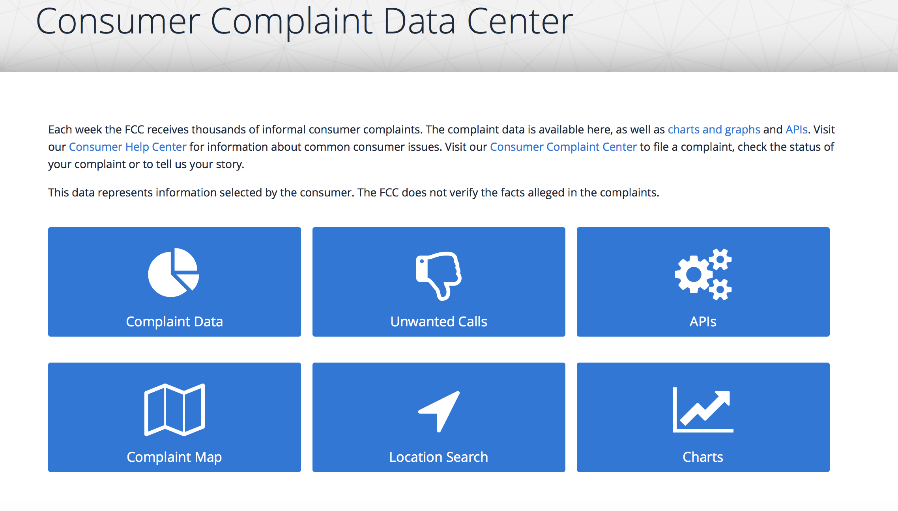
Informal Consumer Complaints
https://www.fcc.gov/consumer-help-center-data

Slide 7
Informal Consumer Complaints
Consumer Support Line
888-CALL-FCC
M-F 8:00 am - 5:30 pm est

Slide 8
Consumer Help Center: www.fcc.gov/consumers
Consumer Complaint Portal: www.consumercomplaints.fcc.gov
FCC Consumer Support Line: 888.CALL.FCC
FCC Disability Rights Office:
www.fcc.gov/disability
e-mail: DRO@fcc.gov
Phone: 202-418-2517
Individuals who are deaf or hard of hearing and use American Sign Language (ASL) and
video relay service can contact the FCC via videophone by dialing:
844-432-2275
Archived webinar will be online available at:
www.fcc.gov/events (search by date)
www.fcc.gov/outreach
For further FCC outreach questions:
outreach@fcc.gov

