Slide 1
IMPROVING THE TRIBAL REVIEW PROCESS INFORMATION REQUESTS
Steve DelSordo
Federal Preservation Officer
Federal Communications Commission
Washington, DC

Slide 2
Basic TCNS Notice
Applicant and Consultant Information
Tower Location, Type, Height
Any Information That a Specific Tribe Might Request

Slide 3
Enhanced TCNS Notice
Form 620 or Form 621
Maps
SHPO Site Data
Cultural Resource Reports
Photographs

Slide 4
Form 620 or Form 621
For the past several years, TCNS and E106 have been linked.
Using E106 improves your workflow
Enables FCC staff to provide more complete guidance and assistance
Enables THPO and SHPO staff to see either TCNS or Form 620/621 from a single interface
Helps THPO staff have a more accurate understanding of the project
Tribes are telling the FCC that being able to see SHPO site files is very important in their review
Not all SHPOs will provide automatic access to SHPO site files

Slide 5
MAPS
Maps provide Context for Geographic Area and Landscapes. Recommended maps include:
Marked-up Google Earth image showing project site, APE, known historic properties and other sites found in the SHPO files
Street map that shows the larger area beyond the APE

Slide 6
SHPO SITE DATA
Many Tribal Nations do not have access to SHPO survey files.
Just as the presence or absence of surveyed sites and notes can help inform the archeological consultant in preparing the cultural resource report of historic context, so do THPO staff find this data invaluable in making informed decisions on the presence or absence of Tribal religious or cultural sites.
For example, information about procurement sites, work sites, and either temporary or permanent/semi-permanent habitation sites will help guide those with Tribal knowledge to traditional religious or cultural sites.

Slide 7
CULTURAL RESOURCE REPORTS
If the Form 620 or Form 621 is not yet ready for distribution, a final or draft cultural resource report or historic context will assist the THPO.
Indicate the status of the report and any restrictions on its use.

Slide 8
PHOTOGRAPHS
Most professionals in cultural and historic preservation are visual people. We rely on material cultural evidence and the things that we can see to help us make decisions. You can help the THPO make the same type of informed decisions by including photographs of the site and project area. If they are not ready when the TCNS notice is first sent, consider providing them as soon as possible.

Slide 9
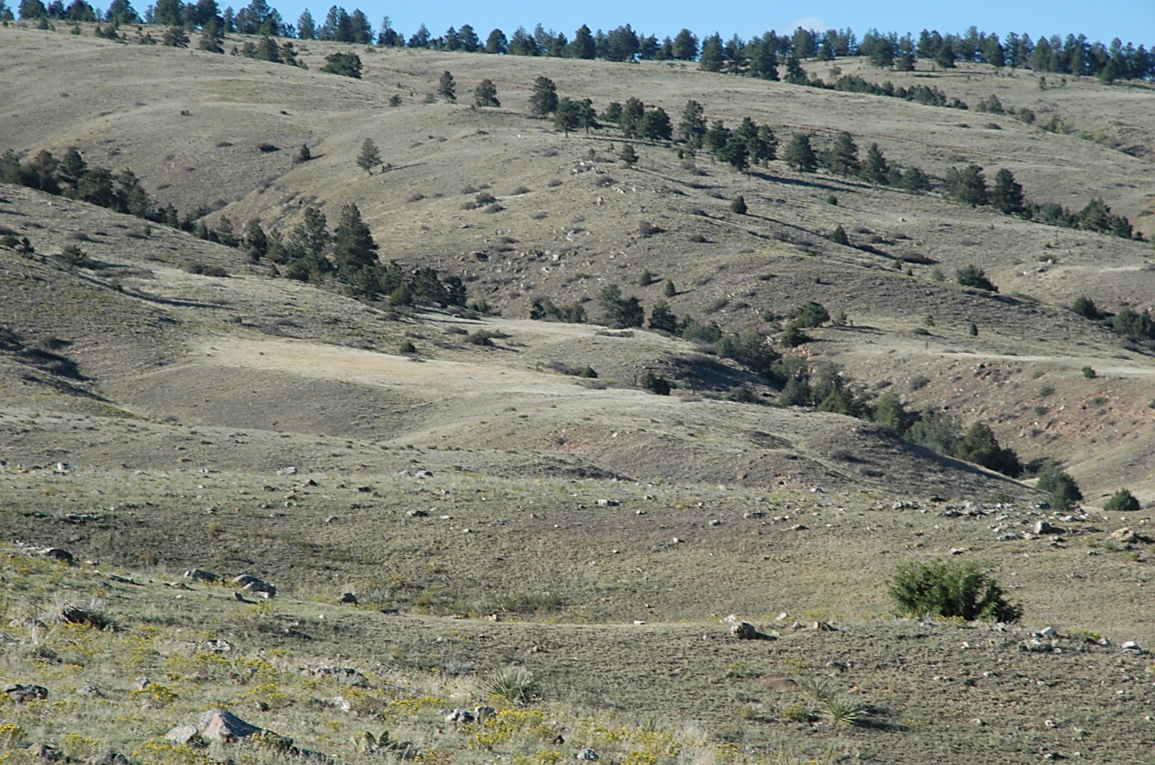
QUESTIONS?

