Slide 1
39 GHz Reconfiguration Procedures Webinar
April 4, 2019

Slide 2
Webinar Objectives
Encourage interested parties to provide informed comment in response to the Initial 39 GHz Reconfiguration Procedures Public Notice, DA 19-196, released March 20, 2019 (PN)
Illustrate key concepts with examples as we talk through the process
Caveat: This presentation is not a substitute for the content of the PN or its Appendices

Slide 3
Topics for Comment
The PN highlighted select topics for comment, which we will focus on in more detail
    The methodology for setting relative weights for holdings by market (PEA)
    Rounding reconfigured holdings
    Boundaries of modified licenses for partial PEAs
    The incentive payment for commonly controlled licensees
Keep in mind that the PN welcomes comment generally, including about the contents of the Appendices

Slide 4
Submitting Comments in Response
  Comments are due April 15
  Reply comments are due April 26
    The Public Notice details how to submit comments, PN paras. 88-91
  Please note that auction procedures will be addressed separately
  The Commission has an Auction Comment Public Notice on its tentative April Meeting Agenda:
  www.fcc.gov/news-events/events/2019/04/april-2019-open-commission-meeting

Slide 5
Ex Parte Information
With a limited exception, attending and/or participating in this webinar to learn about 39 GHz reconfiguration procedures set out in the PN should not require a filing under the Commission’s rules governing ex parte communications. See 47 CFR 1.1200 et seq.
Presentations to Commission personnel directed to the merits or the outcome of the matters raised in the PN or other pending proceedings will require the filing of an ex parte notice

Slide 6
Why Reconfigure 39 GHz Licenses?
Make all 39 GHz licenses more useful for 5G and other advanced services
Provide each incumbent with options for transitioning its existing licenses to these new licenses

Slide 7
Incumbent Initial Commitment Options
The reconfiguration process will give each incumbent 3 options for transitioning existing 39 GHz licenses to new licenses:
Accept modified licenses based on the Commission’s proposed reconfiguration
Accept modified licenses based on the incumbent’s acceptable alternative reconfiguration
Relinquish existing licenses in exchange for incentive payment and option to bid on new licenses in Auction 103
1
2
3

Slide 8
Path to Reconfiguration
Initial 39 GHz Procedures Public Notice
(Released March 20)
Second Public Notice
Updated Data and Procedures
Third Public Notice
FCC Proposed Reconfigurations
Incumbents review data
Updates required by April 15
FCC Form 175-A
Enables incumbent to access the Initial Commitment System
Comments due by April 15
Reply comments due by April 26

Slide 9
Reconfiguration Procedures
The PN describes the Commission’s steps for reconfiguring existing licenses to create modified licenses:
Calculate holdings based on existing 39 GHz licenses
Aggregate holdings within each PEA
Make holdings comparable across PEAs by using relative weights for PEAs
Reconfigure weighted holdings
Determine boundaries for any modified license for holdings equivalent to less than a full PEA

Slide 10
Appendices to the PN
Detailed reconfiguration procedures are in Appendix A
Initial results of each incumbent’s aggregated holdings are in Appendix B

Slide 11
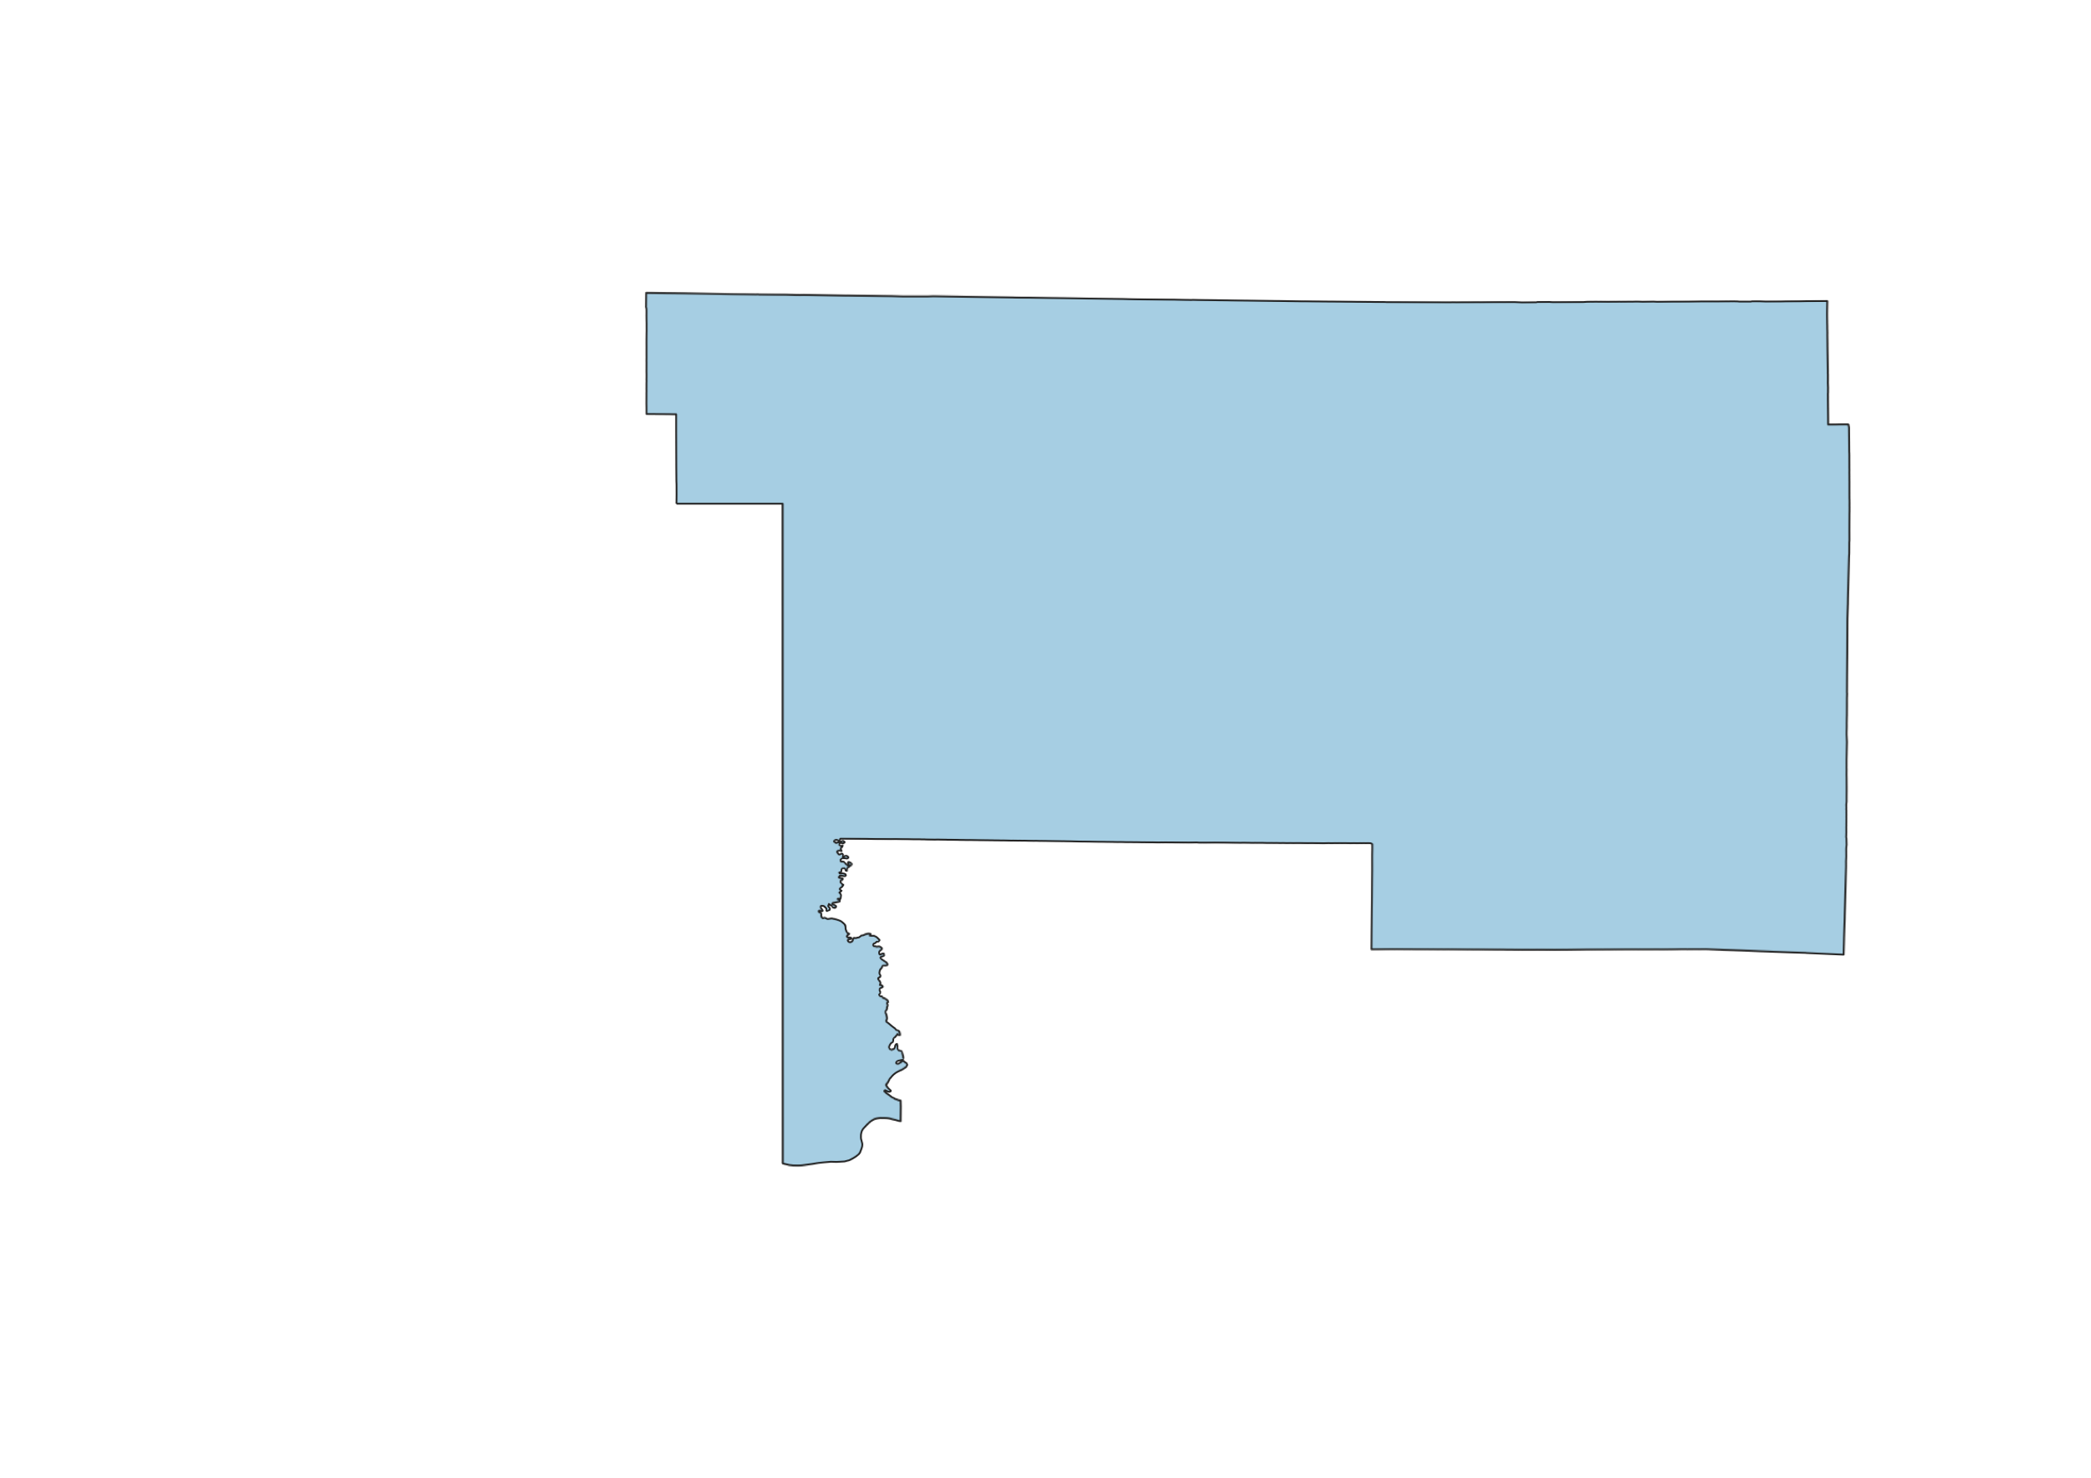
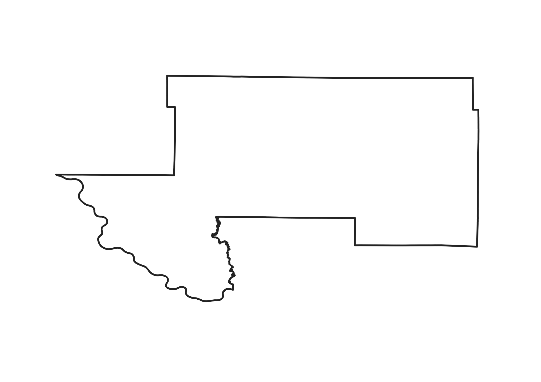
Calculate Existing Holdings
First we identify the area in each PEA where an incumbent has holdings using the license data from ULS
License holdings are quantified by the population covered multiplied by the bandwidth of the existing license (50 MHz) to establish the MHz-population (MHz-pops) of the license

Slide 12
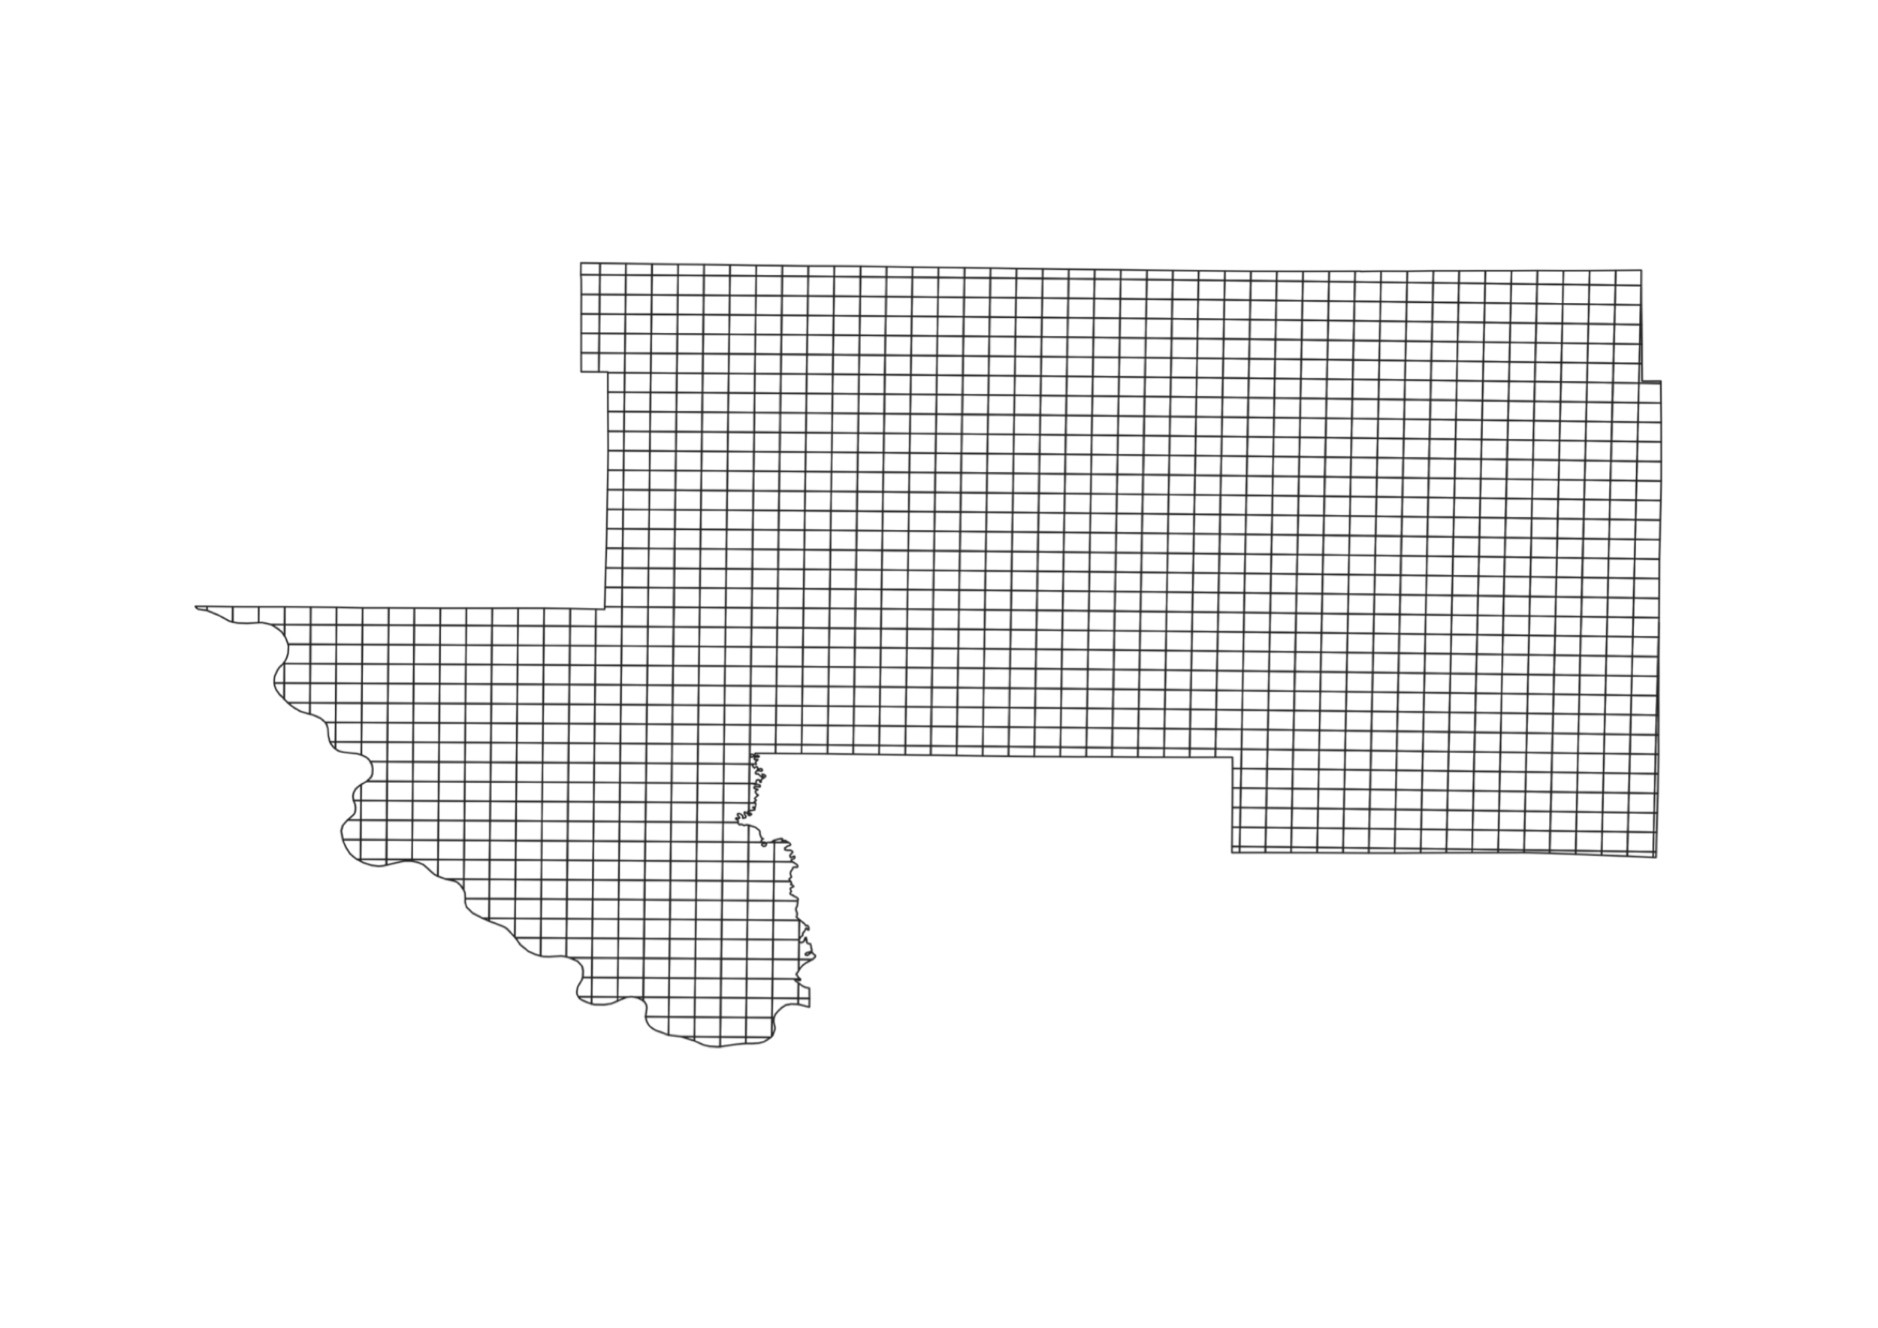

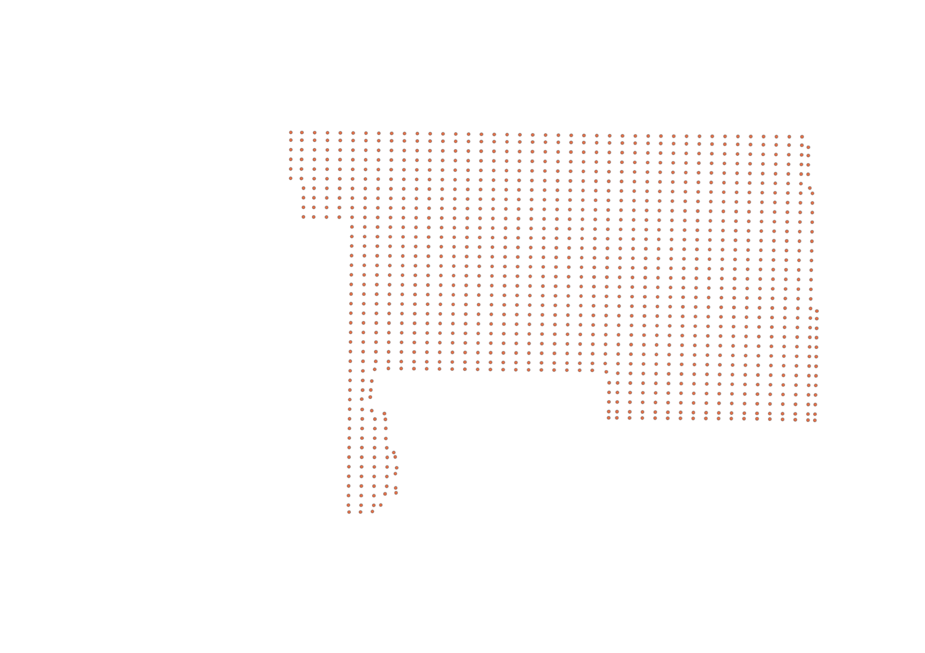
Calculate Existing Holdings
To determine the population covered by the license, we use a
2 km x 2 km grid as described in Appendix A of the PN
This PEA has a total population of 24,500 but the license covers only 19,600. Calculated holdings for this license:
19,600 x 50 = 980,000 MHz-pops

Slide 13
Aggregate Existing Holdings
If an incumbent holds multiple licenses in a PEA, the existing holdings for each license are calculated and summed to determine the aggregate holdings for the PEA

Slide 14
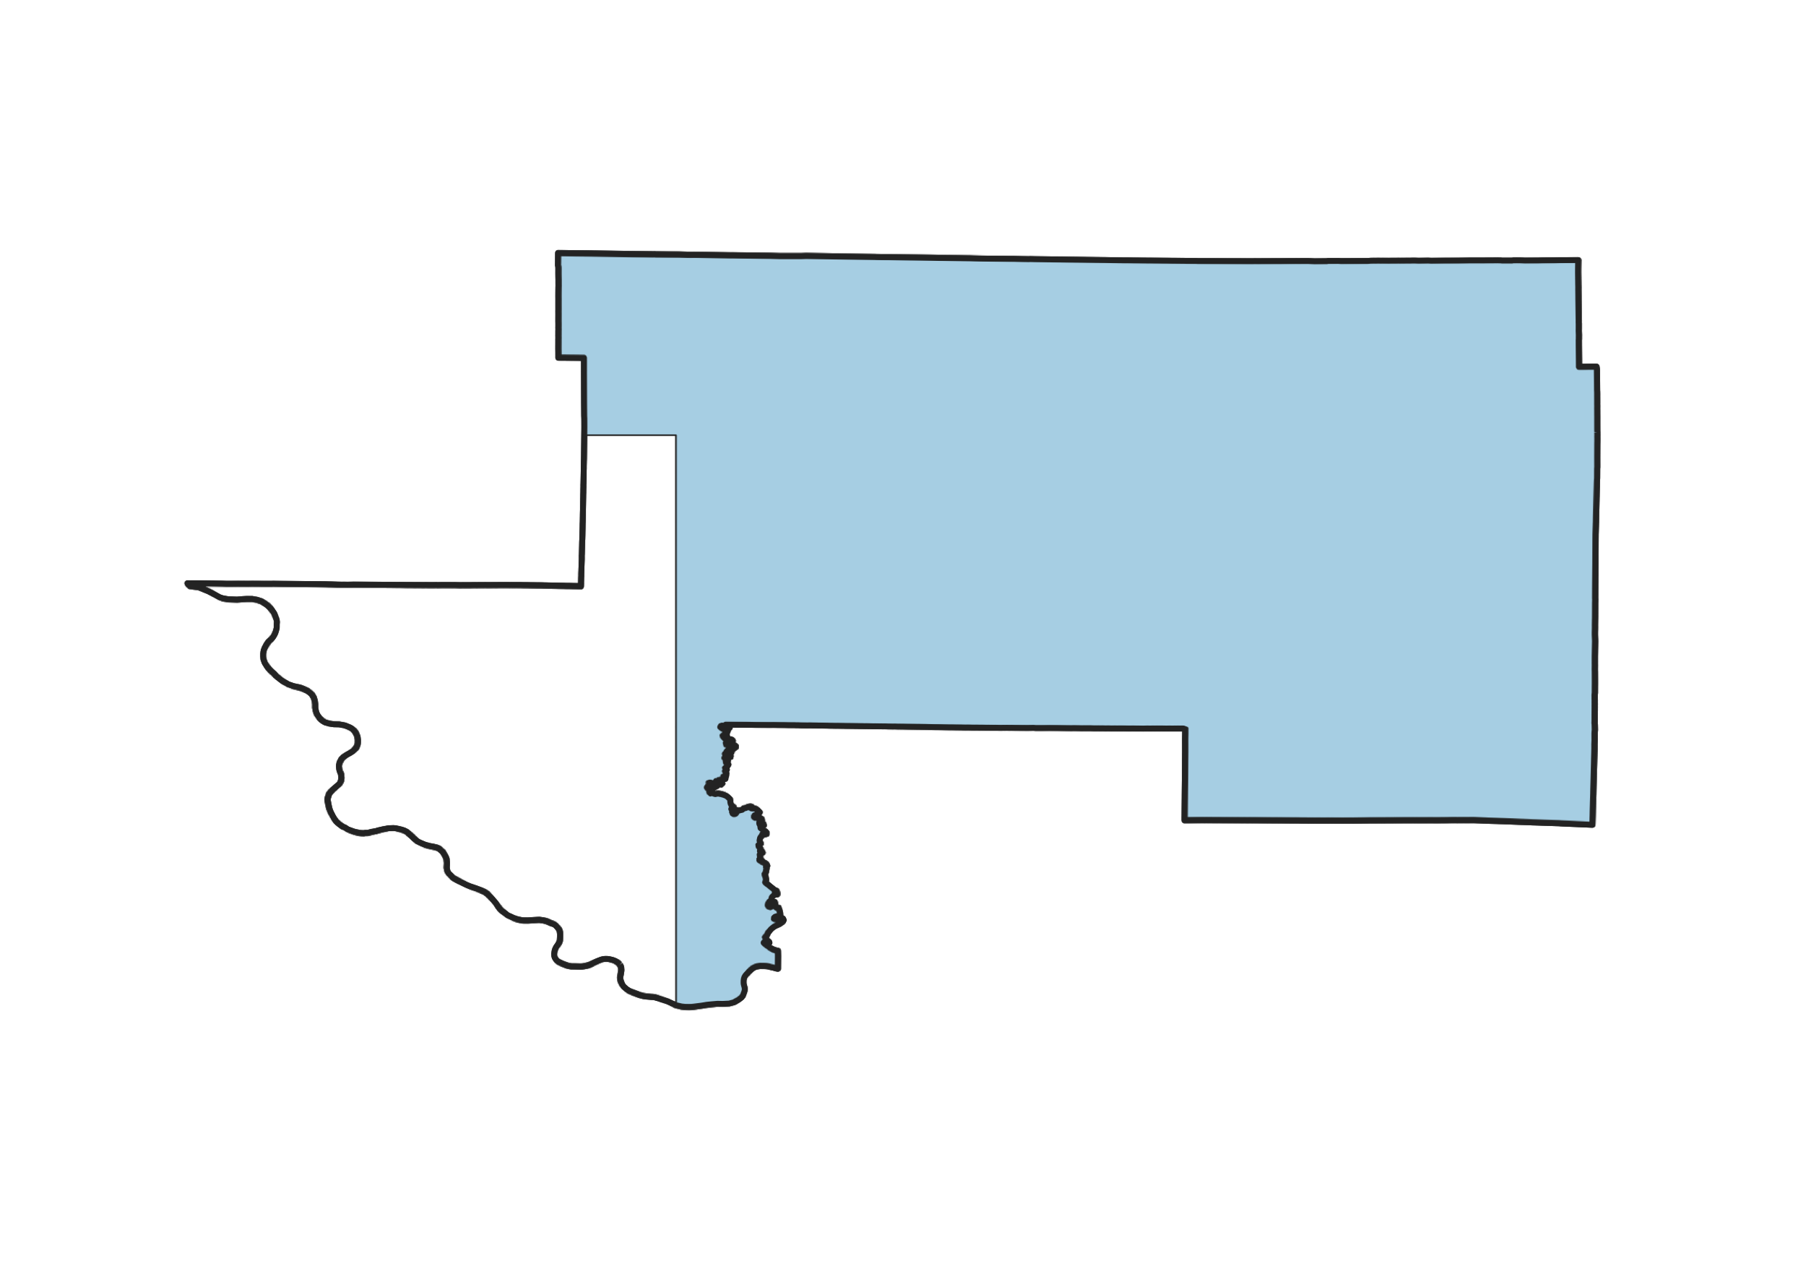
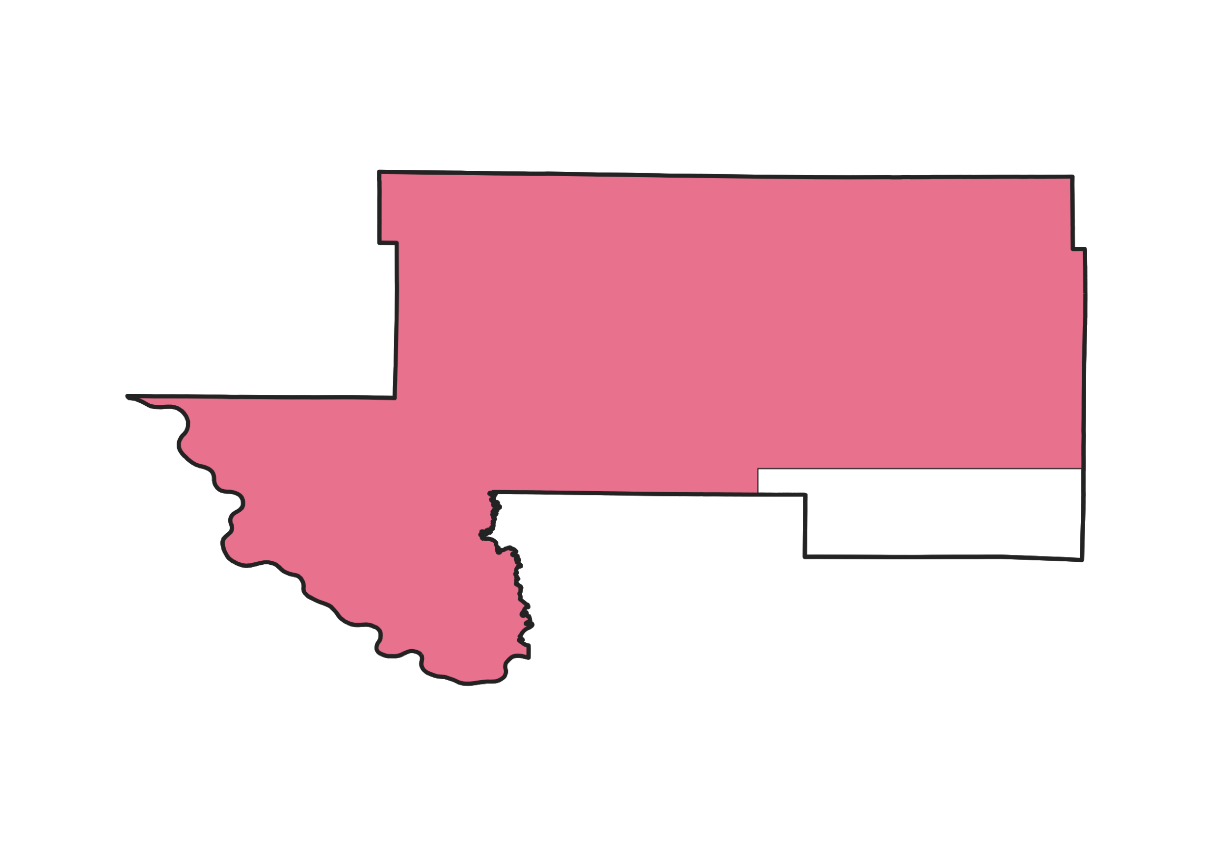
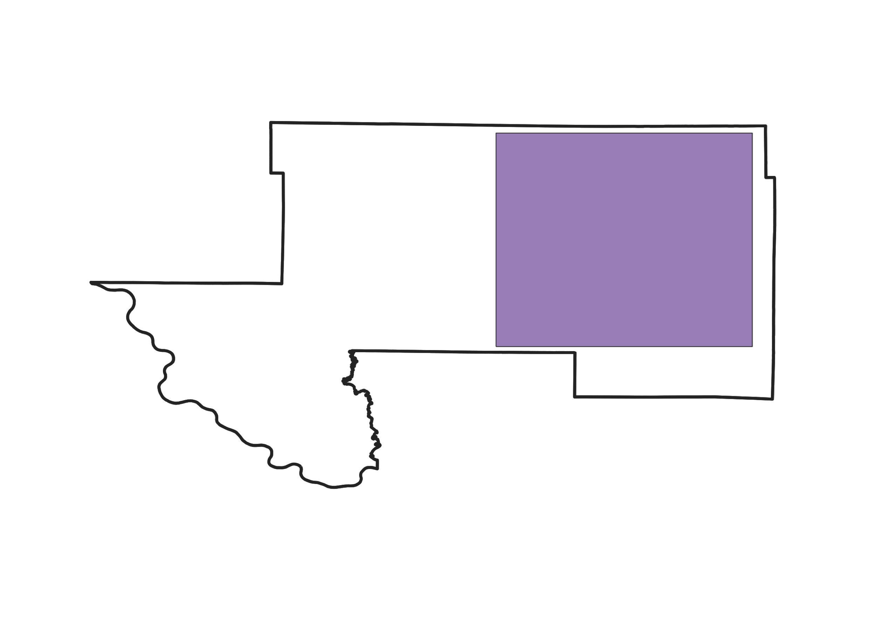
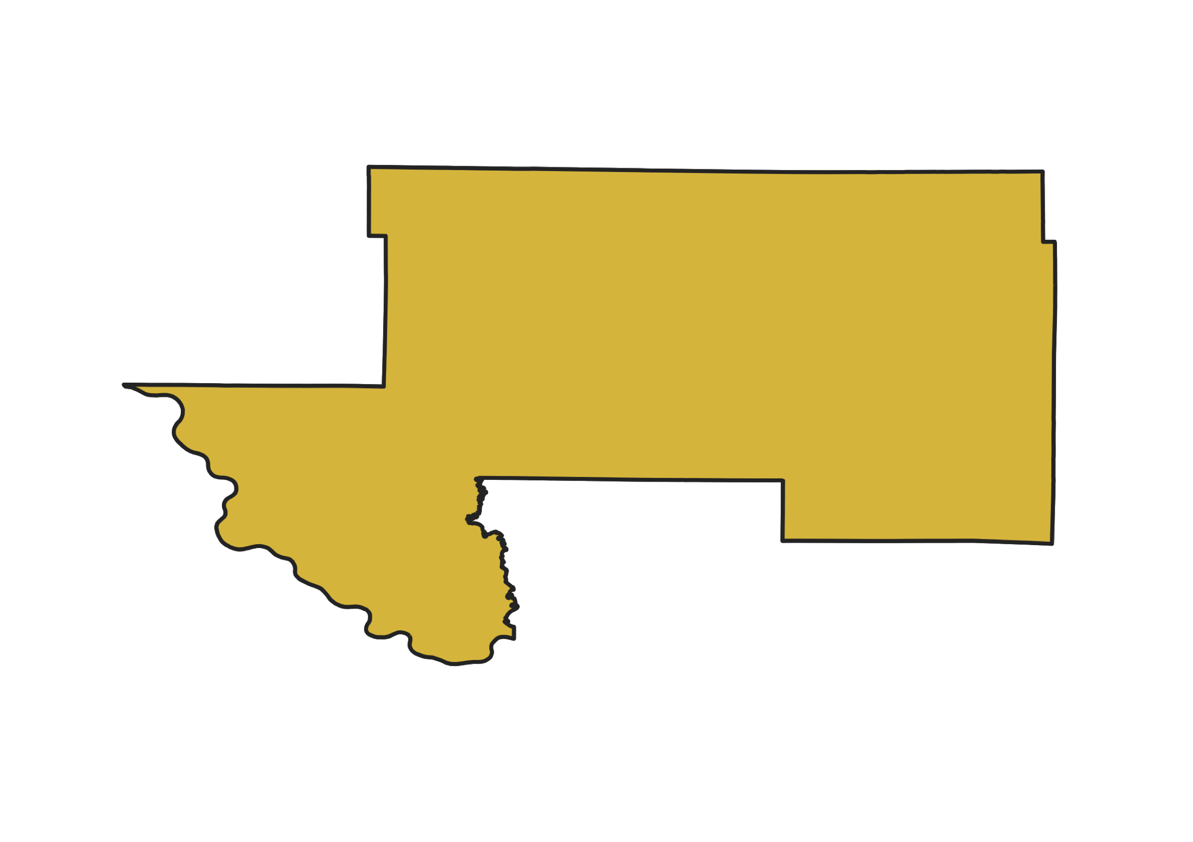
Aggregate Existing Holdings
License |  | Population | x 50 MHz | MHz-pops for each license
1 |  | 19,600 | x 50 | 980,000
2 |  | 22,050 | x 50 | 1,102,500
3 |  | 12,250 | x 50 | 612,500
4 |  | 24,500 | x 50 | 1,225,000
 |  | Total PEA Holdings |  | 3,920,000

Slide 15
Equivalent Auction 103 Licenses
New 100 MHz licenses will cover the entire population in a PEA
For this example, the new license will be 24,500 x 100 = 2,450,000 MHz-pops
The incumbent’s aggregate holdings = 3,920,000 MHz-pops
Equivalent to 1 whole block (2,450,000 MHz-pops) and
a 0.6 partial block (1,470,000 MHz-pops)

Slide 16
Calculate Weighted MHz-pops
PEA | Aggregate holdings in MHz-pops | Block Equivalent | Rounded holdings in MHz-pops | PEA weight | Aggregate holdings in weighted MHz-pops
PEA001 | 3,920,000 | 1.6 | 3,920,000 | 1.1 | 4,312,000
PEA002 | 1,540,000 | 0.7 | 1,540,000 | 1.7 | 2,618,000
PEA003 | 3,200,000 | 2 | 3,200,000 | 2.01 | 6,432,000
PEA004 | 1,793,700 | 1.993 | 1,800,000 | 1.22 | 2,196,000
PEA005 | 2,420,000 | 3.025 | 2,420,000 | 0.8 | 1,936,000
PEA006 | 1,020,000 | 1.7 | 1,020,000 | 1.4 | 1,428,000
Partial holdings greater than or equal to 99% will be rounded to a whole block

Slide 17
Reconfiguration Guidelines
Combines any holdings for less than a full PEA license such that incumbent has whole licenses and at most one partial PEA
Keeps constant total weighted MHz-pops over all PEAs
Remaining partial is in one of the partial PEAs
Holdings for full PEAs are not affected

Slide 18
When Multiple Reconfigurations are Possible
The Commission’s proposed reconfiguration selects the PEA so that the partial holding leaves the least white space
So long as consistent with the reconfiguration guidelines, an incumbent may propose an alternative reconfiguration with a different amount of white space
  Allows incumbents to adjust partial holdings to reflect individual needs

Slide 19
Commission’s Proposed Reconfiguration
PEAs chosen to minimize white space in partial block
Whitespace
3,740,000-3,359,000=
381,000 Weighted MHz-pops
PEA | Weighted MHz-pops In PEA | Block Equivalent | Up/Down/Partial | New Holdings
PEA001 | 2,695,000 | 1.6 | ↓ 1 | 2,695,000
PEA002 | 3,740,000 | 0.7 | PARTIAL 0.8981 | 3,359,000
PEA003 | 3,216,000 | 2 | N/A | 6,432,000
PEA004 | 1,098,000 | 2 | N/A | 2,196,000
PEA005 | 640,000 | 3.025 | ↑ 4 | 2,560,000
PEA006 | 840,000 | 1.7 | ↑ 2 | 1,680,000 | Unallocated Holdings
TOTAL Weighted MHz-pops holdings |  | 18,922,000 |  | 18,922,000 | 0
PEA | Weighted MHz-pops In PEA | Block Equivalent | Up/Down/Partial | New Holdings
PEA001 | 2,695,000 | 1.6 | ↓ 1 | 2,695,000
PEA002 | 3,740,000 | 0.7 | ↑ 1 | 3,740,000
PEA003 | 3,216,000 | 2 | N/A | 6,432,000
PEA004 | 1,098,000 | 2 | N/A | 2,196,000
PEA005 | 640,000 | 3.025 | ↑ 4 | 2,560,000
PEA006 | 840,000 | 1.7 | ↓ 1 | 840,000 | Unallocated Holdings
TOTAL Weighted MHz-pops holdings |  | 18,922,000 |  | 18,463,000 | 459,000
PEA | Weighted MHz-pops In PEA | Block Equivalent | Up/Down/Partial | New Holdings
PEA001 | 2,695,000 | 1.6 | ↑ 2 | 5,390,000
PEA002 | 3,740,000 | 0.7 | ↑ 1 | 3,740,000
PEA003 | 3,216,000 | 2 | N/A | 6,432,000
PEA004 | 1,098,000 | 2 | N/A | 2,196,000
PEA005 | 640,000 | 3.025 | ↑ 4 | 2,560,000
PEA006 | 840,000 | 1.7 | ↑ 2 | 1,680,000 | Unallocated Holdings
TOTAL Weighted MHz-pops holdings |  | 18,922,000 |  | 21,998,000 | (3,076,000)
Only PEAs where holdings are less than a whole new license can be reconfigured

Slide 20
Incumbent 39 GHz Licensee Short-Form Application (FCC Form 175-A)
The FCC Form 175-A enables access to the Commission’s Initial Commitment System
  Accessing the Initial Commitment System allows incumbents to select from the 3 options available for how to transition their existing licenses
Required for:
Submitting an acceptable alternative reconfiguration
Receiving an incentive payment
Default selection is to accept FCC reconfiguration
Form 175-A does NOT require bidding in Auction 103
Bidders must file a separate Form 175 to bid on new licenses

Slide 21
Select Topics for Comment
As already noted, the PN highlights specific topics for comment
  Methodology for setting relative weights for holdings
  Rounding up holdings after reconfiguration
  The boundaries of any licenses for part of a PEA
  The incentive payment for commonly controlled licensees

Slide 22
Relative Weights
Relative weights are applied to all holdings so that the holdings are comparable across PEAs
  Applies to both modified licenses and incentive payments

Slide 23
Proposed Methodology for Setting Weights
The PN proposes to use a weighted average of price indices, using bids from ongoing Auction 102 (24 GHz) and prices from Auction 1002 (600 MHz) and Auction 97 (AWS-3)
  Similar to index for bidding units in previous auctions
  Detailed in PN paras. 26-33
The PN also seeks comment on an alternative that would enable use of data from Auction 101 (28 GHz)
  The estimation for areas unavailable in Auction 101 is described in the PN and Appendix C

Slide 24
Rounding Up Holdings After Reconfiguration
The PN proposes that for post-reconfiguration holdings where 10% or less of a PEA’s population would remain as white space, the holdings will be rounded up to a whole block (PN, para. 42)
  This would increase the 5% threshold
  Protects against stranding hard-to-use white space
  Changes holdings only with respect to modified licenses – not for purposes of an incentive payment

Slide 25
Boundaries for Licenses for Part of a PEA
An incumbent accepting modified licenses may have at most one modified license for only part of a PEA
The PN proposes a method to expand or contract an incumbent’s existing licensed area in a PEA to comply with the reconfiguration chosen
  Applies to modified licenses whether the reconfiguration was proposed by the Commission or by an incumbent

Slide 26
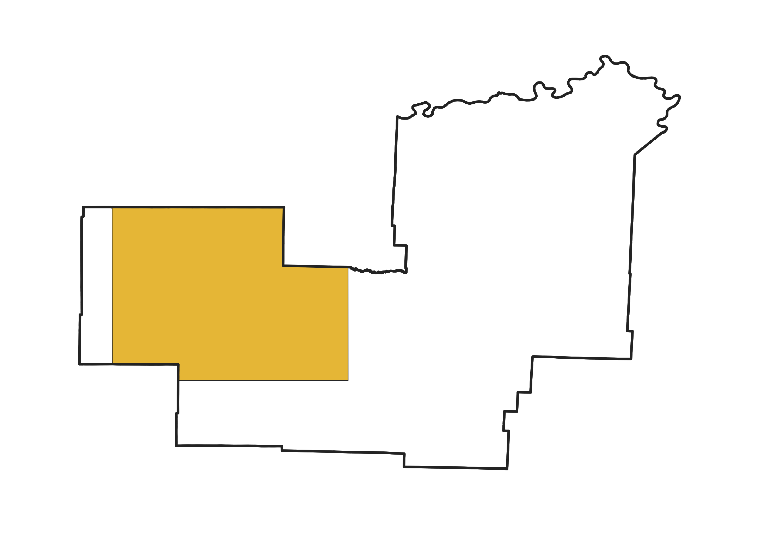
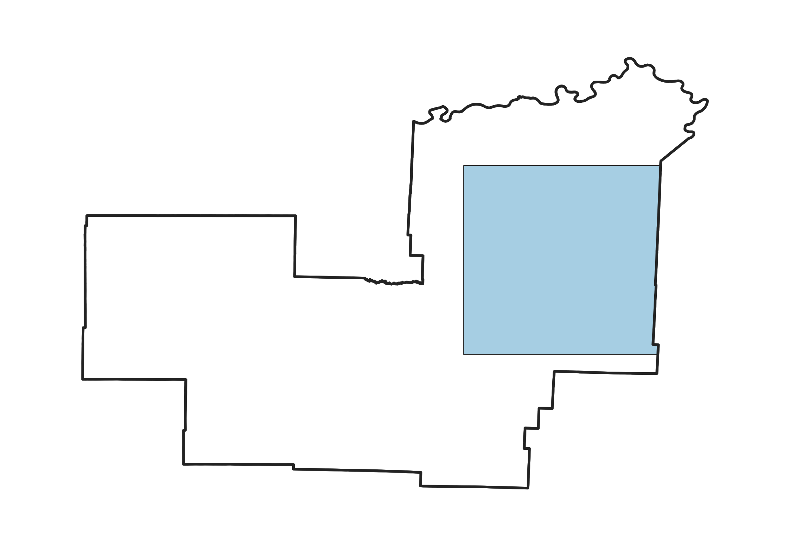
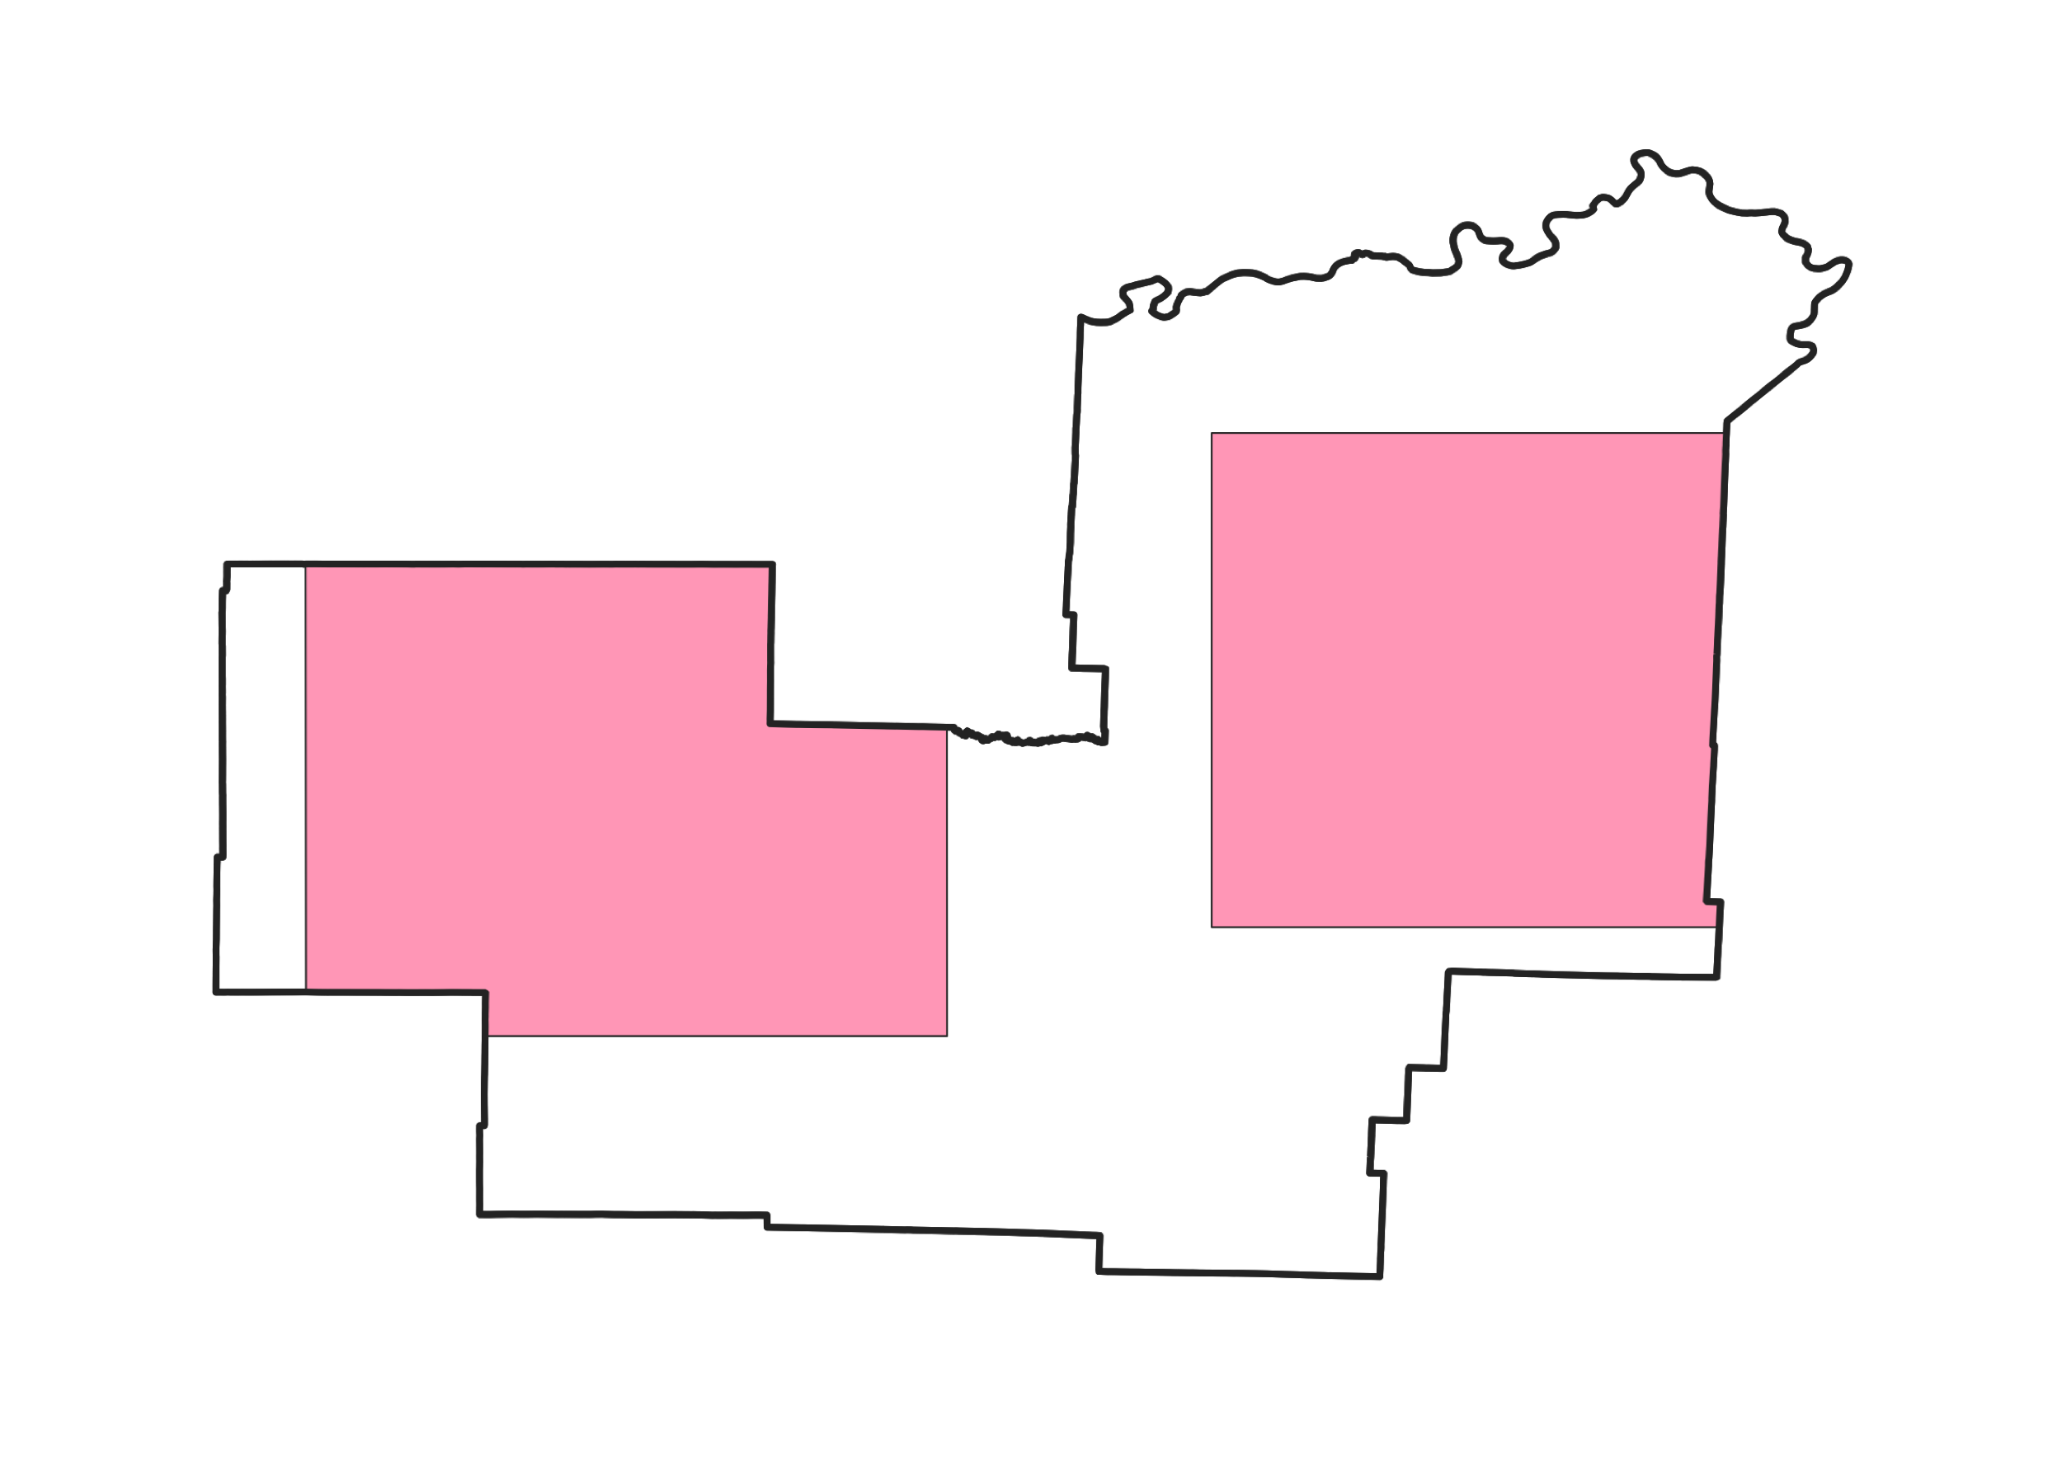
Determining the Geographic Area for Retained Partial License
If an incumbent retains a partial license, the new area of the license will be determined based on the composite of all the incumbent’s licensed areas for that PEA
Base geography for new partial license

Slide 27
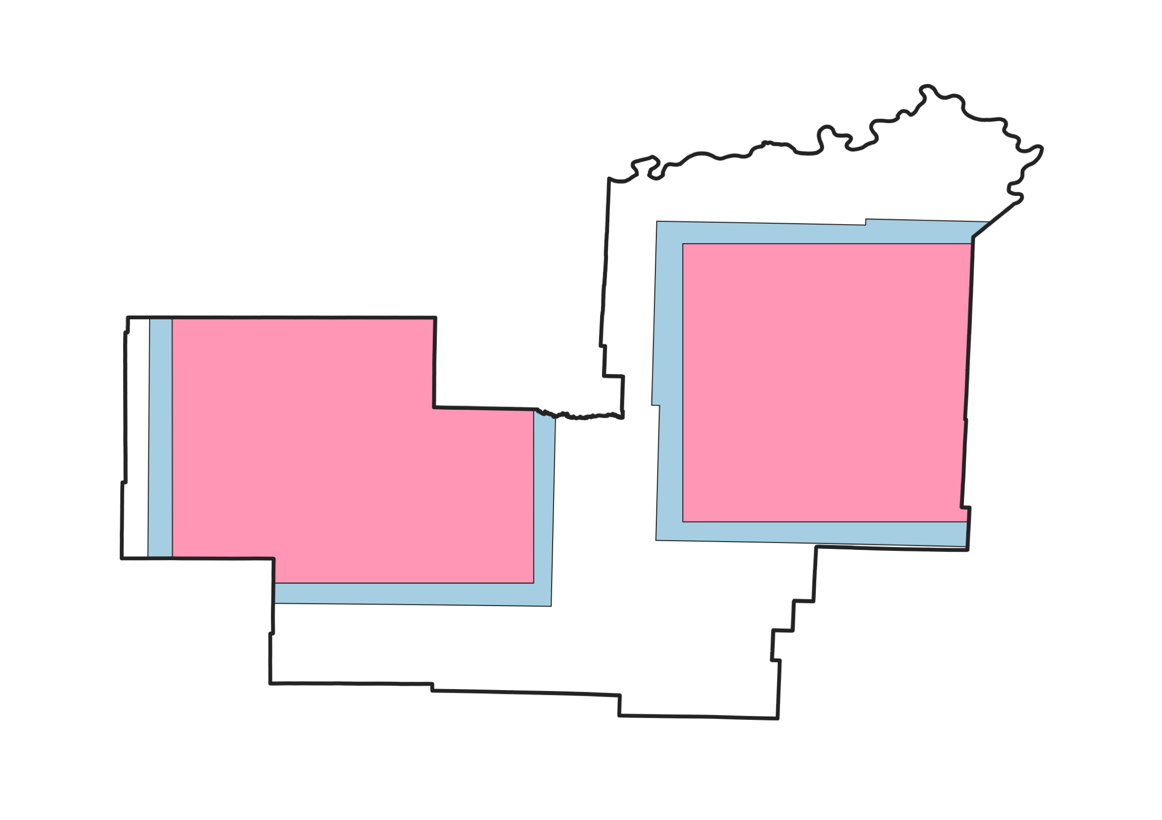
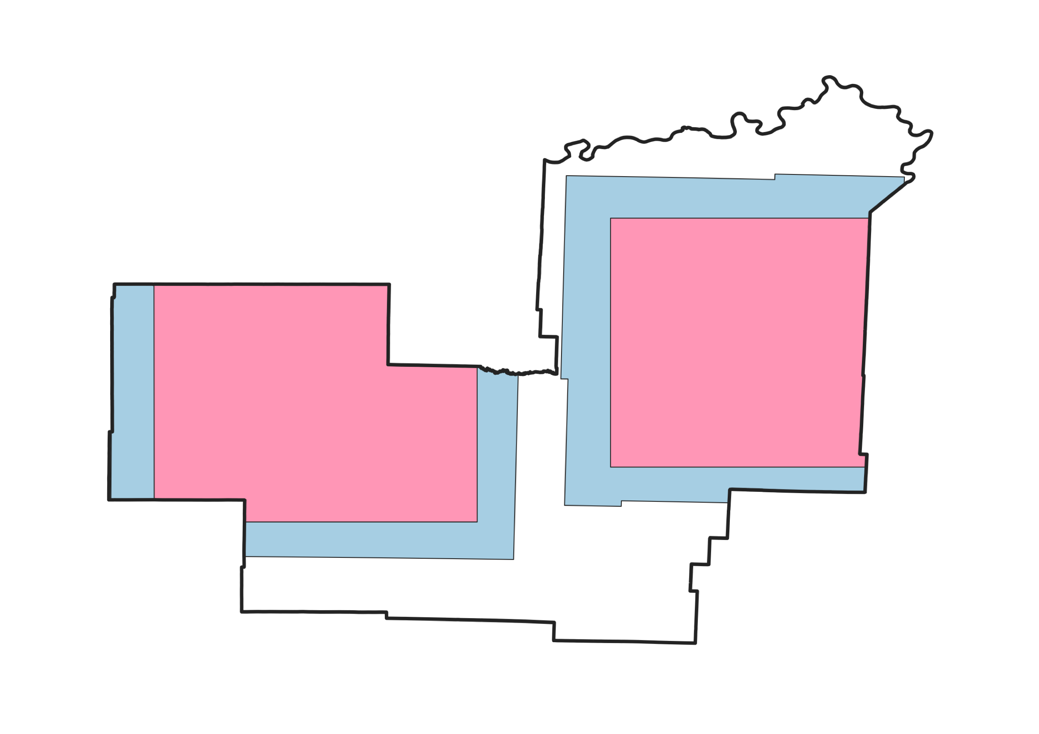
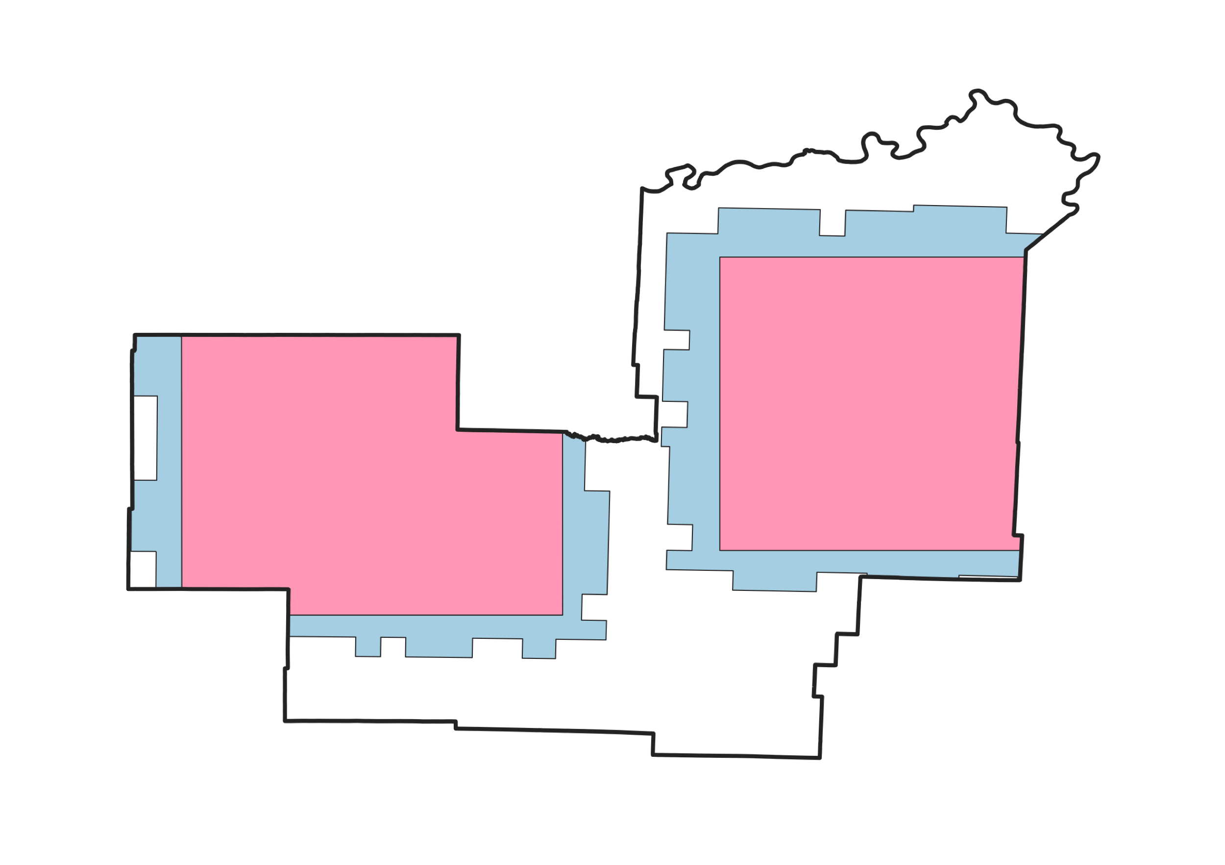
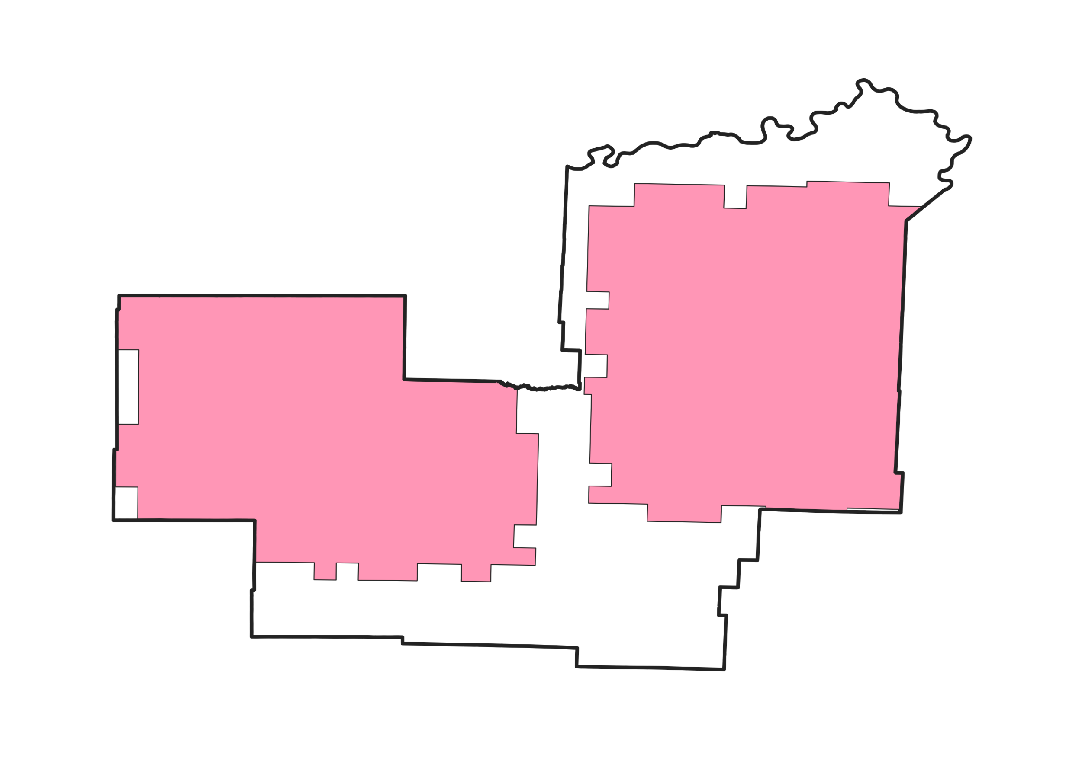
Determining the Geographic Area for Retained Partial License
If the composite holdings are less than the new partial holdings, area will be added to the border until the new area is at least equal to the new partial holdings
If the composite holdings are greater, area will be subtracted from the border
Holdings in current area
New Partial Holdings
80,000
130,100
140,000
120,000
130,000

Slide 28
The Incentive Payment for Commonly Controlled Licensees
Proposes that the incumbent’s single incentive payment must be made to an existing licensee (PN, para. 72)
  Seeks comment on alternative of permitting payment to another commonly controlled entity, even if not a licensee
  Applies to incumbents with multiple commonly controlled licensees and consolidated holdings

Slide 29
Dates to Keep in Mind
By April 15, incumbents should review holdings announced in Appendix B and corresponding data in ULS
  Update or correct related ULS information (such as contact information), if necessary
  May file transaction applications that are excepted from the freeze (PN, para. 13)
By April 15, any interested party should file comments
By April 26, any interested party should file reply comments

Slide 30
Questions?
Questions are welcome at
39GHzReconfiguration@fcc.gov

