Slide 1
FAA-AST Payload Review Process

Slide 2
FAA Office of Commercial Space Transportation (AST)​
Mission: Enable safe space transportation
Vision: To be an agile world leader working to ensure safety while addressing the needs of industry
Authority: U.S. Code: Title 51 – National & Commercial Space Programs
Within the U.S. or by U.S. citizens worldwide, AST:
  Authorizes launch and reentry operations
  Authorizes the operation of launch and reentry sites
  Issues safety element approvals
  Issues independent payload approvals
Note: The FAA authorizes operations and issues approvals; the FAA does not certify space vehicles.

Slide 3
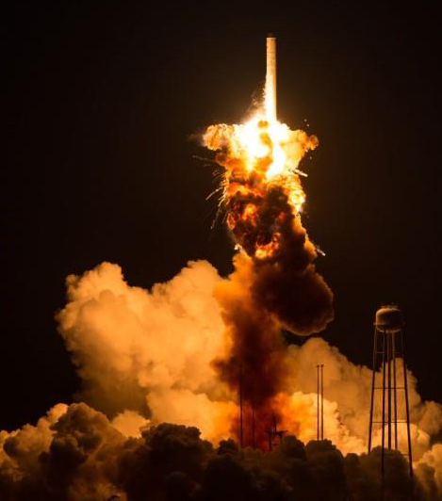
Public Safety – Purpose of Licensing
Commercial Space regulations focus on:
  Public health and safety
  Safety of property
  U.S. national security or foreign policy interests
  International obligations of the United States
AST does not regulate mission assurance beyond public safety measures
Risk-based analysis
  Intensive, highly technical evaluation, proportionate with risk
  Program-specific, with consideration from early planning
!
  IMPORTANT: A single incident involving public safety can affect the entire industry

Slide 4
Licenses, Permits, and Approvals - Regulations
CFR Title 14: Aeronautics and Space; Volume 4; Chapter III;
Parts 400-1199: Commercial Space Transportation
Licenses
  Part 420 – License to Operate a Launch Site (Spaceport)
  Part 433 – License to Operate a Reentry Site (Spaceport)
  Part 450 – Launch and Reentry Licensing Requirements (Vehicles)
Permits
  Part 437 – Experimental Permits
Approvals
  Part 414 – Safety Element Approvals
  § 450.43 – Payload Approvals
Visit ecfr.gov to view all regulations

Slide 5
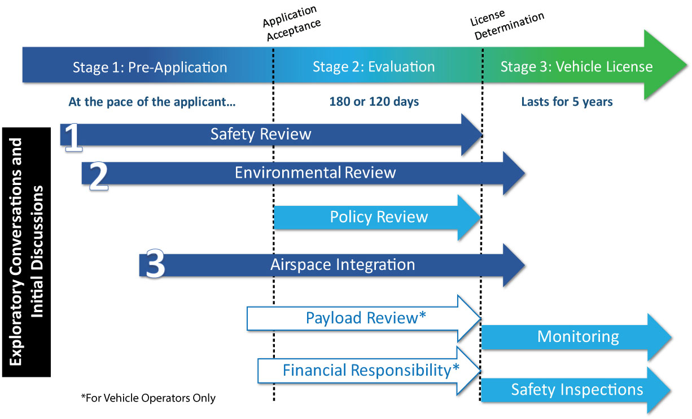
FAA License Application Evaluation Process
Interagency Consultation

Slide 6
Interagency Review Process
FAA reviews the launch and payloads with respect to public safety.
FAA consults with interagency partners for their assistance on identifying the following:
  issues of public health and safety,
  safety of property,
  U.S. national security or foreign policy interests, or
  international obligations of the United States, associated with the launch or reentry of a proposed payload or payload class.
FAA relies on each agency’s expertise on identifying when a proposed launch and/or payload could present issues respective to their agency’s responsibility.

Slide 7
What is a payload?
51 U.S.C. § 50902 (13): "payload" means an object that a person undertakes to place in outer space by means of a launch vehicle or reentry vehicle, including components of the vehicle specifically designed or adapted for that object.
14 CFR § § 401.5, 401.7: payload means an object that a person undertakes to place in outer space by means of a launch vehicle, including components of the vehicle specifically designed or adapted for that object.

Slide 8
Statutory Authority (51 U.S.C. § 50904)
(b) Compliance With Payload Requirements.—The holder of a license or permit under this chapter may launch or reenter a payload only if the payload complies with all requirements of the laws of the United States related to launching or reentering a payload.
(c) Preventing Launches and Reentries.—The Secretary of Transportation shall establish whether all required licenses, authorizations, and permits required for a payload have been obtained. If no license, authorization, or permit is required, the Secretary may prevent the launch or reentry if the Secretary decides the launch or reentry would jeopardize the public health and safety, safety of property, or national security or foreign policy interest of the United States.

Slide 9
Payload Review and Determination (14 CFR § 450.43)
(a) General. If applicable, the FAA issues a favorable payload determination for a launch or reentry to a license applicant or payload owner or operator if—
  (1) The applicant, payload owner, or payload operator has obtained all required licenses, authorizations, and permits; and
  (2) Its launch or reentry would not jeopardize public health and safety, safety of property, U.S. national security or foreign policy interests, or international obligations of the United States.
(b) Relationship to other executive agencies. The FAA does not make a determination under paragraph (a)(2) of this section for—
  (1) Those aspects of payloads that are subject to regulation by the Federal Communications Commission or the Department of Commerce; or
  (2) Payloads owned or operated by the U.S. Government.

Slide 10
Payload Review and Determination (14 CFR § 450.43)
(c) Classes of payloads. The FAA may review and issue findings regarding a proposed class of payload, including communications, remote sensing, or navigation. However, prior to a launch or reentry, each payload is subject to verification by the FAA that its launch or reentry would not jeopardize public health and safety, safety of property, U.S. national security or foreign policy interests, or international obligations of the United States.
(d) Payload owner or payload operator may apply. In addition to a launch or reentry operator, a payload owner or payload operator may request a payload review and determination.
(e) Interagency consultation. The FAA consults with other agencies as follows:
  (1) The Department of Defense to determine whether launch or reentry of a proposed payload or payload class would present any issues affecting U.S. national security;
  (2) The Department of State to determine whether launch or reentry of a proposed payload or payload class would present any issues affecting U.S. foreign policy interests or international obligations; or
  (3) Other Federal agencies, including the National Aeronautics and Space Administration, authorized to address issues of public health and safety, safety of property, U.S. national security or foreign policy interests, or international obligations of the United States, associated with the launch or reentry of a proposed payload or payload class.

Slide 11
Payload Review and Determination (14 CFR § 450.43)
(f) Issues during payload review. The FAA will advise a person requesting a payload determination, in writing, of any issue raised during a payload review that would impede issuance of a license to launch or reenter that payload or payload class. The person requesting payload review may respond, in writing, or amend its application as required by § 413.17 of this chapter.
(g) Denial of a payload determination. The FAA notifies an applicant, in writing, if it has denied a favorable payload determination. The notice states the reasons for the FAA's determination. The applicant may seek further review of the determination in accordance with § 413.21 of this chapter.
(h) Incorporation of payload determination in license application. A favorable payload determination issued for a payload or class of payload may be included by a license applicant as part of its application. However, any change in information provided under paragraph (i) of this section must be reported in accordance with § 413.17 of this chapter. The FAA determines whether a favorable payload determination remains valid in light of reported changes and may conduct an additional payload review.

Slide 12
Payload Review and Determination (14 CFR § 450.43)
(i) Application requirements. A person requesting review of a particular payload or payload class must identify the following:
  (1) For launch of a payload:
    (i) Payload name or class of payload, and function;
    (ii) Description, including physical dimensions, weight, composition, and any hosted payloads;
    (iii) Payload owner and payload operator, if different from the person requesting payload review and determination;
    (iv) Any foreign ownership of the payload or payload operator, as specified in § 450.41(e)(3);
    (v) Hazardous materials as defined in § 401.7 of this chapter, radioactive materials, and the amounts of each;
    (vi) Explosive potential of payload materials, alone and in combination with other materials found on the payload;
    (vii) For orbital launches, parameters for parking, transfer and final orbits, and approximate transit times to final orbit;
    (viii) Delivery point in flight at which the payload will no longer be under the licensee's control;
    (ix) Intended operations during the lifetime of the payload, including anticipated life span and any planned disposal;
    (x) Any encryption associated with data storage on the payload and transmissions to or from the payload; and
    (xi) Any other information necessary to make a determination based on public health and safety, safety of property, U.S. national security or foreign policy interests, or international obligations of the United States.

Slide 13
Payload Review and Determination (14 CFR § 450.43)
  (2) For reentry of a payload:
    (i) Payload name or class of payload, and function;
    (ii) Physical characteristics, dimensions, and weight of the payload;
    (iii) Payload owner and payload operator, if different from the person requesting the payload review and determination;
    (iv) Type, amount, and container of hazardous materials and radioactive materials in the payload;
    (v) Explosive potential of payload materials, alone and in combination with other materials found on the payload or reentry vehicle during reentry; and
    (vi) Designated reentry site.

Slide 14







Pre-Application - Additional Licenses & Coordination
Examples include:
  Federal Communications Commission (FCC)
    Radio frequency requirements, ground- and space- based
  National Oceanic and Atmospheric Administration (NOAA)
    Earth observation, on-board cameras
  FAA Air Traffic Organization (ATO)
    Operations impacting airways
  U.S. Coast Guard (USCG)
    Operations near or over navigable waterways
  For Operations at or near a Federal Range
    National Aeronautics and Space Administration (NASA)
    U.S. Space Force (USSF)
    U.S. Air Force (USAF)
Operations with international impacts require additional coordination

Slide 15
Licenses, Permits, and Approvals
Licenses
U.S. citizens and entities:
  Vehicle operations inside or outside the United States;
  Site operations inside or outside of the United States;
Foreign citizens and entities:
  Vehicle operations inside the United States;
  Site operations inside the United States;
Experimental Permits
Operations of a reusable suborbital vehicle within the United States for research and development
No compensation or hire allowed
Safety Element Approvals
Optional approvals
May be issued independent of a license
Does not confer any authority to conduct activities for which a license is required
Independent Payload Approvals
Optional approval
Requested by payload owner or operator
Integrated into vehicle operator’s authorization
Government Operations
Licensed commercial operations may be contracted for government payloads
FAA does not license launches or reentries wholly controlled by the U.S. Government

Slide 16
Payload Review Requirements (§ 415.59)
§ 415.59 Information requirements for payload review.
(a) A person requesting review of a particular payload or payload class shall identify the following:
  (1) Payload name;
  (2) Payload class;
  (3) Physical dimensions and weight of the payload;
  (4) Payload owner and operator, if different from the person requesting payload review;
  (5) Orbital parameters for parking, transfer and final orbits;
  (6) Hazardous materials, as defined in § 401.5 of this chapter, and radioactive materials, and the amounts of each;
  (7) Intended payload operations during the life of the payload; and
  (8) Delivery point in flight at which the payload will no longer be under the licensee's control.

