Slide 1

Federal Communications Commission (FCC)
Licensing and Role in
Payload Review Process

Slide 2

U.S. FCC Satellite Licensing and Rules
The U.S. FCC licenses non-governmental satellites that are utilizing radiocommunications. FCC issues three types of licenses for satellite operations— amateur, experimental, and “Part 25” (which are typically commercial).
All three types of licenses require submission of information concerning radiofrequency and orbital technical parameters, an orbital debris mitigation plan, and draft International Telecommunication Union (ITU) filing materials.
As part of its regulatory review the FCC considers whether the "public interest" would be served by a particular license grant.
Licenses often include conditions, including conditions requiring that operations must be consistent with what is described in the submitted information.
The FCC rules also include specific operational requirements.

Slide 3
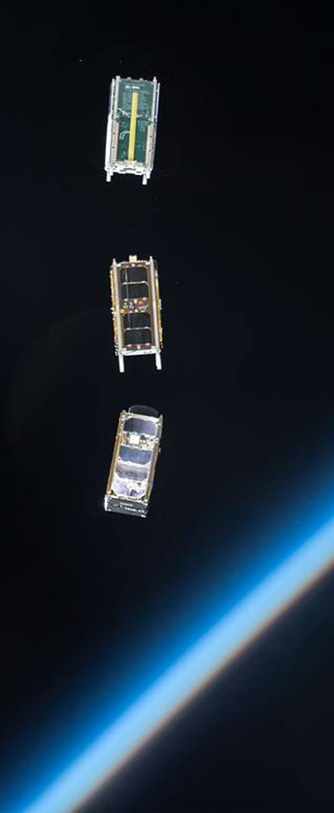


U.S. FCC Satellite Licensing Legal Framework
A license is required for deployment and operation of satellite-based services by a non-federal operator.
Section 301 of the Communications Act of 1934, as amended, prohibits the use or operation of a radio frequency station except in accordance with a Commission-granted authorization.
Section 25.102(a) of the FCC’s rules necessitates FCC approval for the operation of “energy or communications or signals by space or earth stations [satellites or ground stations].” Further, licensees must comply with all conditions placed on their licenses.
Notes:
Commission’s rules necessitate Commission authorization for the operation of “energy or communications signals by space or earth stations [satellites and base stations.” Further, licensees must comply with all conditions placed on their license.

Slide 4




FCC Enforcement Advisory –
Satellite Licensing (2018)
In 2018, the FCC released an Enforcement Advisory alerting the industry
that compliance with satellite licensing requirements is mandatory.
      “Launch service providers should be aware that a satellite integrated into a launch vehicle or deployment device without a current FCC authorization may need to be removed from that vehicle or deployment device if the satellite operator’s application for an FCC authorization is not acted upon favorably, or for various reasons cannot be granted within a time frame consistent with the launch schedule.”
“Launch service providers should exercise particular caution if a satellite operator indicates that it is relying on several possible alternative jurisdictions for radio-frequency approval, or is otherwise altering its mission to obviate the need for radio-frequency approval, particularly at late stages of launch preparations.”
Notes:
Checked w/ outline - done

Slide 5

  Space Bureau
  United States Federal Communications Commission
  satinfo@fcc.gov

