Slide 2
Notes:
VISION: To power ideas that feed the world!
Our vision is to power ideas that feed the world, with the aspiration of using innovative, community-driven approaches to not only solve local food needs but to contribute to global food security. This broader vision reflects our commitment to harnessing creativity and technology in ways that can be replicated worldwide, ensuring a future where food systems are equitable, sustainable, and abundant for all.
MISSION: Solving for local food security using scalable technologies that drive equitable workforce and economic opportunities. ​
​
FARMS mission is to address local food security through scalable technologies that empower communities by fostering equitable workforce development and creating sustainable economic opportunities. This mission is grounded in the belief that technology, when accessible and inclusive, can drive impactful solutions to regional food challenges, ultimately building stronger, more resilient local economies.

Slide 3
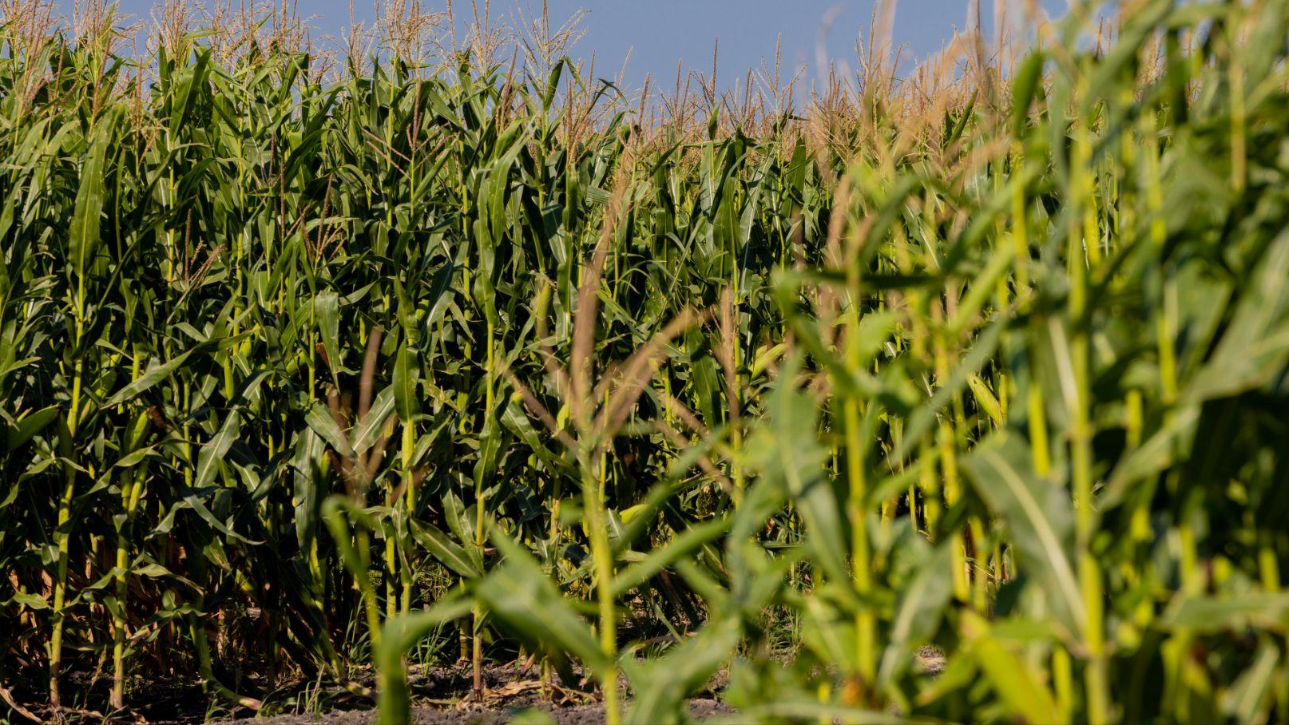
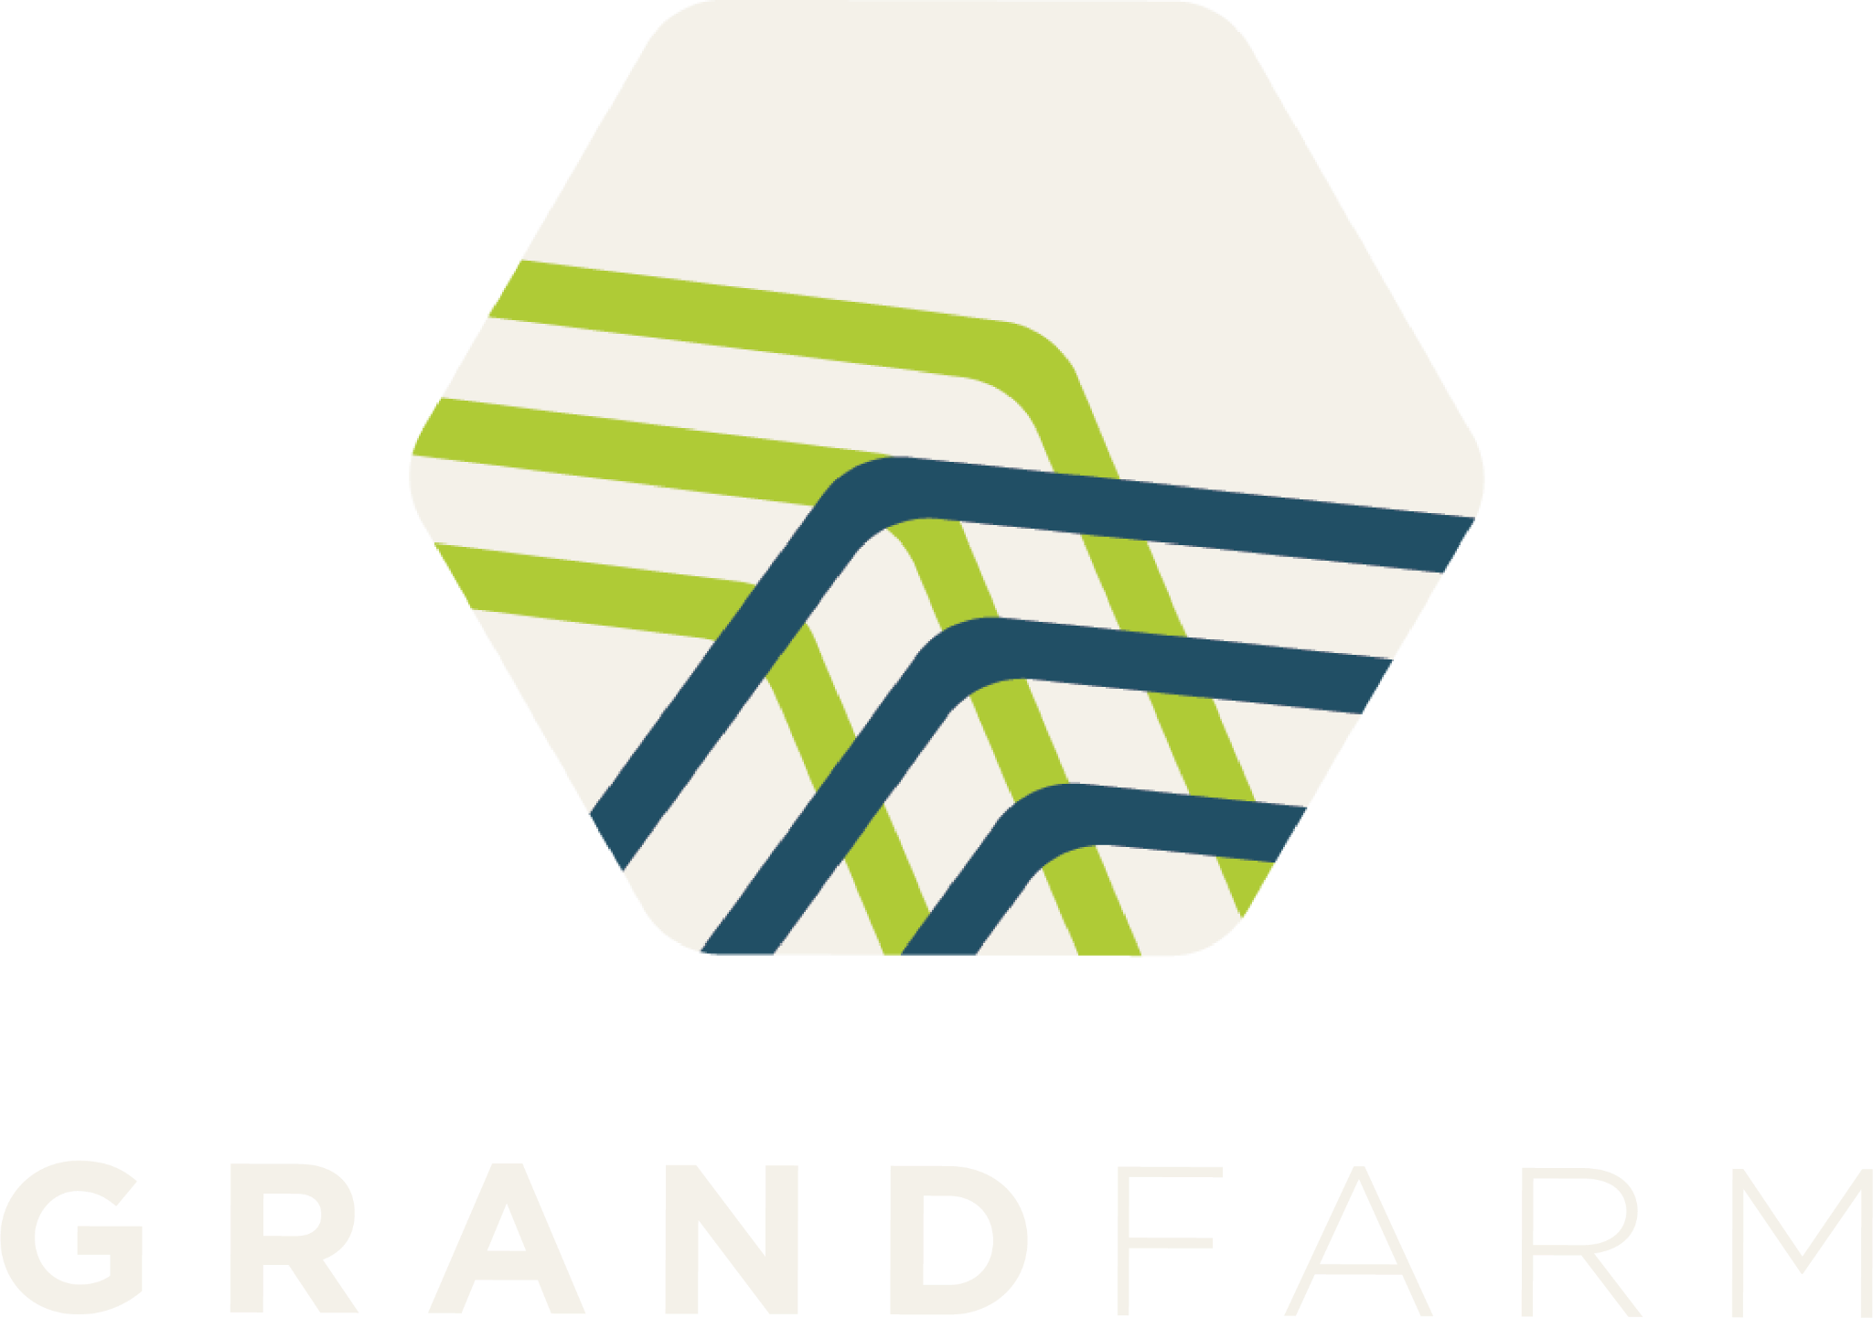

Slide 4
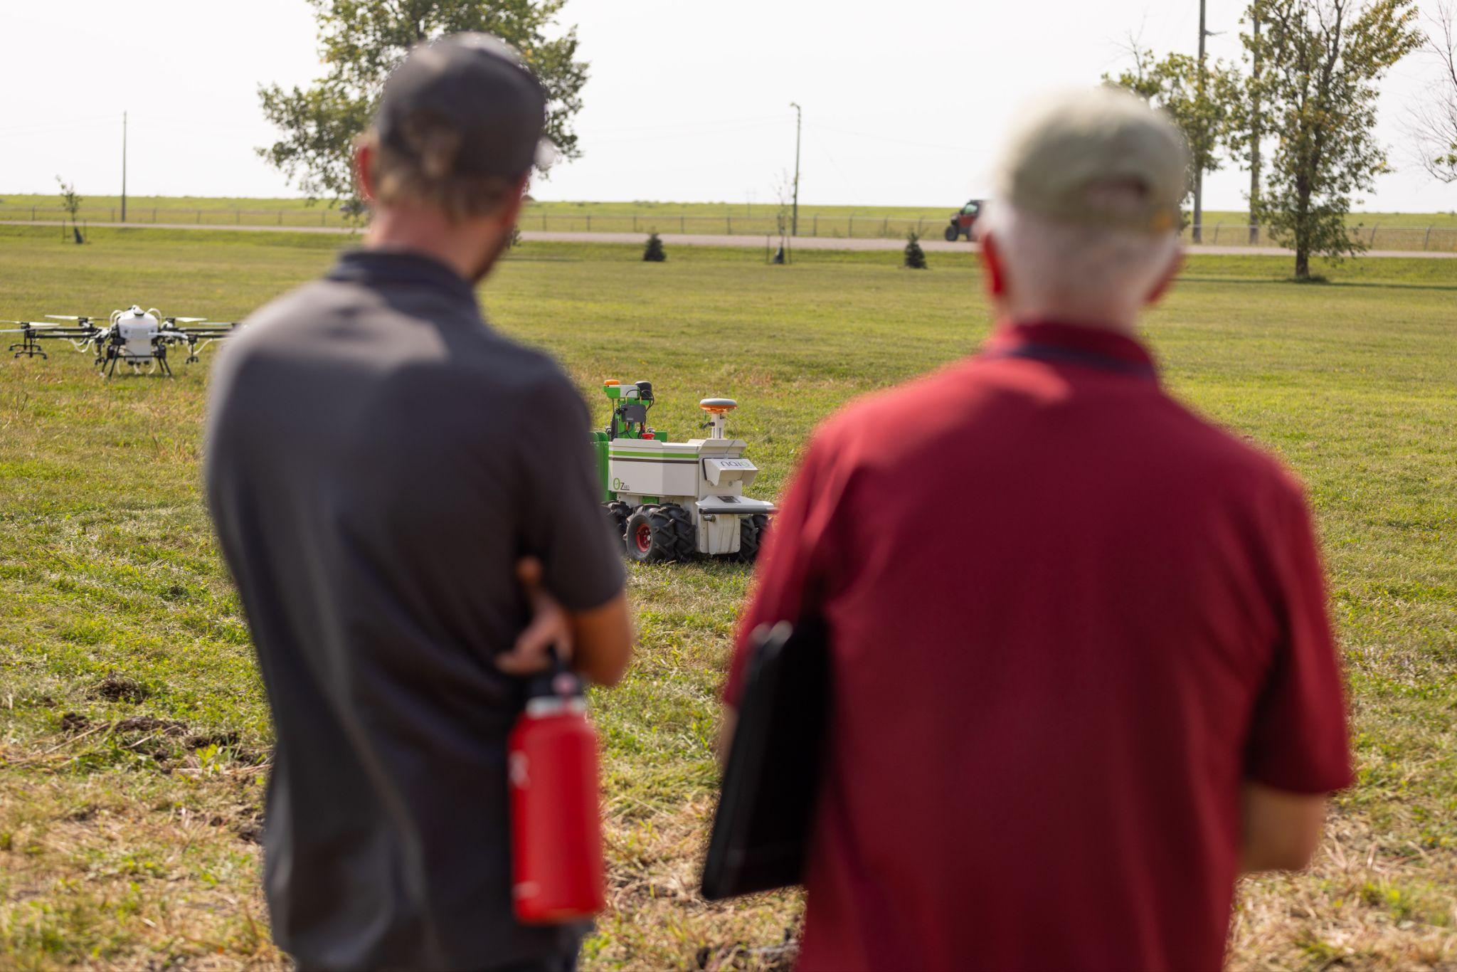
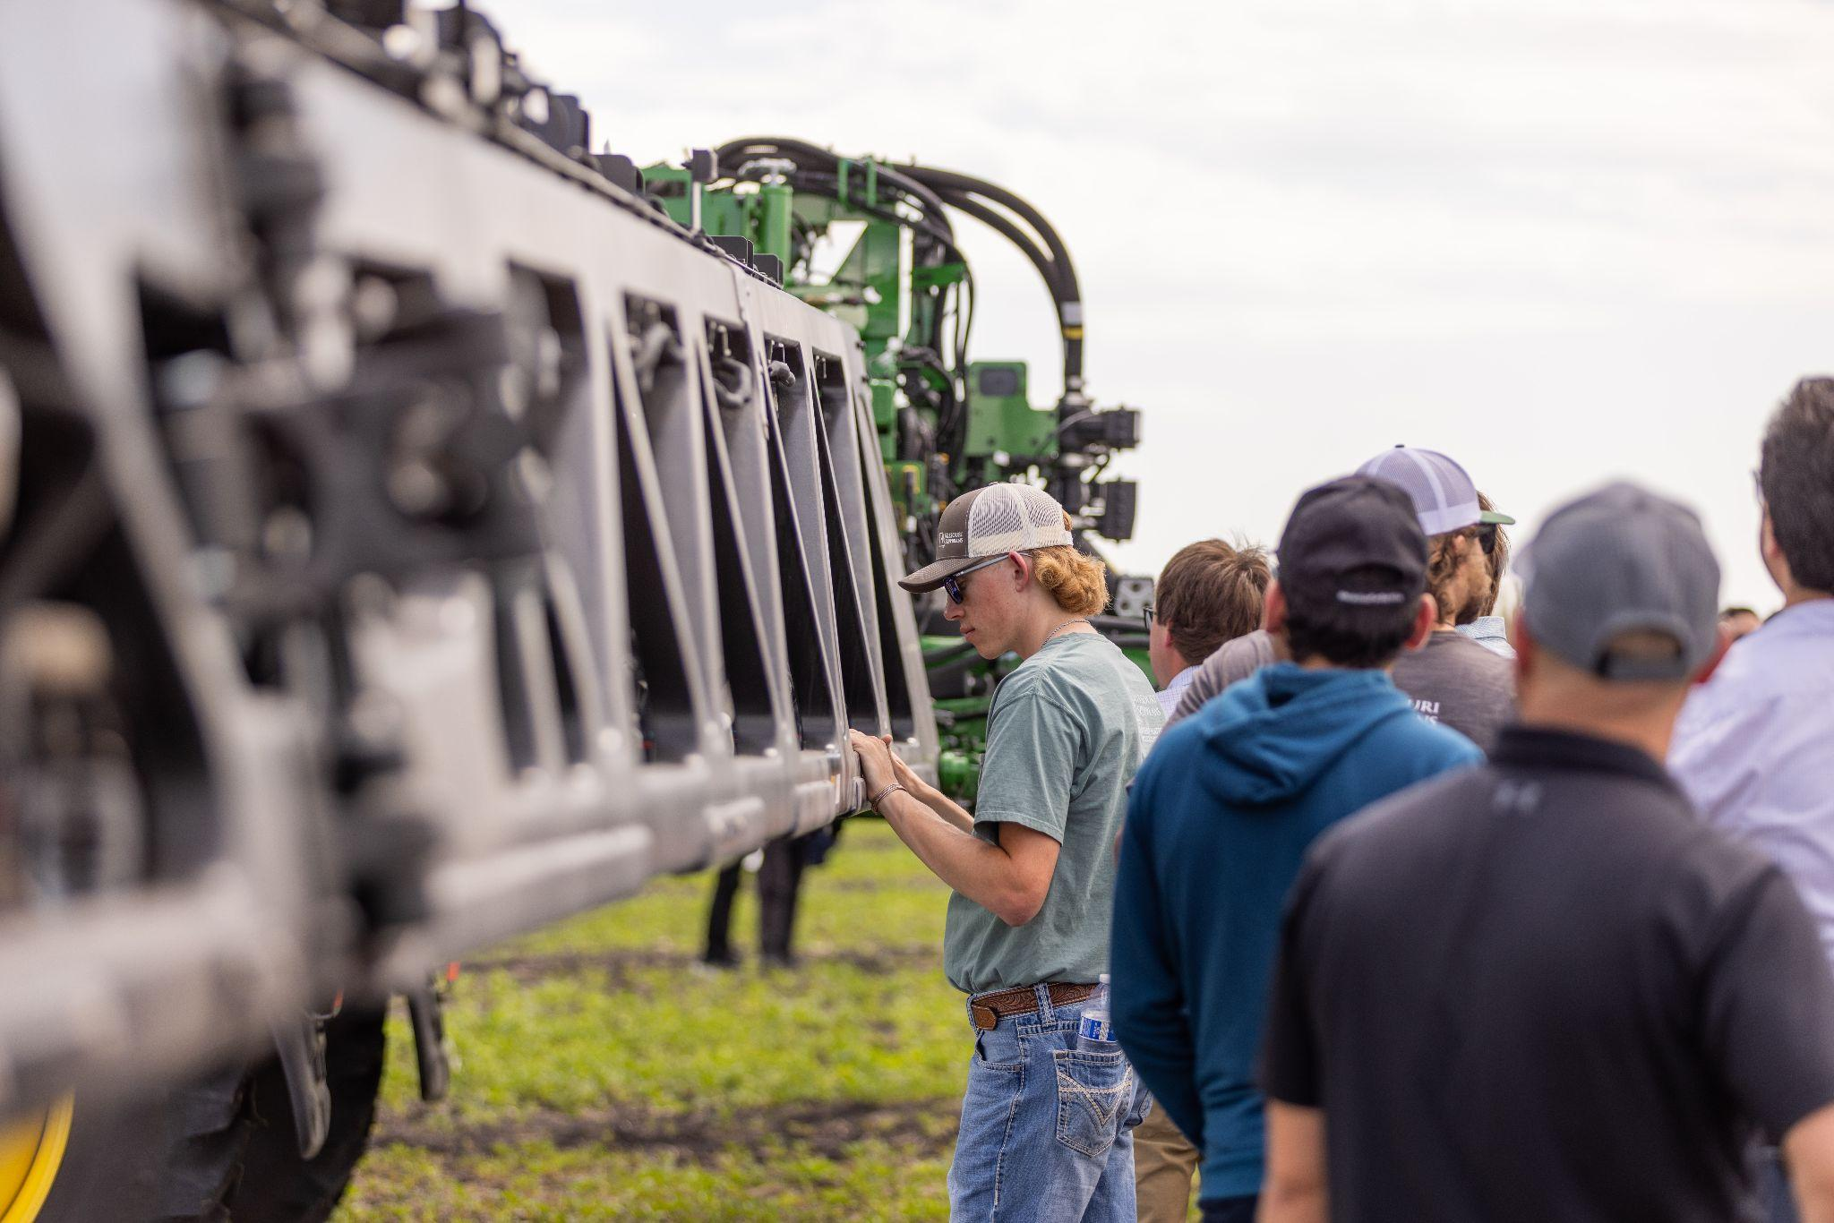
Our mission:
Last acre connectivity:
Grand Farm is a network of growers, technologists, corporations, startups, educators, government, and investors, collaborating to solve agriculture’s challenges through applied technology.
Grand Farm fosters collaboration between innovators in our ecosystem to unlock the potential of precision agriculture. By supporting connectivity solutions and providing a platform for technology validation, we help transform big ideas into practical tools that drive agricultural productivity and efficiency.

Slide 5
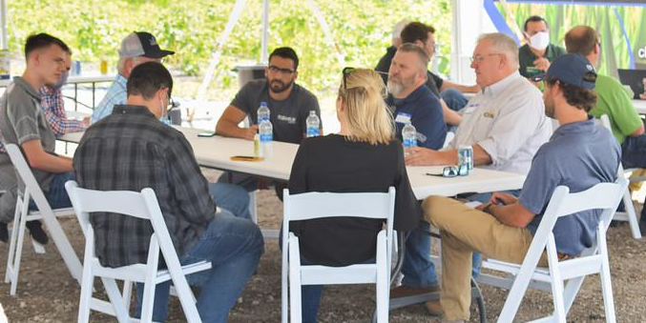
Grand Farm’s Grower Network
What We’ve Heard
Reliability and Consistency
Last Mile + Last Acre Solutions
30% Annual IoT/Sensor Increase
Data Resolution Increases + Economy of Scale Decreases
Future Land Value + Access to Data + Connectivity

Slide 6
THE
FUTURE OF
PRECISION AG?

Slide 7
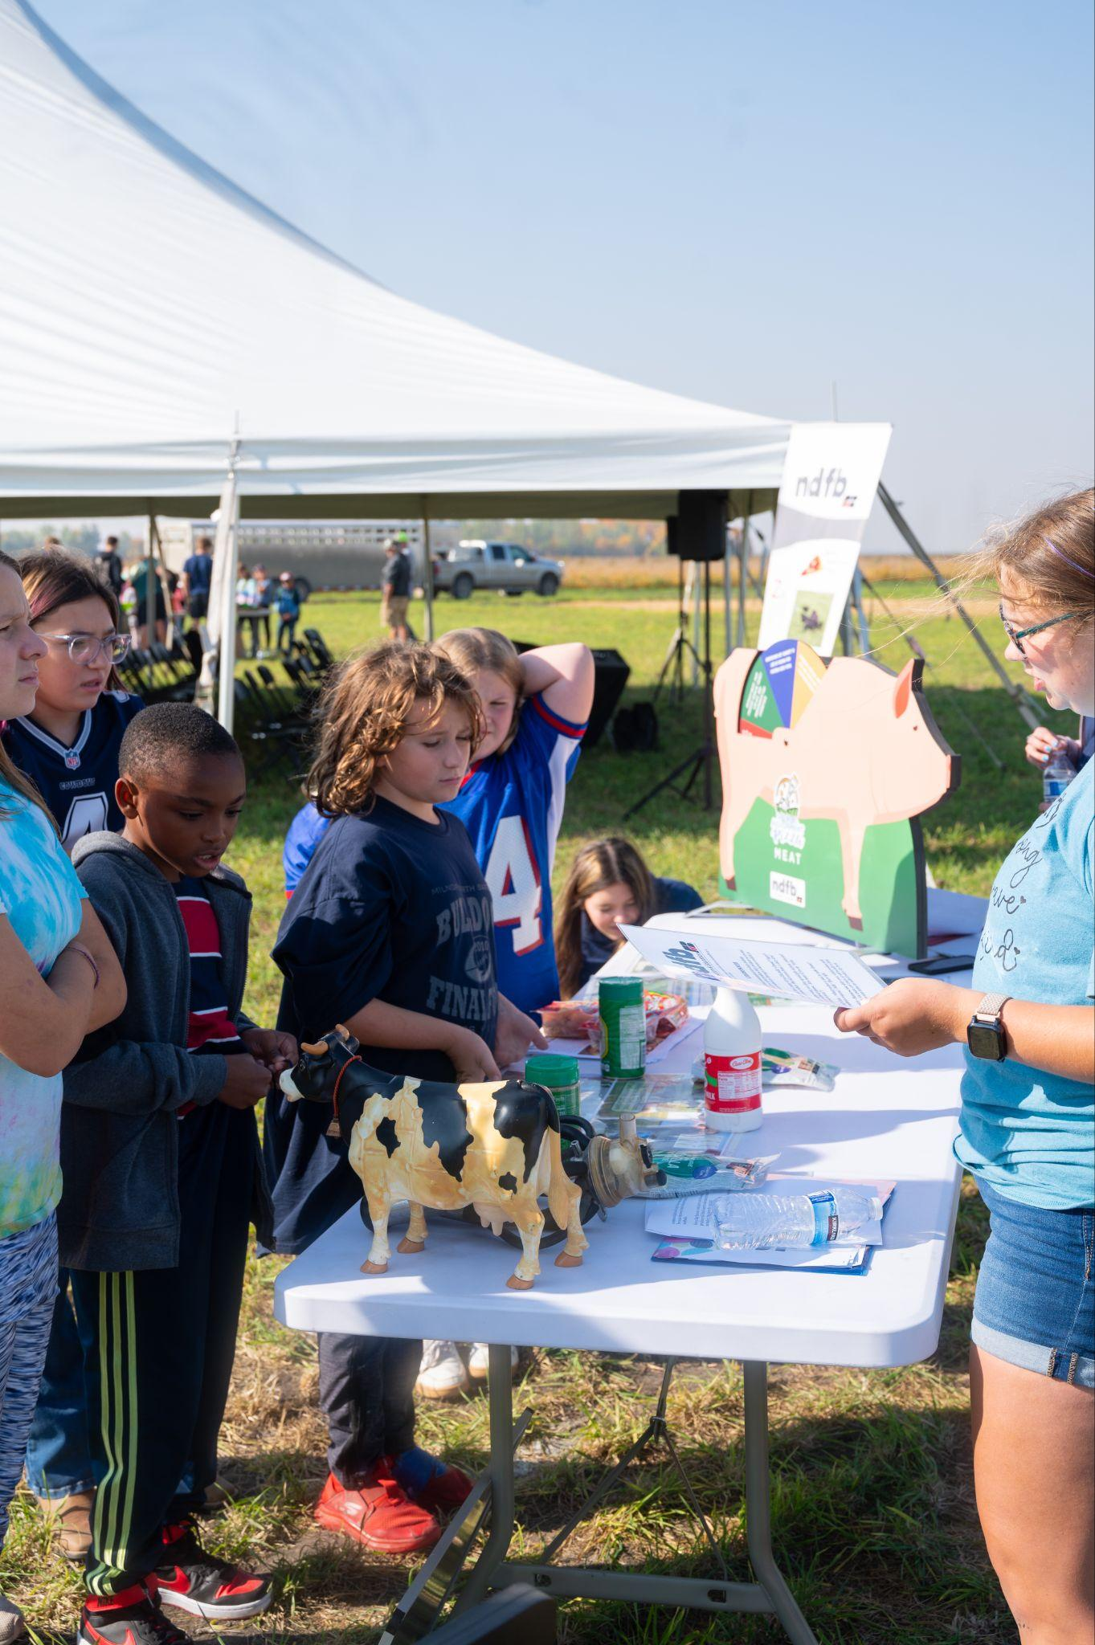
The challenge:
In the next 25 years,
the global population is expected to grow by
30%.
To feed this population,
60%-100% more food
will need to be produced on the same number of acres we have available today.

Slide 8
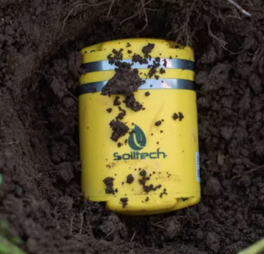
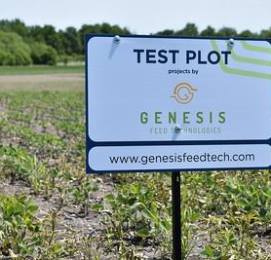
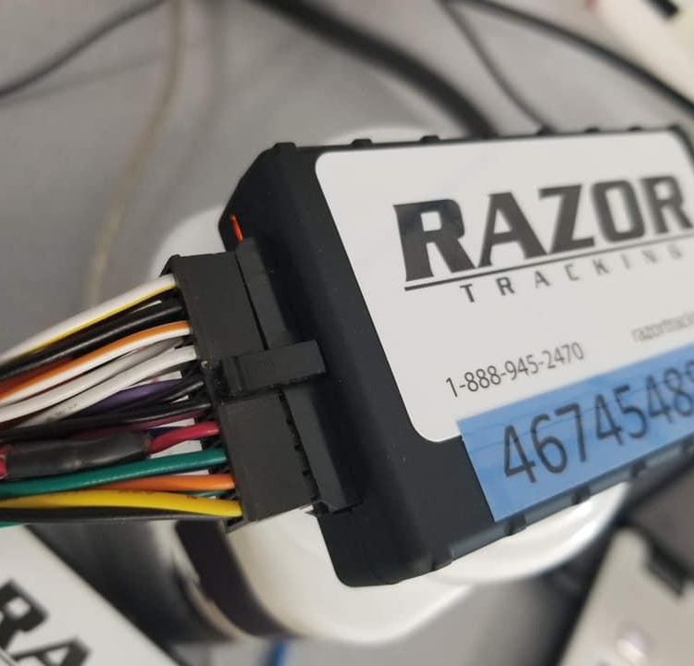
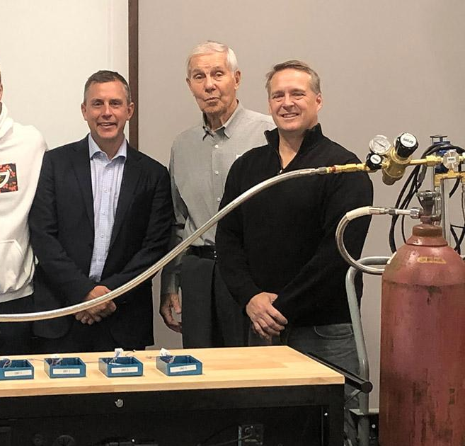
A solution? Technology.
Unmanned Aerial + Ground Systems
Sensors
Heavy Equipment
Data Management Platforms
Traceability
Energy

Slide 9
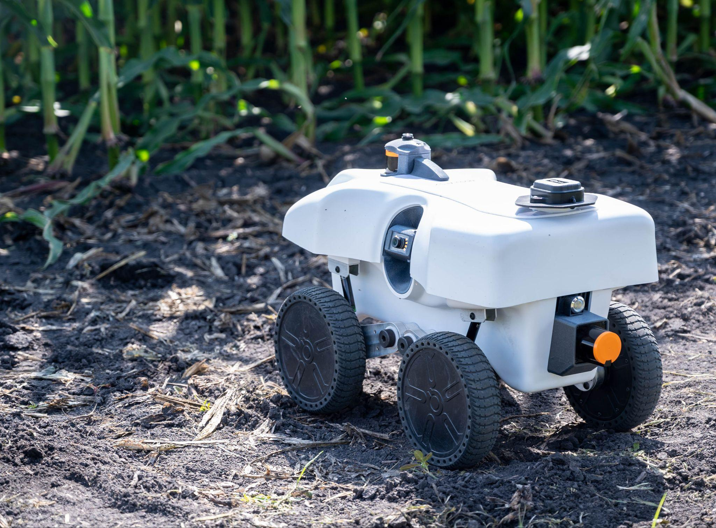
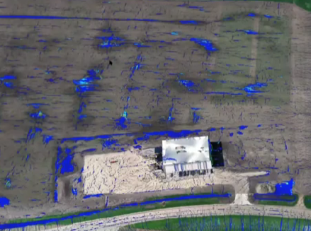
TECHNOLOGY SOLUTIONS
Unmanned Aerial + Ground Systems
Task oriented robotics to assist with ongoing operations
High resolution remote sensing of crops
High bandwidth required

Slide 10
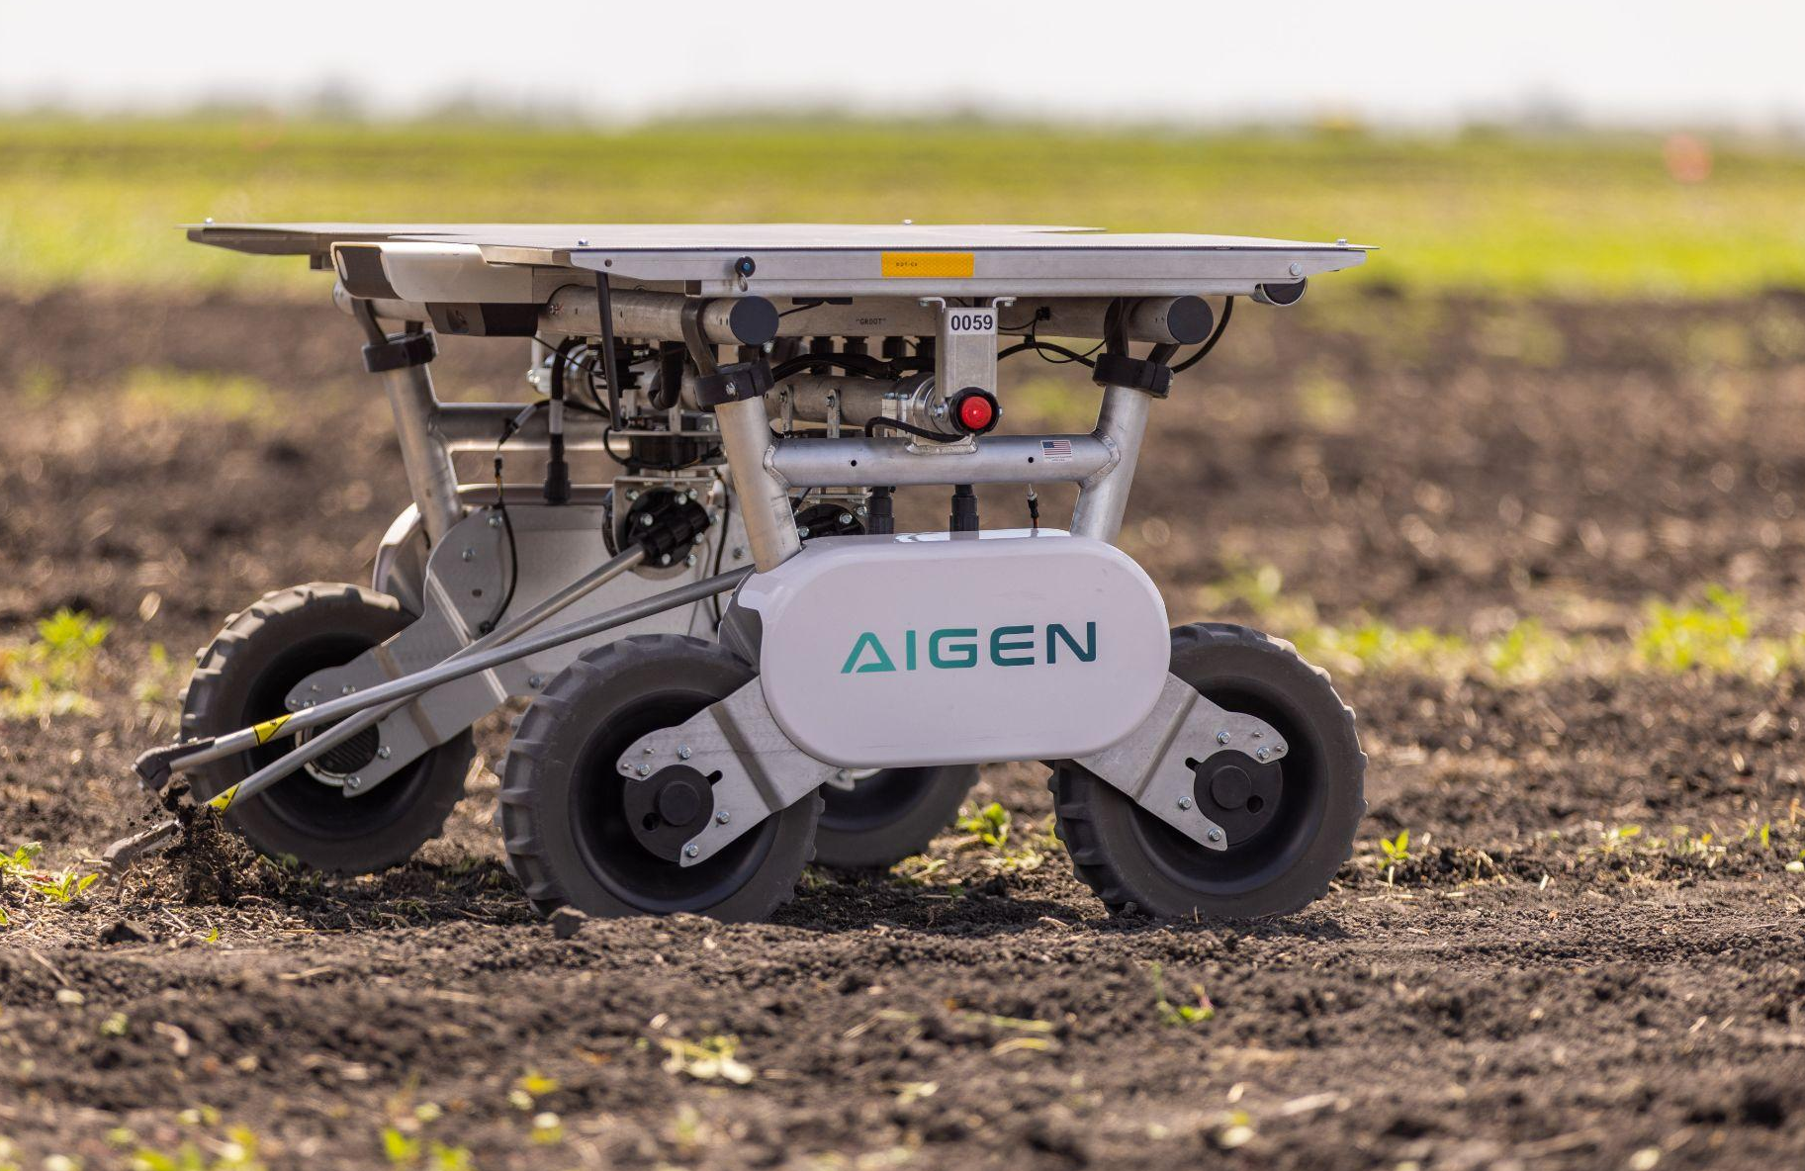
Aigen
THE CHALLENGE:
Growers face rising costs in pest management and weed control, especially as herbicide resistance increases.
WHAT’S BEEN ACCOMPLISHED:
Grand Farm worked to bring Aigen to North Dakota, providing field plot testing and supporting the rapid development of their platform to meet the needs of local growers.
BY THE NUMBERS: The Aigen Element robot has successfully completed over 420 acres of operations on farms.

Slide 11
TECHNOLOGY SOLUTIONS
Heavy Equipment and Smart Implements
Substantial investment
On-board computing with telematics
Some autonomous decision making

Slide 12
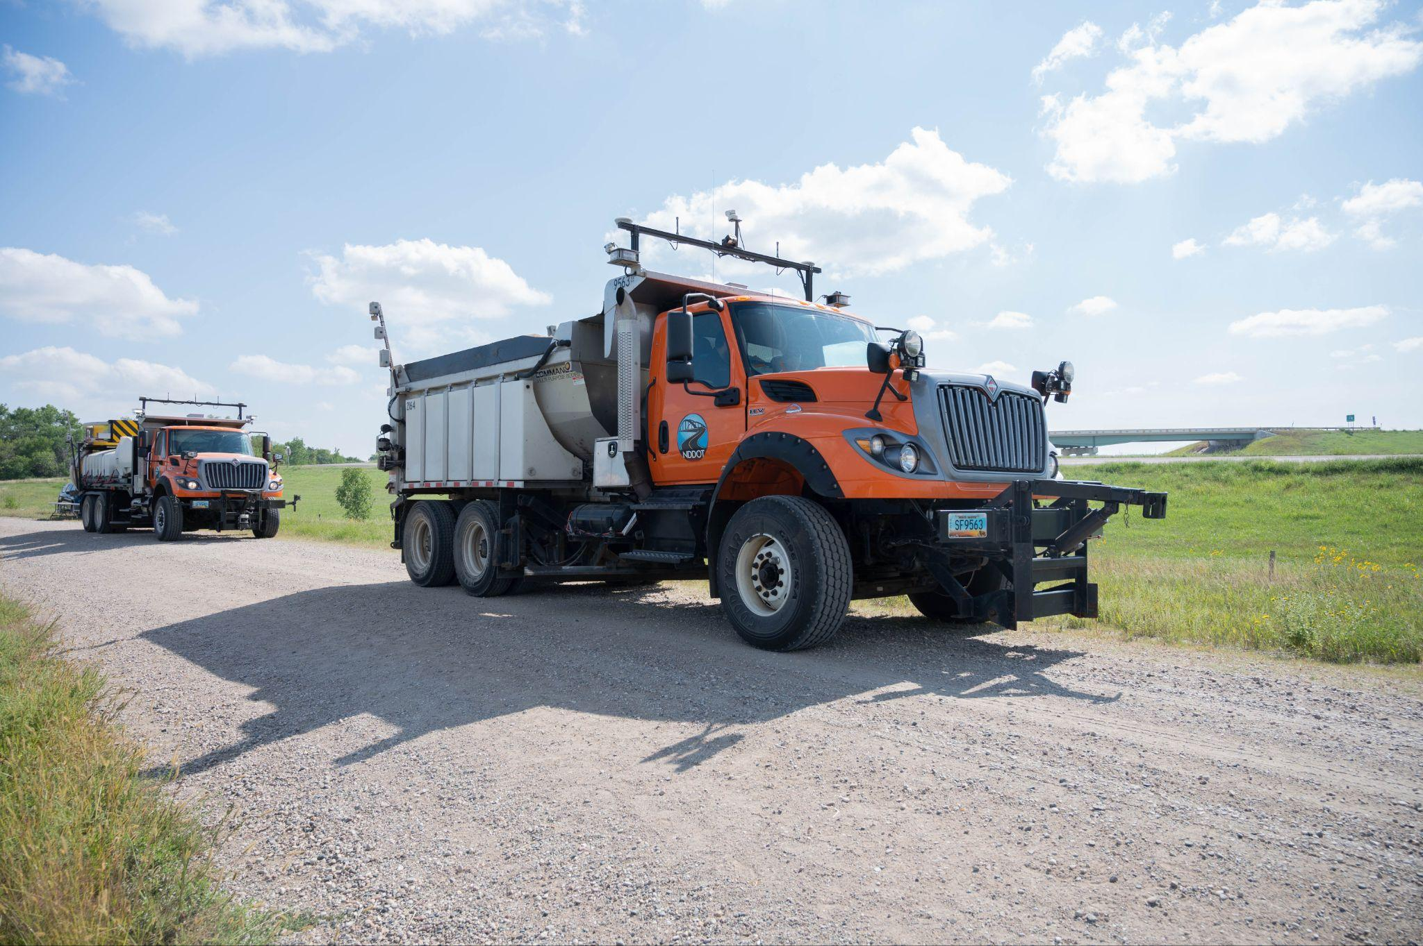
Leader/Follower Trucks
THE CHALLENGE:
North Dakota’s agricultural industry faces delays and higher costs due to a shortage of truck drivers and limited logistical options, impacting agricultural product delivery.
WHAT’S BEEN ACCOMPLISHED:
Grand Farm connected CHS and Minn-Dak Farmers Cooperative to Kratos Defense, where they now deploy a "Leader/Follower" autonomous trucking system to increase efficiency and address labor shortages.
BY THE NUMBERS: Minn-Dak Farmers Cooperative has logged over 100,000 autonomous miles in ND within this project.

Slide 13
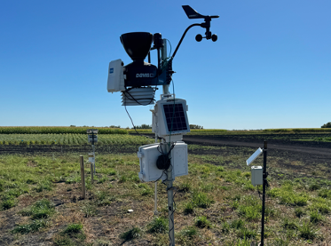
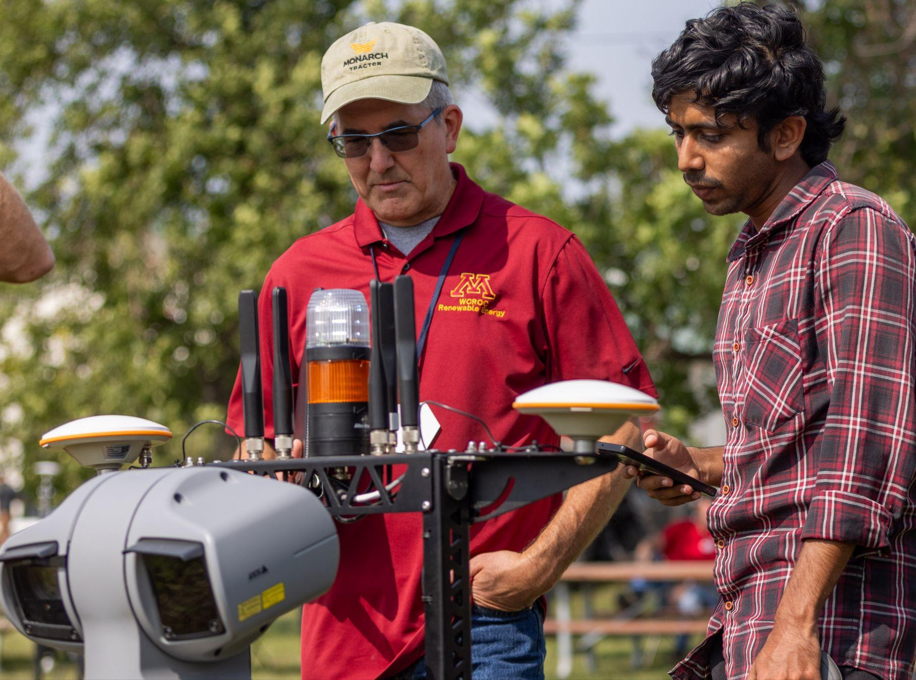
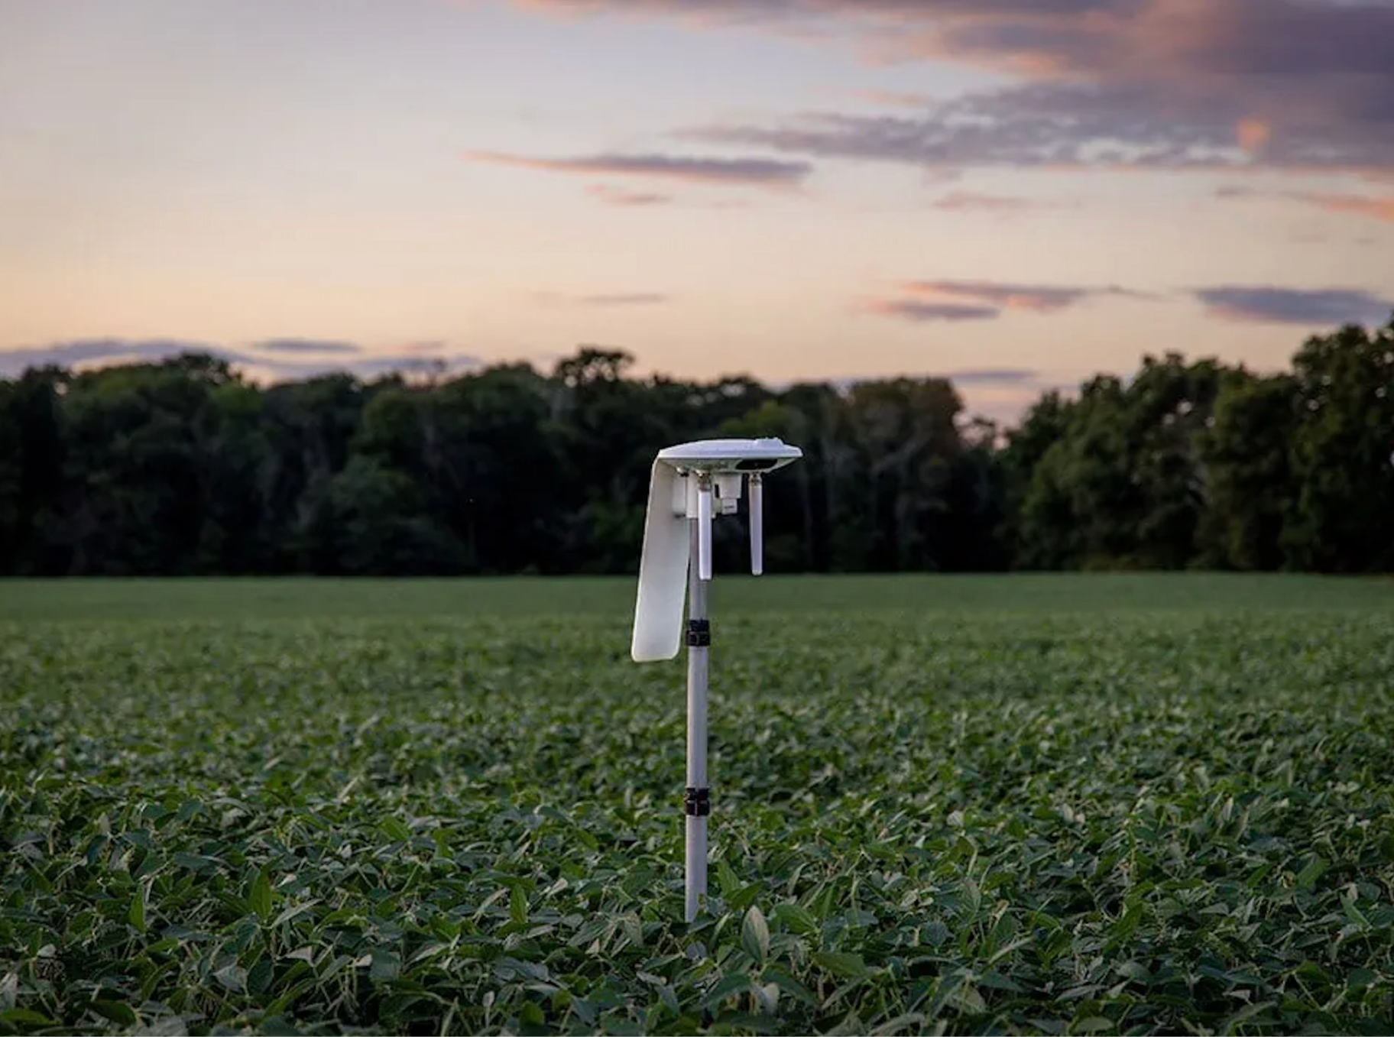
TECHNOLOGY SOLUTIONS
Sensors
Collects data from soil, weather, and crops
Low bandwidth required
10-100kb / 4 hours - 24/7

Slide 14
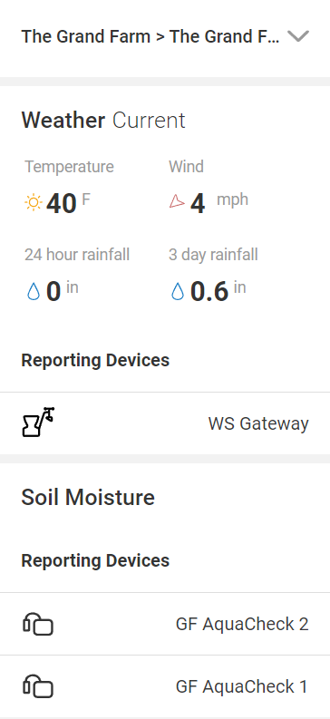
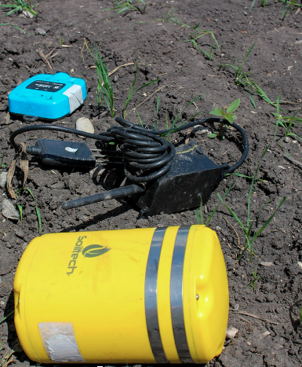
Sensor Sandbox
THE CHALLENGE:
Growers struggle to adopt IoT sensor technologies due to unreliable connectivity and uncertainty about their real-world benefits.
WHAT’S BEEN ACCOMPLISHED:
The Sensor Sandbox, piloted last summer at the Grand Farm Innovation Campus, tests sensor technologies and communication protocols in real farm conditions. This ongoing project will help growers and companies see how these tools can improve practices like irrigation and resource management.
BY THE NUMBERS: 16 sensors were deployed at Grand Farm last summer, collecting data such as soil and ambient conditions.
Notes:
https://farmdocdaily.illinois.edu/2018/07/remain-vigilant-for-palmer-amaranth.html

Slide 15
TECHNOLOGY SOLUTIONS
Last mile + last acre solutions:
Connecting the Fields
Dispersed Connectivity Across Fields
Less Bandwidth, More Coverage
Scalable, Replicable Across Fields
Notes:
Match 13 with header

Slide 16
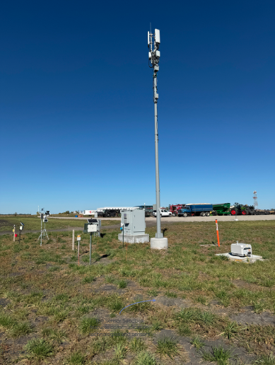
Connectivity Test Bed
THE CHALLENGE:
The evolving landscape of agriculture technology solutions will need both last mile and last acre connectivity.
WHAT’S BEEN ACCOMPLISHED:
Dakota Carrier Network and MLGC partnered with Grand Farm to bring last mile and multiple last acre connectivity solutions to Grand Farm's Innovation Campus to create a connectivity test bed. This is used for several projects, including the sensor sandbox. LoRaWAN from the site is reaching up to two miles away at NDSU's Seed Farm.
BY THE NUMBERS: There are 13+ types of different last acre connectivity networks.

Slide 17
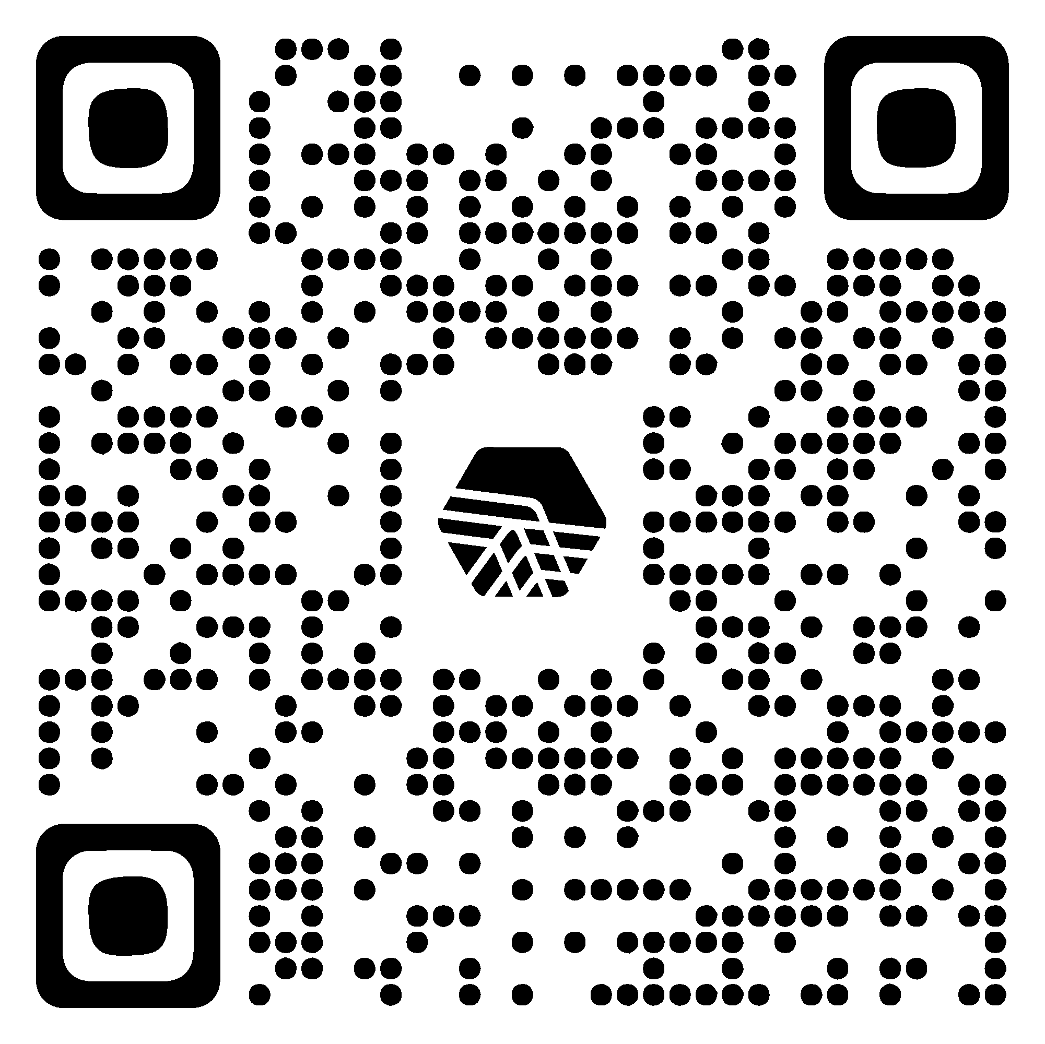
LEARN MORE AND GET INVOLVED ⇢
Questions?
Dr. William Aderholdt
Executive Director of Grand Farm
williama@grandfarm.com
(406) 853-8552

