Slide 1
Reverse Auction (Auction 1001) Initial Commitment Workshop
Clock Phase: Sneak Peak of the Bidding System
March 11, 2016

Slide 2
Disclaimer
Nothing herein is intended to supersede any provision of the Commission's rules or public notices. These slides should not be used as a substitute for a prospective applicant's review of the Commission's relevant orders, rules, and public notices. Applicants must familiarize themselves thoroughly and remain current with the Commission's rules relating to the Incentive Auction, application and auction procedures, and the procedures, terms and conditions contained in auction public notices. All examples use fictional information, are for illustrative purposes only, and are not predictions or advice.

Slide 3
Auction System Home Page
The login process for the clock phase of the reverse auction is the same as the initial commitment login

Slide 4
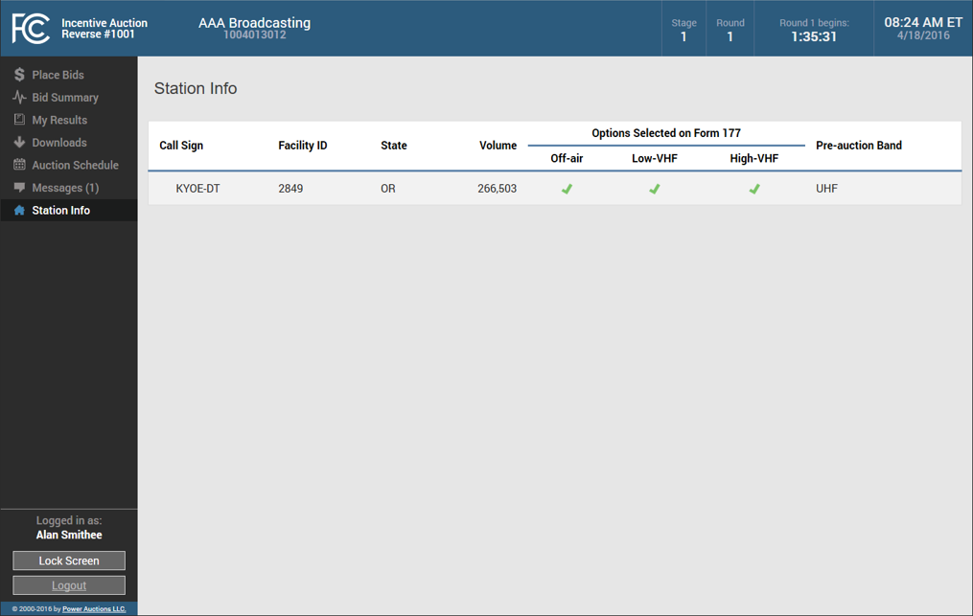
Station Info
As with the Initial Commitment module, bidders can view at any time static information about its stations, including the bid options selected on Form 177

Slide 5
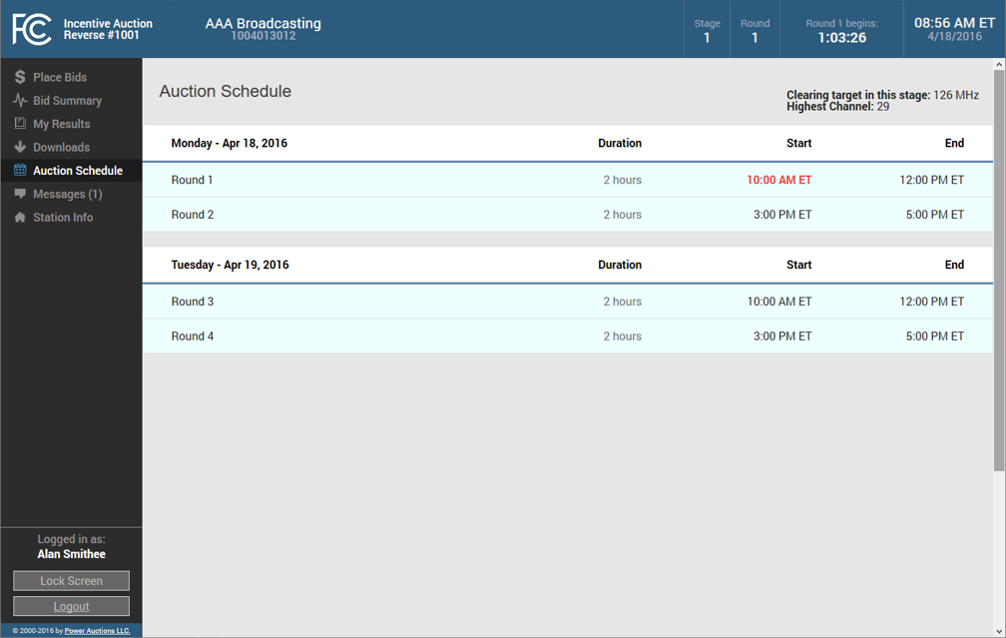
Auction Schedule
The Auction Schedule screen shows the schedule for upcoming bidding rounds
For each round the screen displays:
Round number
Duration
Start time
End time

Slide 6
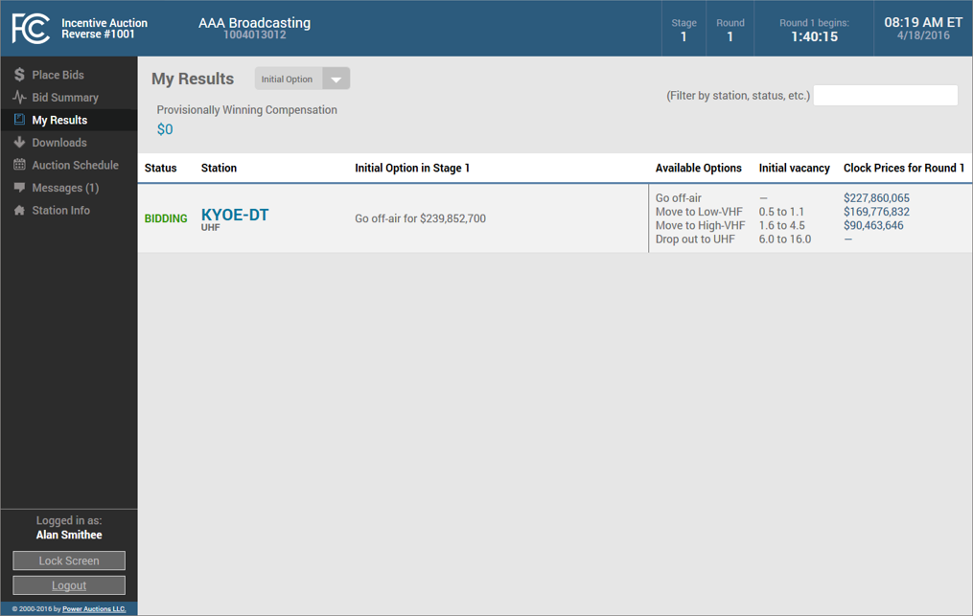
My Results (Initial Option)
Before round 1 opens in any stage of the clock phase, a bidder can view for each of its stations the station’s initial option

Slide 7
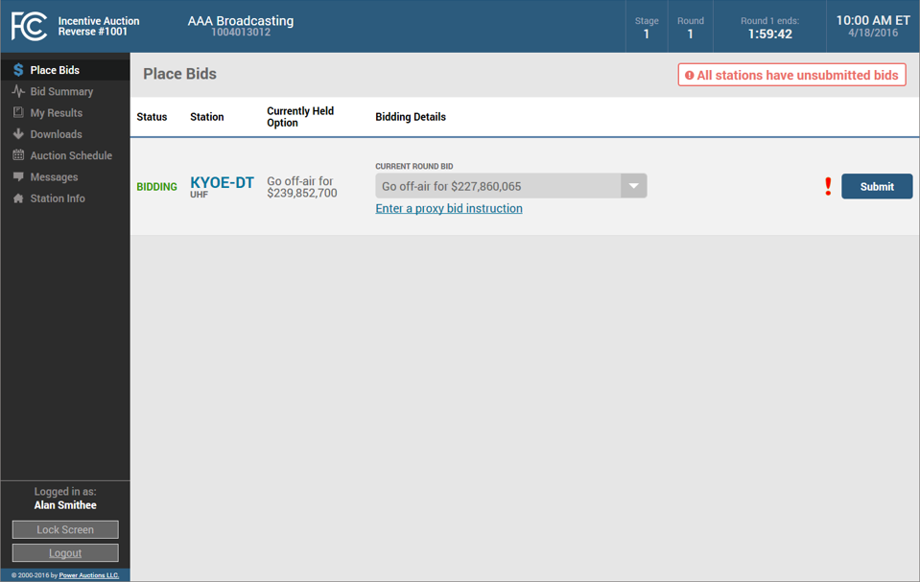
Place Bids (overview)
When a round is open, bidding is available on the Place Bids screen
A box at the top of the screen indicates that all stations have unsubmitted bids

Slide 8
Place Bids (overview)
The Place Bids screen will display all of a bidder’s stations
For each station, a bidder can see its currently held option:
In round 1 this is the initial option and the opening price

Slide 9
Place Bids (overview)
The bidder can select its preferred bid option for the current round

Slide 10
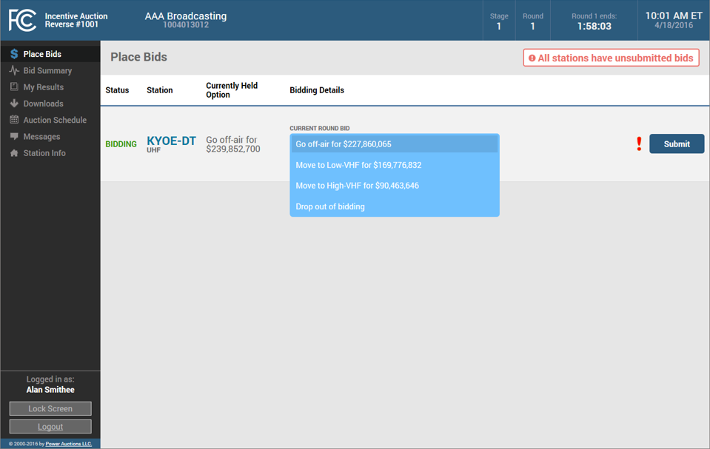
Place Bids (selecting a preferred option)
For each station, a bidder selects its preferred bid option from a drop-down menu
A bidder can select to:
Stay in its currently held option at the new clock price
Switch to any option selected on Form 177 if it is available based on the bidding hierarchy, or
Drop out of bidding if it no longer wants to keep that station in the auction

Slide 11
Place Bids (overview)
If the bidder selects as its preferred option to stay in its currently held option, it can also submit proxy bid instructions

Slide 12
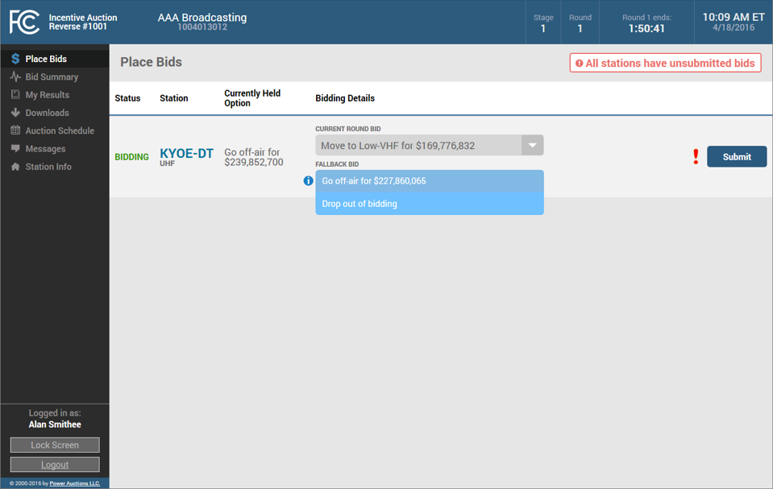
Place Bids (fallback options)
If a bidder chooses to switch its preferred option to move to a VHF band, the system will prompt the bidder to select a fallback option
If the system cannot accommodate the bidder’s preferred option, its selected fallback option will be processed

Slide 13
Place Bids (submitting a bid)
To submit a bid the bidder selects its preferred option and fallback option if applicable and clicks on the Submit button
If a bid has not been submitted, when the round closes the system will automatically consider the preferred option for that station to be a bid to drop out of the auction

Slide 14
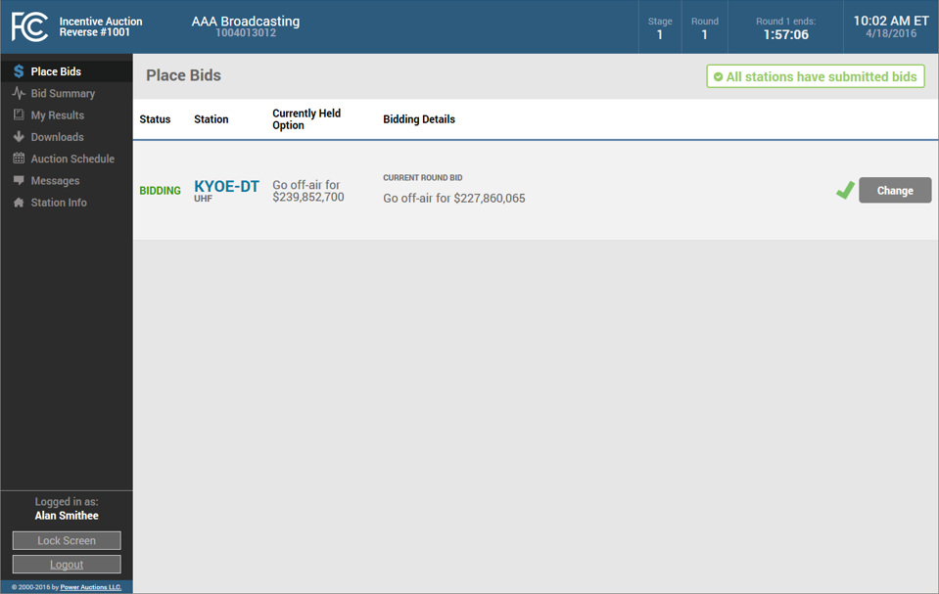
Place Bids (bid placed)
The system will indicate whether a bid has been successfully submitted

Slide 15
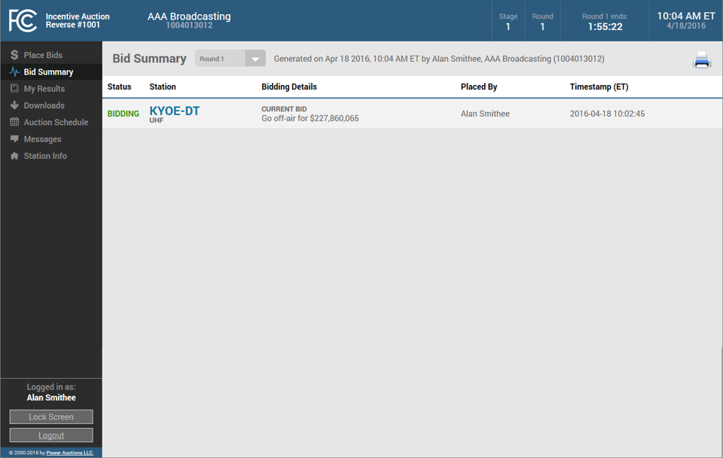
Bid Summary
The Bid Summary screen displays the bids and proxy instructions submitted by a bidder in a round

Slide 16
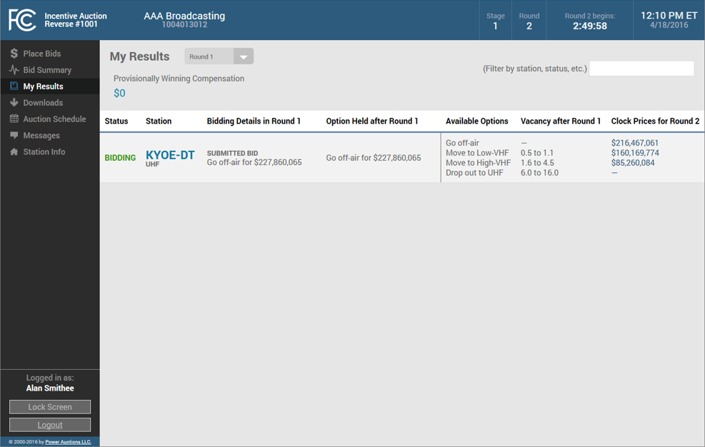
My Results (results posted)
Once bid processing is complete for a round the results will be posted on the My Results page

Slide 17
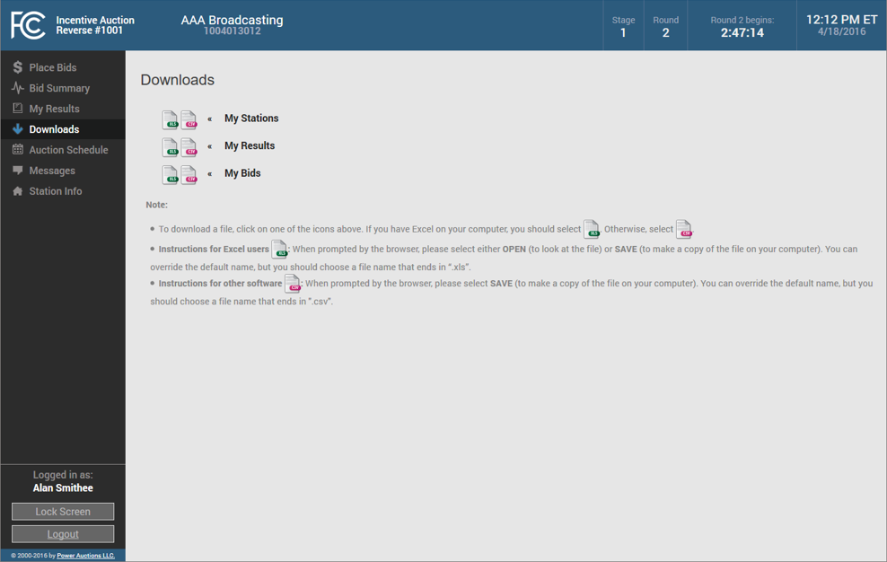
Downloads
On the Downloads screen a bidder can download:
A summary of bids submitted in each round
The bidding results in each round, and
Information about its stations

Slide 18
Contact Information
FCC Auctions Hotline General Auction Questions Auction Process and Procedures | (888) 225-5322, option two; or (717) 338-2868 Hours of service: 8:00 a.m. – 5:30 p.m. ET, Monday through Friday
Auctions and Spectrum Access Division, Wireless Telecommunications Bureau For general auction questions: For Auction 1001 (reverse) auction legal questions: | Linda Sanderson at (717) 338-2868 Erin Griffith or Kathryn Hinton at (202) 418-0660
Technical Support Electronic Filing FCC Auction System (Hardware/Software Issues) | (877) 480-3201, option nine; or (202) 414-1250 (202) 414-1255 (TTY) Hours of service: 8:00 a.m. – 6:00 p.m. ET, Monday through Friday

