Slide 1
Incentive Auction Broadcaster Reimbursement (Form 399)
Quick Start Guide

Slide 2
Form 399 Beta Test References
The Form 399 Beta URL is: https://apps2demo.fcc.gov/dataentry/login.html
Broadcasters must log in with the same FRN and Password used to access production LMS.
Non broadcasters must contact the Reimbursement team at form399beta@fcc.gov to request that their FRN be activated in the beta system.
Please note, while the Beta environment may permit other types of broadcast filings, such as construction permit applications, NO filings in the Beta environment will be processed.

Slide 3
(1) Overview of the Form 399
The Form 399 consists of three main sections – which are displayed in the navigation bar.
Applicant Information
Transition Plan
The Cost Chart
Applicant Information and the Transition Plan are designed to be completed once, though they may be revised at any time if the relevant information changes. Once these section have been completed, users can proceed straight to the cost chart of request reimbursement.
Complete the applicant information section.

Slide 4
(2) Overview of the Form 399 (cont.)
The Form 399 uses the same template as other LMS filings. Every page consists of:
The Callsign and Facility ID being filed for.
A “Save & Quit” button to exit the application without submitting.
“Attachments” and “Draft Copy” links
For uploading supplementary documentation, or
To view current publicly accessible version of a filing
A Navigation Bar
“Back” and “Save and Continue” buttons located on the bottom of each page.

Slide 5
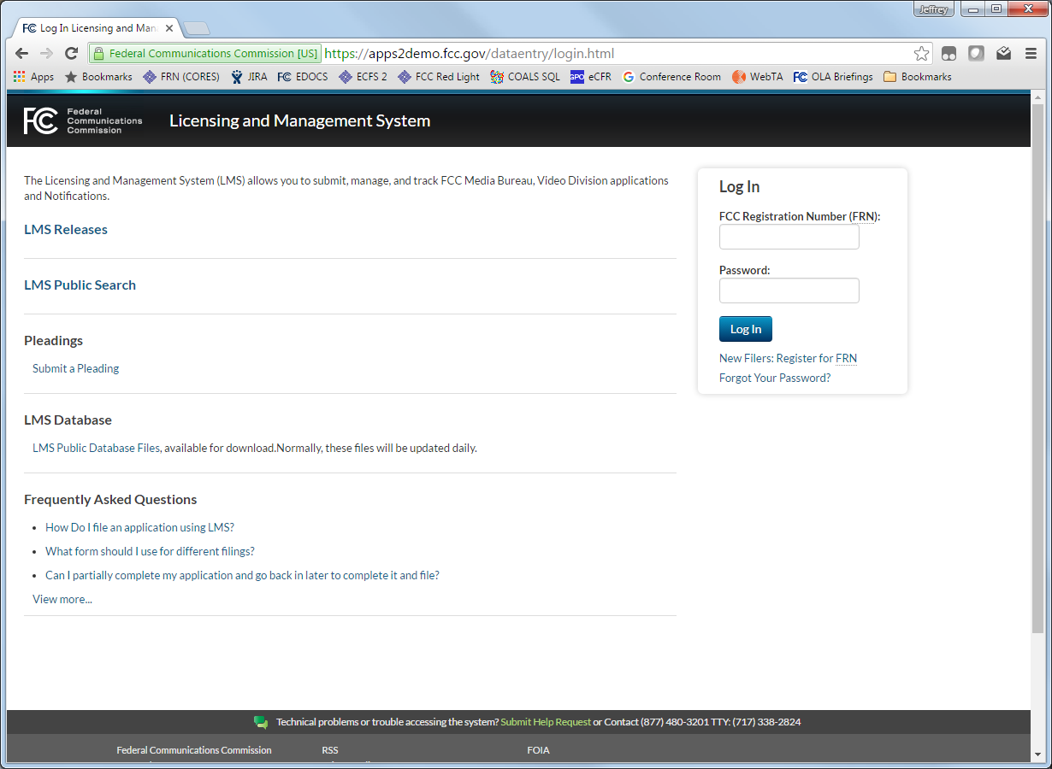
(3) Broadcaster Log In
Log In at: https://apps2demo.fcc.gov/dataentry/login.html
Broadcasters must use the same FRN and password they use to access production LMS. Non-broadcasters must request their FRN be activated by sending an email to form399beta@fcc.gov.
MVPDs will use a separate system to file Form 399. It will be introduced separately.

Slide 6
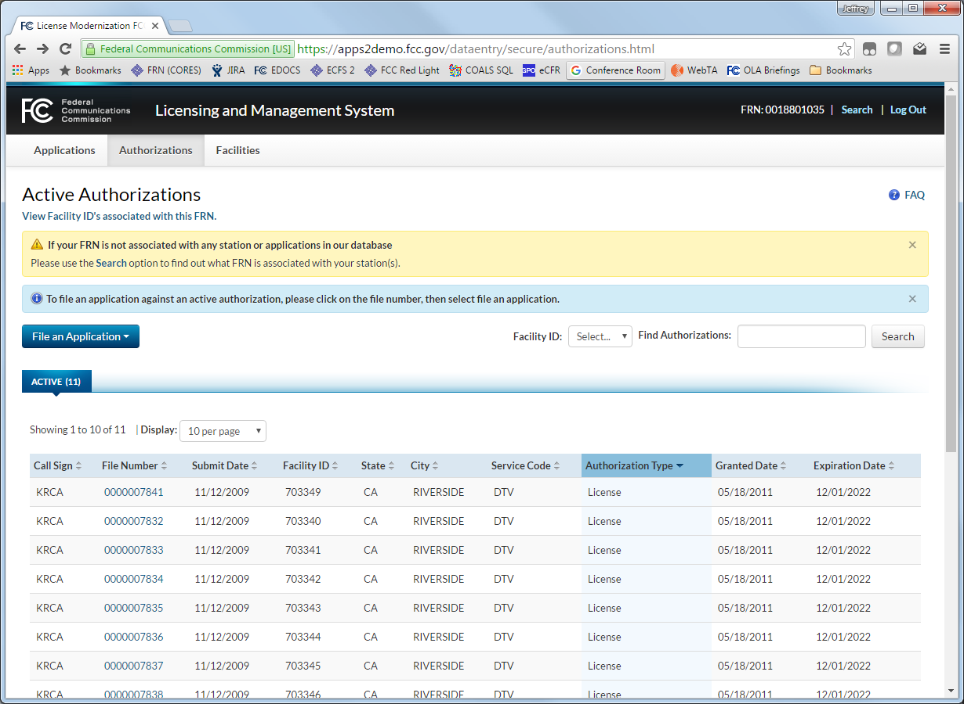
(4) Select a Facility
To begin a new Form 399, Click on the “Authorizations” tab.
Select an active DTV, DTS, Class A, or similar “License” type authorization.
Verify that the Facility ID and Callsign are correct.
Select the “File Number.”

Slide 7
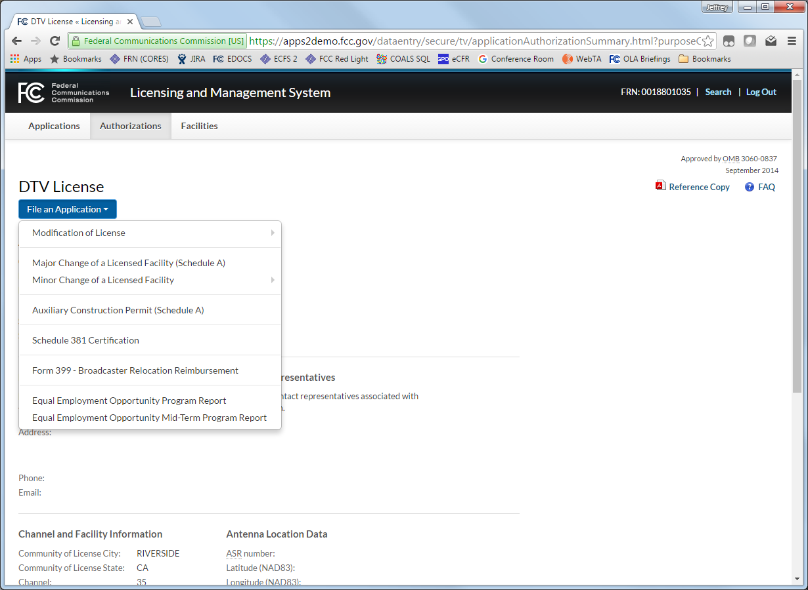
(5) Start a New Form 399
To begin a new Form 399, click on the “File a an Application” button.
Select “Form 399 – Broadcaster Relocation Reimbursement”
If prompted, complete the following
Applicant Information
Reimbursement Contact Information
Preparer Contact information

Slide 8
(6) The Transition Plan
The Transition Plan consists of three sections:
Overview narrative of the transition plan
4 broad categories of expenses related to transmitters, antennas, transmission lines, and towers
Additional questions for:
Outside professional services
Other miscellaneous expenses.
Each section allows the broadcaster to request reimbursement for “Other Costs Not Listed”

Slide 9
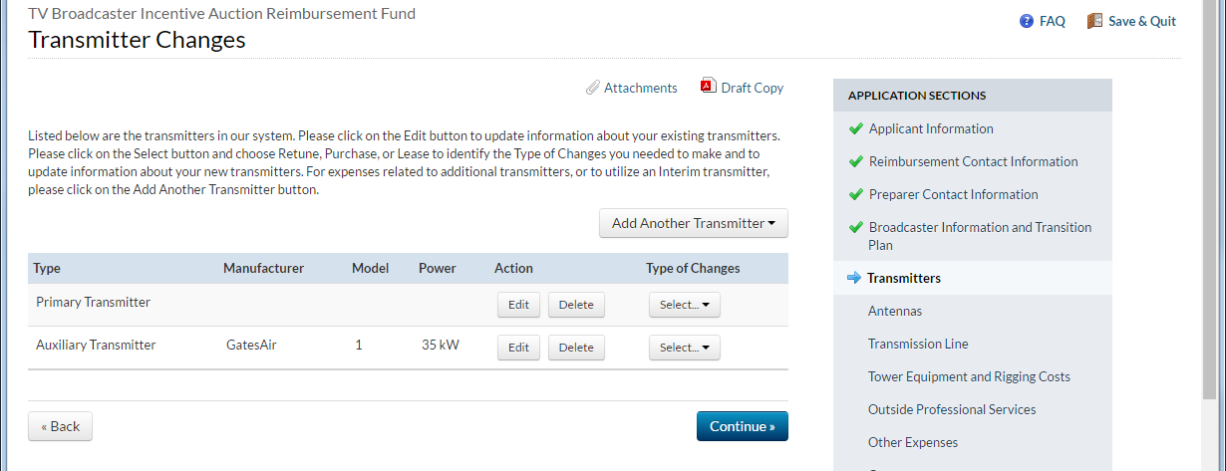
(7) Completing a Technology-Specific Expense Category
Each technology-specific expense category
begins with a “yes/no” question about expenses within that category.
Selecting “no” takes the user to the next expense category.
User will see an entry for each licensed broadcast site.
To add additional sites, such as for unlicensed auxiliary transmitters, select “Add Another __”
Select “Edit” to describe existing equipment
Select “Type of Change” to describe reimbureable costs and select appropriate type of change.
Select “Delete if no costs are associated with a particular equipment type at the site.

Slide 10
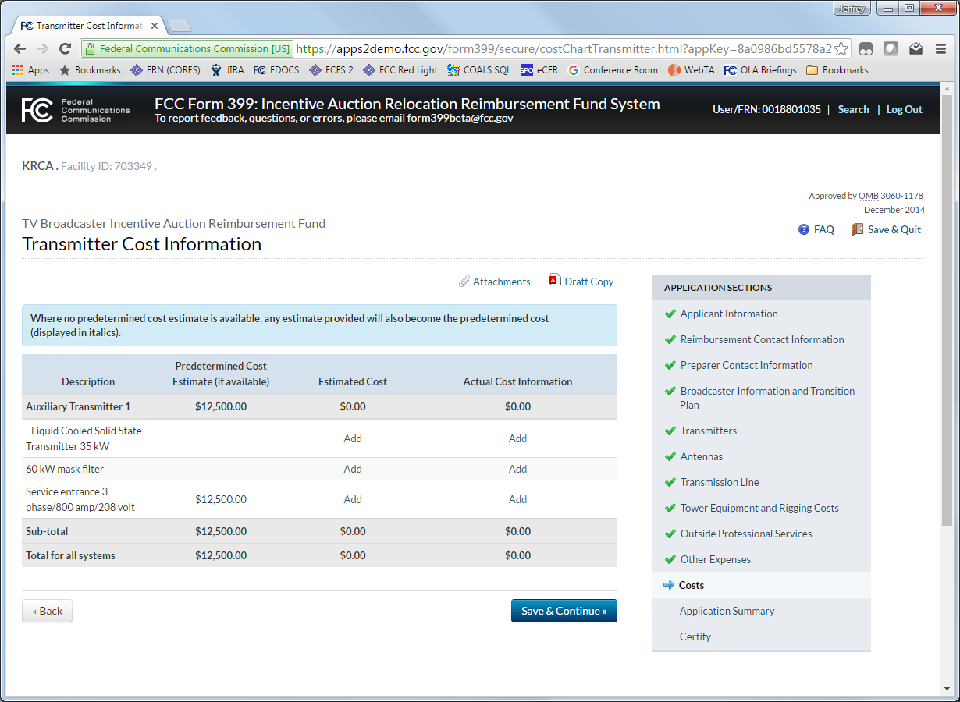
(8) Completing the Cost Chart (Estimates)
The Cost Chart consists of:
Pages for each technology-specific group, and other miscellaneous expenses. Each page has three columns:
Predetermined Cost, if available, from the Widelity Report (located here)
Estimated Cost as entered by user, and
Total of Actual Costs submitted for each entry
If a Predetermined cost is NOT available, the estimate entered will be used.
All estimated costs must be completed before Form 399 may be submitted initially.
Click “Add” to enter an estimated cost
“Actual Cost Information Details” page will open

Slide 11
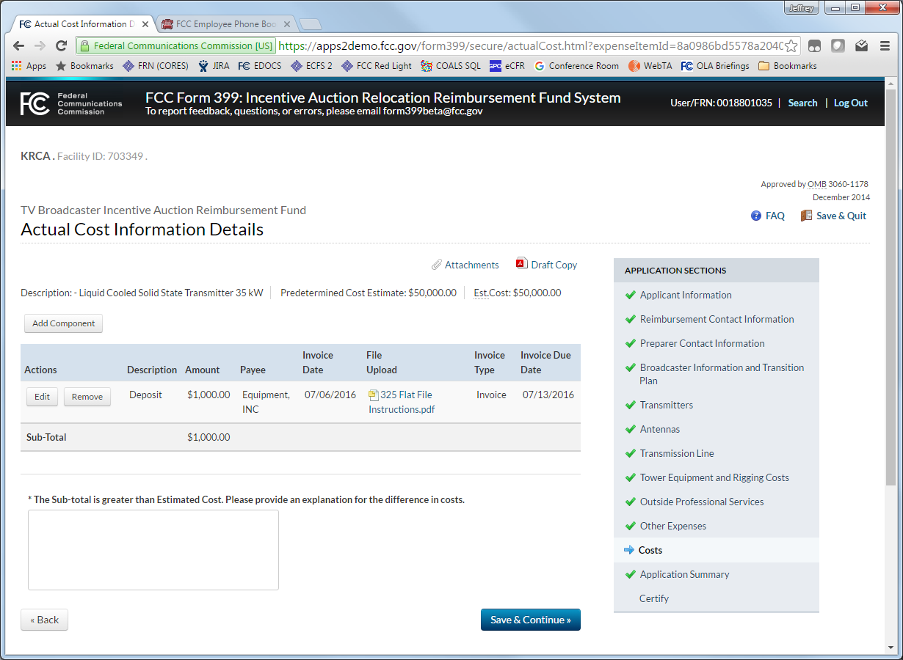
(9) Completing the Cost Chart (Actual Costs)
Actual Cost Information Details page allows user to request reimbursement
Select “Add Component,”
Upload or select an invoice or other documentation (documentation may be used more than once)
Provide invoice description
Describe the cost being reimbursed.
Examples of cost components:
Deposits, payments for specific parts, partial payments of invoice due, etc.
Click “Save and Continue” when all components have been added
This will return the user to the Cost Chart.

Slide 12
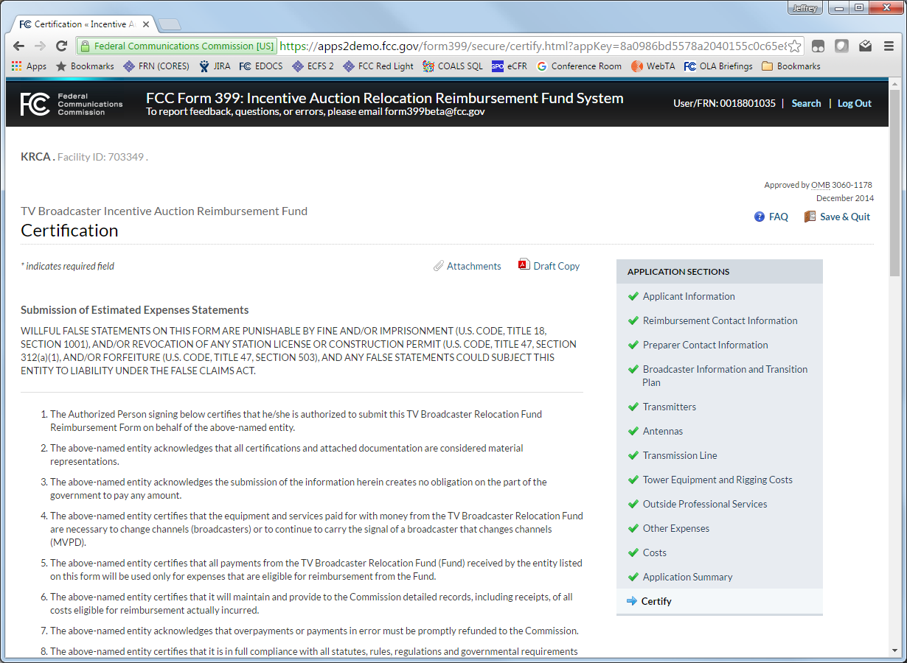
(10) Certifying and Submitting
Once you have entered all costs, continue to the Application Summary and Certification pages.
Certification blogs are displayed dynamically – if changes have been made to estimates, and certification of estimates is required, if changes have been made to actual costs, a certification of actual costs is required. If construction is designated complete, then a final certification is required and the application will be locked.
At the completion of the Cost Chart, you will be asked “If Construction is Complete.” If you answer “Yes,” you will be presented the Final Accounting Certification, after which point the Form 399 will be considered complete and no longer editable.
At the conclusion of the Reimbursement Program, answering “No” will present the Final Allocation workflow. However, prior to that point, answering “No” will merely preserve a 399 for future submissions.

Slide 13
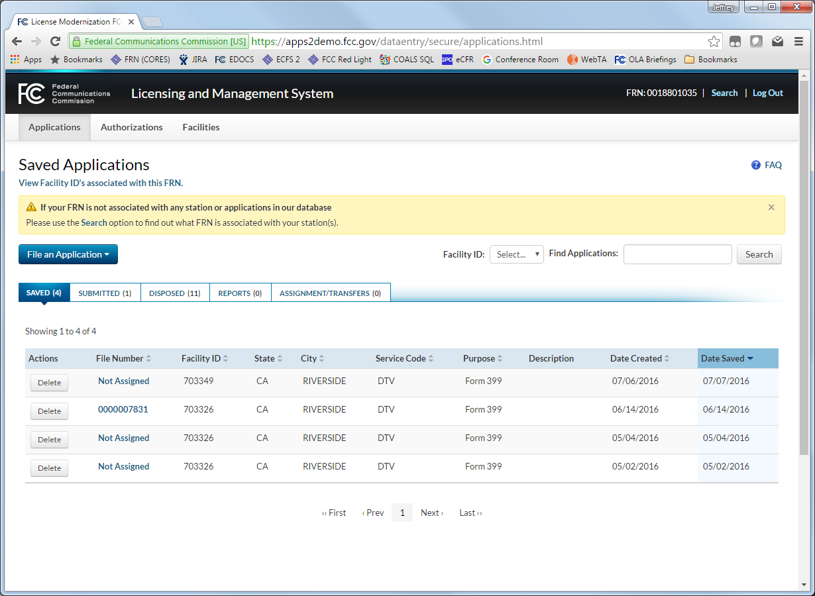
(11) Resuming an In-Progress Form 399
In-Progress Form 399’s will be found under either the “Applications” tab of the LMS Dashboard.
Additionally, they will be located under the “Saved” or “Submitted” tabs of the LMS dashboard depending on the last actions of the user.
If the last action was to “Save & Quit, the 399 will be located under the Saved tab.
If the last action was to “Certify” a filing, the 399 will be located under the Submitted tab.
To resume a 399, click the file number of a “saved” 399, or click the file number and click “continue application” of a “submitted” 399.
The file number of a Form 399 will be “Not Assigned” until a filing as been certified and submitted for the first time.

Slide 14
Question and Feedback
Please submit questions and feedback for form399beta@fcc.gov

