Slide 1
Pre-Symposium Welcome
Please test your audio and video settings
If you are experiencing connectivity difficulties, please text or call Tom Scholfield, MITRE AV, at 781-999-0183
Participants will be on mute throughout the event
Participants are encouraged to raise questions and comments throughout the symposium via Zoom Q&A
Please note that the symposium is being recorded and that members of the media may be in attendance

Slide 2
FCC Digital Health Symposium: Advancing Broadband Connectivity as a Social Determinant of Health
Host: Connect2Health^{FCC} Task Force
Thursday, March 3, 2022
10:00 am – 4:30 pm EST

Slide 3
Welcome, Remarks and Introductions

Slide 4
Welcome, Remarks and Introductions
P. Michele Ellison, JD
General Counsel, FCC
Chair, Connect2Health^{FCC} Task Force

Slide 5
Remarks
Commissioner Geoffrey Starks
FCC

Slide 6
Program Overview
David Ahern, PhD
Senior Advisor Connect2Health^{FCC} Task Force

Slide 7
Connect2Health^{FCC} Task Force
Mission
Vision
By identifying regulatory barriers, as well as incentives, and building stronger partnerships with public and private stakeholders in the areas of telehealth, mobile applications, and telemedicine, we seek to accelerate the adoption of advanced health care technologies — leveraging broadband and other next-gen communications services, highlighting promising health IT and telemedicine initiatives across the country and abroad, and expediting a vital shift to more ubiquitous, broadband-enabled health care solutions along the entire health and wellness continuum.​
Everyone connected ... to the people, services and information they need to get well and stay healthy.

Slide 8
Agenda
10:00 am – 10:20 am | Welcome, Remarks and Introductions
10:20 am – 11:25 am | PANEL 1: Current Perspectives—Relationship Between Broadband and Health
11:25 am – 11:35 am | Brief Break
11:35 am – 12:00 pm | Fireside Chat: The Value Proposition of Broadband Connectivity in Health
12:00 pm – 1:00 pm | PANEL 2: How Connectivity is Enhancing Health and Transforming Health Care; Emerging Technologies and Innovations
1:00 pm – 1:30 pm | Lunch Break

Slide 9
Agenda
1:30 pm – 2:30 pm | PANEL 3: Connecting the Dots—Establishing Broadband Connectivity as a Social Determinant of Health Domain
2:30 pm – 3:30 pm | PANEL 4: Looking Ahead—Implications of Broadband Connectivity as a Social Determinant of Health Domain on Government Policies, Clinical Care, and Health Equity
3:30 pm – 3:35 pm | Brief Break
3:35 pm – 4:25 pm | PANEL 5: Next Steps—A Focus on Broadband and Health Data and Social Determinants of Health Research
4:25 pm – 4:30 pm | C2H Task Force Closing Remarks

Slide 10
PANEL 1: Current Perspectives—Relationship Between Broadband and Health

Slide 11
Carter R. Blakey
Deputy Director, Office of Disease Prevention and Health Promotion and Director, Division of Community Strategies
U.S. Department of Health and Human Services
Natalie C. Benda, PhD
Instructor, Department of Population Health Sciences
Weill Cornell Medicine
Benjamin Sommers, MD, PhD
Deputy Assistant Secretary for Health Policy, Assistant Secretary for Planning and Evaluation
U.S. Department of Health and Human Services
Madjid “MJ” Karimi, PhD, CPH
Assistant Secretary for Planning and Evaluation
Division of Health Care Quality and Outcomes, Office of Health Policy, ASPE
U.S. Department of Health and Human Services
Euny C. Lee, PhD, MS, BA
CDC Public Health Informatics Fellow, ASPE
U.S. Department of Health and Human Services
Karen Onyeije, JD, LLM, BS
Acting Deputy General Counsel, FCC
Chief of Staff, Connect2Health^{FCC} Task Force
Arielle Mancuso, PhD
Director for Research and Data Analytics
Connect2Health^{FCC} Task Force

Slide 12
C2H Overview: Broadband and Health
Arielle Mancuso, PhD
Connect2Health^{FCC} Task Force

Slide 13
TYPES OF RELATIONSHIPS - BROADBAND CONNECTIVITY AND HEALTH
Broadband connectivity as a tool or resource that can be leveraged in the implementation of a broadband-enabled health solution
Broadband connectivity as a social determinant of health, exerting an independent influence on health
Broadband connectivity as a super determinant of health, mediating the relationships that exist between the established social determinants and health

Slide 14
FRAMEWORK FOR IDENTIFYING NEED - BROADBAND CONNECTIVITY AND HEALTH

Slide 15
BROADBAND ACCESS AND OPIOID MORTALITY

Slide 16
MAPPING BROADBAND HEALTH IN AMERICA

Slide 17
Healthy People 2030 Social Determinants of Health Carter Blakey Deputy Director, ODPHP

Slide 18
What is Healthy People?
Provides a strategic framework for a national prevention agenda that communicates a vision for improving health and achieving health equity.
Identifies science-based, measurable objectives with targets to be achieved by the end of the decade.
Requires tracking of data-driven outcomes to monitor progress and to motivate, guide, and focus action.
Offers model for international, state, and local program planning.
Represents collective input from federal, state, local, public, private stakeholders.
Notes:
Over the past 40 years, the Healthy People initiative has established data-driven national objectives with 10-year targets to improve the health and well-being of the nation. Healthy People is grounded on the principal that establishing objectives and providing benchmarks to track and monitor progress over time can motivate, guide, and focus action.
It underpins HHS priorities and strategic initiatives, and provides a framework for prevention and wellness programs for a diverse array of both federal and non-federal users.
Beyond the Federal government, Healthy People is used by state and local health officials, Community Health Advocates, non-governmental organizations, researchers and academia, and even businesses – all of whom seek to improve the health of their constituent populations, and address the social determinants of health, and advance health equity.
To give you just a few examples of how Healthy People is put into practice: It is used as:
A Model for State health improvement plans and Community health assessments,
A resource for securing Public health accreditation,
Metrics for measuring program performance,
And other countries have used healthy People as a model for their own disease prevention and health promotion plans
HHS launched the Fifth iteration of the initiative -- Healthy People 2030 -- a little over a year ago in August 2020. This decade’s initiative builds on knowledge gained over the past 4 decades.

Slide 19
Evolution of Healthy People Across The Decades
Target Year | 1990 | 2000 | 2010 | 2020 | 2030
Overarching Goals | Decrease mortality: infants–adults Increase independence among older adults | Increase span of healthy life Reduce health disparities Achieve access to preventive services for all | Increase quality and years of healthy life Eliminate health disparities | Attain high-quality, longer lives free of preventable disease Achieve health equity; eliminate disparities Create social and physical environments that promote good health Promote quality of life, healthy development, healthy behaviors across life stages | Attain healthy, thriving lives and well-being, free of preventable disease, disability, injury and premature death. Eliminate health disparities, achieve health equity, and attain health literacy to improve the health and well-being of all. Create social, physical, and economic environments that promote attaining full potential for health and well-being for all. Promote healthy development, healthy behaviors and well-being across all life stages. Engage leadership, key constituents, and the public across multiple sectors to take action and design policies that improve the health and well-being of all.
Objectives | 226 | 319 | ~1,000 | >1,200 | 355
Notes:
Over the decades, Healthy People has evolved to reflect our most current science and knowledge to address the latest public health priorities and challenges. And, as a result, each decade’s Healthy People efforts have moved upstream, intensified their focus on health disparities and equity; and expanded to embrace the Social determinants of health.
For example, looking at the overarching goals, the second generation of the initiative, Healthy People 2000, introduced the concept of reducing disparities; Healthy People 2010 raised that bar to be eliminate disparities; Healthy People 2020 not only called for the elimination of health disparities but also achievement of health equity and added an overarching goal for social determinant for health. And, now today, Healthy People 2030 has gone further by adding attainment of Health Literacy and has broadened the social determinants of health to encompass economic environments as well as social and physical.
Likewise on this slide you can see the evolution in the number of objectives, increasing steadily over the first four decades until this current decade, when you see a nearly 75% reduction in the number of objectives, which reflects user input calling for a comprehensive yet more streamlined and focused set of objectives.

Slide 20
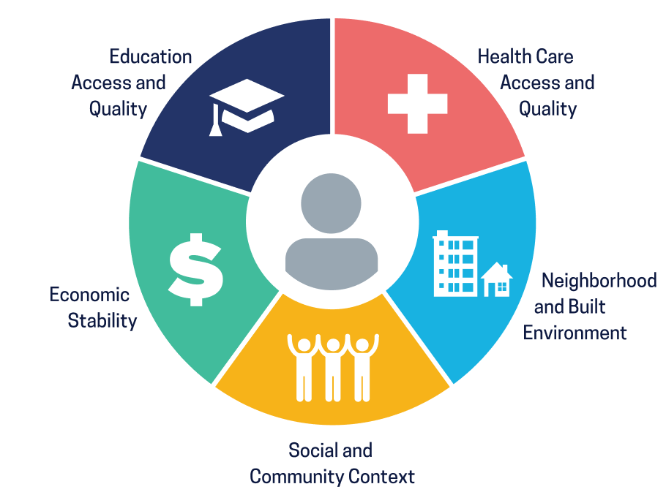
Healthy People 2030 Social Determinants of Health Framework
Social determinants of health (SDOH) are the conditions in the environments where people are born, live, learn, work, play, worship, and age that affect a wide range of health, functioning, and quality-of-life outcomes and risks.
Notes:
We know that the efforts required to eliminate health disparities and achieve health equity, extend well beyond simply promoting healthy choices. The Social determinants of health (SDOH), which have become so vitally important to achieving the Healthy People goals and objectives, are the conditions in the environments where people are born, live, learn, work, play, worship, and age that affect a wide range of health, functioning, and quality-of-life outcomes and risks.
The Healthy People 2030 SDOH framework, conceptualized in this graphic, identifies 5 key domains that influence health: Economic stability, education access and quality, health care access and quality, neighborhood and built environment, and social and community context. Each of these five domains reflects a number of critical underlying factors that impact SDOH.

Slide 21
Increase the proportion of adults with broadband internet — HC/HIT‑05

Slide 22
Current Perspectives: Relationship Between Broadband and Health
Natalie (Nat) Benda, PhD
Division of Health Informatics
Department of Population Health Sciences
Email: ncb4001@med.cornell.edu
Twitter: @nat_benda

Slide 23
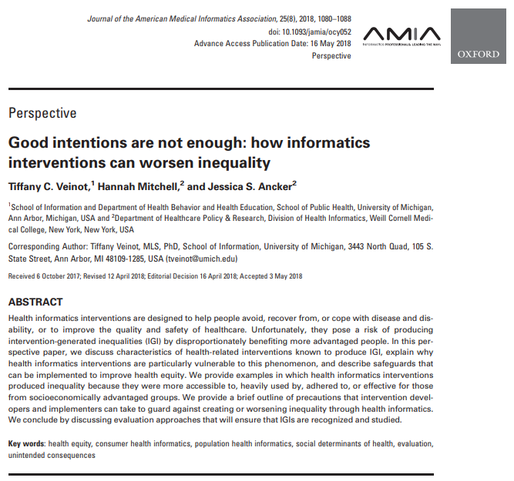
By not supporting broadband Internet access for all, we are creating intervention-generated inequities
What Human Factors is NOT
Intervention-generated inequities are created by the deployment of a well-intentioned interventions that –usually inadvertently –benefits already-advantaged groups over less-advantaged ones

Slide 24
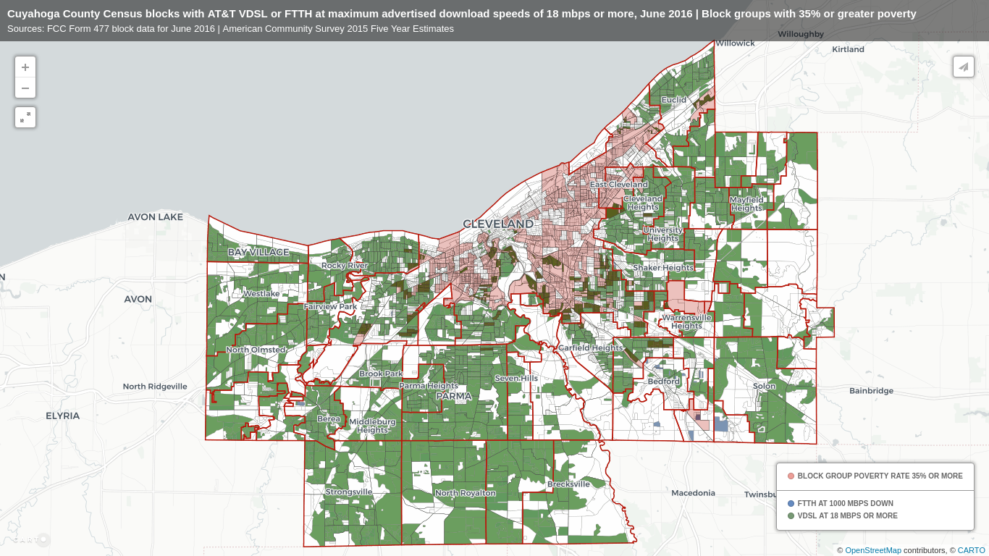
What Human Factors is NOT
"Digital red-lining" further illustrates the systemic inequities associated with broadband internet access
https://www.digitalinclusion.org/blog/2017/03/10/atts-digital-redlining-of-cleveland/
Notes:
Targeted questions -> women within 1 year postpartum vs. women of child-bearing age

Slide 25
Broadband Internet access affects all SDoH
What Human Factors is NOT
Broadband internet access
Information
Healthcare access and quality
Telemedicine
Patient portal
Neighborhood and built environment
Air quality information
Exercise resources
Social and community context
Online communities to reduce social isolation and loneliness
Economic stability
Job applications
Telework flexibility
Education access and quality
Literacy
Numeracy
HealthyPeople 2030 domains
Affects
Health outcomes
Mortality, morbidity, life expectancy, healthcare expenditures, health status, functional limitations
Benda, N.C., Veinot, T.C., Sieck, C.J., Ancker, J.S. (2020). “Broadband Internet Access is a Social Determinant of Health!” American Journal of Public Health. 1123-1125.
Notes:
Targeted questions -> women within 1 year postpartum vs. women of child-bearing age

Slide 26
Limited BIA is also prevalent in urban populations
What Human Factors is NOT
“We were struggling with internet, we relied on hot spots for a while, and had to fight with Optimum to get good internet.” (parent)
“I don't have an actual Wi-Fi service.” (parent)
“The Wi-Fi has been terrible, connection, data and everything has been bad, just bad”. (adolescent)
“I'm paying $95 and the Wi-Fi is not good”. (parent)
Slide and quotes courtesy of Marianne Sharko, MD, MS
Notes:
Targeted questions -> women within 1 year postpartum vs. women of child-bearing age

Slide 27
Healthcare access and quality
What Human Factors is NOT
“It affects everything, my schoolwork, communicating with you guys, communicating with people around me. When I did Urgent Care, we couldn't talk on Zoom, he had to call me.”
(adolescent)
“I didn't attend the meetings, and my therapist dropped me as a patient, which I understand, but since she dropped me, I couldn't receive medication.” (adolescent)
Slide and quotes courtesy of Marianne Sharko, MD, MS
27
Notes:
Targeted questions -> women within 1 year postpartum vs. women of child-bearing age

Slide 28
Neighborhood and built environment / social and community
What Human Factors is NOT
“It's not safe to walk around, there are groups standing in certain spots on our block. If you're going out, you try to be as quick as possible.”
[Are there remote gym classes?]
“It's more like a health class than gym.” (adolescent)
“I don't play [computer games] because the computers don't have the power, but I watch them play. If they're playing with others, I get to hear a group of friends talking.” (adolescent)
Slide and quotes courtesy of Marianne Sharko, MD, MS
28
Notes:
Targeted questions -> women within 1 year postpartum vs. women of child-bearing age

Slide 29
Economic stability (e.g. food access)
What Human Factors is NOT
“I'm paying $95, and the Wi-Fi is not good. $10 more [for better service].”
[So, you want better Wi-Fi, but haven't been able to get it? ]
“For now, it's just one income and we’re not getting food stamps.” (parent)
“When I need something, I send my neighbor. I call her over the phone, I put a piece of paper for her in a plastic bag with what I need, and she gets it for me.”
(parent without internet during quarantine)
Slide and quotes courtesy of Marianne Sharko, MD, MS
29
Notes:
Targeted questions -> women within 1 year postpartum vs. women of child-bearing age

Slide 30
Education access and quality
What Human Factors is NOT
“It takes time out of being able to do assignments, which delays my deadlines.
I usually get in the high 90s, but my grades are borderline passing, and that's not me.”
(adolescent)
“I don't want to be a dropout but they're leading me to be a dropout.” (adolescent)
Slide and quotes courtesy of Marianne Sharko, MD, MS
Notes:
Targeted questions -> women within 1 year postpartum vs. women of child-bearing age

Slide 31
Remarks
Commissioner Brendan Carr
FCC

Slide 32
National Survey Trends in Telehealth Use in 2021: Disparities in Utilization and Audio vs. Video Services
Benjamin Sommers, M.D., Ph.D.
Deputy Assistant Secretary, ASPE
Madjid (MJ) Karimi, Ph.D.
Health Scientist, ASPE
Euny C. Lee, Ph.D.
CDC Public Health Informatics Fellow, ASPE
FCC Symposium March 3, 2022

Slide 33
Overview
Use of telehealth services during COVID-19 pandemic
Analysis using data from the Census Bureau’s 2021 Household Pulse Survey (HPS)
National trends in telehealth utilization across all payers
Use of video-enabled vs. audio-only telehealth services across different subgroups
Policy Implications

Slide 34
Background: Telehealth services during COVID-19 PHE
Literature Review
HRSA-funded health centers expanded telehealth services
CMS enhanced reimbursement in fee-for-service Medicare
CMS waived geographical restrictions
State Medicaid programs undergo changes to encourage greater use of telehealth delivery for health care services
ACCESS
QUALITY
BARRIERS

Slide 35
Research Objectives
Assess national trends in telehealth utilization in 2021 across all payers;
Identify what demographic factors were associated with higher and lower rates of telehealth use; and
Determine how use of video vs. audio-only telehealth differed across these populations.

Slide 36
Methods: Census Household Pulse Survey
The HPS is a 20-minute online survey was fielded approximately every 1 to 2 weeks beginning April 23, 2020
The goal of the survey is to provide timely evidence on the impact of COVID-19 pandemic on U.S. households
In 2021, the National Center for Health Statistics and the HRSA’s Maternal and Child Health Bureau partnered with the Census Bureau to include several questions for monitoring changes in telehealth use

Slide 37
Methods: Survey Telehealth Questions
“At any time in the last 4 weeks, did you have an appointment with a doctor, nurse, or other health professional by video or by phone? Please only include appointments for yourself and not others in your household.”
“At any time in the last 4 weeks, did any children in the household have an appointment with a doctor, nurse, or other health professional by video or by phone?”
For those who selected ‘Yes’: “Did the appointment(s) take place over the phone without video or did the appointment(s) use video?”

Slide 38
Methods: Data Analysis
Two main analyses:
Overall rates of telehealth use (April 2021 to October 2021)
Type of telehealth services used (audio-only vs. video-enabled) among those with telehealth use (July 2021 to October 2021)
Survey-weighted descriptive analyses to assess differences in telehealth use across population subgroups
Two logistic regression models to assess demographic factors associated with telehealth utilization

Slide 39
Methods: HPS Limitations
response rate ranges from 1.3 percent to 10.3 percent, depending on the week
non-response bias
(technology access)
Reflection of groups that are more likely to use any health care
VARIABLES INCONSISTENT DEFINED ACROSS SURVEY PERIODS
AVAILABILITY OF MEASURES: PEOPLE WITH DISABILITIES

Slide 40
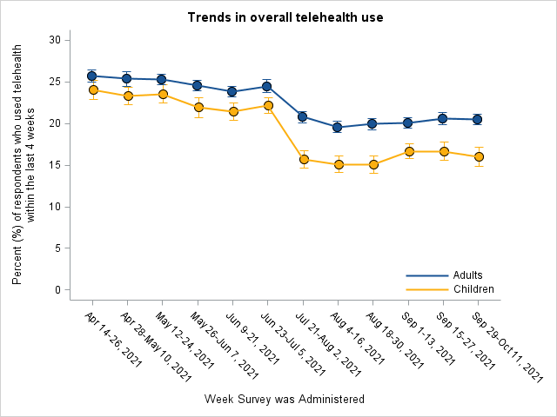
RESULTS: Overall Telehealth Utilization in Prior 4 Weeks
Percentage of Adults and Children who Used Telehealth Services, April 14 - October 11, 2021

Slide 41
RESULTS: Characteristics of Overall Telehealth Users
Notes:
• Telehealth use rates were similar(21.1-26.8%) among most demographic subgroups but
were much lower among those who were uninsured (9.4%) and young adults ages 18 to 24 (17.6%).
• The highest rates of telehealth visits were among those with
Medicaid (29.3%)
Medicare (27.4%)
Black individuals (26.8%)
those earning less than $25,000 (26.7%).

Slide 42
RESULTS: Demographic Patterns for Study Outcomes
 | Full study period (April 14th - October 11th, 2021) % with a Telehealth Visit in the Previous 4 Weeks | Second Half of the Study Period (July 21st to October 11th, 2021)
 |  | % of Telehealth Visits by Video | % of Telehealth Visits by Audio
Age
18-24 years | 17.6 | 72.5 | 27.5
25-39 years | 20.7 | 69.3 | 30.7
40-54 years | 22.7 | 60.9 | 39.1
55-64 years | 23.6 | 52.1 | 47.9
> 65 years | 24.6 | 43.5 | 56.5
Insurance
Medicare | 27.4 | 48.1 | 51.9
Medicaid | 29.3 | 54.5 | 45.5
Private | 20.7 | 65.9 | 34.1
Other Health Insurance | 25.0 | 51.7 | 48.3
Uninsured | 9.4 | 48.8 | 51.2
Notes:
There were significant disparities among subgroups in terms of audio versus video telehealth use.
• highest video use: those earning at least $100,000 (68.8%), those with private insurance (65.9%), and White individuals (61.9%), young adults ages 18 to 24 (72.5%),

Slide 43
RESULTS: Video vs. Audio Use Among Telehealth Users
Notes:
Video telehealth rates were lowest:
< high school diploma (38.1%),
Age > 65 (43.5%), and
Race: Latino (50.7%), Asian (51.3%), and Black individuals (53.6%).
Groups with higher odds of utilizing video-enabled telehealth services were transgender or those with Medicare health insurance coverage.
Conversely, groups with lower odds of using video-enabled telehealth services were respondents who self-identified as Latino, Black, or Asian American / Pacific Islander; men;
those with lower education and income, and those living in the Midwest.
Demographic Factors Associated with Telehealth Utilization, Model 1: April 14 – October 11, 2021
Race/Ethnicity: All races had significantly higher telehealth use compared to whites except for Asians
Education: High school graduates and those with some college including an AAS degree were less likely to use telehealth than their college graduate counterparts
Insurance:
Uninsured were less likely to use telehealth.
Medicare, Medicaid, and other health insurance type beneficiaries had higher telehealth utilization
Region: Compared to the West, all other regions had significantly less utilization
Demographic Factors Associated with Video Telehealth Model 2: July 21 - October 11, 2021
Race/Ethnicity: All races had significantly less telehealth use compared to whites except for multi- or other race.
Gender: male/female transgender were 3 times more likely to use video telehealth than those who identified as cisgender females
Education: Those with less than college education were less likely to use video
Insurance:
Medicare beneficiaries were more likely to use video
Uninsured were less likely to use video telehealth.

Slide 44
Policy Implications
Almost $1 billion from the American Rescue Plan of 2021 was distributed to nearly 1,300 HRSA-funded health centers in all 50 states, the District of Columbia, and the U.S. territories to support a wide range of projects, including access to telehealth
Policy efforts to ensure equitable access to telehealth, in particular video-enabled telehealth, are needed to ensure that disparities that emerged during the pandemic do not become permanent
Video appointments require more complex setup, video-enabled devices, and broadband internet access, which may present barriers for older adults, lower income households, and those with limited English proficiency

Slide 45
Acknowledgements
Nancy De Lew, Associate Deputy Assistant Secretary, Office of Health Policy
Scott R. Smith, Division Director, Office of Health Policy
Violanda Grigorescu, Senior Health Scientist, Office of Health Policy
Sara J. Couture, Health Informatics Fellow, Office of Health Policy
Aldren B. Gonzales, Public Health Informatics Fellow, Office of Health Policy
Link to the Issue Brief: https://aspe.hhs.gov/reports/hps-analysis-telehealth-use-2021

Slide 46
Thank you! Madjid (MJ) Karimi, Ph.D. Madjid.Karimi@hhs.gov Euny C. Lee, Ph.D. Euny.Lee@hhs.gov

Slide 47
Appendix/ Reference Slides

Slide 48
References, I
Bailey Z.D., Krieger N., Agénor M., et al. (2017). Structural racism and health inequities in the USA: evidence and interventions. Lancet, 389 (10077): 1453–63. https://pubmed.ncbi.nlm.nih.gov/28402827/
Demeke, H.B., Pao, L.Z., Clark, H., et al. Telehealth practice among health centers during the COVID-19 pandemic—United States, July 11–17, 2020. MMWR Morb Mortal Wkly Rep. (2020); 69:1902–5. https://www.cdc.gov/mmwr/volumes/69/wr/mm6950a4.htm
Centers for Medicare & Medicaid Services. COVID-19 emergency declaration blanket waivers for health care providers. Baltimore, MD: U.S. Department of Health and Human Services, Centers for Medicare & Medicaid Services. https://www.cms.gov/files/document/covid19-emergency-declaration-health-care-providers-fact-sheet.pdf
Chu, R.C., Peters, C., De Lew, N., and Sommers, B.D. State Medicaid Telehealth Policies Before and During the COVID-19 Public Health Emergency (Issue Brief No. HP-2021-17). Office of the Assistant Secretary for Planning and Evaluation, U.S. Department of Health and Human Services. July 2021. https://aspe.hhs.gov/reports/state-medicaid-telehealth-policies
Russo, J.E., McCool, R.R., and Davies, L. (2016). VA telemedicine: An analysis of cost and time savings. Telemed J e-Health: Off J Am Telemed Assoc., 22(3):209-215.
Dorsey, E.R., and Topol, E.J. State of telemedicine. N Engl J Med. (2020) 375(2): 154-161.
Rush K.L., Howlett L., Munro A., et al. Videoconference compared to telephone in healthcare delivery: A systematic review. Int J Med Inform 2018; 118: 44–53. https://pubmed.ncbi.nlm.nih.gov/30153920/

Slide 49
References, II
2020 Household Pulse Survey. Census.gov. Accessed at: https://www2.census.gov/programs-surveys/demo/technical-documentation/hhp/Source-and-Accuracy-Statement-May-28-June2.pdf
Source of the data and accuracy for the estimates for the 2020 Household Pulse Survey—phase 2: Interagency Federal Statistical Rapid Response Survey to measure household experiences during the coronavirus (COVID-19) pandemic. US Census Bureau. Accessed October 16, 2021. https://www2.census.gov/programs-surveys/demo/technical-documentation/hhp/Phase2_Source_and_Accuracy_Week_17.pdf
The AP-NORC Center for Public Affairs Research. (December 2021). “Telehealth and Equity” https://apnorc.org/projects/telehealth-and-equity/
Roberts E.T., & Mehrotra A. (2020). Assessment of disparities in digital access among Medicare beneficiaries and implications for telemedicine. JAMA Intern Med, 180 (10): 1386. https://pubmed.ncbi.nlm.nih.gov/32744601/
Lam K., Lu A.D., Shi Y., et al. (2020). Assessing telemedicine unreadiness among older adults in the United States during the COVID-19 pandemic. JAMA Intern Med, 180 (10): 1389. https://pubmed.ncbi.nlm.nih.gov/32744593/
Biden-Harris Administration Provides Nearly $1 Billion in American Rescue Plan Funds to Modernize Health Centers and Support Underserved Communities. (2021).
Chu, R.C., Peters, C., De Lew, N., and Sommers, B.D. State Medicaid Telehealth Policies Before and During the COVID-19 Public Health Emergency (Issue Brief No. HP-2021-17). Office of the Assistant Secretary for Planning and Evaluation, U.S. Department of Health and Human Services, July 2021. https://aspe.hhs.gov/reports/state-medicaid-telehealth-policies

Slide 50
Demographic Characteristics of Overall and Audio vs. Video Telehealth Users
 | Full study period (April 14th - October 11th, 2021) % with a Telehealth Visit in the Previous 4 Weeks | Second Half of the Study Period (July 21st to October 11th, 2021)
 |  | % with a Telehealth Visit in the Previous 4 Weeks | % of Telehealth Visits by Video | % of Telehealth Visits by Audio
Race and Ethnicity
Latino | 24.4 | 21.8 | 50.7 | 49.3
White alone, not Latino | 21.1 | 19.0 | 61.9 | 38.1
Black alone, not Latino | 26.8 | 24.7 | 53.6 | 46.4
Asian alone, not Latino | 22.2 | 20.2 | 51.3 | 48.7
Multiracial or Other | 26.2 | 23.5 | 58.9 | 41.2
Education
Less than high school | 24.1 | 22.4 | 38.1 | 61.9
High school or GED | 21.1 | 18.9 | 48.2 | 51.8
Some college/associate’s degree | 23.3 | 20.9 | 58.9 | 41.1
Bachelor’s degree or higher | 23.0 | 20.8 | 67.4 | 32.6

Slide 51
Demographic Factors Associated with Telehealth Utilization, April 14 – October 11, 2021
Demographics | Odds Ratios (95% CL) | P-value | P-value
Race and Ethnicity
Latino | 1.27 (1.22, 1.33) | <.0001
Black alone, not Latino | 1.36 (1.30, 1.42) | <.0001
Asian alone, not Latino | 1.02 (0.96, 1.08) | 0.61
Multiracial or Other | 1.27 (1.20, 1.35) | <.0001
White alone, not Latino | Ref | Ref
Census Region
Northeast | 0.91 (0.88, 0.95) | <.0001
Midwest | 0.70 (0.67, 0.72) | <.0001
West | Ref | Ref
South | 0.82 (0.79, 0.85) | <.0001
Education
Less than high school | 0.91 (0.78, 1.05) | 0.20
High school or GED | 0.77 (0.74, 0.80) | <.0001
Some college/associate’s degree | 0.95 (0.92, 0.97) | <.0001
Bachelor’s degree or higher | Ref | Ref
Insurance
Medicare | 1.70 (1.62, 1.79) | <.0001
Medicaid | 1.36 (1.30, 1.44) | <.0001
Private | Ref | Ref
Other Health Insurance | 1.24 (1.13, 1.35) | <.0001
Uninsured | 0.35 (0.32, 0.38) | <.0001

Slide 52
Demographic Factors Associated with Video Telehealth Utilization Among Telehealth Users, July 21 - October 11, 2021
Demographics | Odds Ratios (95% CI) | P-value
Race and Ethnicity
Latino | 0.74 (0.66, 0.83) | <.0001
Black alone, not Latino | 0.85 (0.76, 0.96) | 0.0077
Asian alone, not Latino | 0.55 (0.47, 0.64) | <.0001
Multiracial or Other | 0.98 (0.84, 1.14) | 0.75
White alone, not Latino | Ref | Ref
Gender Identity
Male | 0.93 (0.87, 1.00) | 0.0384
Transgender | 3.12 (1.72, 5.68) | 0.0002
Other | 1.10 (0.83, 1.46) | 0.50
Female | Ref | Ref
Census Region
Northeast | 1.07 (0.96, 1.19) | 0.2474
Midwest | 0.86 (0.78, 0.94) | 0.0015
West | Ref | Ref
South | 1.05 (0.96, 1.14) | 0.26
Education
Less than high school | 0.50 (0.35, 0.71) | 0.0001
High school or GED | 0.60 (0.54, 0.66) | <.0001
Some college/associate’s degree | 0.81 (0.75, 0.86) | <.0001
Bachelor’s degree or higher | Ref | Ref
Insurance
Medicare | 1.23 (1.09, 1.38) | 0.0005
Medicaid | 0.989 (0.87, 1.13) | 0.87
Private Health Insurance | Ref | Ref
Other Health Insurance | 0.974 (0.78, 1.22) | 0.81
Uninsured | 0.727 (0.57, 0.94) | 0.01

Slide 53
Broadband Connectivity: A Super Determinant of Health
Connect2Health^{FCC} Task Force
FCC DIGITAL HEALTH SYMPOSIUM
March 3, 2022

Slide 58
Brief Break

Slide 59
Fireside Chat: The Value Proposition of Broadband Connectivity in Health

Slide 60
David Ahern, PhD
Senior Advisor
Connect2Health^{FCC} Task Force
FCC
Donald Berwick, MD, MPP, FRCP, KBE
President Emeritus and Senior Fellow, Institute for Healthcare Improvement
Faculty, Department of Health Care Policy, Harvard Medical School
Former Administrator of the Centers for Medicare & Medicaid Services

Slide 61
PANEL 2: How Connectivity is Enhancing Health and Transforming Health Care; Emerging Technologies and Innovations

Slide 62
Joe Drygas, BA
Vice President-Global Business-Healthcare
AT&T Business
Karen Rheuban, MD
Medical Director, Office of Telemedicine, University of Virginia Health System
Professor of Pediatrics, University of Virginia
David C. Rhew, MD
Global Chief Medical Officer, VP Healthcare
Worldwide Commercial, Microsoft
Michael R. Crawford, MBA, MHL
Associate Dean for Strategy, Outreach, and Innovation
Howard University College of Medicine
Elisabeth Myers, MBA, BA
Deputy Director, Office of Policy
Office of the National Coordinator for Health Information Technology
René Quashie, JD, BS (Moderator)
Vice President of Policy & Regulatory Affairs, Digital Health
Consumer Technology Association

Slide 63
Lunch Break

Slide 64
PANEL 3: Connecting the Dots—Establishing Broadband Connectivity as a Social Determinant of Health Domain

Slide 65
Susan Dentzer, MS
Incoming Chief Executive Officer
America's Physician Groups
Jill Egeth, PhD, MS, BA
Managing Director, Healthcare Delivery & New Opportunities
The MITRE Corporation
Gretchen Purcell Jackson, MD, PhD, FACS, FACMI, FAMIA
President and Board Chair
American Medical Informatics Association
Lauren Riplinger, JD, BA
Vice President of Policy and Government Affairs
American Health Information Management Association
Gopal Singh, PhD
Senior Health Equity Advisor, Office of Health Equity
Health Resources & Services Administration
Michael “Chris” Gibbons, MD, MPH (Moderator)
Senior Advisor
Connect2Health^{FCC} Task Force, FCC

Slide 66
Broadband Internet Connectivity as a Social Determinant of Health and Its Role in Promoting Health Equity FCC Digital Health Symposium: Advancing Broadband Connectivity as a Social Determinant of Health
Gopal K. Singh, Ph.D., Senior Health Equity Advisor
Office of Health Equity
Health Resources and Services Administration

Slide 67
Aims of the Study
To discuss consideration of broadband connectivity and access as an important social determinant of health
To examine inequalities in broadband internet access according to racial/ethnic, socioeconomic, and demographic characteristics
To examine inequalities in population health indicators and individual health outcomes according to broadband internet access both at the individual and community-level
To describe health equity and health promotion efforts through advancement of digital equity

Slide 68
Data, Variables, and Methods
American Community Survey (ACS), 2013-2017
U.S. National Vital Statistics System, 2013-2020
County Health Rankings and Roadmaps, 2019
Population health outcomes: life expectancy, age-adjusted mortality rates per 100,000 population for leading causes of death, hospitalization rate, disability rates, self-assessed health status, mental distress, health insurance, smoking rate, obesity rate, and physical inactivity rate
Prevalence (%), Rates, Rate Ratios, Relative Risks, and Regression Modeling

Slide 69
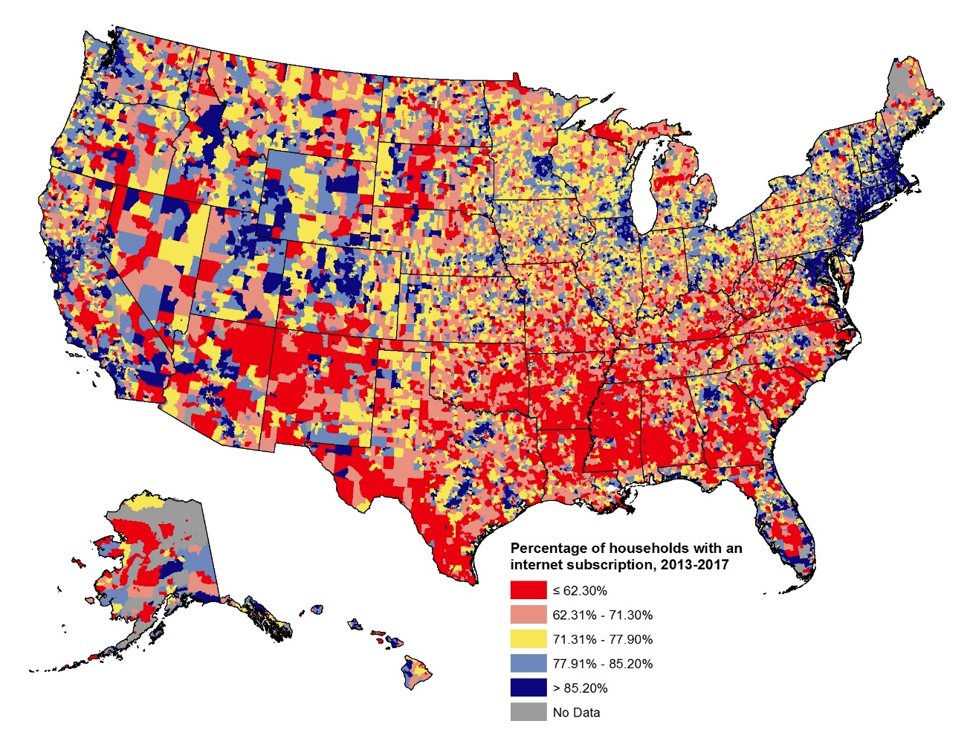
Percentage of Households with Internet Access, United States, 2013-2017 (32,989 Zip Codes)
Source: Singh GK, Girmay M, Allender M, Ramey CT. Digital Divide: Marked Disparities in Computer and Broadband Internet Use and Associated Health Inequalities in the United States. International Journal of Translational Medical Research and Public Health. 2020;4(1):64-79. Data derived from the 2013-2017 American Community Survey.

Slide 70
Broadband Internet Access (%) by Race/Ethnicity and Socioeconomic Status, U.S. Adults Aged 18 Years and Older, 2017
Source: Singh GK, Girmay M, Allender M, Ramey CT. Digital Divide: Marked Disparities in Computer and Broadband Internet Use and Associated Health Inequalities in the United States. International Journal of Translational Medical Research and Public Health. 2020;4(1):64-79.

Slide 71
Internet Use Among U.S. Adults Aged ≥18 Years by Levels of Urbanization (2013 Rural-Urban Continuum Code), 2013-2017
Metropolitan (urban) counties include: (1) large metro = counties in metropolitan areas of ≥1 million population,
(2) medium metro = counties in metropolitan areas of 250,000-999,999 population,
(3) small metro = counties in metropolitan areas of <250,000 population
Nonmetropolitan (rural) counties include: (4) urban nonmetropolitan counties or small urban towns =
population 2,500 to 49,999, (5) nonmetropolitan rural counties or small rural towns with a population of <2,500.
Source: Singh GK, Girmay M, Allender M, Ramey CT. Digital Divide: Marked Disparities in Computer and Broadband Internet Use and Associated Health Inequalities in the United States. International Journal of Translational Medical Research and Public Health. 2020;4(1):64-79.

Slide 72
Relationship Between Internet Use and Population Health Indicators, United States, 2013-2017 (N = 3,143 Counties)
Source: Singh GK, Girmay M, Allender M, Ramey CT. Digital Divide: Marked Disparities in Computer and Broadband Internet Use and Associated Health Inequalities in the United States. International Journal of Translational Medical Research and Public Health. 2020;4(1):64-79.

Slide 73
County-Level Correlations Between Internet Use and Population Health and Sociodemographic Indicators, United States, 2013-2017 (N = 3,143 Counties)
Total disability rate | -0.7002 |  | Current smoking rate | -0.6589
Ambulatory disability rate | -0.7478 |  | Physical inactivity rate | -0.6583
Cognitive disability rate | -0.6442 |  | Obesity rate | -0.6094
Life expectancy | 0.6883 |  | Hospitalization rate | -0.5440
All-cause mortality rate | -0.6815 |  | Uninsurance rate, total population | -0.3901
Cardiovascular disease mortality rate | -0.6795 |  | Uninsurance rate, children <18 | -0.2585
Cancer mortality rate | -0.5703 |  | Uninsurance rate, adults 18-64 | -0.4543
Diabetes mortality rate | -0.5555 |  | Ethnic minority population (%) | -0.2942
Homicide rate | -0.5869 |  | Poverty rate | -0.7212
Suicide rate | -0.2732 |  | College degree or higher (%) | 0.7371
Self-assessed fair/poor health, adults (%) | -0.7209 |  | Unemployment rate | -0.4229
Mental distress, adults (%) | -0.3013
Source: Singh GK, Girmay M, Allender M, Ramey CT. Digital Divide: Marked Disparities in Computer and Broadband Internet Use and Associated Health Inequalities in the United States. International Journal of Translational Medical Research and Public Health. 2020;4(1):64-79.

Slide 74
Association between Broadband Internet Access and Disability and Health Insurance Characteristics, United States, 2017 (N = 2,090,921 Adults Aged 18 Years and Older)
Source: Singh GK, Girmay M, Allender M, Ramey CT. Digital Divide: Marked Disparities in Computer and Broadband Internet Use and Associated Health Inequalities in the United States. International Journal of Translational Medical Research and Public Health. 2020;4(1):64-79.

Slide 75
Conclusions
Despite high levels of internet use, significant racial/ethnic, socioeconomic, and geographic disparities exist.
Broadband access is an important predictor of population health outcomes, often independent of other social determinants such as education, income, employment, and race/ethnicity.
Communities with low internet access have seven years shorter life expectancy than communities with high access and are at an increased risk of mortality from various chronic conditions, poor health, mental distress, preventable hospitalization, smoking, obesity, and physical inactivity.

Slide 76
Conclusions (Continued)
More than a quarter million (or 34%) American Indians and Alaska Native adults, 5.1 million (23%) Black/African Americans, and 7.2 million (21%) Hispanics lack access to broadband internet.
More than 30% of the rural population (or 46 million people) lack access to broadband internet. Lack of broadband access is particularly acute in small rural towns.
Closing the social divide in broadband internet access can positively impact individual empowerment, educational attainment, economic growth, community development, access to health care and health-related information, and health promotion efforts.

Slide 77
Contact Information
Gopal K. Singh, Ph.D. (Email: GSingh@hrsa.gov)
Office of Health Equity
Health Resources and Services Administration
U.S. Department of Health and Human Services
Web: https://www.hrsa.gov/about/organization/bureaus/ohe/index.html

Slide 78
Connect with HRSA
Learn more about our agency at:
www.HRSA.gov
Sign up for the HRSA eNews
FOLLOW US:

Slide 79
A National Strategy for Digital Health
Jill D. Egeth, PhD

Slide 80
1. Scope and Purpose

Slide 81
Digital Health…
...is the convergence of health-related sciences and digital technologies that empower people and populations to manage their health and well-being (MCRA)
…includes categories such as mobile health (mHealth), health information technology (IT), wearable devices, telehealth and telemedicine, and personalized medicine (FDA)
….connects and empowers people and populations to manage health and wellness, augmented by accessible and supportive provider teams working within flexible, integrated, interoperable, and digitally-enabled care environments that strategically leverage digital tools, technologies and services to transform care delivery (HIMSS)

Slide 82
Why do we need a National Strategy?
COVID-19 is a watershed
The strategy provides a framework to aid in determining priorities and laying the groundwork for change
Intended for leaders in the digital health community—including government, care providers, community champions, academia, and technology developers
Authored by the Health FFRDC and Health Innovation Center, with guidance from the Health Advisory Committee

Slide 83
2. Strategy Goals and Objectives

Slide 84
Vision
Improved health and well-being of the nation powered by a digital health ecosystem
Collaborative Governance
Goals and Objectives
Form a connected health ecosystem defined by timely, secure data exchange
Empower individuals to take charge of their health and well-being
Establish artificial intelligence as a trusted cornerstone of digital health
Institutionalize rapid sharing of integrated data for public health
Build a workforce skilled in application of digital health
Grow digital equity to achieve health equity
Standardize patient identification
Standardize health data
Standardize the health architecture
Secure the connected health ecosystem
Provide individuals with ownership of data relating to their health
Create a national action plan to improve digital health literacy
Develop a framework for reasonable use of digital health
Assess options for reimbursing use of digital modalities
Analyze impact of restrictions on use of telemedicine
Further mature the nation’s precision medicine capability
Create governance for reliable, transparent and ethical AI development
Apply a maturity model to guide AI development and use
Support practices that will ensure AI integrity
Conduct rigorous AI evaluations and establish performance metrics
Foster informed AI users through certification and continuing credit training
Develop funding strategies to encourage a systems approach to investment in public health workforce and infrastructure
Establish a representative governance entity to drive modernization of digital public health infrastructure
Partner to expand available data and improve reporting to public health agencies
Support the National Health Care Workforce Commission
Invest in upskilling workforce
Modernize post-secondary accreditation requirements
Support model programming for continuing education in digital health and data science
Establish a newly defined digitally-enabled workforce
Create a new National Broadband Plan
Ensure community engagement in digital health development and research
Improve measurement, monitoring, research, and practice to account for inequities and varying levels of access

Slide 85
Grow digital equity to achieve health equity
Create a new National Broadband Plan.
Ensure community engagement in digital health development and research.
Improve measurement, monitoring, research, and practice to account for inequities and varying levels of access

Slide 86
Create a New National Broadband Plan
The FCC developed the most recent broadband in 2010 . Given the reliance on broadband by all individuals and communities, the nation needs a new plan to:
Consider the expanding needs and widening digital health disparities among U.S. communities while also recognizing significant technological advancements over the past decade and opportunities to ensure universal access to broadband and other infrastructure.
Provide opportunities for all communities to participate in a broadband-needs assessment and proposed interventions.
Create an accurate mapping of broadband availability and speed.
Include broadband capability as part of a larger plan to develop “smart” communities.
Create a government-wide approach to broadband adoption and affordability that replaces the current approach to broadband infrastructure, which is fragmented across the government and sometimes not aligned across federal agencies.

Slide 87
Improve Measurement, Monitoring, Research, and Practices to Account for Health Inequities and Varying Levels of Digital Access
Tracking progress toward health equity requires continual capture of indicators to monitor access to digital technology, use of that technology, and skills of diverse populations. Actions should include:
Enhance measurement of successes and failures in digital access and equity
Identify and apply a systematic approach for assessing equity impacts of digital health interventions.
Design health equity metrics appropriate to enhancing measures of digital health.
Ensure that analysis includes a focus on different populations that have faced unique historical barriers and appropriately customize solutions
Take steps to minimize bias in AI and the underlying algorithms.

Slide 88
Governance Reform
Reform of fragmented and out-of-date governance structures is needed using a whole-of-nation approach to achieve an effective process that harmonizes efforts across the ecosystem.
Declare digital health a national priority.
Establish an entity to drive development of a governance structure across the public and private sectors.
Define explicit roles, responsibilities and rights.
Develop and support actionable guidelines.
Incrementally institutionalize governance structures into law.

Slide 89
For more information and to share your thoughts:
Contact us:
DigitalHealth@mitre.org

Slide 90
PANEL 4: Looking Ahead—Implications of Broadband Connectivity as a Social Determinant of Health Domain on Government Policies, Clinical Care, and Health Equity

Slide 91
Joshua Edmonds, MPP, BA
Director of Digital Inclusion, Department of Innovation and Technology
City of Detroit
William England, PhD, JD
Senior Advisor, Office for the Advancement of Telehealth
Health Resources & Services Administration
John Horrigan, PhD, BA
Senior Fellow
Benton Institute for Broadband and Society
Mikelle Moore, MBA, MHSA, BS
Senior Vice President, Chief Community Health Officer
Intermountain Healthcare
Jorge A. Rodriguez, MD
Digital Health Equity Researcher and Hospitalist
Division of General Internal Medicine and Primary Care, Brigham and Women's Hospital and Harvard Medical School
Adie Tomer, MPP, BA
Senior Fellow
The Brookings Institution
David Blumenthal, MD, MPP (Moderator)
President, The Commonwealth Fund
Former National Coordinator for Health Information Technology

Slide 92
Broadband Adoption & Health Care
John B. Horrigan
Benton Institute

Slide 93
Broadband inequities and income
Just 48% of those in poverty have wireline broadband subscriptions at home:
Compared with 84% for those with annual incomes above $75,000. (2019 ACS)
Low-income households struggled during the pandemic → subscription vulnerability:
18% lost service in 2021 because of pandemic-driven economic difficulties.
46% say affording their monthly broadband service fee is difficult
The EBB (now ACP) helped:
9% of low-income households say they have used EBB/ACP or discount programs
Lots more to do on spreading the word about ACP benefits

Slide 94
Place & race are significant
Cities with highest poverty have lowest home broadband adoption rates:
67% of households subscribe among 20 large cities with highest rates of poverty
82% for 20 large cities with lower poverty rates.
Residential segregation matters:
Highly residentially segregated cities → 68% of households with broadband
Cities with less residential segregation have higher broadband adoption rate → 79%

Slide 95
Can broadband address health inequity?
Half (53%) of new internet subscribers use it to search for health & medical information.
Often access to health information is a motivation for getting service
Digital skills training enhances this!
65% of those with training use home online connectivity for health & medical information
Trust – must overcome significant worries for low-income and other individuals in sharing personal data
Digital navigators: many new adopters benefit from one-to-one help getting started

Slide 96
Telehealth at HRSA and The Office for the Advancement of Telehealth FCC Digital Health Symposium: Advancing Broadband Connectivity as a Social Determinant of Health
William England, PhD, JD
Senior Advisor, Office for the Advancement of Telehealth
Health Resources and Services Administration (HRSA)

Slide 97
Health Resources and Services Administration
HRSA Mission
To improve health outcomes and achieve health equity through access to quality services, a skilled health workforce, and innovative, high-value programs.
Notes:
HRSA Goals:
1. Take actionable steps to achieve health equity and improve public health 2. Improve access to quality health services 3. Foster a health workforce and health infrastructure able to address current and emerging needs 4. Optimize HRSA operations and strengthen program engagement
In September 2021, the HHS Office of the Assistant Secretary for Health launched an initiative to strengthen primary health care, ensure high quality health care for all, improve health outcomes, and advance health equity. HHS is developing a plan and actions that HHS and its agencies would take to strengthen the primary health care foundation of our nation’s health system. Among other considerations, planners noted that the COVID-19 pandemic forced payers to enhance the ability of patients to access primary care teams virtually by video and telephone and that these forms of care provide many benefits and CMS should minimize payment and regulatory barriers to their use.

Slide 98
HRSA Leadership and History in Telehealth
For over 30 years HRSA has been a leader in the field of telehealth.
HRSA Telehealth Workgroup created
2017
Joint Working Group on Telemedicine created (FedTel)
1995
Telehealth Resource Center program established
2006
OAT becomes a stand-alone office with a broader role
2021
21 HRSA programs with telehealth identified
1,009 HRSA awards with telehealth identified
3,876 HRSA awards with telehealth identified
Nearly $20 million in new telehealth awards
1988
HRSA’s first telehealth program in the Federal Office of Rural Health Policy
2002
The Office for the Advancement of Telehealth established
2016
Federal Telehealth Compendium created
2020
COVID-19 changed the telehealth landscape

Slide 99
Telehealth Activities Across HRSA
Currently approximately 3,876 awards include a telehealth component
50 states and 9 federal districts/territories have awards
Target populations include rural, tribal and underserved communities, low-income populations, and health care providers
Notes:
In Fiscal Year 2020
HRSA awarded more than $1 billion for telehealth activities in FY2020.
HRSA had approximately 3,876 awards that included telehealth during FY2020. This was an increase of 106% from FY2019.
Nearly 2,600 (67%) awards had COVID-19 funding. Over 680 (18%) awards using telehealth were not using it before the COVID-19 public health emergency.
These awards were located in all 50 states and in nine of the federal districts/territories/freely associated states eligible for HRSA funding.
Telehealth uses supported by HRSA included workforce training, direct clinical services, distance learning, clinician support, infrastructure development, technical assistance, administrative support, and research/reports.
Over 550 (14%) awards included distance learning (Project Echo® and Project Echo-like).
Over 150 (4%) awards supported infrastructure development.
Telehealth can be a tool to improve health equity. Target populations supported by telehealth awards included rural communities, underserved communities, low-income populations, children, family/caregivers, women, school-based populations, LGBTQ, homeless populations, and tribal communities.
Over 520 (13%) awards included a focus on mental health care and/or substance/opioid use disorder (SUD/OUD).

Slide 100
HRSA FY20 Awards with Telehealth Use

Slide 101
Office for the Advancement of Telehealth
HRSA is home to the Office for the Advancement of Telehealth
Serves across HHS to promote the use of telehealth in health care delivery, education, and health information services to improve access, enhance outcomes, and support clinicians and patients
Provides funding for direct services, research, and technical assistance in telehealth
Supports Telehealth Resource Centers to provide hands-on information and training on telehealth to all states and territories, including a policy center and a technology center
Launched a Telehealth Broadband Pilot Project to assess broadband availability for provider and patient communities
Operates Telehealth.HHS.gov for patients, providers and researchers to learn about telehealth

Slide 102
Contact Information
William L England, PhD, JD
Senior Advisor
Office for the Advancement of Telehealth
wengland@hrsa.gov
Notes:
Are there any questions?

Slide 103
Connect with HRSA
Learn more about our agency at:
www.HRSA.gov
Sign up for the HRSA eNews
FOLLOW US:

Slide 104
Brief Break

Slide 105
PANEL 5: Next Steps—A Focus on Broadband and Health Data and Social Determinants of Health Research

Slide 106
Robin Gelburd, JD
President
FAIR Health
Kiersten Frobom, MPA, MPH, BA
Senior Evidence Analyst on Evidence & Policy Analysis Team, County Health Rankings & Roadmaps
Population Health Institute, University of Wisconsin
Patricia Keenan, PhD
Senior Researcher
Agency for Healthcare Research and Quality
Adam Perzynski, PhD
Associate Professor, Department of Medicine, Case Western University
Director, Patient-Centered Media Lab, Center for Health Care Research and Policy, MetroHealth Medical Center
Dr. Robin Vanderpool, DrPH
Chief, Health Communication and Informatics Research Branch, Division of Cancer Control and Population Sciences
National Cancer Institute
David Ahern, PhD (Moderator)
Senior Advisor
Connect2Health^{FCC} Task Force

Slide 107
A Window into FAIR Health Telehealth Data
Robin Gelburd, President
March 3, 2022

Slide 108
The FAIR Health Private Claims Repository
36+
Medical and Dental Claims from 2002 to the Present
70+
Contributors
Nationwide
Coverage
Billion
2+
Updated on a monthly basis
New Claims
Every Year
Billion
Includes Medicare Advantage Claims
Quality Testing and Control
493
Regions in the
United States

Slide 109
Targeted Telehealth Claim Lines
Place of Service = 02
Modifier is
GT, GQ or 95
CPT® code is a telehealth-only procedure
86.98
78.07
165.05
Million
Million
Million
2020
2021

Slide 110
All Telehealth Utilization, 2020 vs. 2021

Slide 111
Top Five Diagnoses Treated via Telehealth, 2021

Slide 112
CPT Codes Included in Audio Only and Video Telehealth Categories
Audio Only
CPT Code | Description
98967 | Telephone assessment and management service, 11-20 minutes of medical discussion
98966 | Telephone assessment and management service, 5-10 minutes of medical discussion
98968 | Telephone assessment and management service, 21-30 minutes of medical discussion
99441 | Physician telephone patient service, 5-10 minutes of medical discussion
99442 | Physician telephone patient service, 11-20 minutes of medical discussion
99443 | Physician telephone patient service, 21-30 minutes of medical discussion
Video
CPT Code | Description
98969* | Internet or similar electronic online patient assessment and management service by qualified nonphysician healthcare professional
98970 | Qualified nonphysician healthcare professional online digital evaluation and management service, for an established patient, for up to 7 days, cumulative time during the 7 days; 5-10 minutes
98971 | Qualified nonphysician healthcare professional online digital evaluation and management service, for an established patient, for up to 7 days, cumulative time during the 7 days; 11-20 minutes
98972 | Qualified nonphysician healthcare professional online digital evaluation and management service, for an established patient, for up to 7 days, cumulative time during the 7 days; 21 or more minutes
99421⁺ | Online digital evaluation and management service, for an established patient, for up to 7 days, cumulative time during the 7 days; 5-10 minutes
99422⁺ | Online digital evaluation and management service, for an established patient, for up to 7 days, cumulative time during the 7 days; 11-20 minutes
99423⁺ | Online digital evaluation and management service, for an established patient, for up to 7 days, cumulative time during the 7 days; 21 or more minutes
99444* | Physician or healthcare professional evaluation and management of patient care by internet (email) related to visit within previous 7 days
* Code retired at the end of 2019.
⁺ Code introduced at the beginning of 2020.
Modifiers 93 and FQ:
On January 1, 2022, modifiers 93 and FQ were added. These modifiers indicate that the service was furnished using interactive audio-only communication technology.
Modifier FR:
On January 1, 2022, modifier FR was added. This modifier specifies that this service was conducted via two-way, audio/video communication technology.

Slide 113
Telehealth Services by Type, 2019 vs. 2021

Slide 114
Video Telehealth: Rural vs. Urban, 2021

Slide 115
Audio Only Telehealth: Rural vs. Urban, 2021

Slide 116
Video vs. Audio Only Telehealth Usage by Age and Gender, 2020-2021

Slide 117
Broadband: A super determinant of health
Access
Service is available
Affordability
People can afford service & devices
Adoption
People have skills & know benefits

Slide 118
How do we benefit from broadband?
Employment
Increased labor market participation, especially for rural, and especially with higher speeds (100 Mbps)
Via health-promoting services:
Telemedicine
Distance education
Social services
E-commerce
Civic engagement
Social connection

Slide 119
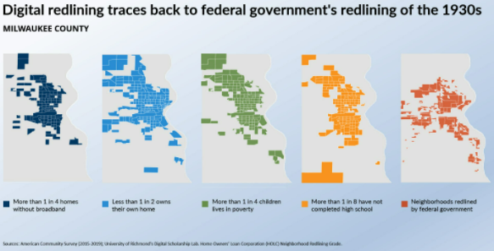
Without broadband,
economic, social, educational, and health inequalities are worsened.
https://www.countyhealthrankings.org/reports/digital-redlining

Slide 120
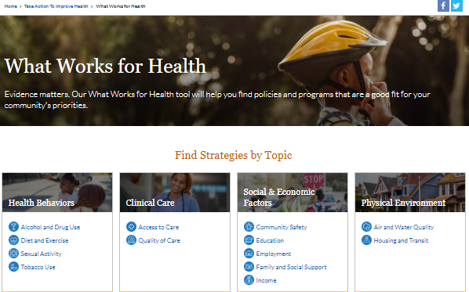
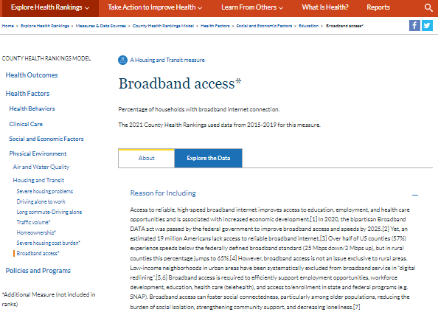
Where can I find data and solutions to close the digital divide?
Broadband initiatives for unserved & underserved areas
Technology-enhanced classroom instruction
Telemedicine
Telemental health services

Slide 121
Examples: Empirical support for the links between health behaviors, preventive screening and health outcomes
Adam T. Perzynski, PhD
Associate Professor of Medicine and Sociology
The MetroHealth System
Case Western Reserve University
@ATPerzynski
Adam.Perzynski@case.edu
Feb 28 2022

Slide 122
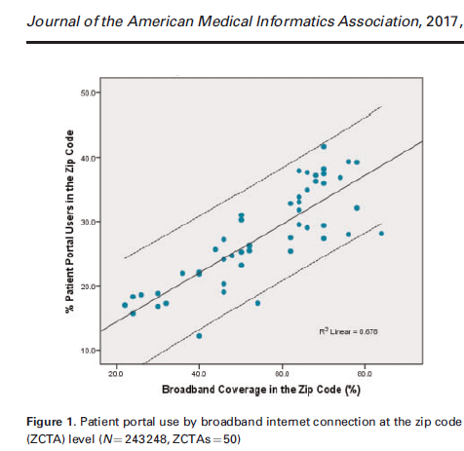
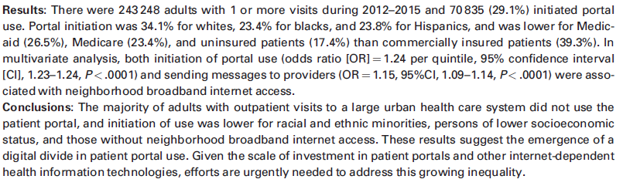
Perzynski AT, Roach MJ, Shick S, Callahan B, Gunzler D, Cebul R, Kaelber DC, Huml A, Thornton JD, Einstadter D. Patient portals and broadband internet inequality. Journal of the American Medical Informatics Association. 2017 Sep 1;24(5):927-32.

Slide 123
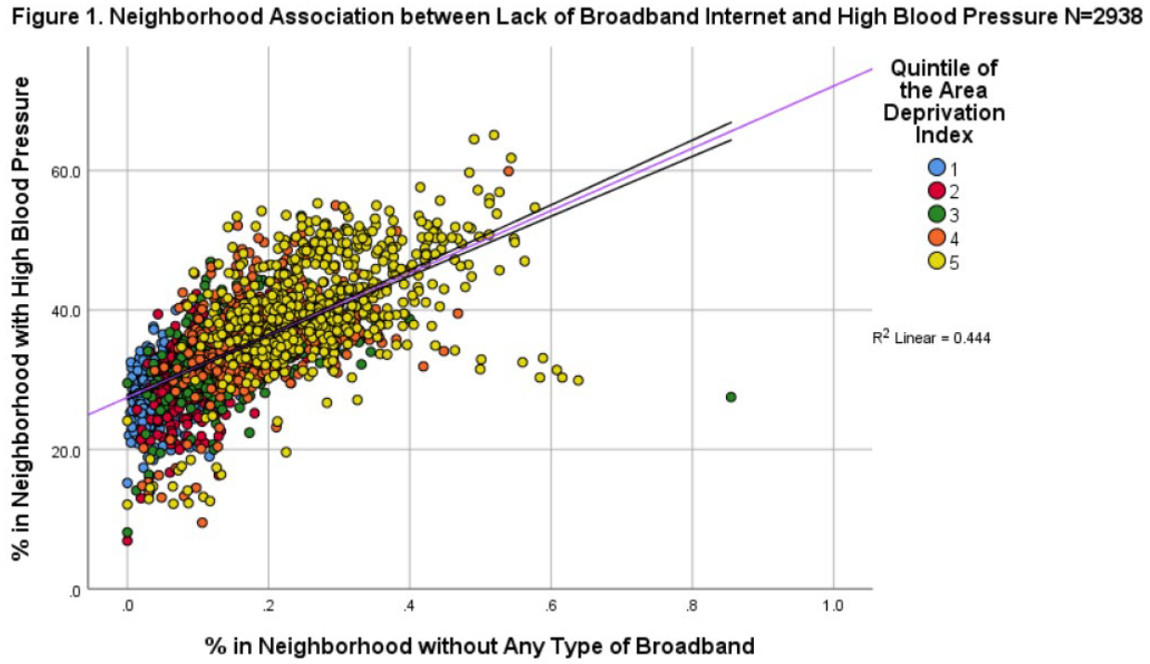
Ruff JM, Berg KA, Gunzler DD, Dalton JE & Perzynski AT (2021). A Population Disconnected from Health: Broadband Access, Neighborhood Disadvantage, Prevention and Disease. American Medical Informatics Association Clinical Informatics Conference.

Slide 124
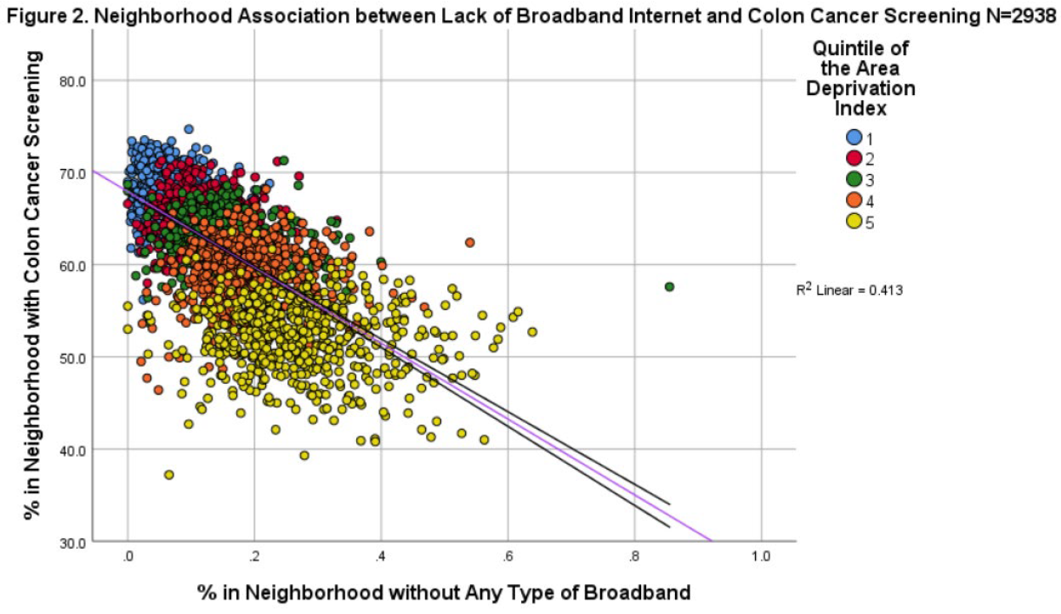
Ruff JM, Berg KA, Gunzler DD, Dalton JE & Perzynski AT (2021). A Population Disconnected from Health: Broadband Access, Neighborhood Disadvantage, Prevention and Disease. American Medical Informatics Association Clinical Informatics Conference.

Slide 125
AHRQ Social Determinants of Health (SDOH) Database
Patricia Keenan

Slide 126
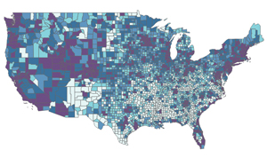
AHRQ Social Determinants of Health (SDOH) Database
“One stop” standardized community level SDOH data from multiple public sources
Uses
Analyze community-level variations
Inform efforts to improve health, equity
Initial database (2020)
County level (2009-2018)
Zip code tabulation area (2011-2018)
Database update (Spring 2022)
Adds census tract-level data; additional data years; new data sources and variables
Percent of Households with any Broadband Internet Access, Including Cellular
Source: Poverty and Access to Internet, by County. AHRQ SDOH Database (Beta version), from American Community Survey 5-year files, 2014-2018. Darker shading is higher.
https://www.ahrq.gov/sdoh/data-analytics/sdoh-data.html

Slide 127
C2H Task Force Closing Remarks

Slide 128
Connect with the Connect2Health^{FCC} Task Force
Website: https://www.fcc.gov/health
E-mail: connect2health@fcc.gov
Twitter: #C2HFCC
Schedule a Meeting: engageC2H@fcc.gov

