Slide 1
CONSUMER ADVISORY COMMITTEE FINAL MEETING
Federal Communications Commission Washington, DC Friday, September 25, 2020 10:30 a.m. – 2:30 p.m.

Slide 2
10:30 AM Introduction and Agenda
Steve Pociask, CAC Chairperson
Debra Berlyn, CAC Vice Chairperson

Slide 3
10:40 AM Roll Call
Steve Pociask, CAC Chairperson
Debra Berlyn, CAC Vice Chairman

Slide 4
10:50 AM Welcome and Overview
Ajit Pai, Chairman, FCC
Brendan Car, Commissioner, FCC

Slide 5
11:15 AM FCC Staff Presentations and Updates

Slide 6
11:15 am Panel A: Addressing COVID-19 Challenges
Accessibility During the Pandemic
Diane Burstein, Deputy Chief, CGB
COVID-19 Scam Alerts and Updated Consumer Guides
Ed Bartholme, Associate Chief, CGB
Update on Telehealth Initiatives
Hayley Steffen, Attorney-Advisor, Telecommunications Access Policy Division, WCB

Slide 7
Accessibility During the Pandemic
Diane Burstein
Deputy Bureau Chief
Consumer and Governmental Affairs Bureau
Federal Communications Commission

Slide 8
Waivers to Ensure Continued TRS Service
Providers expressed significant concerns about the impact of the coronavirus on telecommunications relay services (TRS)
Increase in call volume
Decrease in ability to handle calls from call centers
Potential shortage of qualified personnel due to coronavirus
FCC granted several waivers to provide more flexibility, starting in March
Most recently, extended previously granted waivers until November 30, 2020

Slide 9
Reminders to Video Providers about Accessible Emergency Information
TV stations and other video providers must make emergency information about the pandemic accessible to people with disabilities
Critical details about emergencies must be presented visually and aurally
Best practice is to ensure that the sign language interpreter is visible on the television screen at all times in order to benefit viewers who use American Sign Language

Slide 10
Letter Urging Governors to Assist Communications Industry During Pandemic
On May 26, 2020, FCC and the Cybersecurity and Infrastructure Security Agency released a joint letter to the nation’s governors and D.C. mayor.
With regard to accessibility, the letter asked the governors to declare the following as essential and to ensure they have appropriate resources and access:
Businesses and personnel that provide communications support to medical and healthcare facilities, assisted care and living facilities, and people with disabilities, and
TRS providers and closed captioning providers.

Slide 11
Uninterrupted Consumer Services
Consumers can still reach the FCC to obtain assistance and information and to file complaints by phone and email or online at www.fcc.gov/complaints
ASL users may call the FCC directly by videophone
844-432-2275
Contact the Disability Rights Office for more information at:
DRO@fcc.gov
202-418-2517
www.fcc.gov/accessibility

Slide 12
COVID-19 Scam Alerts and
Updated Consumer Guides
Ed Bartholme
Associate Bureau Chief
Consumer and Governmental Affairs Bureau
Federal Communications Commission

Slide 13
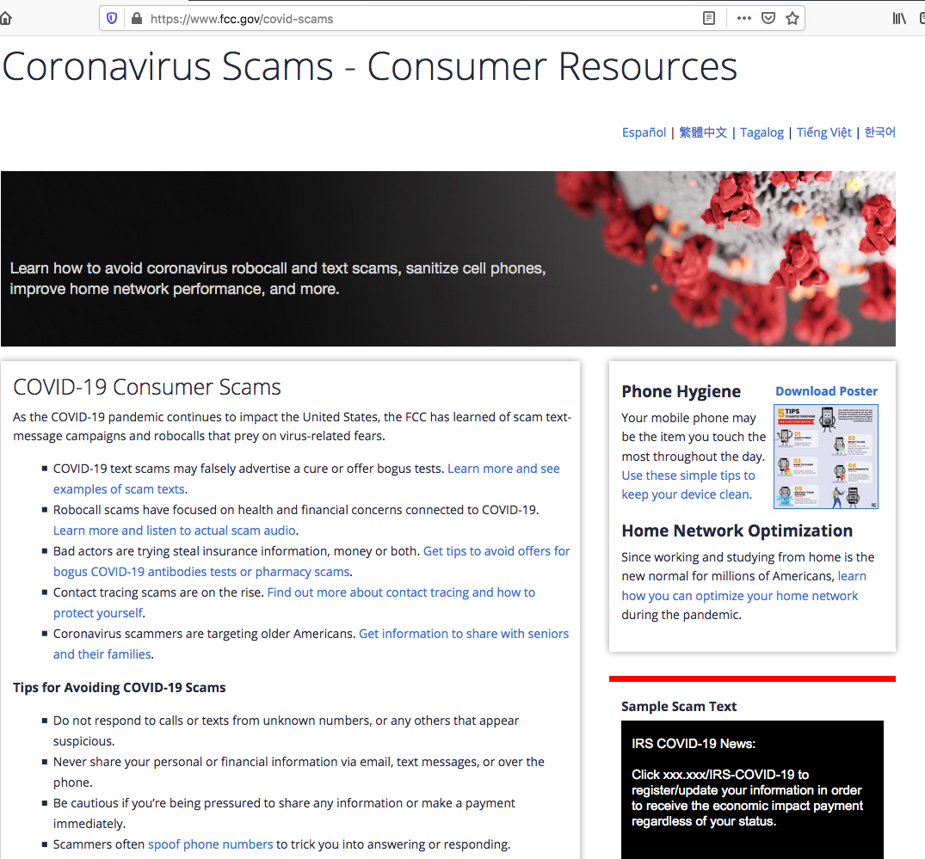
COVID-19
Scams Web Page

Slide 14
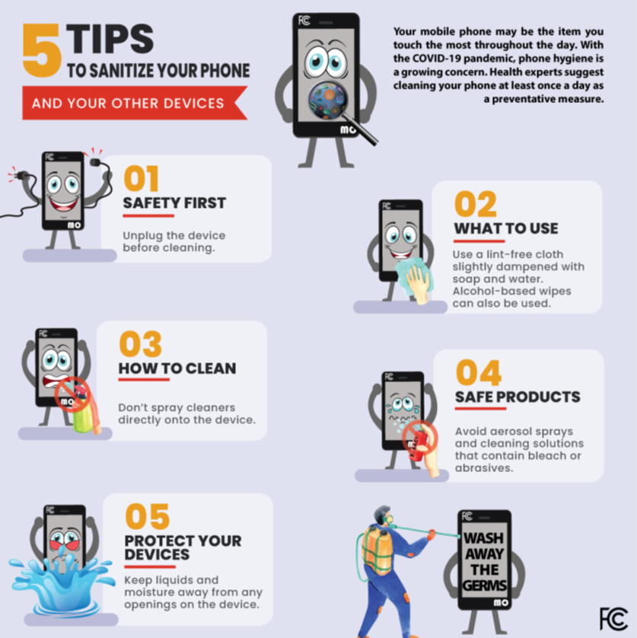
Sanitize Your Phone Infographic

Slide 15
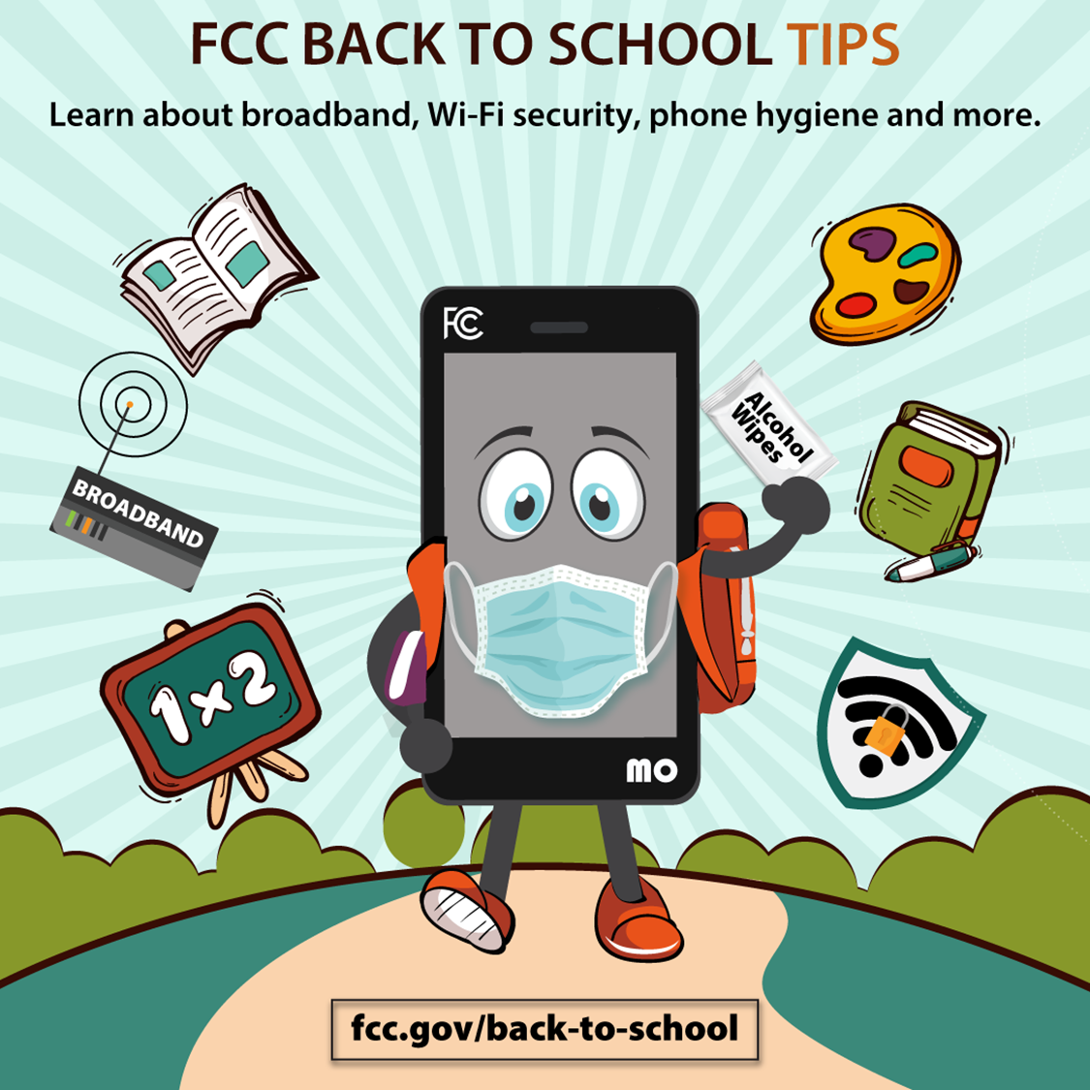
Back to School
Poster

Slide 16
Update on Telehealth Initiatives COVID-19 Telehealth Program Connected Care Pilot Program
Hayley Steffen
Attorney Advisor
Wireline Competition Bureau Telecommunications Access Policy Division

Slide 17
Overview
COVID-19 Telehealth Program
Connected Care Pilot Program
(Upcoming)

Slide 18
COVID-19 Telehealth Program
Congressionally appropriated budget of $200 million to help eligible health care providers maximize their provision of connected care services during the COVID-19 pandemic. CARES Act, Pub. L. No 116-136, 134 Stat. 281 (2020)
Report & Order, FCC 20-44 (April 2, 2020)
Funding Awards – 539 funding applications in 47 states plus Washington, D.C. and Guam for a total of $200 million in funding.
For more information: https://www.fcc.gov/covid-19-telehealth-program

Slide 19
Connected Care Pilot Program
Established - Report & Order, FCC 20-44 (April 2, 2020) – 47 U.S.C. § 254(h)
What is the Pilot Program?
A limited duration program that will make available up to $100 million of universal service support over a three-year funding period to help defray health care providers’ qualifying costs of providing connected care services, particularly to low-income Americans and veterans.

Slide 20
Connected Care Pilot Program
Who can apply?
Public and Non-Profit Eligible Health Care Providers that fall into one of the categories in 47 U.S.C. § 254(h)(7)(B)
Determine whether you are eligible by filing an FCC Form 460 with USAC.
What services are eligible?
85% of the qualifying costs of: (1) patient broadband Internet access services, (2) health care provider broadband data connections, (3) other connected care information services, and (4) certain network equipment. The Pilot Program will not fund end-user devices or medical equipment.

Slide 21
Connected Care Pilot Program
Where can I find the application?
The application is not yet available, and the Commission has not announced when the application filing window will open. A Public Notice with details about the application requirements was recently released (DA-1019) and can help to prepare interested applicants for the application becoming available.
Where can I find updates about the Connected Care Pilot Program?
The FCC’s Connected Care webpage: https://www.fcc.gov/connectedcarepilot

Slide 22
Questions?
For more information and Frequently Asked Questions (FAQs) about the Connected Care Pilot Program, please visit https://www.fcc.gov/connectedcarepilot.
For questions about the Connected Care Pilot Program, please email ConnCarePltProg@fcc.gov.

Slide 23
11:40 PM panel b: combatting robocalls
Call Blocking Report and Order
Jerusha Burnett, Attorney-Advisor, Consumer Policy Division, CGB
Call Blocking Tools Report
Mika Savir, Attorney-Advisor, Consumer Policy Division, CGB
Hospital Robocalls Protection Group
Donna Cyrus, Designated Federal Officer, HRPG, CGB

Slide 24
HOSPITAL ROBOCALL PROTECTION GROUP
Donna Cyrus, DFO
September 2020

Slide 25
On June 25, 2020, the Commission established the Hospital Robocall Protection Group (HRPG), a new federal advisory committee dedicated to combatting robocalls to hospitals.
Congress directed the FCC to establish the HRPG in the Telephone Robocall Abuse Criminal Enforcement and Deterrence Act of 2019 (TRACED Act). The HRPG also is organized under, and operates in accordance with, the FACA.
The TRACED Act requires that the HRPG produce hospital robocall mitigation recommendations no later than the week of December 21, 2020.
overview

Slide 26
In accordance with the TRACED Act, the HRPG will issue best practices regarding the following:
How voice service providers can better combat unlawful robocalls made to hospitals
How hospitals can better protect themselves from such calls, including by using unlawful robocall mitigation techniques
How the Federal Government and State governments can help combat such calls
Overview (cont’d)

Slide 27
HRPG’s initial meeting was on July 27, 2020. Since then, its three working groups have been actively meeting and working to produce the required recommendations.
The Traced Act also requires that the Commission complete a proceeding no later than June 2021 to assess the extent to which the voluntary adoption of the best practices can be facilitated to protect hospitals and other institutions.
Overview (cont’d)

Slide 28
Website?
Follow HRPG at: https://www.fcc.gov/hospital-robocall-protection-group

Slide 29
12:05 PM LUNCH BREAK (35 MINUTES)

Slide 30
12:40 PM PANEL C: ADVANCING EMERGENCY RESPONSE CAPABILITIES
PSAPs’ Real-Time Text Capacity
Suzy Singleton, Chief, Disability Rights Office, CGB
National Suicide and Mental Health Lifeline
Jesse Goodwin, Attorney-Advisor, Competition Policy Division, WCB

Slide 31
911 Call Centers and Real-Time Text Technology
Consumer Advisory Committee
September 25, 2020
Suzy Rosen Singleton, Chief, Disability Rights Office, CGB
Federal Communications Commission

Slide 32
TTY –RTT Transition Necessary for Modernized Times
TTY technology was developed for use on the PSTN
FCC rules requiring TTY support
TTYs do not work well in an IP environment: packet loss, distortion, transmission errors can degrade quality of communications
TTY usage is rapidly declining, especially for wireless services
Real-Time Text (RTT) recognized as superior accessibility solution for IP networks
Fully integrated with mainstream voice communications (simultaneous voice and text)
Can be used with off-the-shelf devices
Uses Unicode character set (allows symbols, languages)
Notes:
(Parts 6, 7, 9, 14, 64)

Slide 33
Modernizing Communications: FCC Report and Order and Further Notice of Proposed Rulemaking on Real-Time Text
December 2016: FCC adopted rules to facilitate the transition from TTYs to RTT over wireless Internet Protocol (IP) technologies.
New rules permit the support of RTT in lieu of supporting TTY technology.
Covered entities that support RTT in compliance with the FCC’s rules will be relieved of TTY support requirements on all wireless networks and equipment, including services and devices used for legacy non-IP facilities.
Covered entities:
IP-based wireless providers.
Manufacturers of end user equipment.

Slide 34
Required RTT Core Functionalities
Interoperable across networks and services
(RFC 4103 standard is used as the safe harbor standard)
Backward compatible with TTYs
Support for 911 communications
Simultaneous text and voice in the same call session
Ability to initiate and receive call with the same telephone number

Slide 35
Compliance Timelines
Service Providers. By December 31, 2017, each Tier I CMRS provider and, by June 30, 2020, each non-Tier I provider (except resellers) choosing to support RTT shall support RTT either:
(1) through a downloadable RTT application or plug-in that supports RTT; or
(2) by implementing native RTT functionality into its core network, offering at least one handset model that supports RTT, and including support for RTT in future design specifications.
By December 31, 2019, each Tier I CMRS provider and, by June 30, 2021, each non-Tier I CMRS provider (including resellers) choosing to support RTT shall support RTT for all new authorized user devices.
Manufacturers. Covered manufacturers that choose to support RTT, instead of TTYs, shall implement RTT in newly manufactured equipment by December 31, 2018, if readily achievable or unless not achievable.

Slide 36
PSAP Readiness for RTT
FCC requires that carriers deliver text messages to PSAPs that are text-enabled within six months of a PSAP’s request.
The FCC maintains a text-to-911 registry, and RTT will be included once OMB approves the updated form. The comment period closed in early September 2020 with no opposition filed. The registry is found at www.fcc.gov/text-to-911.
The FCC hosted a PSAP RTT Awareness Day in October 2018, and resources are available at www.fcc.gov/rtt.
On August 3, 2020, NENA published draft “NENA PSAP Readiness for Real-Time-Text Information Document” with guidelines for installation and use of RTT. The comment period closed September 11, 2020.
Case study: CA’s 438 PSAPs and Cal. Gov. Code Section 53112: by January 1, 2021, each CA PSAP shall be RTT and SMS-enabled.

Slide 37
Resources
Subscribe to AccessInfo@fcc.gov
Visit FCC Disability Rights Office webpage:
http://www.fcc.gov/accessibility
FCC’s webpage about RTT
https://www.fcc.gov/rtt
Contact FCC DRO at:
DRO@fcc.gov (e-mail)
844-432-2275 (VideoPhone)
202-418-2517 (Voice)
Online Complaint Form: www.fcc.gov/complaints

Slide 38
Consumer Advisory Committee 988 National Suicide Hotline Overview
Jesse Goodwin
Attorney Advisor
Federal Communications Commission
Wireline Competition Bureau
Competition Policy Division
September 25, 2020
Notes:
38

Slide 39
Overview
The FCC has designated 988 for the National Suicide Prevention Lifeline, to be available July 16, 2022.
988 is not active yet. If you want to call the National Suicide Prevention Lifeline, call 1-800-273-TALK.
This presentation will cover:
988’s background;
the Notice of Proposed Rulemaking;
the Order; and
Next steps

Slide 40
2018 Act and Report
On August 14, 2018, Congress passed the National Suicide Hotline Improvement Act of 2018, which tasked the FCC with examining and reporting on the technical feasibility of designating a shorter number—“a simple, easy-to-remember, 3-digit dialing code”—for a national suicide prevention and mental health crisis hotline.
One year later, FCC staff, in consultation with the North American Numbering Council, Substance Abuse and Mental Health Services Administration, and Department of Veterans Affairs, released a report recommending the FCC initiate a rulemaking to adopt 988 as a single-purpose 3-digit code for the National Suicide Prevention Lifeline.
40

Slide 41
Why 988?
A unique 3-digit code obviates the need to age an existing N11 code and should reduce the overall implementation timeline.
A wholly unique 3-digit code would be less disruptive to existing users.
Consumer education campaigns for a unique 3-digit code would be simpler and likely more effective than those necessary for repurposing or expanding use of an existing N11 code.
988 is less technically complicated than using other unique 3-digit dialing codes.
41

Slide 42
Rulemaking Proceeding
On December 16, 2019, the FCC released a Notice of Proposed Rulemaking that proposed to designate 988 as the 3-digit dialing code for the National Suicide Prevention Lifeline
We received a robust record of comments from the mental health community, telecommunications companies, and other interested parties
On July 16, 2020, the FCC adopted a Report and Order that adopted 988 as the 3-digit code for the Lifeline and required providers to implement 988 within two years.

Slide 43
Timeline and Implementation
The Order requires all telecommunications carriers, interconnected voice over Internet Protocol (VoIP) providers, and one-way VoIP providers to make any network changes necessary to ensure that users can dial 988 to reach the Lifeline by July 16, 2022.
Providers will route calls to 988 to the existing toll free access number (1-800-273-8255 / 1-800-273-TALK).
Requires covered providers to implement 10-digit dialing in areas that both use 7-digit dialing and 988 as the first three digits of a number.
North American Numbering Plan Administrator currently working with providers toward implementation.

Slide 44
Non-Voice Communication
Several ways to get help:
Several text messaging options for suicide prevention are available nationwide, including a short-code to reach the Veterans Crisis Line (838255) and the non-profit Crisis Text Line (741741).
Lifeline offers online chat
Lifeline maintains a separate TTY number
The FCC did not mandate text messaging or direct video calling to 988 because it does not control the features of the Lifeline.

Slide 45
Questions/Contacts/Links
Jesse Goodwin
Federal Communications Commission
Attorney Advisor
202.418.0958
Benjamin.Goodwin@fcc.gov
Links:
National Suicide Hotline Improvement Act of 2018,
https://www.congress.gov/115/plaws/publ233/PLAW-115publ233.pdf
NANC Report
https://www.fcc.gov/ecfs/filing/10531153709624
FCC Report to Congress
https://docs.fcc.gov/public/attachments/DOC-359095A1.pdf
Order
https://docs.fcc.gov/public/attachments/FCC-20-100A1_Rcd.pdf
45

Slide 46
1:00 PM panel d: Promoting 21st century technologies and services
Spectrum and Infrastructure Policies to Accelerate Access to Spectrum and 5G Deployment
Susan Mort, Legal and Policy Advisor, WTB
Rural Digital Opportunity Fund and 5G Fund for Rural America
Audra Hale-Maddox, Chief of Staff, Rural Broadband Auctions Task Force, OEA

Slide 47
PRESENTATION TO CONSUMER ADVISORY COMMITTEE September 25, 2020 Susan Mort, Legal & Policy Advisor, Wireless Telecommunications Bureau
* This presentation and its contents are for informational purposes only; the Commission’s rules in part 47 of the Code of Federal Regulations and the Commission’s previous Reports and Orders adopting those rules represent the binding rules and determinations of the Commission.

Slide 48
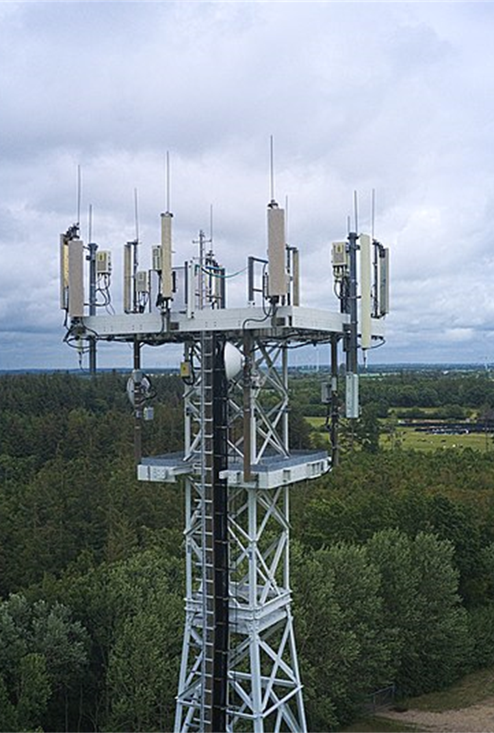
IMPACTS OF 5G
Estimated 3 million new jobs, $275 billion in private investment, and $500 billion in new economic growth in the US*
Connection speeds anticipated to be over 10 Gbps - 100x faster than 4G. Lag times anticipated to be one-tenth of what they are today (50 milliseconds to 1 millisecond).
Smart cities and smart transportation networks that reduce traffic, prevent accidents, and limit pollution.
Wireless healthcare and remote surgeries.
Precision agriculture.
Industry automation.
And, of course, 5G will unlock innovations that are yet to be imagined.
* Source: Accenture Strategy, How 5G Can Help Municipalities Become Vibrant Smart Cities, 2017
(Image: Fabian Horst / CC BY-SA)

Slide 49
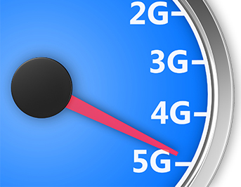
FCC 5G FAST PLAN
Market-based U.S. approach to 5G innovation, investments, and deployment
Three key components:
(1) pushing more spectrum into the marketplace
(2) updating infrastructure policy
(3) modernizing outdated regulations
Roll-out of 5G systems is underway!

Slide 50
FCC SPECTRUM ACTIONS FOR 5G USE
High-band:
Mid-band:
2.5 GHz, 3.45-3.55 GHz, 3.5 GHz, and 3.7-4.0 GHz bands
Low-band:
Unlicensed:
Creating opportunities for Wi-Fi in the 6 GHz, 61-71 GHz and above 95 GHz bands; also taking a fresh and comprehensive look at the 5.9 GHz (5.850-5.925 GHz) band that has been reserved for use by Dedicated Short-Range Communications (DSRC)
Targeted changes to 600 MHz, 800 MHz, and 900 MHz bands to improve use of low band spectrum for 5G services
28 GHz band auction (27.5 GHz – 28.35 GHz; 2 x 425) Completed January 2019
24 GHz band auction (24.25 – 24.45; 25.25 -25.75 GHz; 7 x100) Completed May 2019
37 GHz, 39 GHz, and 47 GHz Largest auction in U.S. history, releasing 3,400 megahertz of spectrum into the commercial marketplace. Completed March 2020
Currently working to free up additional high band spectrum

Slide 51
INFRASTRUCTURE SITING AND REVIEW
Federal Review: The FCC modernized Federal historic preservation and environmental reviews of wireless deployments
State and Local Review: The FCC removed regulatory barriers such as unreasonable application fees and instituted two new ‘shot clocks’ for small wireless facilities

Slide 52
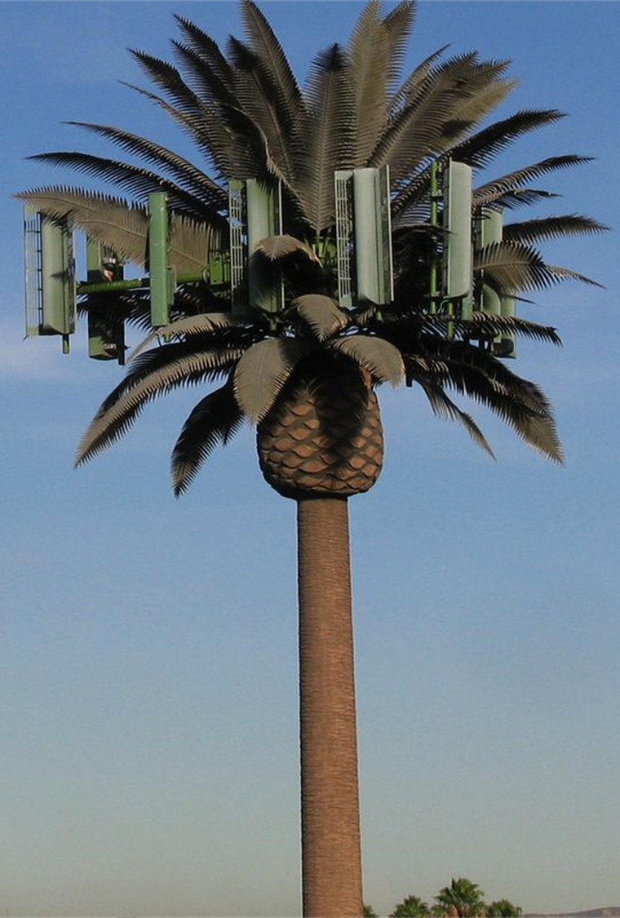
INFRASTRUCTURE SITING: SECTION 6409
Section 6409(a) of the Spectrum Act streamlined state and local government review of certain requests to modify transmission equipment on existing structures
In June 2020, the FCC adopted a Declaratory Ruling, clarifying that when the 60-day shot clock for local review begins and how certain aspects of proposed modifications might impact the eligibility for streamlined review under the rules
The FCC also adopted a Notice of Proposed Rulemaking seeking comment on proposed rule changes regarding excavation and deployment outside the boundaries of an existing tower site and the effects of such activities on eligibility for streamlined review
Separate from clarifying the rules on streamlined local review, the Declaratory Ruling clarified a portion of the FCC’s rules on environmental and historic preservation review that differed from most other U.S. federal agencies
(Image: Daniel R. Blume)

Slide 53
Modernizing Outdated Regulations
One-Touch Make-Ready: The FCC has updated its rules governing the attachment of new network equipment to utility poles in order to reduce cost and speed up 5G backhaul deployment.
Speeding the IP Transition: The FCC revised its rules to make it easier for companies to invest in next-generation networks and services instead of the fading networks of the past.
Business Data Services: In order to incentivize investment in modern fiber networks, the FCC updated rules for high-speed, dedicated services by lifting rate regulation where appropriate.

Slide 54
Thank You!

Slide 55
Rural Broadband Auctions
5G Fund
FCC Consumer Advisory Committee
September 25, 2020

Slide 56
Universal Service Fund and Auctions
USF provides support to carriers
consumers in rural and high cost areas have access to reasonably comparable telephone and information services
2011 Transformation Order fundamentally reformed the USF program to require that carriers receiving support provide not only voice but also broadband services
Commission also created a Mobility Fund to distribute support for mobile services through reverse auctions
Also proposed using competitive bidding to distribute support for fixed services

Slide 57
Rural Broadband Reverse Auctions
2011 USF Transformation Order
Introduced new funding approach for price-cap areas using cost-model to identify high-cost areas and competitive bidding to allocate support
Reverse auctions are a formal process to determine what support a provider needs to extend service meeting program requirements to under-served or unserved areas (lowest bidder wins)
2012/2014 Mobility Fund I and Tribal Mobility Fund I
-- One-time single-round reverse auctions for extension of wireless voice and 3G or 4G broadband service
-- $300M for Mobility Fund I, $50 M for Tribal Mobility Fund I
Notes:
History: So, how did we get here?
[CLICK]: In 2011, the Commission adopted the USF/ICC Transformation Order, which introduced the use of a cost model to identify high-cost areas and competitive bidding (auctions) to award support. The Transformation Order also determined that USF funds could be applied to reduce the digital divide between served and unserved areas, often urban and rural areas.
The first reverse auctions after the Transformation Order were wireless auctions -- Mobility Fund I and Tribal Mobility Fund I.

Slide 58
Initial Wireline Reverse Auctions
2014 Connect America Cost Model (CAM)
Estimated cost of providing service and locations by census blocks
Identified census blocks with costs above a specified benchmark
2015 Offer of Model-Based Support to Price Cap Carriers
9 carriers accepted over $1.5 billion/year to serve 3.6M homes and businesses in their study areas by end of 2020 in 45 states & 1 territory
Notes:
[CLICK]: The Connect America Cost Model was developed in 2014. The model estimates cost of providing service and number of locations in census blocks nationwide
High-cost blocks were identified as those with locations that had estimated costs above a cost threshold
[CLICK]: The Commission offered model-based support to price cap carriers in 2015 to deploy service to high-cost locations in their study areas by 2020

Slide 59
In-Process Rural Broadband Auctions
Connect America Fund Phase II (completed):
$1.48B over 10 years for fixed broadband and voice services
Rural Digital Opportunity Fund (ongoing):
Up to $20.4B over 10 years for fixed broadband and voice services
Phase I: up to $16B (Auction 904)
Phase II: up to $4.4B + remainder of Phase I budget
Phase I auction bidding scheduled to commence on October 29, 2020
5G Fund for Rural America (proposed):
Up to $9B for 5G mobile voice and broadband service, with up to $1B for network deployments facilitating precision agriculture
Notes:
Rural Auctions Overview: Over last couple of years, the Commission has taken a number of steps to close the digital divide by awarding support via auction, including:
[CLICK]: CAF Phase II which awarded almost $1.5b over 10 years in Auction 903
[CLICK]: The Rural Digital Opportunity Fund which will award up to $20.4b over 10 years in two phases:
Phase I will award up to $16b in Auction 904, and bidding is scheduled to commence on Oct. 29, 2020
Phase II will award the remainder of the $20.4b at a later date
[CLICK]: The 5G Fund for Rural America, proposed by the Commission in April, which would award up to $9b to support deployment of 5G service to rural America

Slide 60
Case Study: 5G Fund
$9 billion in two phases; multi-round reverse auctions to bring rural areas mobile voice and 5G broadband
Phase Two focused on most rural areas and precision agriculture
Pushing early expansion of mobile 5G in rural areas

Slide 61
5G Fund Details
Eligibility by rurality vs. eligibility by coverage
Adjustment factor to preference difficult terrain or economically impoverished rural areas
Proposing performance and reporting obligations for legacy support recipients

Slide 62
1:30 PM CAC Member Discussion and QUESTIONS FROM THE PUBLIC

Slide 63
2:00 PM FAREWELL AND APPRECIATION

Slide 64
2:30 PM Adjournment

Slide 65
THANK YOU!
https://www.fcc.gov/consumer-advisory-committee

