Slide 1


Connect America Fund
Introduction to
Phase II
Auction

Slide 2
Today’s Topics
Brief introduction to proposed application procedures
High-level description of proposed descending clock auction and bidding procedures
  Bidding basics for this clock auction
  Rounds before and after the budget clears
  Assigning winning bids
  Determining support amounts
  Additional topics: Package Bids, Proxy Instructions, Prohibited Communications
Caveat: This presentation is not meant to substitute for the PN. For details and examples see the Technical Guide

Slide 3
Ex Parte Information
With a limited exception, attending and/or participating in this webinar on proposed procedures to conduct the Connect America Fund Phase II auction made by the Commission in the recent Comment Public Notice¹ will not require a filing under the Commission’s rules governing ex parte communications²
Presentations to Commission personnel directed to the merits or the outcome of the matters raised in the Comment Public Notice or other pending proceedings will require the filing of an ex parte notice
¹ Comment Sought On Competitive Bidding Procedures And Certain Program Requirements For The Connect America Fund Phase II Auction (Auction 903), AU Docket No. 17-182 and WC Docket No. 10-90, Public Notice, FCC 17-101 (rel. Aug. 4, 2017). ² See 47 C.F.R. §§ 1.1200 et seq.

Slide 4
Overview
The Connect America Fund Phase II Auction Comment Public Notice seeks comment on proposed application and bidding procedures
  Phase II Auction designated as Auction 903
  Comments due September 18th; Replies due October 18th
  The Commission will release a Procedures Public Notice to announce the final procedures, the start date of the auction, and other important information

Slide 5
Why an Auction?
In the 2011 Universal Service Transformation Order the Commission decided to use competitive bidding to distribute ongoing CAF Phase II support to areas where model-based support was declined
The auction is a mechanism for determining how much of a fixed budget should go to specific providers in specific areas so that the funds can be used most cost effectively

Slide 6
Auction 903 Decisions
Some key decisions for Auction 903 have already been made
  The auction will distribute up to $1.98 billion in support over 10 years
  Eligible areas include those where price cap carriers declined model support as well as certain other areas
  Bidders can bid to provide different levels of performance (speed and usage, latency)
  Supported providers will have six years to deploy service, with interim milestones
  Two-stage application process: a “short-form application” to participate in Auction 903, and, if a winning bidder, a “long-form application” to be authorized to receive support

Slide 7
Application Procedures
Comment PN proposes to require with short-form application:
  (1) State(s) in which an applicant intends to bid
    To prohibit applicants that are commonly controlled or parties to a joint bidding arrangement from being eligible to bid in the same state
  (2) Technical information (e.g., operational info, spectrum access)
    To determine each applicant’s eligibility to bid for performance tier and latency combinations based on information submitted, in addition to leveraging existing FCC data
  (3) Financial information (audited or unaudited)
    To determine each applicant’s eligibility to bid based on certain financial metrics
    Low-scoring applicants will be subject to more in-depth review of their finances to determine eligibility

Slide 8
Bidding Basics
Preview Period
Place Bids
Round Opens
Round Closes
There is still competition
Bidder
View Results
Process Bids
Auction System
No more competition
Auction
Ends
Event

Slide 9
Bidding Basics
What is a Bid?
  A request for support in a given area for a given performance tier and latency at a given percentage (which corresponds to a support amount -- more later)
    An area consists of the eligible census blocks in a census block group
    Performance tier and latency options
      Minimum, Baseline, Above Baseline, and Gigabit performance
      High and Low latency
    Once a round has closed, a submitted bid obliges you to provide service if you are a winning bidder
      If you are a winning bidder, your support amount will be at least the amount you agreed to accept by bidding
Note: For ease of explanation, we focus first on bids for single areas

Slide 10
Bidding Basics
Proposed Reserve Prices
Each area has a reserve price
  limits the amount of support a bidder can receive for the area
Set using the Connect America Cost Model (CAM)
  For each census block group (CBG), the reserve price is the sum of the support amounts calculated by the CAM for each eligible census block within the CBG
  Extremely high-cost census blocks will be capped at $146.10 per-location-per-month

Slide 11
Bidding Basics
Implied Support Amounts
Bids are submitted at a specific percentage
  Clock denominated in terms of a percentage
  To determine implied support amounts, the bid percentage is adjusted for performance tier and latency, and multiplied by the area’s reserve price
  Each performance tier and latency combination (T+L) has an associated adjustment weight:
A formula converts bid percentage, reserve price, and T+L weights to an “implied support” amount
  Final support amount will be based on a percentage that is equal to or greater than the bid percentage
Weights for Performance Tiers and Latencies
Minimum |  | Baseline |  | Above Baseline |  | Gigabit
High Latency | Low Latency | High Latency | Low Latency | High Latency | Low Latency | High Latency | Low Latency
90 | 65 | 70 | 45 | 40 | 15 | 25 | 0

Slide 12
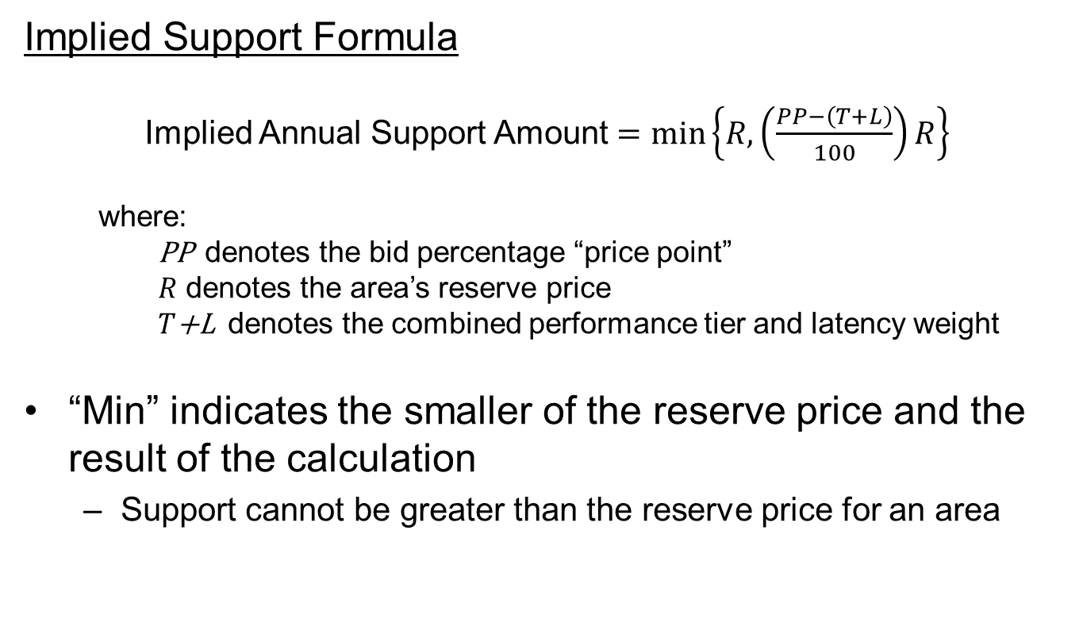
Bidding Basics
Implied Support Formula
Implied Annual Support Amount $=\min\left\{R, \left(\frac{PP−\left(T+L\right)}{100}\right)R\right\}$
    where:
    PP denotes the bid percentage “price point”
    $R$ denotes the area’s reserve price
    $T$+L denotes the combined performance tier and latency weight
“Min” indicates the smaller of the reserve price and the result of the calculation
  Support cannot be greater than the reserve price for an area

Slide 13
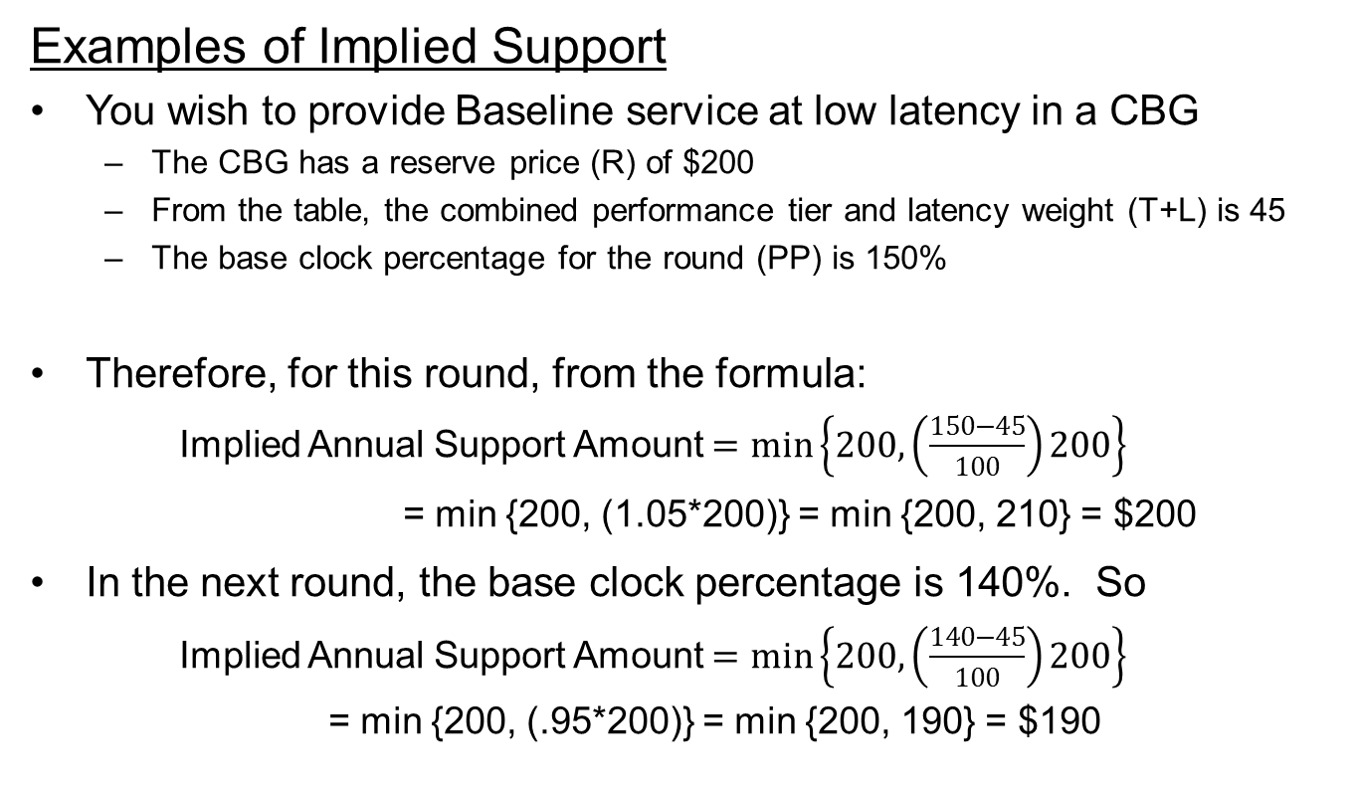
Bidding Basics
Examples of Implied Support
You wish to provide Baseline service at low latency in a CBG
  The CBG has a reserve price (R) of $200
  From the table, the combined performance tier and latency weight (T+L) is 45
  The base clock percentage for the round (PP) is 150%
Therefore, for this round, from the formula:
  Implied Annual Support Amount $=\min\left\{200, \left(\frac{150−45}{100}\right)200\right\}$
= min {200, (1.05*200)} = min {200, 210} = $200
In the next round, the base clock percentage is 140%. So
  Implied Annual Support Amount $=\min\left\{200, \left(\frac{140−45}{100}\right)200\right\}$
  = min {200, (.95*200)} = min {200, 190} = $190

Slide 14
Bidding Basics
You wish to provide service in a CBG with reserve price $200 and T+L = 45
Opening clock: 170%
Possible bid percentages for round 1
Round 1 clock: 160%
Implied support at round 1 clock: $200
Possible bid percentages for round 2
Round 2 clock: 150%
Implied support at round 2 clock: $200
Possible bid percentages for round 3
Round 3 clock: 140%
Implied support at round 3 clock: $190
Possible bid percentages for round 4
Round 4 clock: 130%
Implied support at round 4 clock: $170
.
.
.
.
.
.

Slide 15
Bidding Basics
Mechanics of Multiple Round, Descending Clock Auction
Each round is associated with a base clock percentage
Base clock percentage starts high and decreases in each bidding round
  Proposed to start above 100% to allow all T+Ls to compete
  Is decremented by 10 percentage points in each round
  Each percentage corresponds to a support amount for a given area at a given T+L (using the formula)
Bidding rounds continue as long as there is competition among areas for the budget or among bidders for support to a given area

Slide 16
Bidding Basics
Bidding at an Intermediate Percentage
What if support at 140% is enough but support at next decrement (say 130%) is not enough?
  Can choose to bid at 140% but not at 130%
Or, can bid at an in-between percentage
  For prior example, recall implied support at 140% was $190
  However, you are unwilling to accept less than $175
  At 130%, implied support is $170
  At 132.5%, implied support is $175
  You can submit a bid at 132.5%, and if the bid is assigned, support will be at least $175

Slide 17

Bidding Basics
Bidder’s Decision
As base clock percentage decreases, given the corresponding support amount for each area, do you still want to bid for an area or do you want to drop out of bidding?
Hmmm . . . I really don’t want to go lower than $175 . . . So I’ll bid at 132.5% and that will be my final bid.

Slide 18
Bidding Basics
Activity Rules
Require that you do not bid for more support than you did in the prior round
  Measured in implied support dollars
Limit the extent to which you can switch to bid on different areas
  Proposed switching percentage is 10% of prior round’s implied support for bids made at base clock percentage
Encourage straightforward bidding
  Make info on number of other bidders in an area more reliable
For details of the activity rules, see PN or the Technical Guide

Slide 19
Rounds Before the Budget Clears
Checking for Budget Clearing
The budget is said to “clear” when the total implied support for the bids at a round’s base clock percentage, counting support for no more than one bid for a given area, is equal to or less than the budget.
  If there are multiple bids at the base clock percentage for the same area, the system uses the most expensive option in its calculations
The auction system checks whether this condition holds after each round of bidding.
If the total implied support exceeds the budget, the base clock percentage is decremented again and another bidding round is conducted

Slide 20
During the Clearing Round
Budget Clearing
After some round, when the auction system adds up the total implied support required to fund all the areas with bids at the clock percentage, the total will fall within the auction’s budget. There are two reasons for this:
  Implied support amounts fall for areas with bids
  Bidders have dropped out of bidding for some areas because the implied support corresponding to the current percentage is too low

Slide 21
During the Clearing Round
Example
BUDGET: $15,000
Opening clock: 170%
Round 1 clock: 160%
Cost* at round 1 clock: $20,000
Round 2 clock: 150%
Cost at round 2 clock: $19,000
Round 3 clock: 140%
Cost at round 3 clock: $17,000
CLEARING ROUND
Round 4 clock: 130%
Cost at round 4 clock: $14,000
.
.
.
.
.
.
Bidding rounds continue if there are areas with more than one bid at the round 4 clock percentage
* Aggregate Cost at Base Clock Percentage

Slide 22
During the Clearing Round
Clearing Round Procedures
Once the total implied support at the base clock percentage falls within the budget, the just-closed round becomes the “clearing round”
In the clearing round, the auction system will begin the process of
    assigning winning bids and
    determining final support amounts

Slide 23
During the Clearing Round
Assigning Bids (High Level)
The auction system first considers bids at the base clock percentage
  It assigns a bid for an area if there are no other bids for the same area at the base clock percentage
The system then looks at bids above the clock percentage, in order of ascending percentage.
  For a given area, it considers assigning the first bid it comes to (that is, the one at the lowest percentage)
Remember: The T+L doesn’t matter for assignment, only the percentage matters (but T+L does affect the winner’s support amount)

Slide 24
During the Clearing Round
Finding the Clearing Percentage
As the auction system assigns bids in ascending percentage order, it calculates the effect on the budget of each assigned bid, keeping a running tally of cost
The “clearing percentage” is the point at which the budget is just enough to cover support for the assigned areas and the areas that still have competition at the base clock percentage
Any areas with bids above the clearing percentage won’t fit in the budget and won’t be assigned

Slide 25
During the Clearing Round
Second Price Rule
The auction determines support at “second-prices”
  General principle: Select as winners those bidders willing to accept support at the lowest percentages, but determine support amounts based on the percentage at which competition is resolved
    “Competition is resolved” when it is clear whether a bid for an area is a winning bid

Slide 26
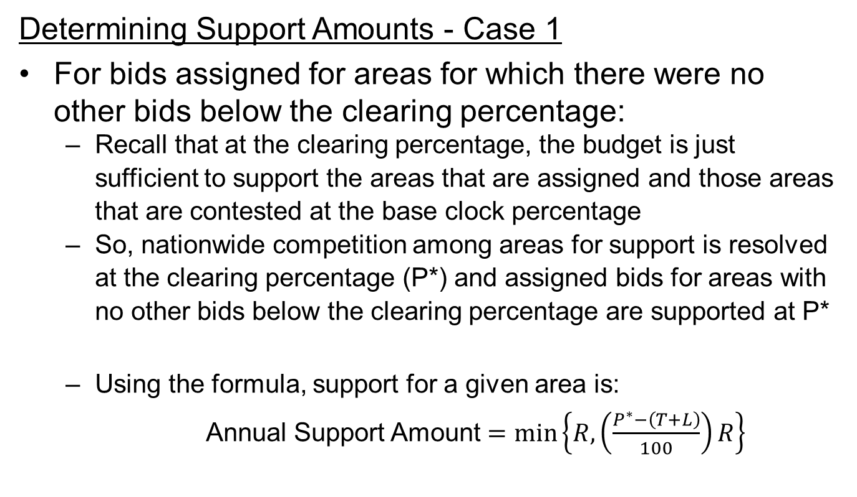
During the Clearing Round
Determining Support Amounts - Case 1
For bids assigned for areas for which there were no other bids below the clearing percentage:
  Recall that at the clearing percentage, the budget is just sufficient to support the areas that are assigned and those areas that are contested at the base clock percentage
  So, nationwide competition among areas for support is resolved at the clearing percentage (P*) and assigned bids for areas with no other bids below the clearing percentage are supported at P*
  Using the formula, support for a given area is:
  Annual Support Amount $=\min\left\{R, \left(\frac{P^{∗}−\left(T+L\right)}{100}\right)R\right\}$

Slide 27
During the Clearing Round
You bid to provide service with T+L = 45 in a CBG with reserve price $200 at 132.5%
Case 1: There are no other bids for that CBG below the clearing percentage
Round 3 clock: 140%
Clearing percentage: 137.5%
Your assigned support: $185
Your bid percentage: 132.5% Implied support: $175
Round 4 clock: 130%

Slide 28
During the Clearing Round
Determining Support Amounts – Case 2
For bids that won support for areas where there were other bids below the clearing percentage
  For bids assigned in the clearing round where there were two or more bids for an area at different percentages at or below the clearing percentage, the bid at the lowest percentage wins and is supported at the percentage of the next lowest bid
  If there are multiple bids at the base clock percentage of the clearing round, there will be more clock rounds until only one bidder for each area remains
    The lowest bidder for an area will win and be assigned support at the percentage at which the next lowest bidder drops out

Slide 29
During the Clearing Round
You bid to provide service with T+L = 45 in a CBG with reserve price $200 at 132.5%
Case 2: There is another bid for that CBG below the clearing percentage
Round 3 clock: 140%
Clearing percentage: 137.5%
Percentage of other bid: 135%
Your assigned support: $180
Your bid percentage: 132.5% Implied support: $175
Round 4 clock: 130%

Slide 30
Rounds After the Budget Clears
There will be additional clock rounds with bidding only for areas with multiple bids at the base clock percentage of the previous round
  Same areas, same bidders, same T+L only
  As many rounds as needed to resolve all competition
Bids at the base clock percentage carry forward to the next round.
  Bidders can also make lower bids, as in rounds before the budget cleared
For each area, the bid at the lowest percentage wins, but is supported at the percentage at which the next lowest bidder dropped out

Slide 31

Auction Close
The auction ends after the budget has cleared, and when there is no area with more than one bid at the clock percentage

Slide 32
Additional Topic: Package Bidding
In addition to submitting bids for support to individual areas, a bidder can submit a single bid for a group of areas
A package bid:
Must be submitted at a single percentage (base clock or an intermediate percentage up to the previous base clock percentage)
May include T+Ls that differ by area
A given area can only be included in one bid (for the area alone or in a package including the area)
Packages may be partially assigned
  Package bids are not “all-or-nothing” bids

Slide 33
Additional Topic: Package Bidding
A package bid must include a “minimum scale percentage”
  Bidder-specified, capped at 80% (proposed)
  The bidder may be assigned support for only some of the areas in the package, as long as the total amount of implied support for those areas is at least the minimum scale percentage of the total implied support associated with the package
For example, for a package bid that specifies a 70% minimum scale percentage:
  None of the areas will be assigned if the auction system can assign only areas with implied support totaling 65% of the total support for the package
  The partial package will be assigned if areas with implied support totaling 95% of the total package support can be assigned
  The package will be fully assigned if all of the areas in a package can be assigned

Slide 34
Additional Topic: Package Bidding
Assignment procedures for package bids
  In the clearing round, package bids are considered for assignment in ascending percentage order, along with single area bids
    If the minimum scale requirement cannot be met, the package is not assigned
  A package bid at the base clock percentage of the clearing round, if “contested,” will carry forward to the next round
  Remainders of package bids at the base clock percentage not fully assigned will carry forward as single area bids
  For further details on processing package bids, see the Technical Guide

Slide 35
Additional Topic: Proxy Bidding
Proposal for Proxy Instructions
Would tell the auction system to submit a proxy bid in each round, down to a bidder-specified proxy percentage
  Instructions can apply to a single-area or a package
  Proxy bids are treated like manually submitted bids
A bidder can change its proxy instructions at any time
Safeguards against missing a bidding round

Slide 36
Additional Topic: Prohibited Communications
Rule section 1.21002 prohibits Auction 903 applicants from collaborating or communicating, in any way, with any other applicant regarding any applicant’s bids or bidding strategies, unless the applicants are members of a joint bidding agreement disclosed on their applications
  Applies to applicants starting at application deadline whether they qualify or bid
  “Applicant” includes entity applying, any party with control of the entity, any party controlled by the applicant entity or controlled by a party controlling the applicant entity
  “Bids or bidding strategies” –
    Does not include whether or not an application has been filed
  Take care with communications to third parties that may be conduits
  Consider past guidance on this and related rules for spectrum auctions (e.g., DA 15-1129, rel. Oct. 6, 2015)

Slide 37
Additional Information
Additional information, including links to documents referred to in this presentation, is available at
www.fcc.gov/connect-america-fund-phase-ii-auction
Please email any questions to auction903@fcc.gov

