Slide 1


Emergency Broadband Benefit
What Is the Benefit?
Who Is Eligible?
How Can Households Apply?

Slide 2

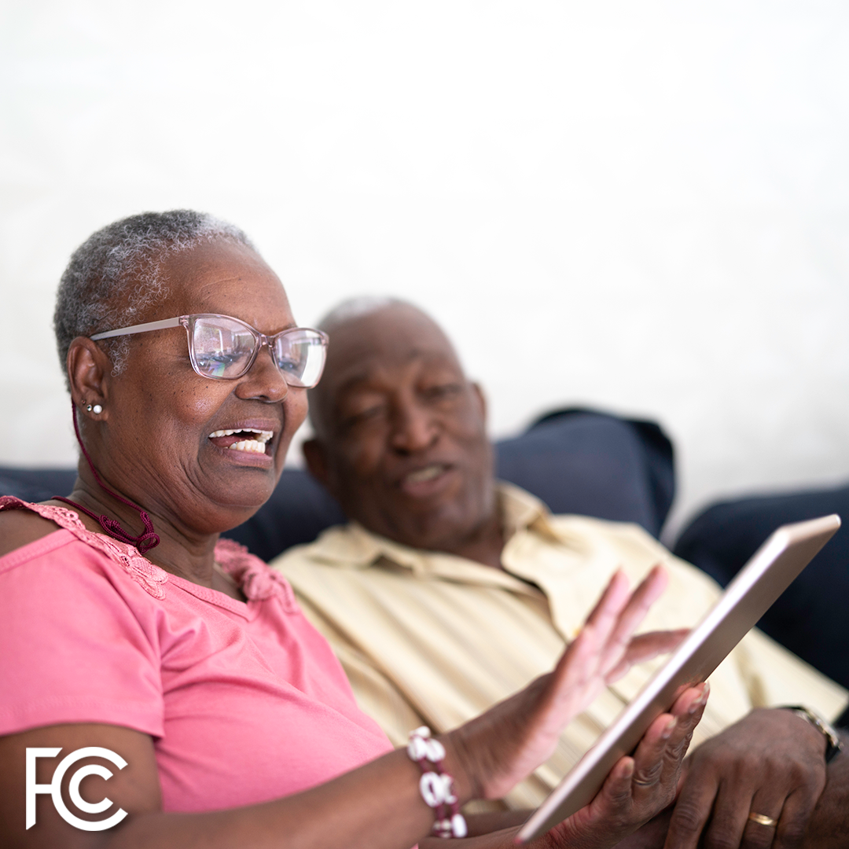
The Emergency Broadband Benefit Program is a Federal Communications Commission (FCC) Program that provides a temporary discount on monthly broadband bills for qualifying low-income households. Eligible households can receive:
Up to $50/month discount for broadband service and associated equipment rentals;
Up to $75/month discount for households on Tribal lands, and;
A one-time discount of up to $100 for a laptop, desktop computer, or tablet purchased through a participating provider.

Slide 3

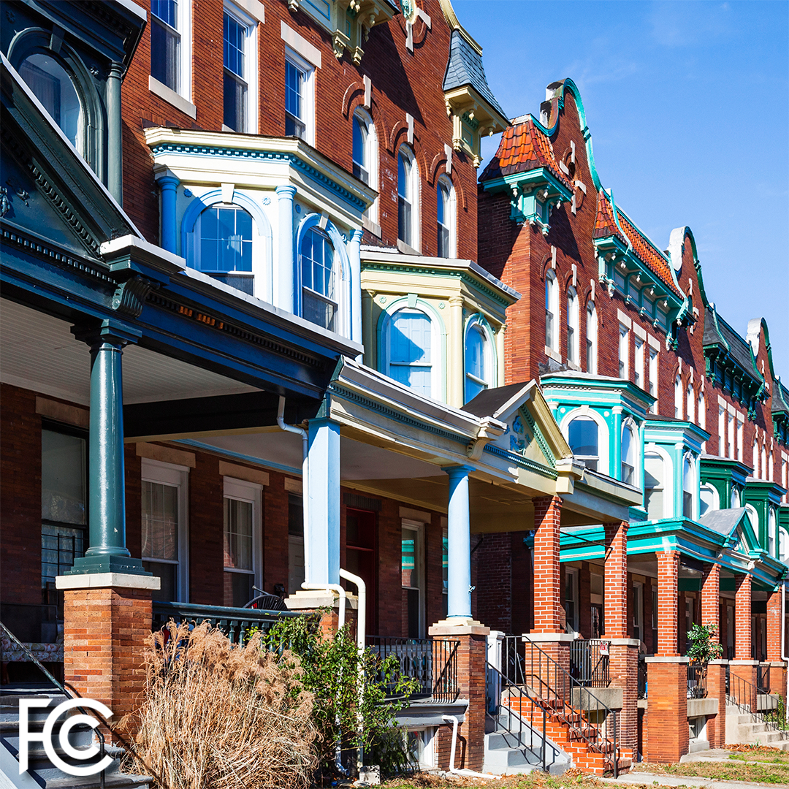
A household is eligible if a member of the household meets one of the criteria below:
Has an income that is at or below 135% of the Federal Poverty Guidelines or participates in certain assistance programs, such as SNAP, Medicaid, or Lifeline;
Received a Pell Grant in the current award year;
Is approved to receive benefits under the free and reduced school lunch program or school breakfast program in the 2019-2020, 2020-2021, or 2021-2022 school year;
Experienced a substantial loss of income, due to a job loss or furlough since 2/29/20 and the household had a total income in 2020 below $99,000 (single filers) or $198,000 (joint filers); or
Meets the eligibility of a participating providers’ existing COVID-19 or low-income program.

Slide 4

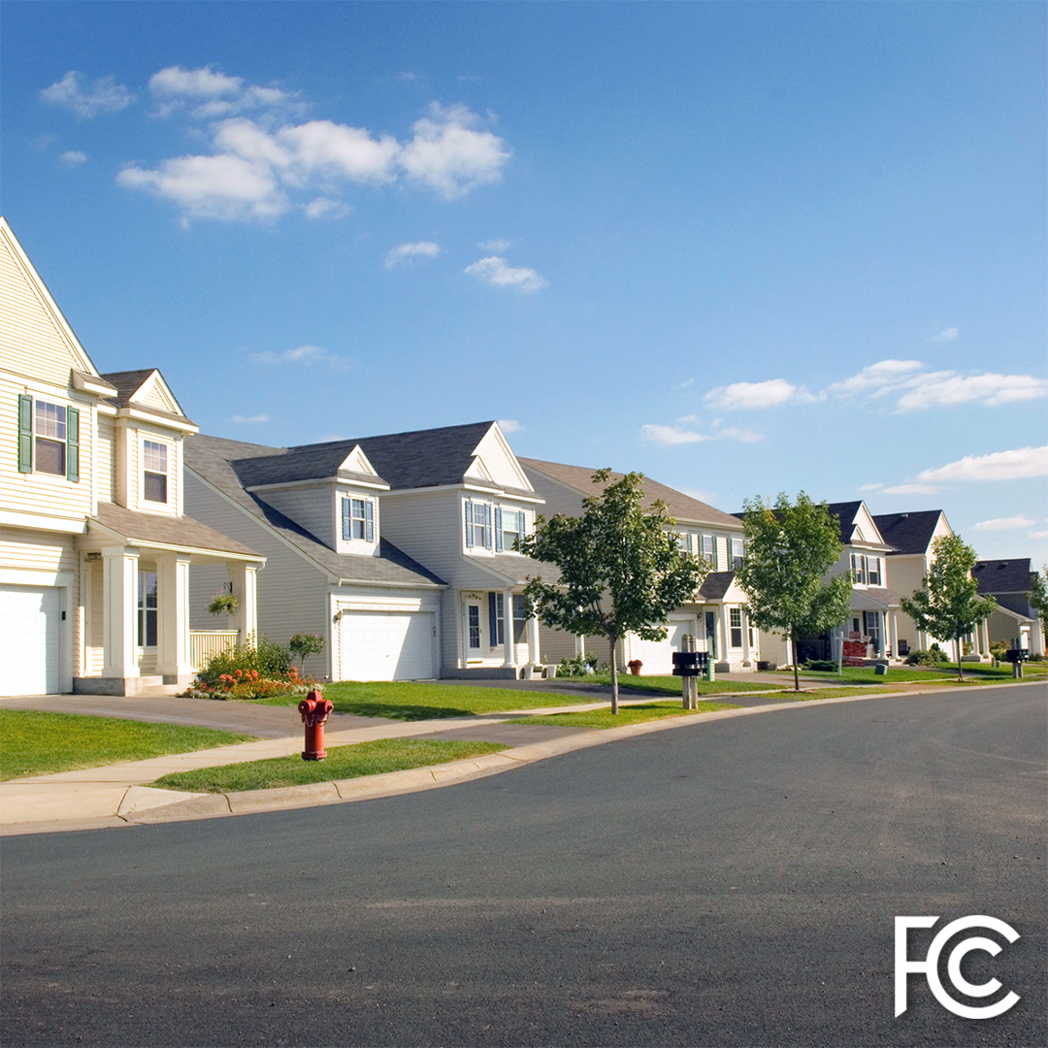
A household is a group of people who live together and share money (even if they are not related to each other.) If you live together and share money, you are one household. If you either don’t live together or you don’t share money, you are two or more households.
A household can qualify because of eligible dependent children that meet the eligibility criteria.
You may have to answer questions about your household when you apply for the Emergency Broadband Benefit Program.
A household worksheet will be available to assist in determining household eligibility.

Slide 5


Eligible households within multi-unit dwellings such as apartment buildings, nursing homes, and group homes can also take advantage of the benefit.
Households within multi-unit dwellings, where the landlord or the property manager is the internet account holder, may be able to apply the benefit to that broadband service if they otherwise qualify.
If the household has a bill or other liability for their broadband access that someone else, such as the property owner, is helping to pay, the household could switch temporarily to using EBB support to pay for broadband service instead of relying on that third party’s support.

Slide 6


The Emergency Broadband Benefit will open its enrollment on May 12, 2021.
The Emergency Broadband Benefit is a temporary program developed in response to the COVID-19 pandemic. The program will end once the program funds are exhausted, or six months after the Department of Health and Human Services declares and end to the pandemic, whichever comes first.
The program is administered by the Universal Service Administrative Company (USAC). They also administer the Lifeline program. USAC hosts the application portal and the GetEmergencyBroadband.org consumer website.

Slide 7

Participating providers must give households notice about the last date or billing cycle that the full benefit will apply to their bill and the date or billing cycle that a partial benefit will apply to their bill, in addition to information about the cost of broadband service after the program ends.
Households will need to opt-in or request to continue broadband services with their provider. If they don’t opt-in or select a new service plan with the provider, their broadband service will end once the program ends. Even if they had service with the same provider before enrolling in the Emergency Broadband Benefit, they will need to opt-in to continue broadband services after the program ends.

Slide 8

The program is open to all broadband providers, not just those currently offering Lifeline services.
Fixed broadband services are provided to your home, or a single location. These include cable, fiber optic, DSL, satellite, and fixed wireless services.
Mobile broadband services are device-based and available throughout the service provider’s cellular coverage area, similar to cell phone services.
Check with the broadband providers in your area to learn about their plans for program participation and eligible service offerings. You can find a list of participating providers by state and territory linked on www.fcc.gov/broadbandbenefit.
Not all providers plan to offer connected devices through the program.

Slide 9


There are three ways to apply for the Emergency Broadband Benefit
Option 1: Contact a participating broadband provider directly to learn about their application process.
Option 2: Go to GetEmergencyBroadband.org
to apply online and to find participating providers near you.
Option 3: Send a mail-in application, along with proof of eligibility to:
      Emergency Broadband
      Support Center
      P.O. Box 7081
      London, KY 40742

Slide 10


Contact a service provider. Find a list of participating service providers by state at: www.fcc.gov/broadbandbenefit.
The service provider assists the consumer (in-person) with applying through the National Verifier Service provider portal; or
The service provider helps the consumer apply using their FCC approved alternate verification process.

Slide 11

Visit
Visit GetEmergencyBroadband.org
Submit
Click "How to Apply" and complete the electronic application.
Contact
After receiving an eligibility determination from the National Verifier, the consumer can contact a service provider to enroll in the EBB program.

Slide 12

Download and print a paper application from GetEmergencyBroadband.org.
(Participating providers may also supply consumers with paper applications)
Mail the completed application to:
Emergency Broadband Support Center
P.O. Box 7081
London, KY 40742
To help with application processing include supporting documents to prove eligibility and the household worksheet.

Slide 13

When applying for the Emergency Broadband Benefit using USAC’s online application, they will attempt to confirm your information automatically.
Online and mail-in applicants may be asked to provide information or documentation to verify identity, address, or eligibility.
To confirm your eligibility, additional documentation can be mailed or submitted electronically. Examples of acceptable documents that can be used to validate information can be found at: getemergencybroadband.org/how-to-apply/show-you-qualify/

Slide 14


The FCC’s EBB Consumer Hub:
www.fcc.gov/broadbandbenefit
Toll free number for questions:
833-511-0311
To apply: GetEmergencyBroadband.org

