Slide 1

Webinar For Low Power Broadcasters on the Emergency Alert System (EAS) and the EAS Test Reporting System (ETRS)
_________________
Public Safety and Homeland Security Bureau
Federal Communications Commission
August 15, 2023
Email Questions to: alerting@fcc.gov

Slide 2
Goal of this Webinar
Increase low power broadcaster participation in the nationwide EAS test and increase low power ETRS filing rates.
Educate low power broadcasters on the EAS.
For more information about wireless emergency alerts (WEA), please visit our WEA page at https://www.fcc.gov/consumers/guides/wireless-emergency-alerts-wea.

Slide 3
Low Power Broadcaster Participation
  Low power broadcasters participated in relatively low rates in the 2019 nationwide EAS test.
  In that 2019 test, participation rates were:
    55.9 percent for Low Power FM radio broadcasters and 48.1 percent for Low Power TV broadcasters, compared to 81.8 percent for all radio broadcasters and 63.5 percent for all television broadcasters.

Slide 4
Emergency Alert System
The Emergency Alert System (EAS) is a national public warning system commonly used by state and local authorities to deliver important emergency information, such as weather and AMBER alerts, to affected communities.
EAS Participants – radio and television broadcasters, cable systems, satellite radio and television providers, and wireline video providers – deliver local alerts on a voluntary basis, but they are required to provide the capability for the President to address the public during a national emergency. 47 CFR§11.11.

Slide 5
The Emergency Alert System (EAS)
EAS Rules – 47 CFR §11.1, et seq.
EAS Participants must deliver Presidential alerts and nationwide monthly and weekly tests.
      Delivery of other alerts (weather, state, AMBER) is voluntary.
    EAS Alerts must be accessible to people with disabilities.
      The visual message portion of an EAS alert, whether video crawl or block text, must be displayed at the top of the television screen or where it will not interfere with other visual messages, in a manner (i.e., font size, color, contrast, location, and speed) that is readily readable and understandable that does not contain overlapping lines of EAS text or extend beyond the viewable display (except for video crawls that intentionally scroll on and off of the screen), and in full at least once during any EAS message.

Slide 6
EAS Distribution
  EAS alerts are delivered to EAS Participants either over the internet from FEMA’s Integrated Public Alert and Warning System (IPAWS) gateway or by over-the-air broadcast.
  EAS Participants are required to monitor both systems for redundancy.

Slide 7
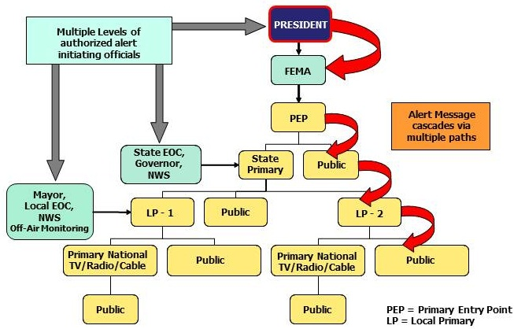
The EAS Protocol “Daisy Chain”

Slide 8
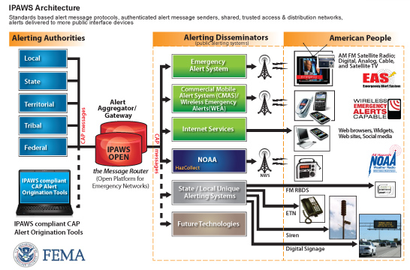
EAS Distribution over IPAWS
Integrated Public Alert and Warning System (IPAWS)

Slide 9
Are Low Power Broadcasters EAS Participants?
EAS Participants include Low Power FM stations (LPFM), low power television stations (LPTV), Class D non-commercial educational FM stations, and EAS Participants that are silent pursuant to a grant of Special Temporary Authority.
EAS Participants are required to participate in nationwide tests and register and file in ETRS.

Slide 10
FAQs
Are low power television stations that operate as television broadcast translator stations required to register and file in ETRS?
Analog and digital low power television (LPTV) stations that operate as television broadcast translator stations are not required to register and file in ETRS.
Are satellite stations or repeaters of a hub station required to register and file in ETRS?
Analog and digital broadcast stations that operate as satellites or repeaters of a hub station (or common studio or control point if there is no hub station) and rebroadcast 100 percent of the programming of the hub station (or common studio or control point) are not required to register and file in ETRS. However, the hub station (or common studio or control point) is required to register and file in ETRS.
Are FM broadcast booster stations or translator stations that entirely rebroadcast the programming of other local FM broadcast stations required to register and file in ETRS?
FM broadcast booster stations and FM translator stations which entirely rebroadcast the programming of other local FM broadcast stations are not required to register and file in ETRS.

Slide 11
EAS Test Reporting System
There are three filings associated with the nationwide test: Form One (Identifying Information, Form Two (“day of test” snapshot), and Form Three (more detailed information about participation in the test).
Pursuant to Section 11.61 of the Commission’s rules, EAS Participants must renew their identifying information required by ETRS Form One on a yearly basis.
Filers can access ETRS by visiting the ETRS page of the Commission’s website at https://www.fcc.gov/general/eas-test-reporting-system. See 47 CFR § 11.61(a)(3)(iv)(A).

Slide 12
Filing in ETRS
How do I access ETRS?
The following links provide access to ETRS new user registration, login, password reset and user profile updates:
Log In: https://fccprod.servicenowservices.com/login_with_sso.do?glide_sso_id=10db4616dbb07200f2f2f6531f9619de&fcc_portal_link=etrs
New User Registration: https://apps2.fcc.gov/fccUserReg/pages/createAccount.htm
Note: All EAS Participants must register a FCC Username in the Commission’s CORES system. EAS Participants can no longer use ETRS-specific accounts that they created in 2016.
Password Reset: https://apps2.fcc.gov/fccUserReg/pages/reset-passwd-identify.htm
Profile Update : https://apps2.fcc.gov/fccUserReg/pages/login.htm
Where can I look for ETRS-related questions?
The ETRS FAQs: https://www.fcc.gov/sites/default/files/ETRS%20FAQs%200823.docx

Slide 13
Filing in ETRS
Filers can associate their Username to an FRN by logging in at https://apps.fcc.gov/cores/userLogin.do and clicking on the appropriate option.
Additional information regarding creating and associating FRNs with a Username can be found on the CORES FAQs page at https://apps.fcc.gov/coresWeb/publicHome.do?faq=true.
When a user enters their FRN and Facility ID, ETRS looks for previous filings and prepopulates data into the current filing window Form 1.
More information about ETRS and the nationwide Emergency Alert System (EAS) test can be found on the FCC’s ETRS website at https://www.fcc.gov/general/eas-test-reporting-system.

Slide 14
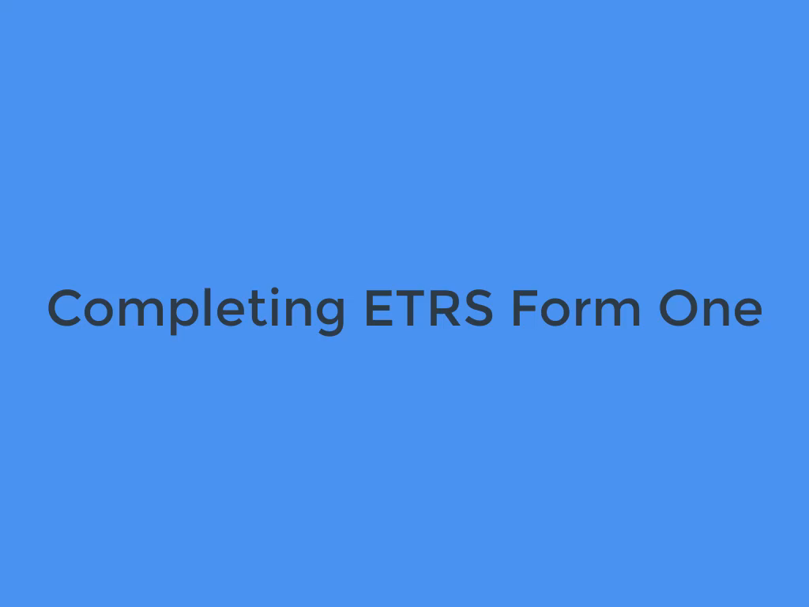
ETRS Video – Form One

Slide 15
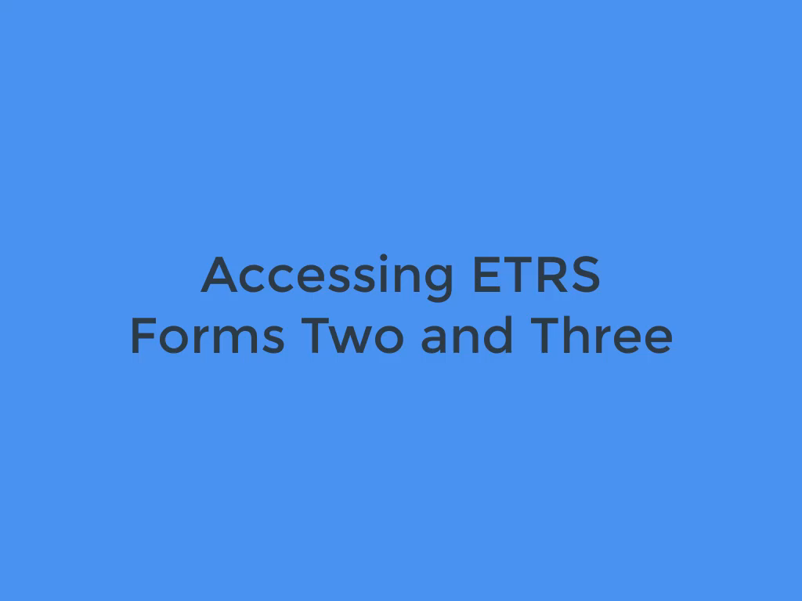
ETRS Video – Forms Two and Three

Slide 16
Test Preparations - State EAS Plans
EAS Participants must follow monitoring assignments, including monitoring IPAWS, during a test.
Contact your state’s SECC to learn more. For SECC contact information, see https://www.fcc.gov/public-safety-and-homeland-security/policy-and-licensing-division/alerting/general/state-eas-plans
EAS Participants must monitor two sources of the national emergency message and the test message (NPT and EAN).

Slide 17
Test Preparations – EAS Handbook
Ensure that a copy of the EAS Operating Handbook is located at normal duty positions, or EAS equipment locations, and is otherwise immediately available to operators.
Review the EAS Operating Handbook for the actions to be taken by operators upon receipt of the test alert and tailoring any actions as necessary that are specific to the EAS Participants’ facilities.
A writeable PDF version of the EAS Operating Handbook can be found on the Bureau’s web site at https://www.fcc.gov/general/eas-test-reporting-system.

Slide 18
Test Preparations - Equipment
Ensure that EAS equipment is accurately configured to monitor the assigned sources.
Ensure that EAS equipment can receive and process the NPT code, the “six zeroes” national location code, and otherwise operate in compliance with the Commission rules.
Upgrade EAS equipment software and firmware to the most recent version.
Manually synchronize EAS equipment clocks to the official time provided by the National Institute of Standards and Technology, if an EAS Participant’s equipment does not automatically synchronize to an Internet time source.
National Institute of Standards and Technology, The Official NIST US Time, http://www.time.gov.

Slide 19
Questions?
Please email alerting@fcc.gov
Public Safety & Homeland Security Bureau
Federal Communications Commission

