Slide 1
Mobility Fund II
Introduction to
The MF-II Challenge Process
mf2challengeprocess@fcc.gov

Slide 2
Ex Parte Information
With a limited exception, attending and/or participating in this webinar on proposed procedures to conduct the Mobility Fund Phase II challenge process will not require a filing under the Commission’s rules governing ex parte communications¹
Presentations to Commission personnel directed to the merits or the outcome of the matters raised in the Comment Public Notice or other pending proceedings will require the filing of an ex parte notice
¹ See 47 C.F.R. §§ 1.1200 et seq.

Slide 3
Today’s Topics
Generating Initial Eligible Areas Map
Background
Processing Steps
Challenging Initially Ineligible Areas
Filing a Challenge
Automated Validation
Responding to a Challenge
Adjudicating Challenges
Other Important Information
USAC Portal Access
Timing, Deadlines, and Comment Filing Instructions
Note: this presentation is not meant to substitute for reading the Commission’s Orders and Public Notices. For additional detail, please see FCC 17-11; FCC 17-102; and DA 17-1027.

Slide 4
MF-II Overview
The Commission determined that universal service funding should be used to advance 4G LTE service where there is no qualifying unsubsidized service
Budget of $4.53B over ten years
Areas determined to be eligible for MF-II support will be included in an auction
Bidders submit bids for support to provide service in eligible areas
The Commission explained that conducting an auction for MF-II support is an efficient mechanism for determining how much of the fixed budget should be awarded to specific providers in underserved areas

Slide 5
Why Conduct a Challenge Process?
Ensures that support does not go to areas that already have unsubsidized, qualified 4G LTE service
Allows interested parties to review the coverage analysis for the determination of initially eligible areas

Slide 6
2017 MF-II Challenge Process Order
Adopted a new, one-time collection of qualifying 4G LTE coverage data
Used to determine the initial map of areas eligible for MF-II support
Adopted a robust challenge process
Interested parties can challenge areas determined ineligible for support
Directed the Bureaus to determine additional specifications and parameters for the challenge process
Public Notice seeking comment on those proposed details released October 18, 2017
Comments are due by November 8, 2017
Reply comments are due by November 29, 2017

Slide 7
Eligibility for MF-II Support
Areas without unsubsidized, qualified 4G LTE service are eligible for MF-II support
“Qualified” 4G LTE service is mobile broadband with download speeds of at least 5Mbps at the cell edge with 80 percent cell edge probability and a 30 percent cell loading factor
Determinations of whether a provider that deploys qualified 4G LTE in an area is subsidized or unsubsidized will be based only on whether it receives high-cost support for that area

Slide 8
Generating Initial Eligible Areas Map
New, one-time collection of qualified 4G LTE service coverage data
Entities that previously reported mobile LTE coverage on Form 477 and have qualified mobile 4G LTE coverage are required to file
Coverage data due January 4, 2018
Coverage data will be combined with USAC subsidy data to establish initial eligible areas
Any area where a carrier receives frozen high-cost support or received MF-I support is considered to be subsidized

Slide 9
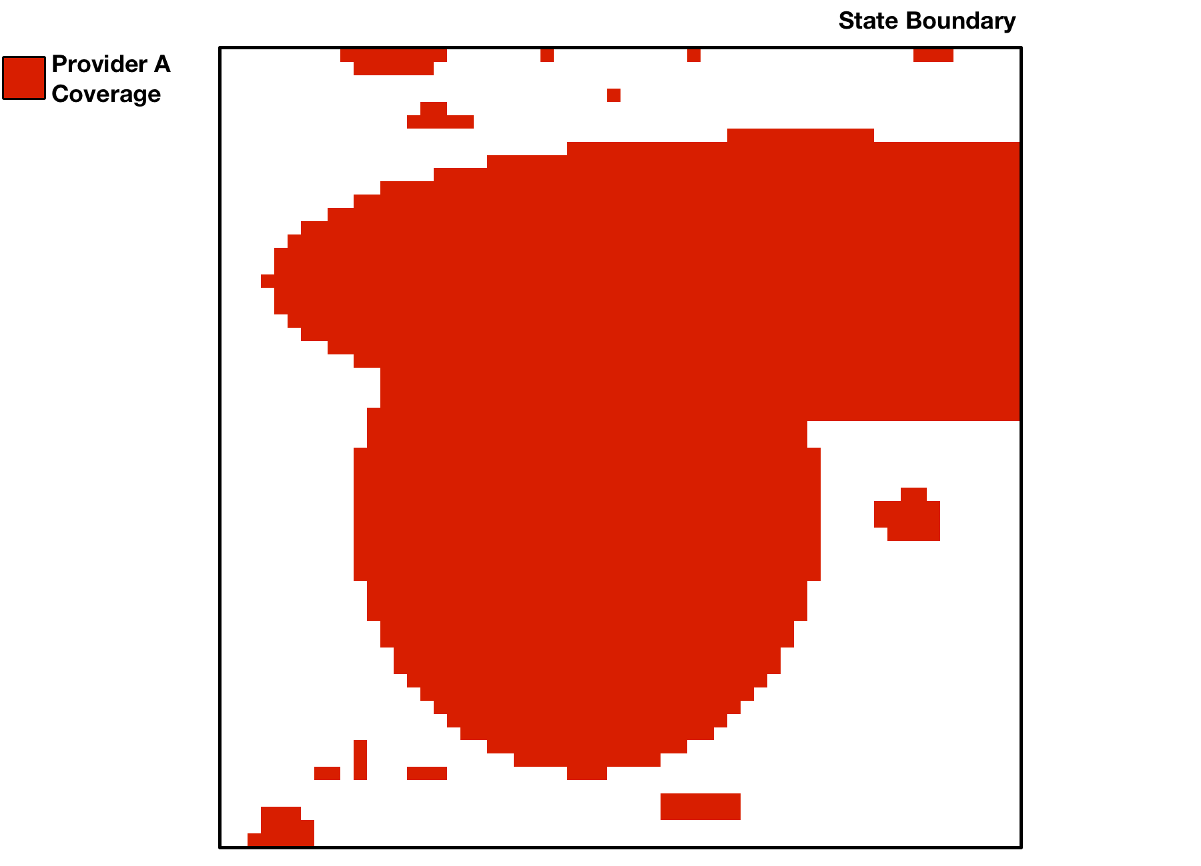
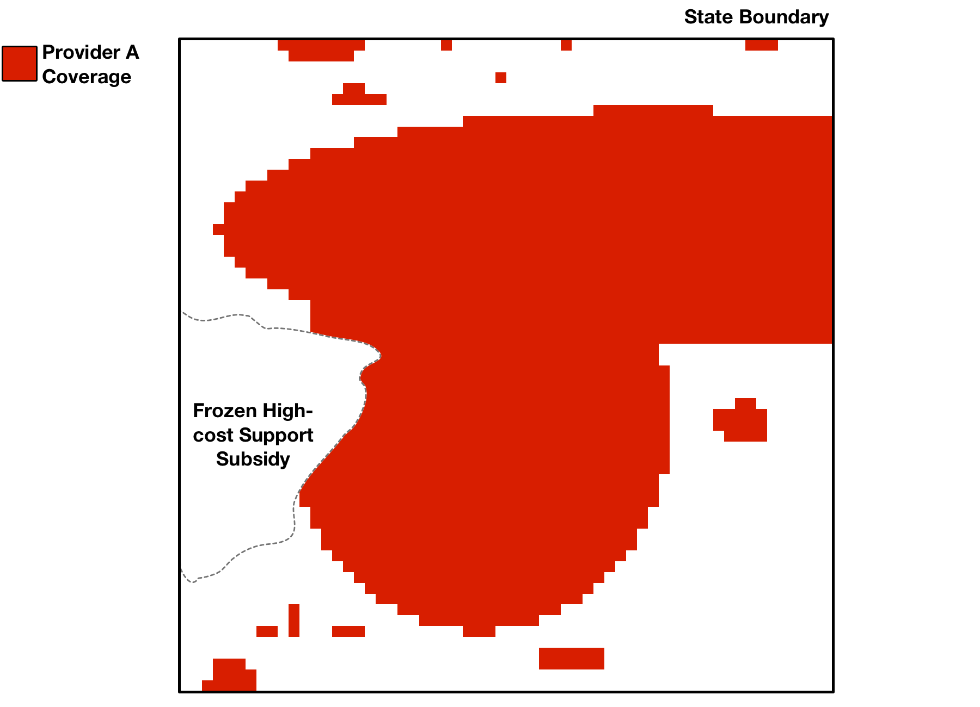
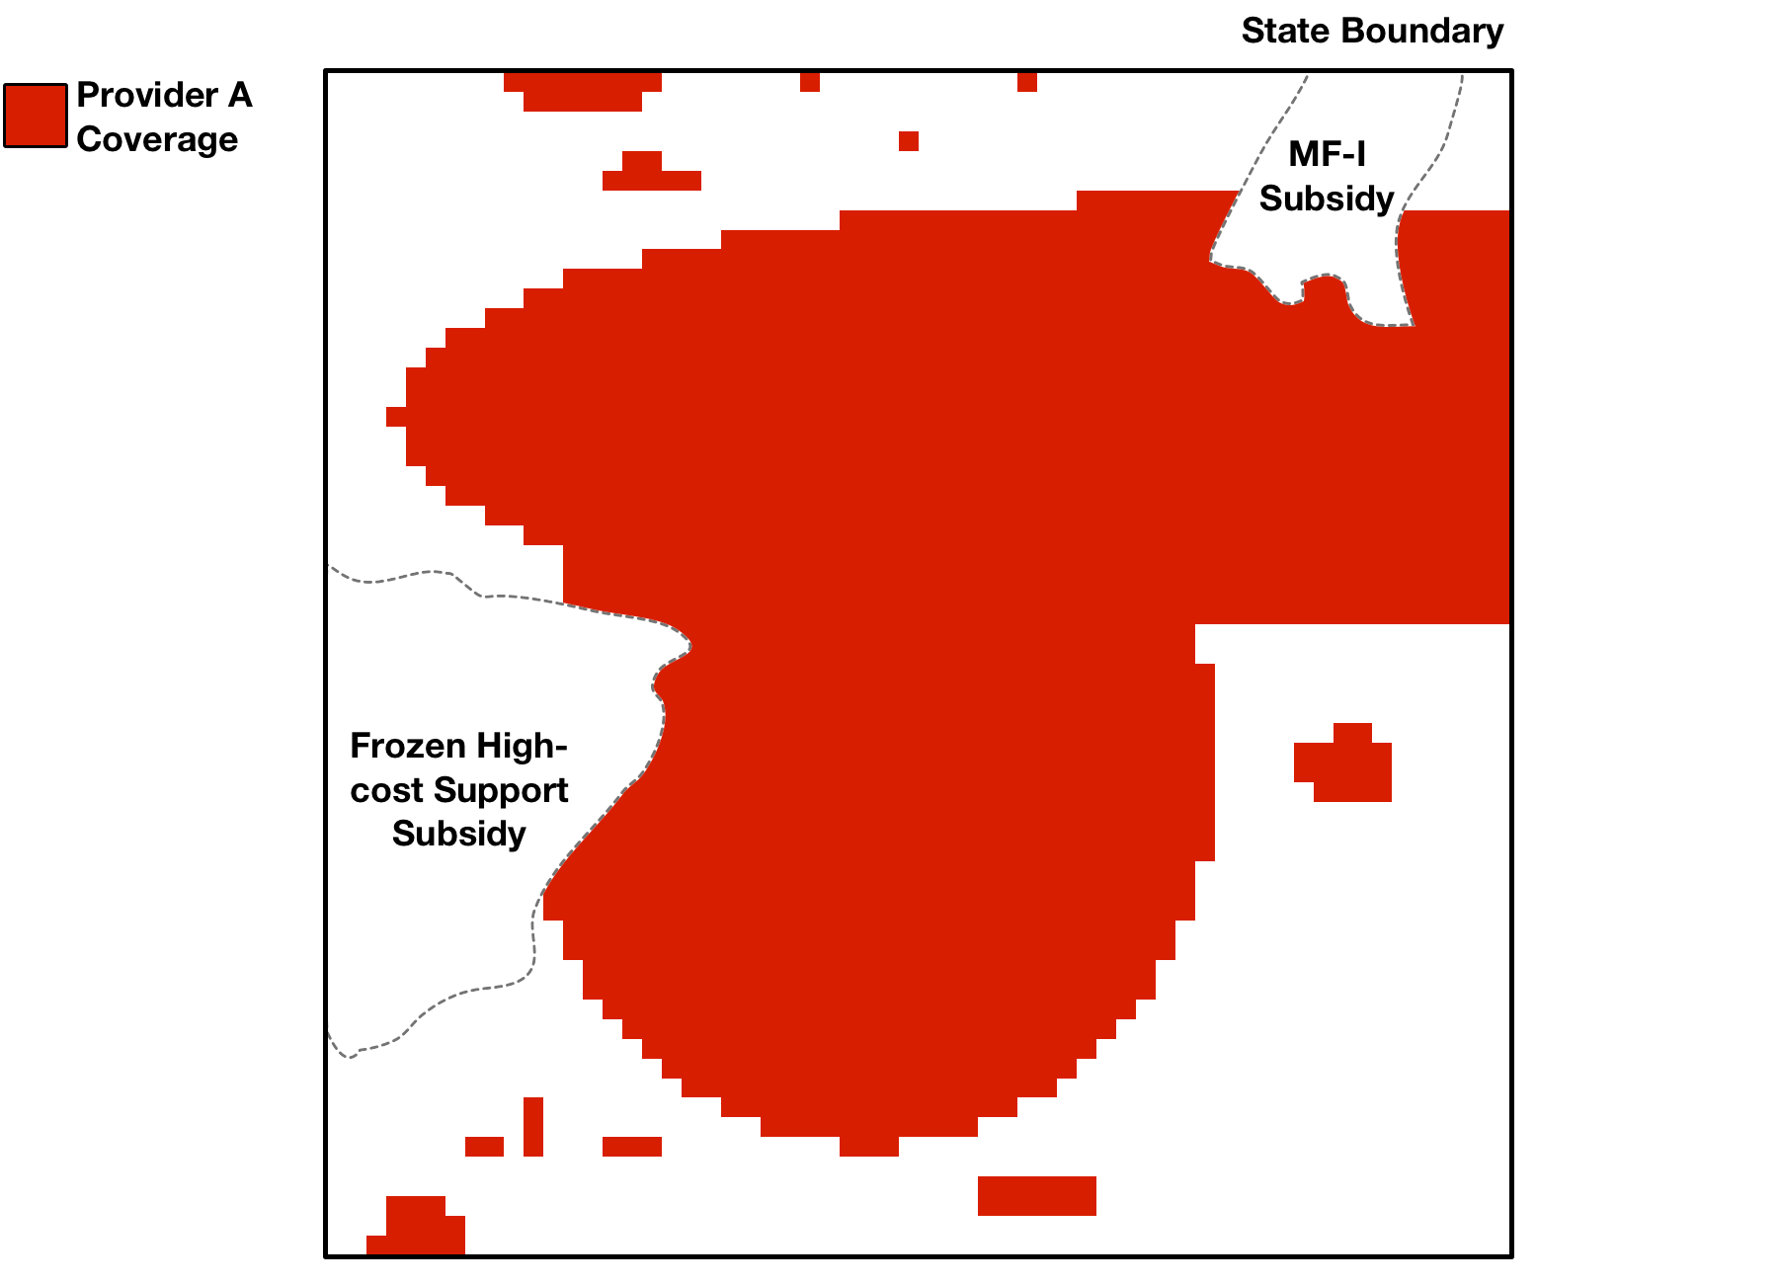
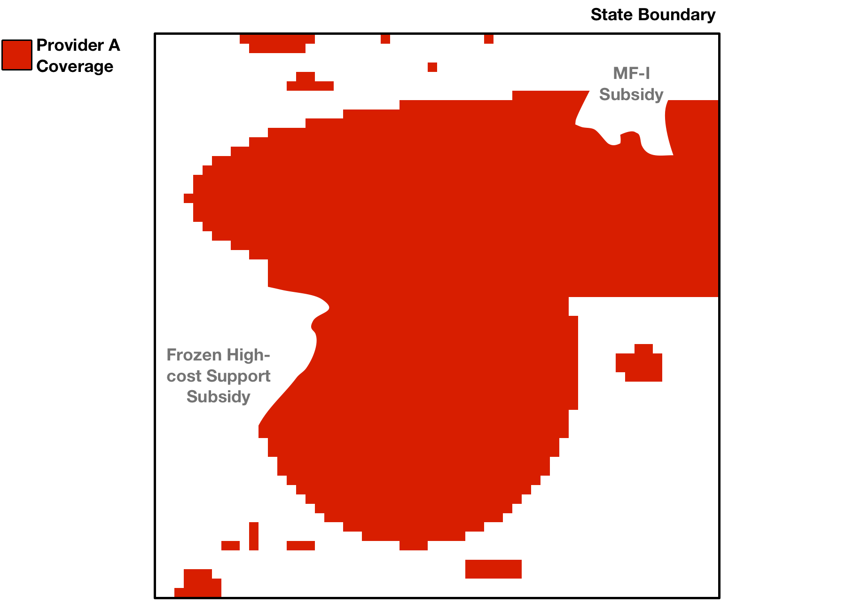
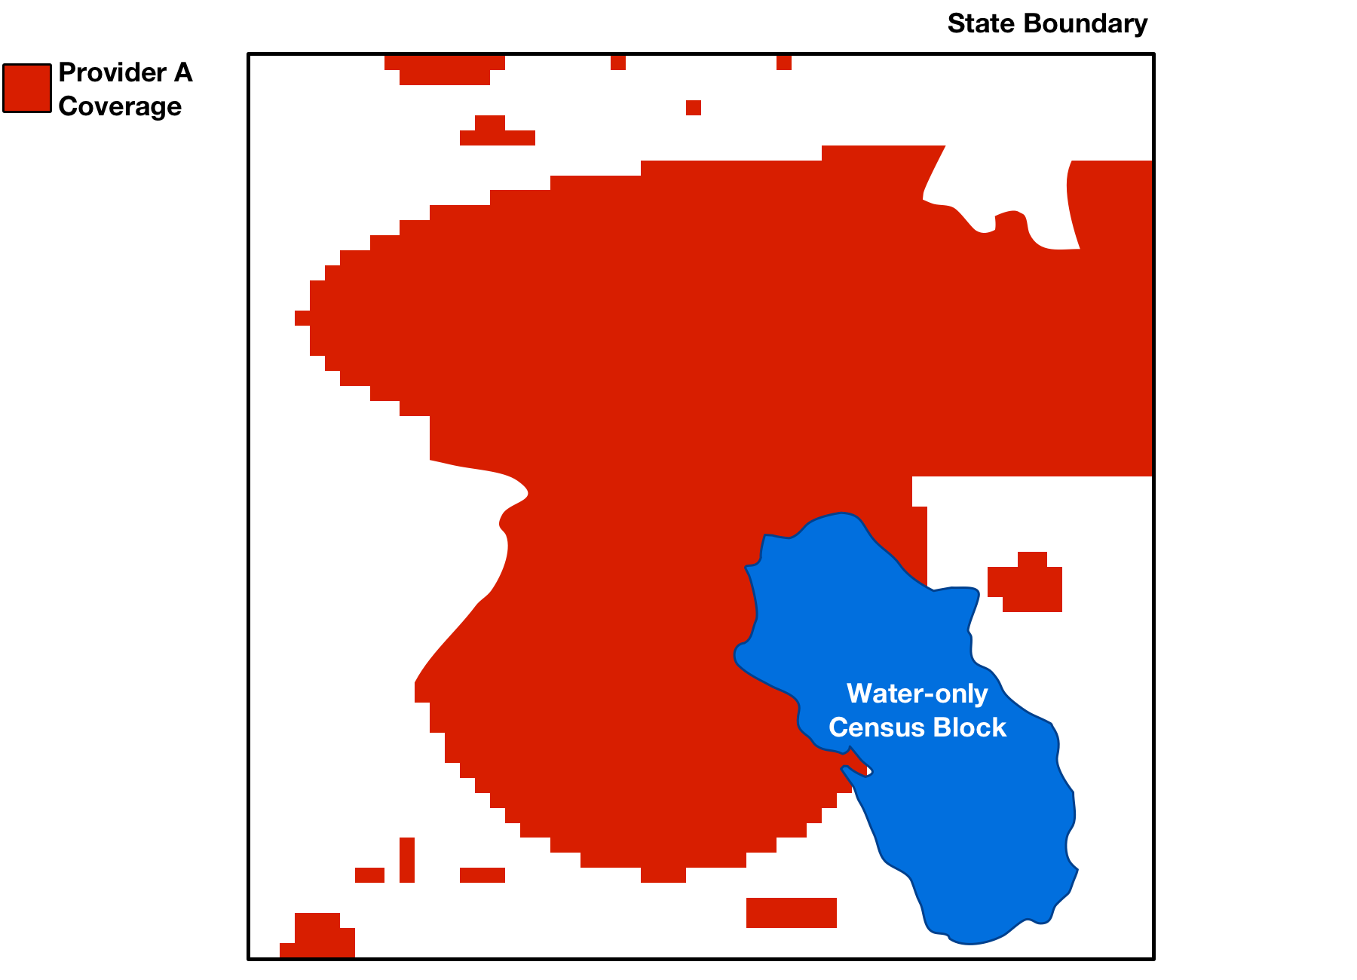
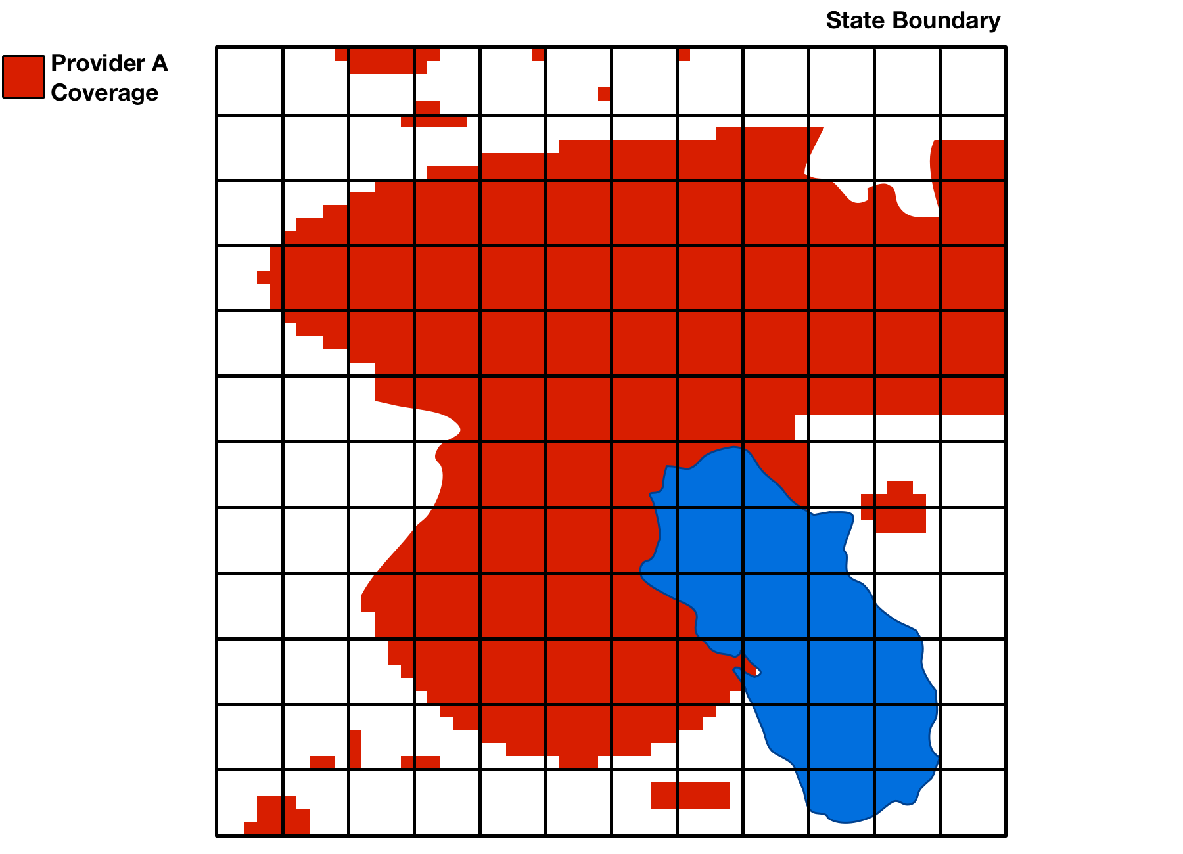
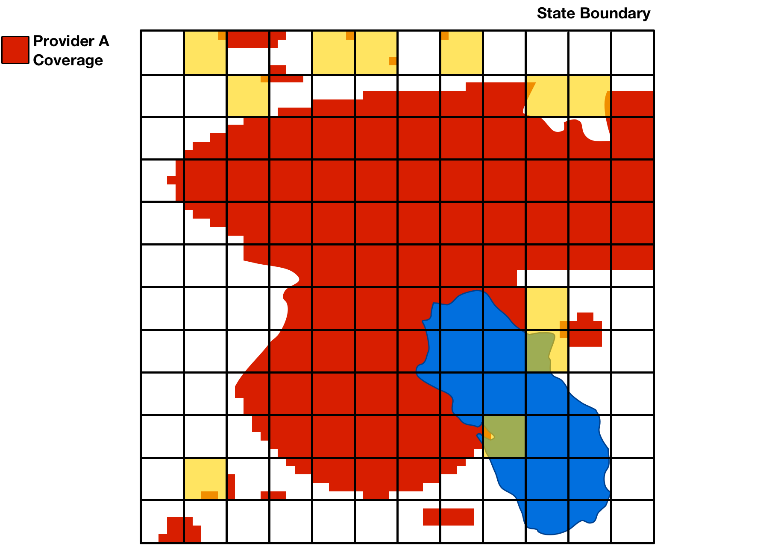
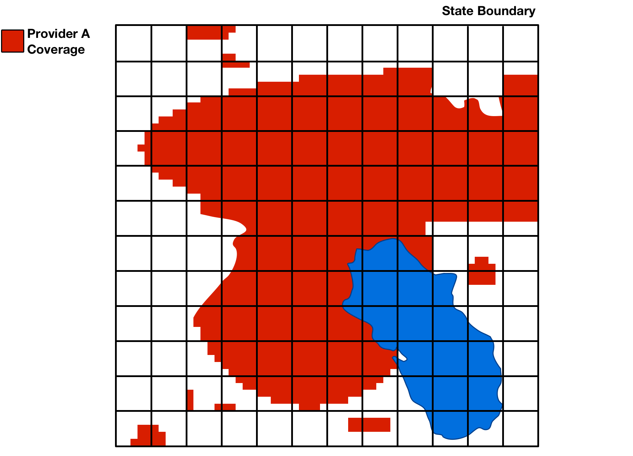
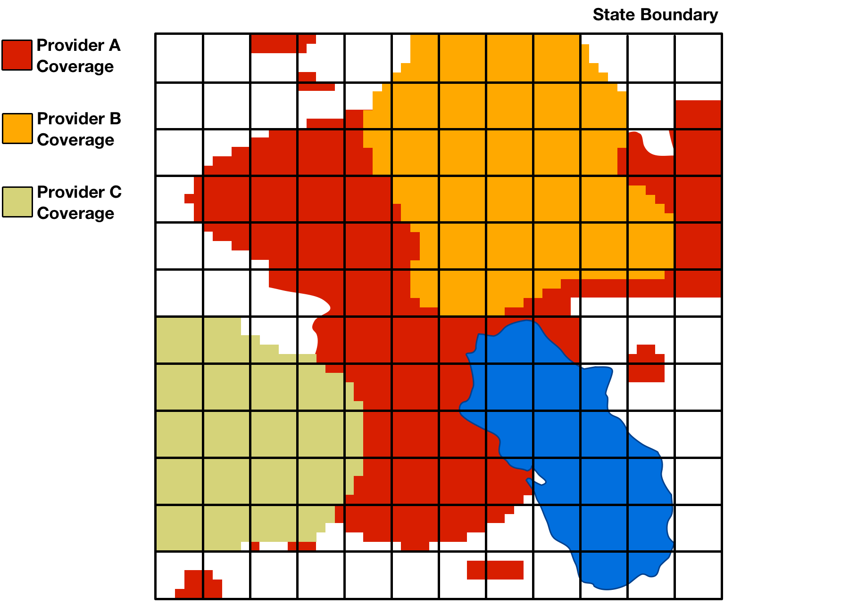
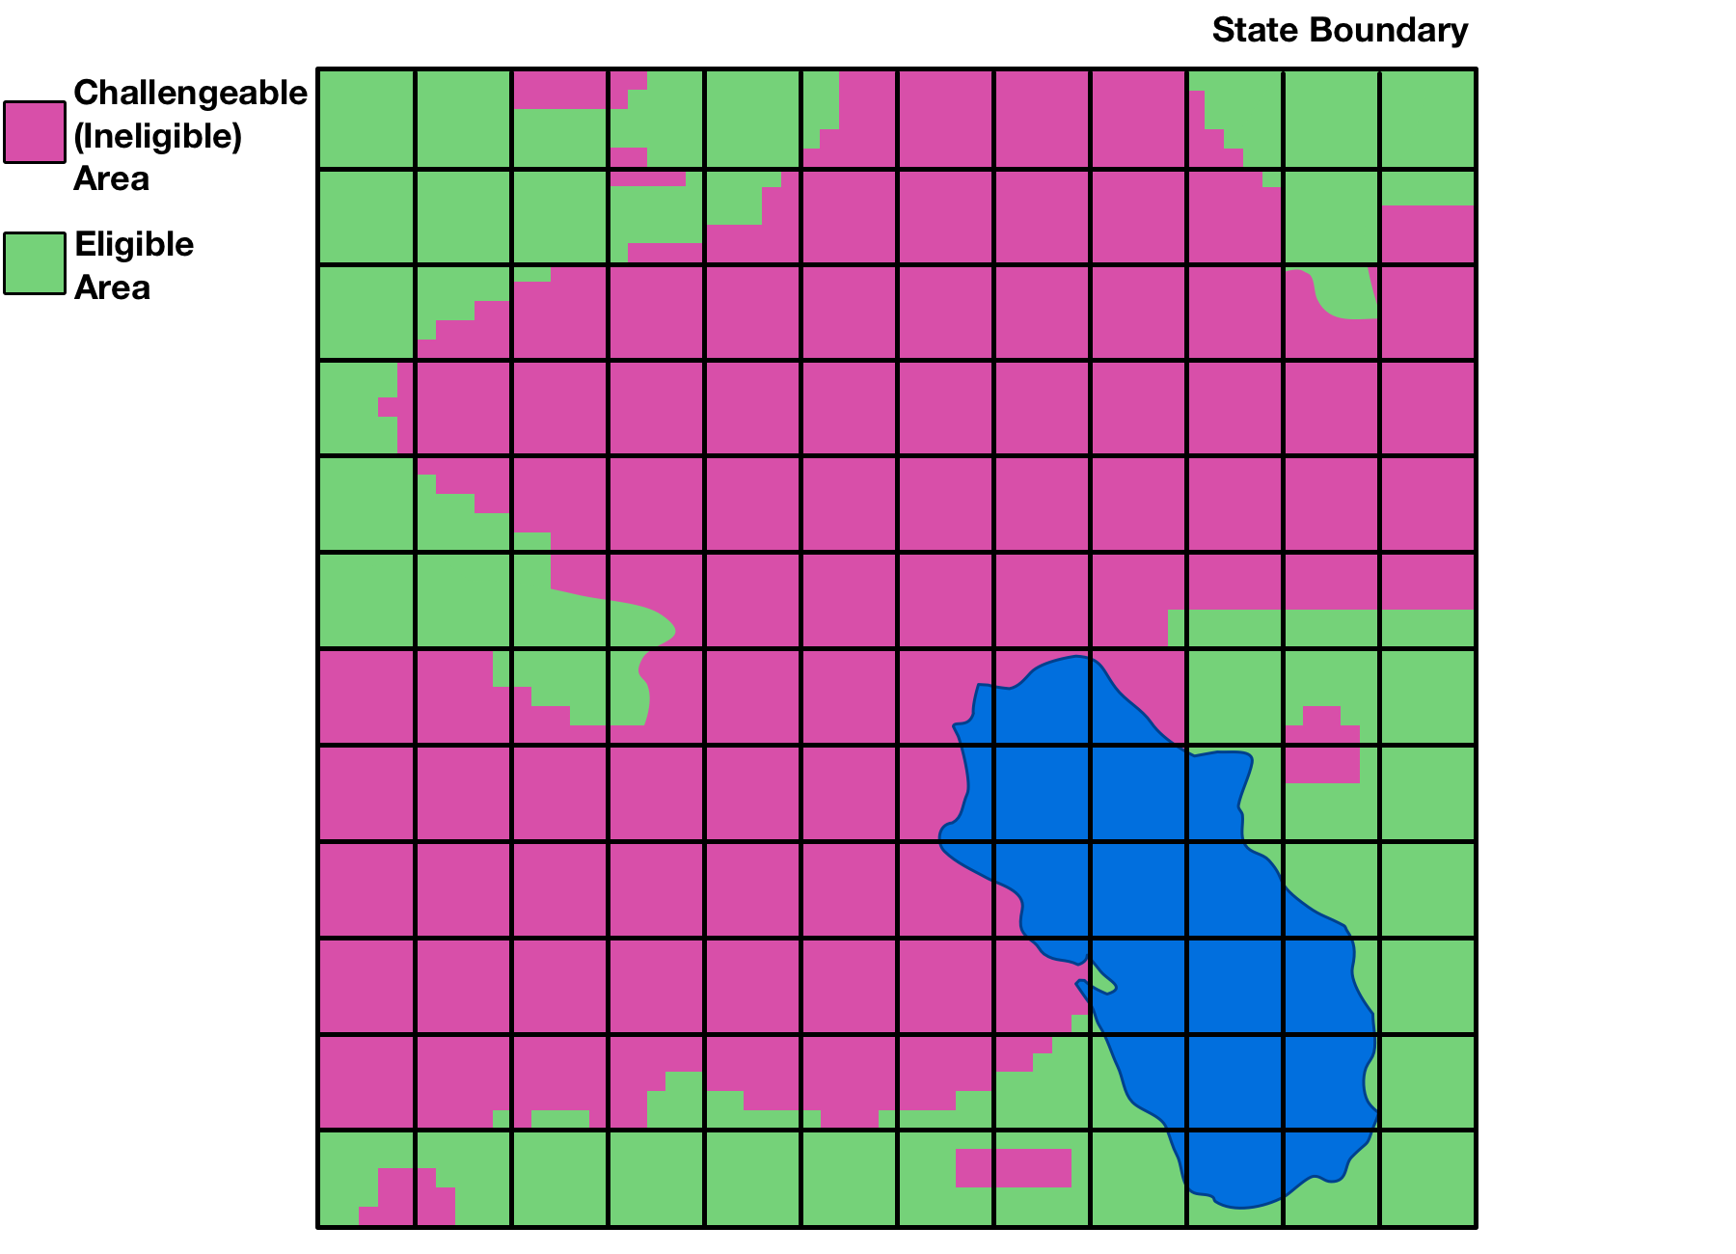
Processing Coverage Data
Multi-step procedure proposed:
Remove subsidized area from a provider’s coverage data where support is received
Remove census blocks that are water-only
Overlay a uniform grid of 1 sq. kilometer cells
Remove minimal coverage from cells
Minimal coverage is where total coverage in a cell is less than the smallest area that could be covered by a single speed test in a cell
Merge resulting coverage maps for all providers to create challengeable areas
Eligible areas are not challengeable nor water-only

Slide 10
General Information on Challenges
Who can challenge?
Mobile service providers
State, local, and tribal government entities
Other parties seeking to challenge must submit and be granted a waiver
May challenge areas presumptively ineligible for MF-II support
Eligible areas will not be challengeable
Challengers must submit speed tests showing lack of coverage to initiate a challenge
Challenged parties may respond
Challenges will be adjudicated at the end of the process using a preponderance of the evidence standard

Slide 11
Preparing to File a Challenge
Map of initial eligible areas expected to be released in 1Q 2018
Publicly released map will include the uniform grid overlay
As proposed, the challenge window would open the next business day
Challenge window open for 150 days
Challengers can download confidential provider-specific maps via USAC portal
Challengers submit speed tests by state

Slide 12
Challenger Speed Tests
Hardware- or software-based drive tests or app-based tests
Use handsets specified by the mobile provider
Outdoor between 6:00 AM and midnight
After release of the map and no more than 6 months before close of the challenge window
Must be conducted for each provider
Must be certified by a qualified engineer

Slide 13
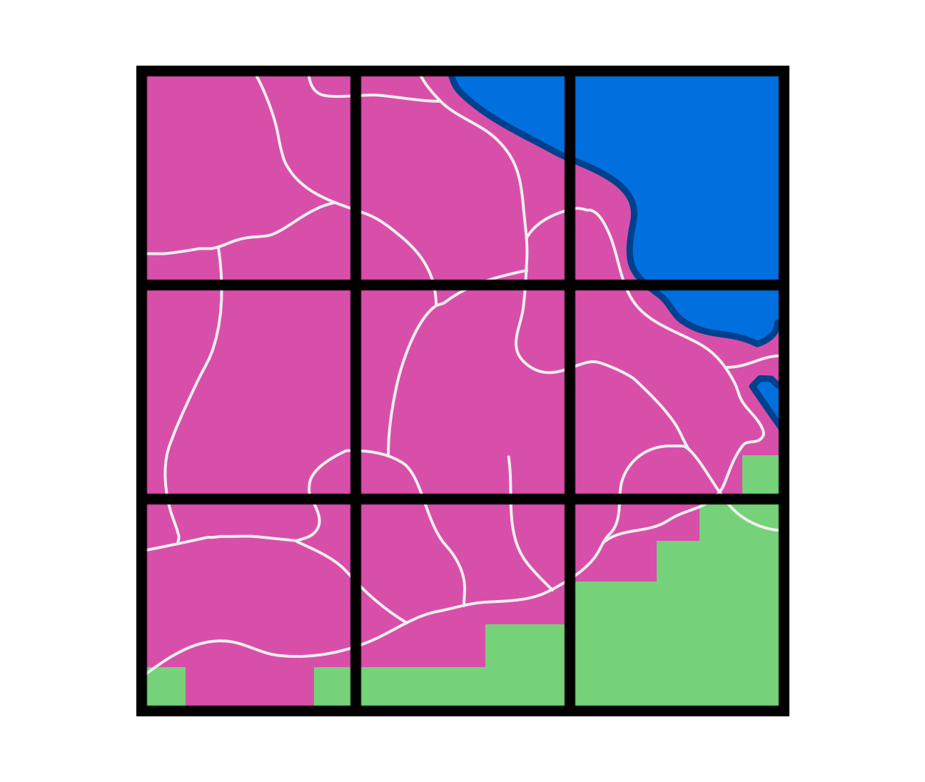
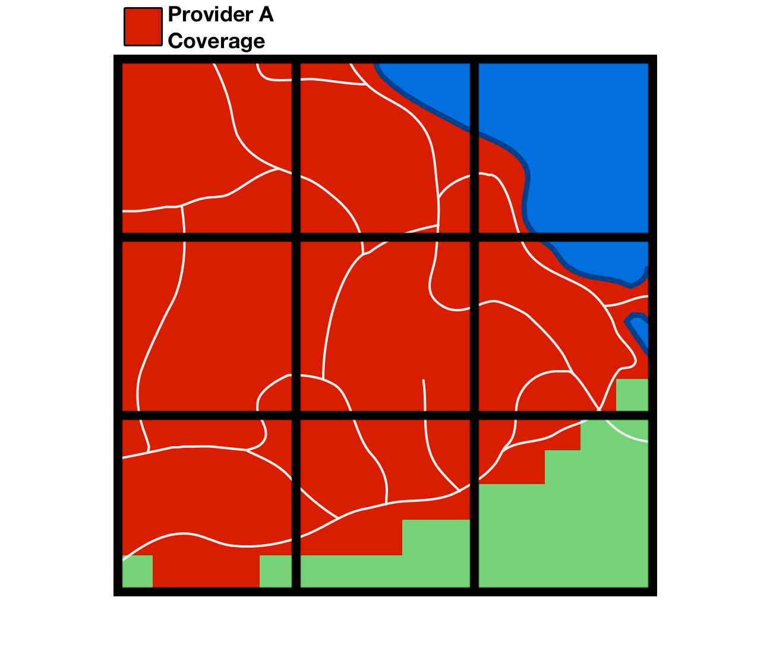
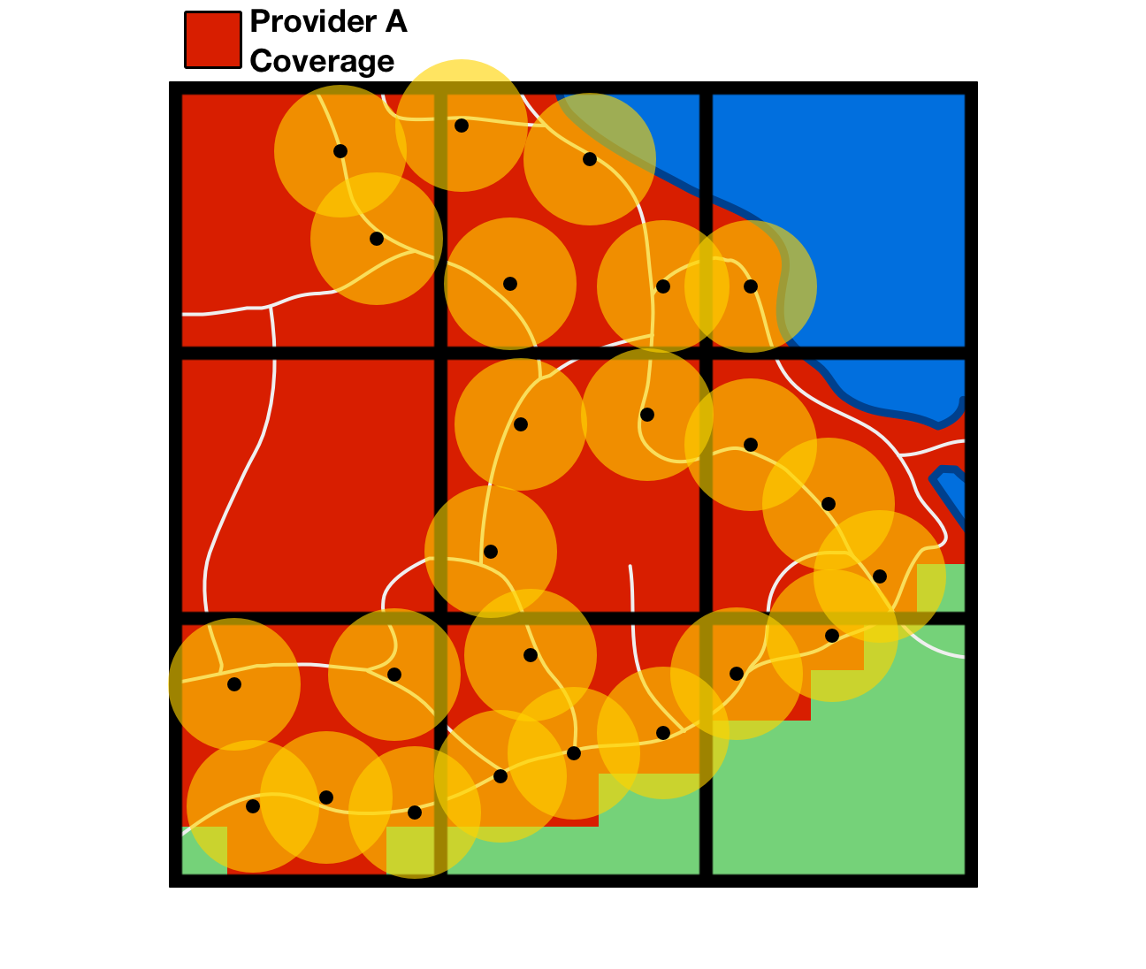
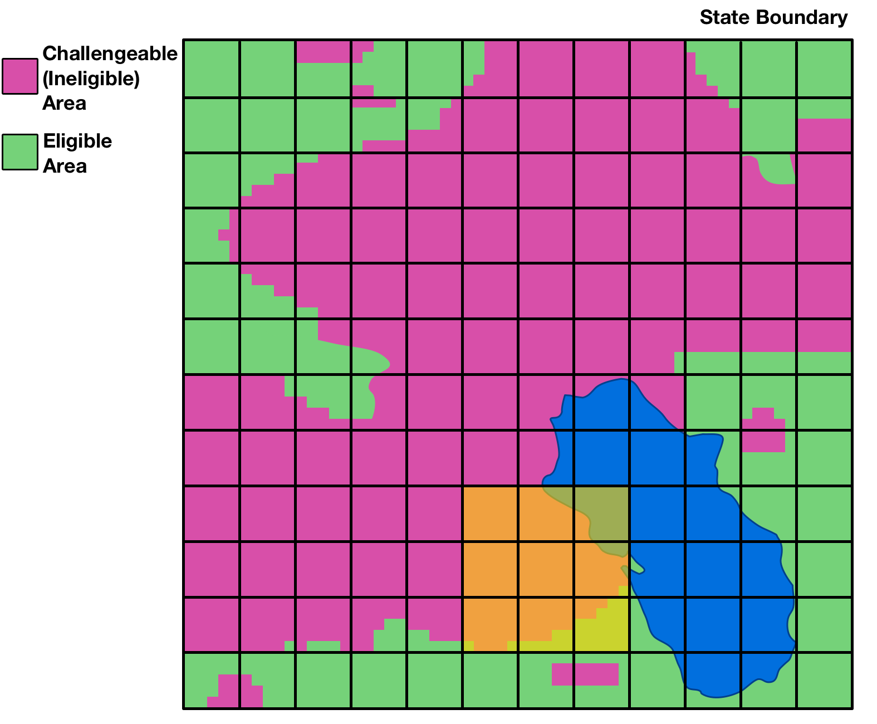
Steps to Challenge an Area
How do challengers go about challenging an area?
Review confidential data in the USAC portal
Identify area to challenge
Collect speed tests for each provider in the area
Speed tests must use standard parameters and meet specified requirements in order to be to counted
Each counted speed test is considered evidence for a larger, “buffered” area
Submit all collected evidence in tabular (CSV) format via the USAC portal for automated system processing

Slide 14
Automated Validation of Speed Test
Determine whether the identified challenged area meets the de minimis threshold
Total challengeable area must be at least 1 sq. km within the state
Analyze each record to ensure it meets all standard parameters
Create a buffer around each counted speed test using a radius equal to half of the parameter for the maximum distance between speed tests
As proposed, radius would be ¼ km for a max distance of ½ km
Determine whether the buffered area of all counted speed tests covers at least 75% of challengeable area in each cell

Slide 15
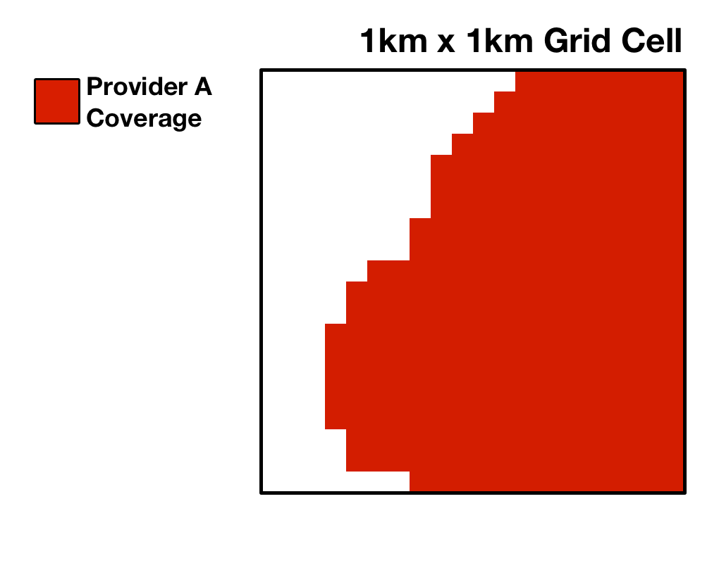
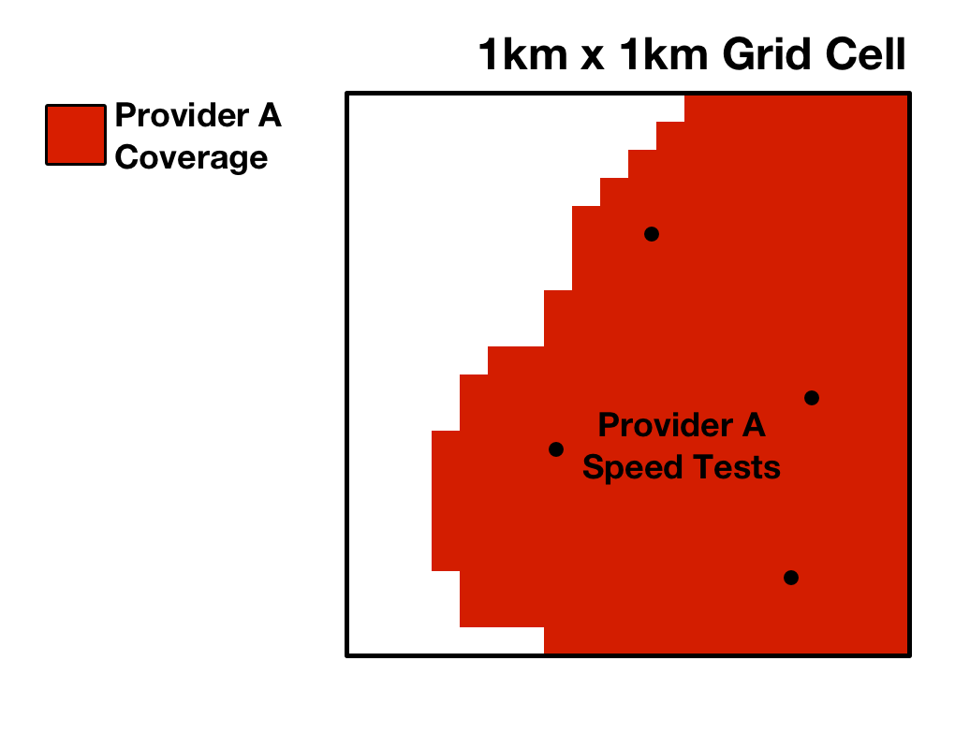
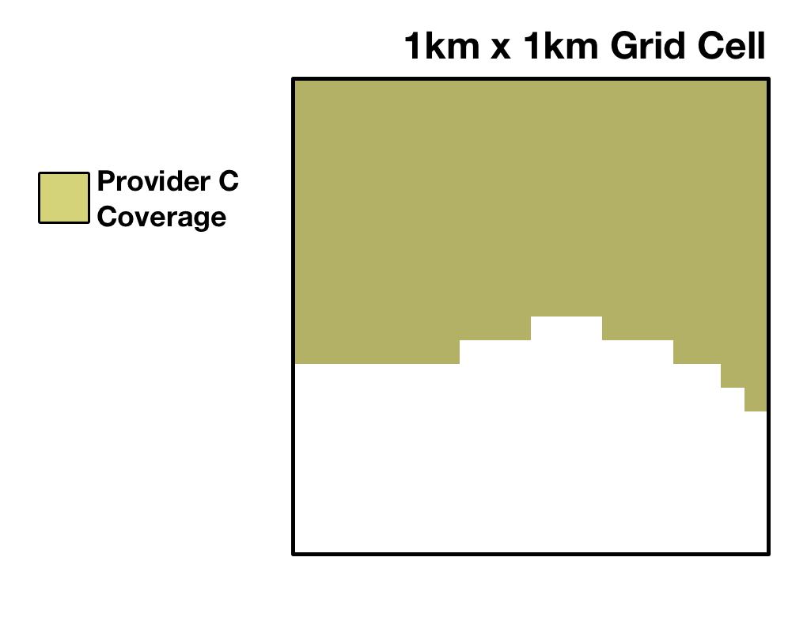
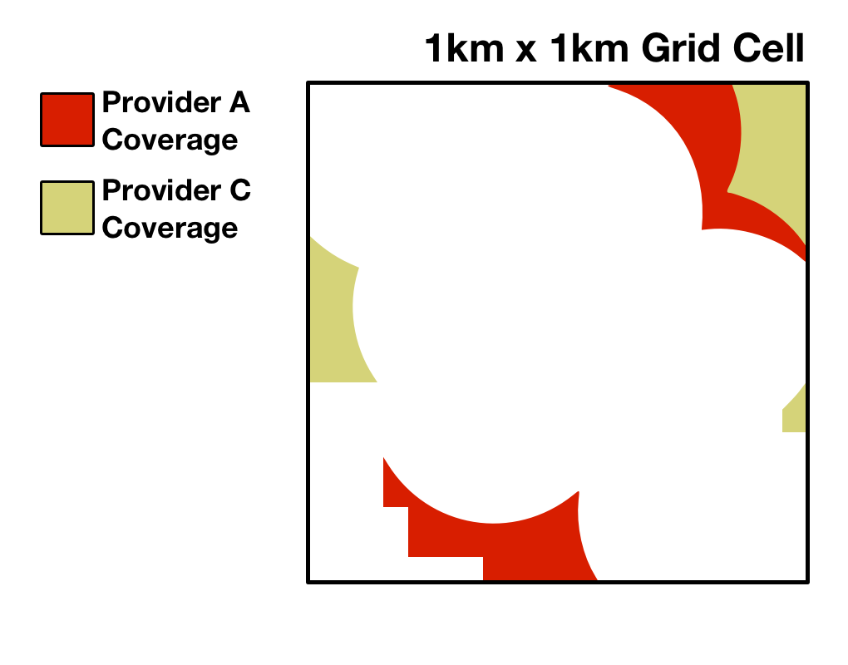
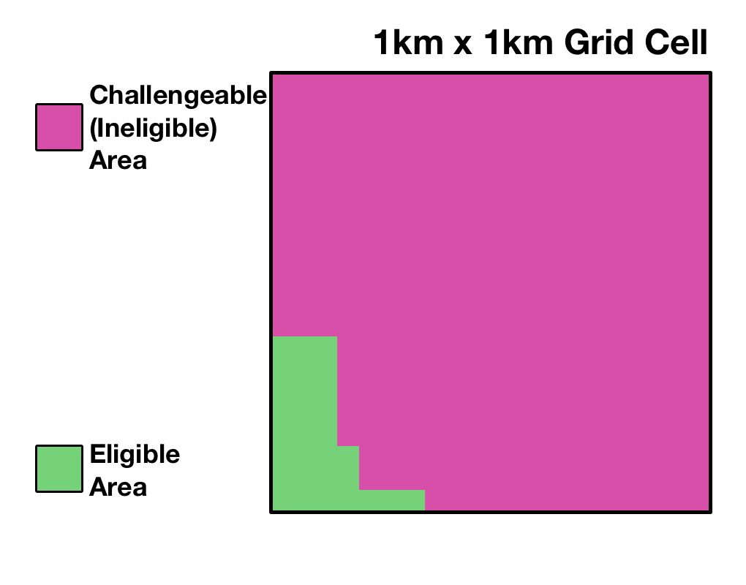
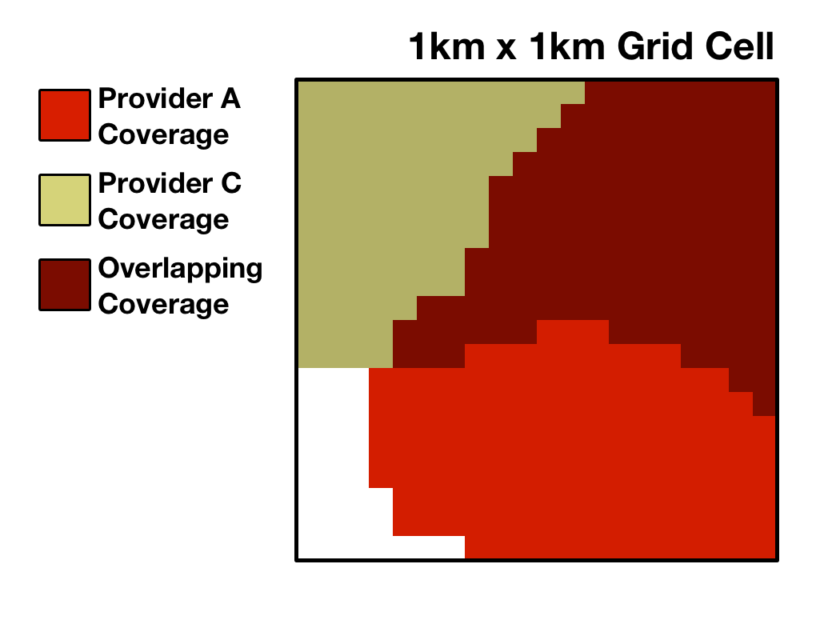
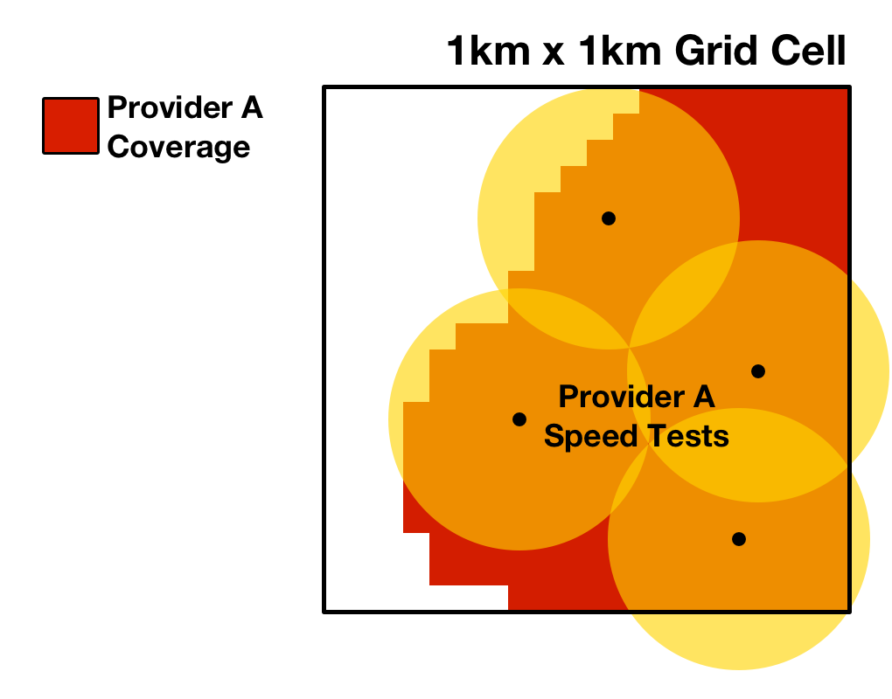
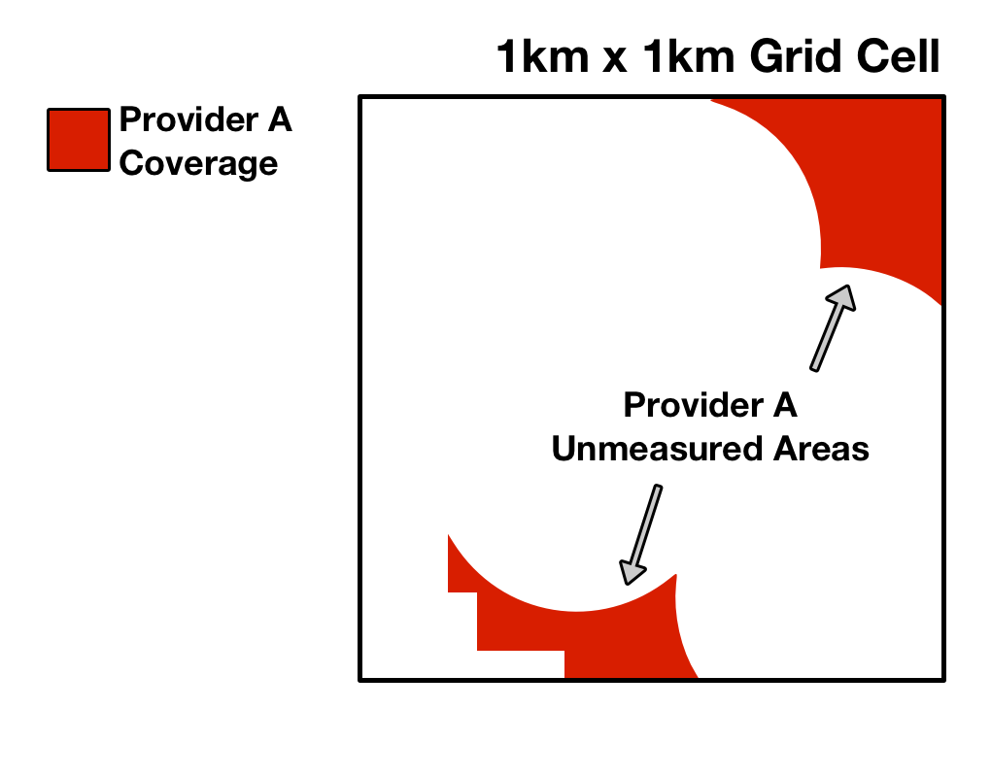
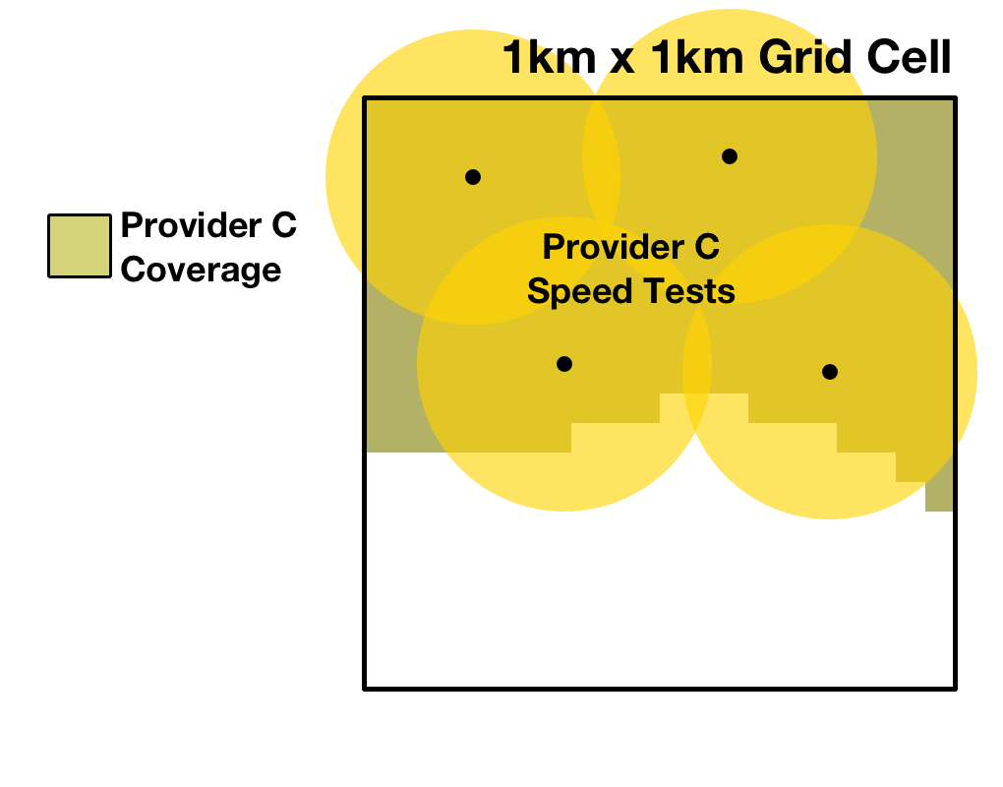
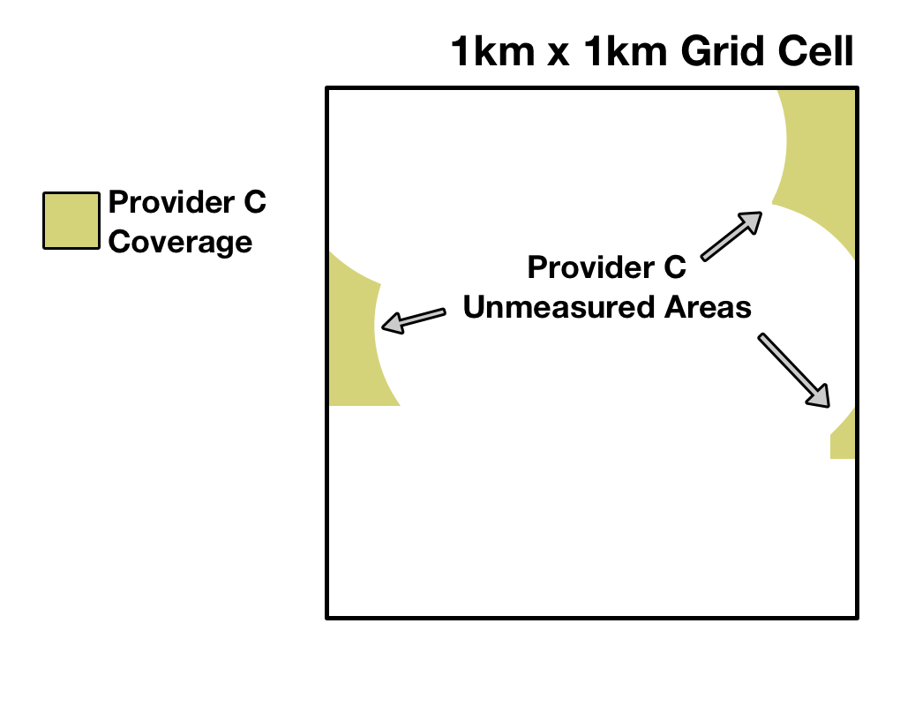
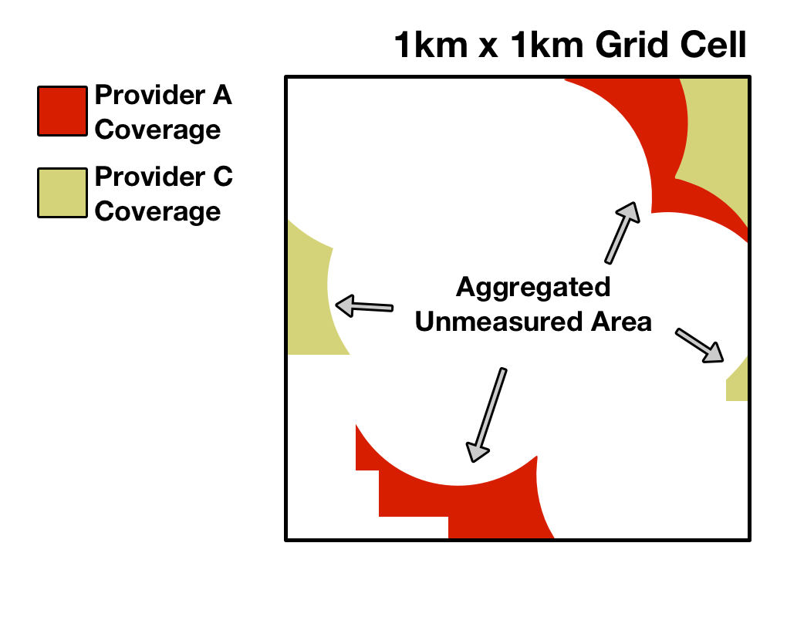
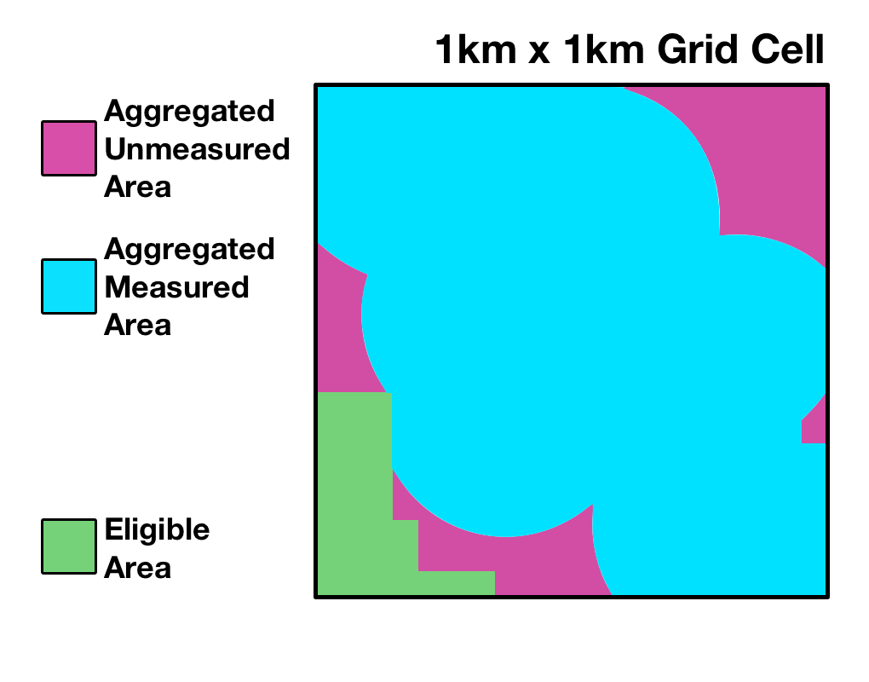
Automated Validation and the Grid
Proposed to evaluate each challenger’s speed tests using the uniform grid on a cell-by-cell basis
The system would buffer all speed tests in a grid cell submitted for a provider’s network
Measured area: any buffered area that overlaps coverage
Unmeasured area: any coverage/challengeable area not overlapped by speed test buffer
The system would perform this calculation for each provider in the grid cell
The unmeasured areas across all providers would be combined to determine the aggregated unmeasured area
The aggregated unmeasured area would be compared to the total challengeable area:
If aggregated unmeasured area is ≤ 25% of challengeable area, density requirement is met because at least 75% of the area has been measured
If aggregated unmeasured area is > 25% of challengeable area, density requirement is not met

Slide 16
Opportunity to Respond to a Challenge
Each challenged party will be able to view certified challenges to its coverage area during the response window
Challenged parties may, but are not required to, respond to a challenge
Challenged parties may submit their own technical evidence

Slide 17
Challenged Parties May Submit:
Their own speed test data
Must conform to the same standards adopted for challenger data
Except: response speed test data must be collected no more than 6 months before the close of the response window
Device-specific speed data collected from transmitter monitoring software
showing actual speed measurements and device locations
A report identifying that a device used by a challenger was subject to data speed reduction
All evidence must be certified by a qualified engineer

Slide 18
Responding to a Challenge
Once the response window opens, a provider that submitted new 4G LTE coverage data may access the USAC portal to view challenges to its coverage
A provider would only see a challenge if one or more challengers certified a challenge to a grid cell where the provider has coverage
Response data must be submitted via the USAC portal within 30 days of the opening of the response window
Response window would open no earlier than 5 business days after the close of the challenge window

Slide 19
Adjudicating Challenges
The Commission will use a preponderance of evidence standard to adjudicate disputes over coverage
A challenger must demonstrate that it is more likely than not that the challenged area does not have qualified LTE coverage
The challenger will bear the burden of proof

Slide 20
Access to the USAC Portal
USAC will create login accounts for all service providers
Log-on information to access the portal will be issued via email
Government entities eligible to participate would submit contact information to the Commission via email
Other parties seeking to participate must first submit and be granted a waiver

Slide 21
Timing, Deadlines, and Filing Procedures
Comments on the MF-II Challenge Process Public Notice are due on or before November 8
Reply comments are due on or before November 29
Comments may be filed electronically using ECFS
Paper filers must file an original and three copies of each filing
See filing instructions in the Public Notice

Slide 22
Questions?
Please email any questions to:
mf2challengeprocess@fcc.gov
For further information on Mobility Fund II:
https://www.fcc.gov/mobility-fund-phase-2

